Slide 1

Professional Development PLANNING
LDE Assignment 2: Task 2 Support guide.

Slide 2
Assignment 2: Task 2
Produce a Professional Development Plan (PDP) using an appropriate template (such as the one provided on Moodle).
Reflect and document several personal/professional development goals.
Your plan should demonstrate the application of SMART development goals (included in the tempalate provided).
Research and reference supporting sources that will aid your personal/professional development and help you to achieve your developmental goals.
You should apply an appropriate reflective model to frame your reflection (e.g. Gibbs Reflective Model) and if relevant refer to some concepts/areas introduced in this module and/or other modules that have contributed to your awareness of areas you would like to develop.

Slide 3

Development Plan (PDP) Guidance
Use the PDP template provided or an appropriate alternative.
Make sure your plan is SMART (see Template on Moodle).
  Bg. Note: For more information about SMART, simply see the headings in the PDP template on Moodle, or for further examples click-here).
You should aim to include 3 entries in your plan.
Tutor show: PDP Template. And review each section.

Slide 4
Bg. PDP TEMPLATE GUIDE:
Development Plan Content
Column 1 - What do I want/need to learn or develop?: Identify a development need and record this. The skills could be a hard or soft skill. A technical, academic, digital or employability skill. You might say something like: After some reflection, I need to develop my referencing or report writing skills or Teamwork or communication skills, a growth mindset, or programming or network security skills.
Column 2 - What will I do to achieve this?: you will then identify a development activity to help you with your learning need. On the Skills You Need website I have identified some resources which I am going to read and activities I will practice.
Column 3 - What resources or support will I need?: you must identify the resources you will need, this could be research, a trainnig course, a person, help from others etc. You can reference here the support resources that will help you.
Column 4 - What will my success criteria be?: is where you record how you will know you have achieved the learning identified. This might be something like ‘I am able to more confidently …….’.
Column 5 - Target dates: you can state a date by which you would like to achieve the goal.

Slide 5

Reflective learning
Reflect and document several personal/professional development goals.
You could use a framework, such as ‘Gibbs Reflective Cycle’, to reflect on your experience life/academic/work experience to help you document several personal/professional development goals.

Slide 6
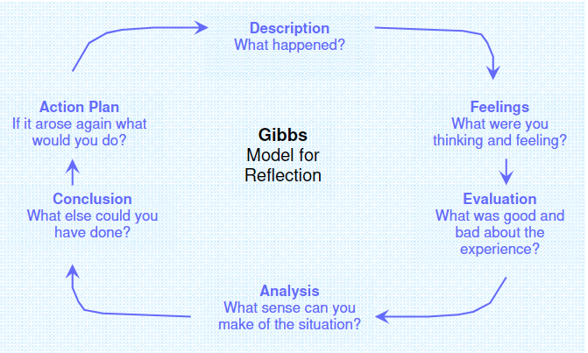
Gibbs Reflective model
1.
CC Reference source: (r)
Bg. Overview: Gibbs' Reflective Cycle, developed by Graham Gibbs in 1988, is a well known cyclical model of reflection that helps us to learn from our life experiences, and leads us through six stages, including: 1. Description, 2. Thoughts & feelings, 3. Evaluation, 4. Analysis, 5. Conclusion and 6. Action plan.

Slide 7
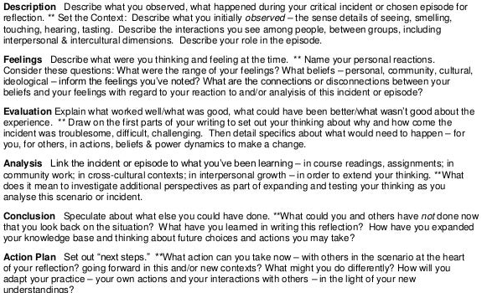
Bg. Gibbs model described
Bg. Gibbs Reflective model described
CC Reference source: (r)

Slide 8

Citation and referencing
  You could include citations related to:
  * Gibbs Reflective Cycle
  * Resources to support the achievement of your PDP goals.
  Reminder: include visible citations in the Video slides and a list of references at the end your video (aim for 5).

Slide 9

Submission
Your submission to Turnitin should include the following:
1. A professional cover page (inc. Module title, Your name, student number, Course title and Assignment title).
2. A content page including:
  A working link to your Online Video presentation.
  A Screenshot image of your video presentation.
  Note: Your Video presentation should refer to your Self-evaluation results, PDP plan and include citations and a reference list at the end.

Slide 10
Bg. FURTHER SUPPORT
UWTSD study support services are available to help you, if you are struggling and need assistance with e.g. time management, study support, stress management, report writing / content creation, revision. Please click here for more information: https://www.uwtsd.ac.uk/study-skills/.
For research, referencing or Library support, the library staff can help you if you are struggling. For more information about Library & Learning support services for students please click here: https://uwtsd.ac.uk/library/help-and-support/llr-staff/ and to discover your personal Library support staff member contact details (Emily Hywel) please click here: https://uwtsd.ac.uk/library/help-and-support/llr-staff/.

