Slide 1
What is HR?
Human Resources

Slide 2
Purpose and Key Objectives of the HR Function
Purpose – support the delivery of the organisation’s strategy and objectives through the effective management of people and performance. As such an organisation’s HR strategy and all activities should be clearly aligned with the strategy and activities of the business.
HRM is about attracting and retaining people with the required skills and experience and then seeking to develop them, maximise their performance, involve and engage them in the work of the organisation.

Slide 3
External Context Trends and Effect on HR Strategy
Political – UK parliament and devolved assemblies, local government, privatisation, marketisation. Government involvement in labour markets. Need to reward staff to retain them, compete for staff in open labour market. Implications of Brexit.
Economic – globalisation, downturn to be followed by upturn, demand for skilled workers, less manufacturing more service orientated businesses, EU single market. Free movement of labour, impact on recruitment strategy.
Socio-Cultural – ageing population, growing population, inequality, trends such a single person household – affect supply and demand for labour, has resulted in demand for flexible working, job mobility, less union involvement, individual orientated HR policies.
Technological – internet, email, HR databases, Google’s search engine, Wikipedia, BBC iplayer, Social Media, medical advances – changing ways people are managed and how long they are in the labour market for.
Legal – UK, EU law.
Environmental – sustainability, acting ethically. Moral rules apply to business behaviour. Green HR policies such as teleconferencing over travel.

Slide 4
SWOT analysis
A SWOT analysis is a planning tool used to understand the Strengths, Weaknesses, Opportunities, and Threats involved in a project or in a business.
It involves stating the objective of the business or project and identifying the internal and external factors that are either supportive or unfavourable to achieving that objective.
SWOT is often used as part of a strategic or business planning process, but can be useful in understanding an organisation or situation and decision-making for all sorts of situations.

Slide 5
SWOT
Strengths: positive tangible and intangible attributes, internal to an organisation and within the organisation’s control
Weaknesses: internal factors within an organisation’s control that detract from the organisation’s ability to attain the desired goal. Which areas might the organisation improve?
Opportunities: external attractive factors that represent the reason for an organisation to exist and develop. What opportunities exist in the environment, which will propel the organisation? Identify them by their ‘time frames’.
Threats: external factors beyond the organisation’s control which could place the organisation mission or operation at risk. The organisation may benefit by having contingency plans to address them if they should occur. Classify them by their severity and probability of occurrence.

Slide 6
Organisational Size
Small/micro: with less than 10 employees
Small to medium: with less than 250 employees
Large: with more than 250

Slide 7
Organisational Orientation
Organisational orientation is split between production or service
A product is a physical, tangible item
A service is intangible and consumed at the point of delivery
Orientation can also be considered by reference to activities –
Primary: eg agriculture, mining
Secondary: eg manufacturing, production
Tertiary: eg services, finance, health

Slide 8
Role of Management
Management
  The planning, organising, leading, and controlling of human and other resources to achieve organisational goals effectively and efficiently.
Managers
  The people responsible for supervising the use of an organisation’s resources to meet its goals.
Resources are organisational assets
  People ➢Skills ➢Knowledge ➢Information
  Raw materials ➢Machinery ➢Financial capital
  (McGraw-Hill, 2004)

Slide 9
Management is Organised by Function
Finance
Marketing
Operations
Strategy
HRM
And more recently - Risk management, Quality management, Customer Care, Performance Management.

Slide 10
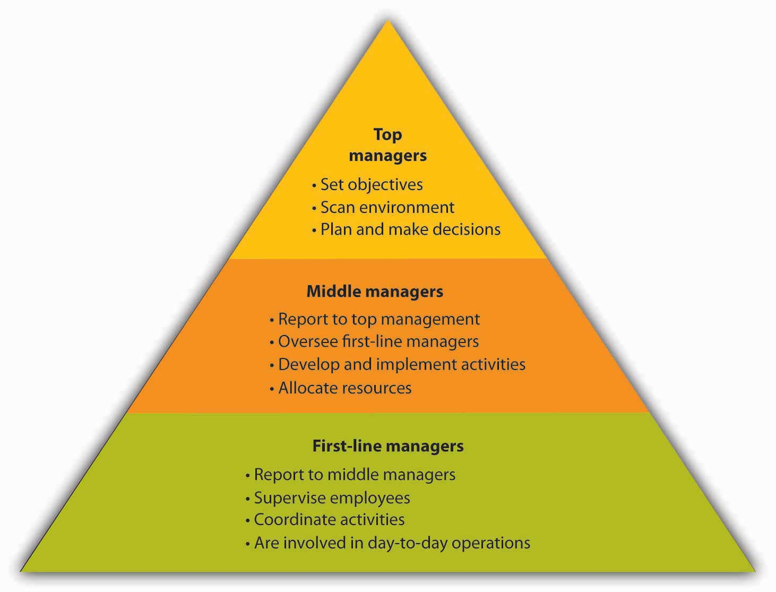
Types of Managers

Slide 11
The HR Equation
Much HR research seeks to demonstrate the links between effective people management practices and improved business performance.
HR Equation - the link between effective people management and high performing organisations.
Pfeffer’s (1998) analysis – the importance of the human equation in firms which argues that profits are built by putting people first in organisations.
A key concept in this debate is the psychological contract.

Slide 12
The Psychological Contract
Schein (1980) – the expectations that employers and employees have of their relationship, what each expects the other to deliver
If changes are made by managers which mean long-standing expectations are dashed it can lead to a loss of loyalty and commitment, dissatisfaction, demotivation and turnover.
Guest (2007), Boxall and Purcell (2008) – research suggests that a positive psychological contract is necessary to release discretionary effort and work beyond the contract.
Nature of psychological contracts may be changing because of greater volatility in product markets leading to less job security. Less ‘relational’ and more transactional. (Taylor, 2014)

Slide 13
Effective HR
Effective organisations do more than just manage people in accordance with the law and best practice – they differentiate themselves by leading their people imaginatively and inspirationally, in line with their vision of ‘next practice’.
Effective HRM is about creating an efficient infrastructure and mobilising an effective set of differentiators that make a difference to the quality of the organisation and its resulting performance.

Slide 14
History of SHRM
From personnel management, to HRM to SHRM.
Change towards end of 20th Century – notion that non-monetary factors could have a bigger impact on productivity and motivation than wages. HR went from being passive to dynamic. People seen as a valuable resource, rather than cogs in a machine.
Further change at end of century - due to increased free market competition at a global level, growth of technology and knowledge based industries, the importance of people to company success was elevated.
From cogs to resources to assets – people were now a valuable source of competitive advantage.

Slide 15
Adding Value
A key difference between traditional personnel management and contemporary HR is requirement for HR to demonstrate it adds commercial value.
Added value can be achieved mostly through continuous improvement and change management activities. Makes sense to spend less time on maintenance and crisis prevention activities (processes/procedures).
Requirement to write business cases for senior managers when advocating change.

Slide 16
Labour Markets
Labour markets influence the supply and demand of human resources
The employment market can be described as an economic exchange between the employer and employee
Supply is represented by the economically active workforce
Demand is represented by the availability of jobs (in turn driven by the demand for the product or service of the organisation)
The composition of the labour supply influences the method of sourcing and salaries to be paid
The age structure of a population also affects labour supply

Slide 17
Labour Markets (2)
HR managers have to ensure that supply meets demand for qualified staff via effective HRM activities such as: – Recruitment, induction, appraisal, promotion, training, reward, retirement, and redundancy
One of HR’s roles is to plan and predict the supply and demand of labour using a variety of sources: –surveys, applications, newspapers and periodicals
Organisations may also benchmark to allow them to learn and adopt better HR practices

