Slide 1

Coaching and Mentoring in Leadership
Day 6

Slide 2
Session Outcomes
These are the areas we will be exploring today:
differentiate between coaching, mentoring and counselling;
recognise and employ optimum questioning and listening skills;
evaluate self-awareness and interpersonal skills;
employ practical tools to help frame coaching and mentoring conversations.

Slide 3
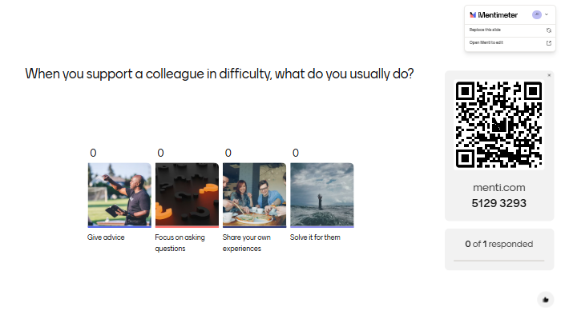
When you support a colleague in difficulty, what do you usually do?

Slide 4

Group Activity
Discuss, agree and record a one-line definition of the following roles:
Coach
Mentor
Counsellor

Slide 5

Coaching is releasing a person’s potential to maximise their own performance. It is helping them to learn rather than teaching them.
Mentoring focusses on personal and professional growth, career development, and sharing of experience and wisdom
Counselling offers support on mental health concerns, and problem-solving related to personal issues

Slide 6
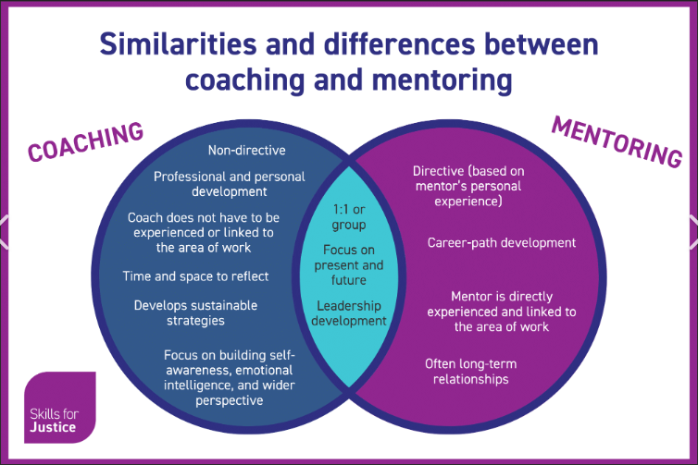

Slide 7

Coaches facilitate learning through effective questioning and listening skills. The premise being that the coachee/employee has all the answers
Mentors are an advocate for the mentee/employee who offers advice based on experience and expertise

Slide 8

Coaches use structured frameworks and techniques to help clients identify goals, develop strategies, and enhance their performance. They often provide feedback and hold clients accountable for their progress.

Slide 9

“A mentor is not someone who walks ahead of us to show us how they did it. A mentor walks alongside us to show us what we can do”
(Simon Sinek 2021)

Slide 10


“One of the common misconceptions about mentors is that they give lots of advice”, David Clutterbuck told European CEO.
“That’s simply not the case. They help the mentee with the quality of their thinking, sometimes providing context (information the Mentee doesn’t have that will help them make better decisions), but never telling them what they should do, or expecting them to follow the Mentor’s career path.”

Slide 11
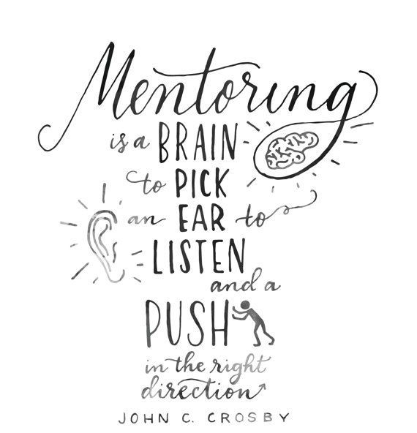
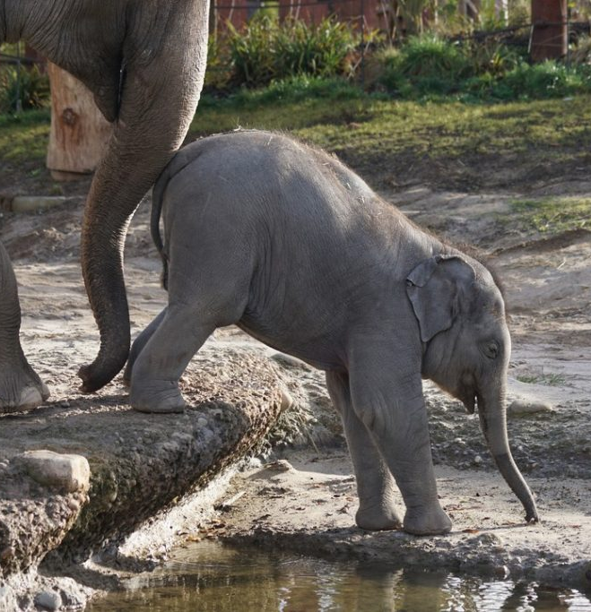

Slide 12

Essential skills and qualities
Excellent interpersonal skills:
Observation skills and a genuine affinity for people
Empathy
Patience
Sensitivity
Building rapport and listening
Giving and receiving feedback
Using effective questioning techniques

Slide 13

Questioning and listening skills

Slide 14
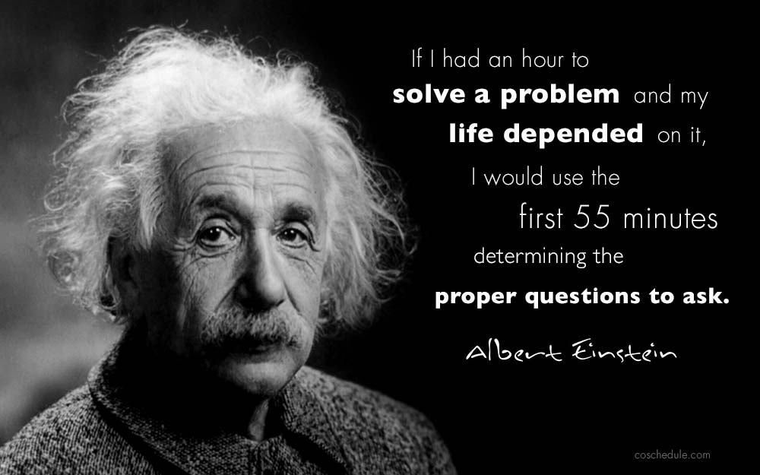

Slide 15

LISTEN

Slide 16
SILENT

Slide 17

Active listening
Being able to hear what is said as well as what is not being said
Requires astute observation to be in touch and in tune with who is saying what, how, when and to whom
Careful listening enables you to acquire a “helicopter-level” perspective and holistic view
Able to focus on any concerns as well as on the development of the individual

Slide 18
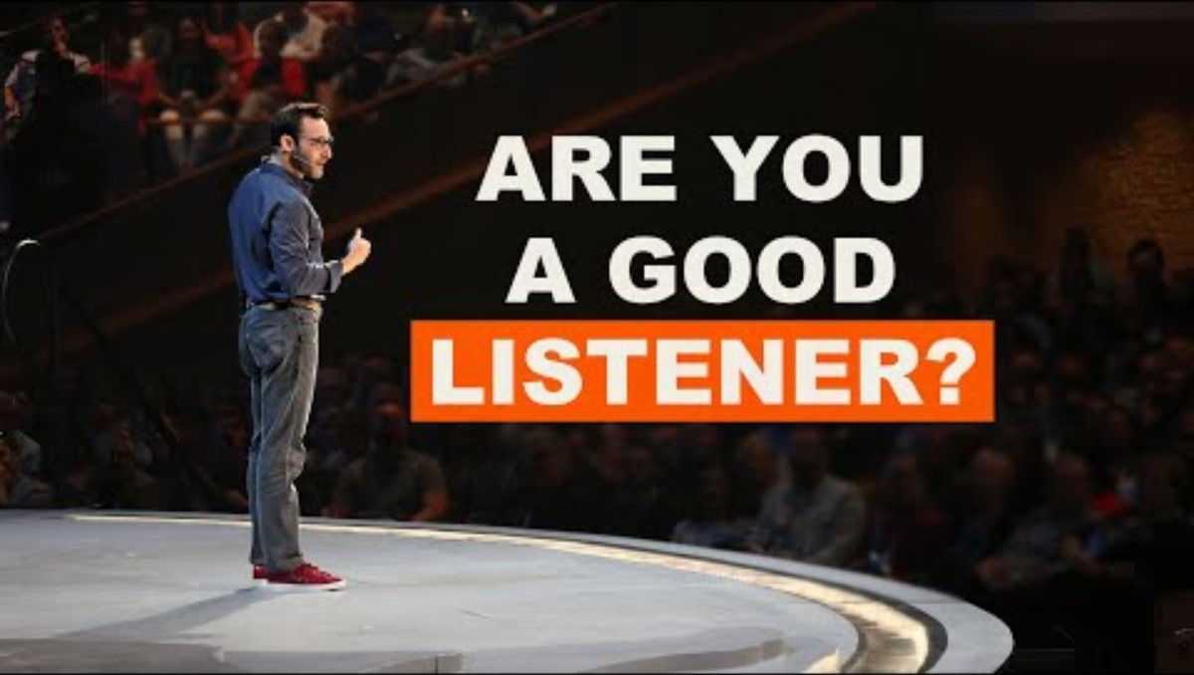

Slide 19
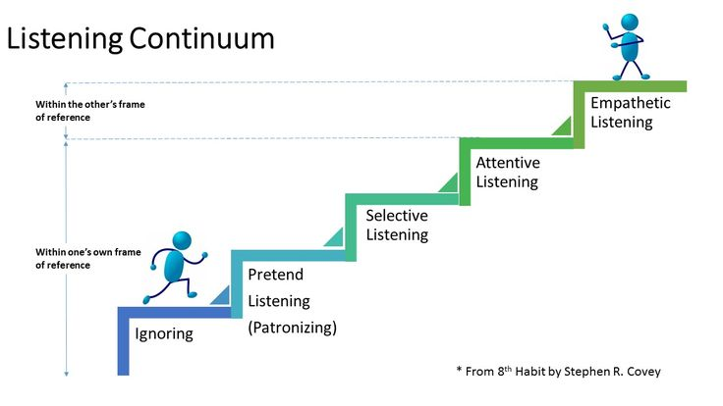

Slide 20
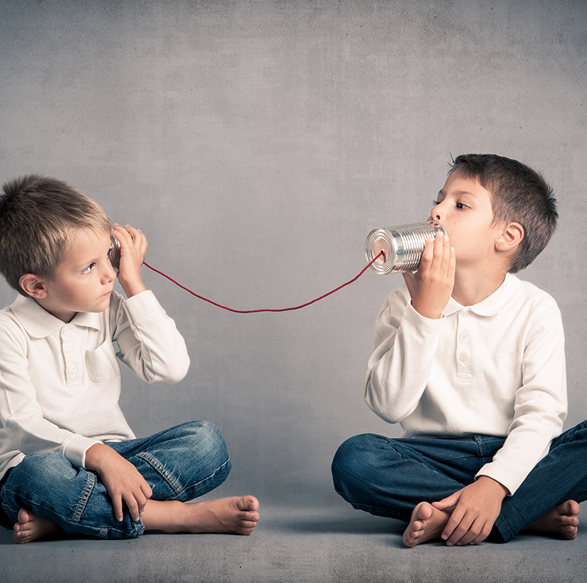
Coaching and mentoring

Slide 21
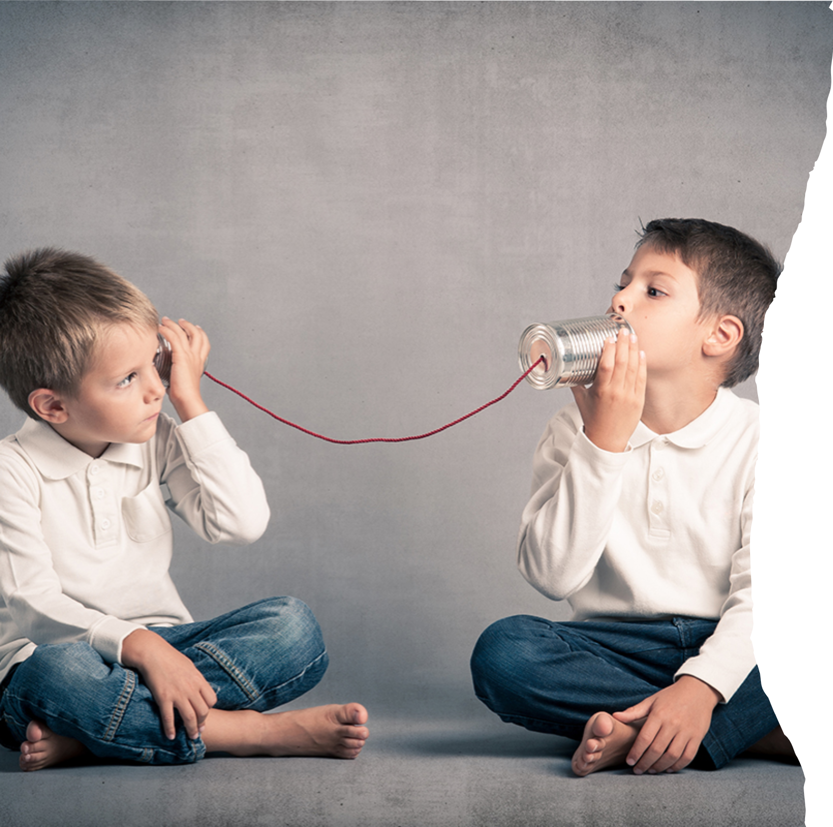
Feedback on the activity

Slide 22

Thank you!
Diolch
Next session date: 18.09.2025 Module 2

