Slide 1
South Korean education comparison:
A glimpse of our future?
By Ryan Friend

Slide 2
Topics to be covered:
Why I chose South Korean education
What does the South Korean national education system look like?
How does this compare to the Welsh curriculum?
What are the benefits and drawbacks of their system?
What can we learn from both forms of curriculum?

Slide 3
Curriculum
What does the curriculum mean to you?
‘In some cases, people see the curriculum entirely in terms of the subjects that are taught, and as set out within the set of textbooks, and forget the wider goals of competencies and personal development.’ (UNESCO, 2017)

Slide 4
South Korean education/ curriculum
The primary curriculum consists of nine principal subjects: moral education, Korean language, social studies, mathematics, science, physical education, music, fine arts, and practical arts. English-language instruction now begins in the third grade. (Diem et Al, 2017)
In middle school ‘The curriculum consists of 12 basic or required subjects, electives, and extracurricular activities. While elementary school instructors teach all subjects, middle school teachers, like their colleagues in the United States, are content specialists. High schools are divided into academic and vocational schools. (Diem et Al, 2017)

Slide 5
Compared to the Welsh national curriculum
The National Curriculum is made up of the following subjects:
English*, Welsh, Mathematics, Science, Design and Technology, Information Technology, History, Geography, Music, Art and Physical Education (PE).
A modern foreign language is added from the start of Key Stage 3 and most schools provide personal and social education. Children must also study Religious Education (according to the syllabus laid down by the local authority). (Welsh Government, 2007)

Slide 6
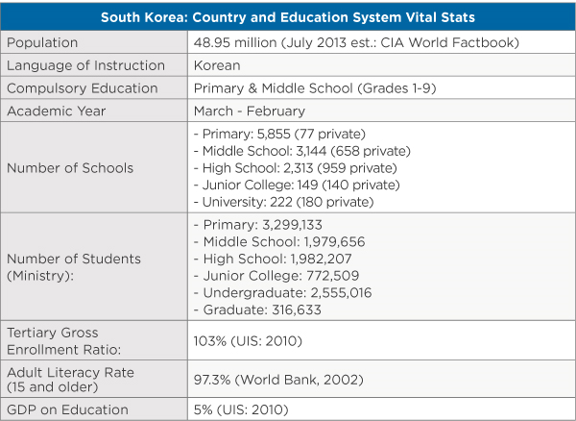
Pro’s of the South Korean curriculum
A study by education firm Pearson, with data from the Economist Intelligence Unit, found South Korea to have the second-best education system in the world (after Finland). (Clark, 2013)
South Koreans ranked second in reading, fourth in math, and sixth in science in 2009, the last year for which results are currently available. (Clark, 2013)
Compared to Wales’ 40th in reading, 39th in maths and 35th in science.

Slide 7
Cons of the South Korean curriculum
A typical day finds high schoolers studying before school begins at about 8:00 A.M. Classes run for 50 minutes each, with a morning break and a 50-minute lunch period. The afternoon session resumes at about 1:00 P.M., and classes continue until about 4:00 or 4:30, followed by the cleaning of the classroom. Students return to the school library to study or attend private schools or tutoring sessions until between 10:00 P.M. and midnight. (Diem et al, 2017)
By some measures, the average Korean child spends 13 hours a day studying after supplemental class time is factored in. (Clark ,2013)
South Korea has had the highest suicide rate in the industrialized world for eight consecutive years. It’s the No.1 cause of death for people between the ages of 10 and 30. Among the youth, the pressure over college entrance examinations is often blamed. (Kim, 2014)
Therein lies the educational conundrum that policymakers in Korea face. They have a highly motivated and educated populace, but the system is failing to maximize the effort being put in by its students and teachers.(Clark,2013)

Slide 8
Conclusion and questions
For all the difference there is in academic attainment there seems to be very little difference in delivery or pedagogy between South Korean and Welsh curriculum and as a result both face similar issues.
South Korean education perhaps provides a glimpse of what Welsh educations future may look like. One must ask themselves what is the price of academic achievement if we are to follow our current path.

Slide 9
References
Clark, 2013 Education in South Korea https://wenr.wes.org/2013/06/wenr-june-2013-an-overview-of-education-in-south-korea (Accessed 23/11/2017)
Diem et Al, 2017 South Korean Education http://asiasociety.org/global-cities-education-network/south-korean-education (Accessed 23/11/2017)
Kim, 2014 South Korea’s Struggle With Suicide https://www.nytimes.com/2014/04/03/opinion/south-koreas-struggle-with-suicide.html (Accessed 24/11/2017)
UNESCO, 2017 Education http://www.unesco.org/new/en/education/themes/strengthening-education-systems/quality-framework/technical-notes/different-meaning-of-curriculum/ (Accessed 23/11/2017)
Welsh Government, 2007 How is your child doing at primary school? http://www.caerphilly.gov.uk/CaerphillyDocs/Schools/How-is-your-child-doing-at-Primary-School.aspx (Accessed 24/11/2017)

