Slide 1
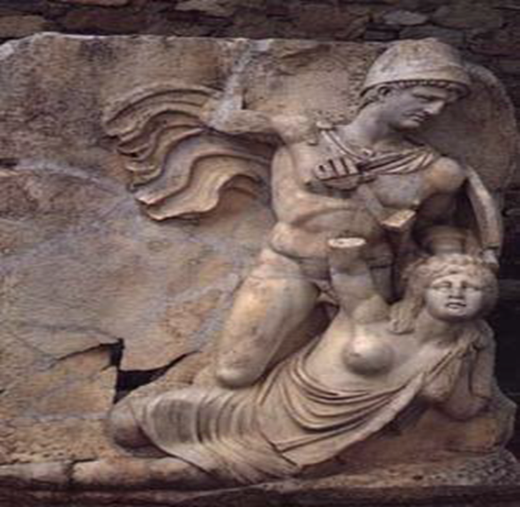
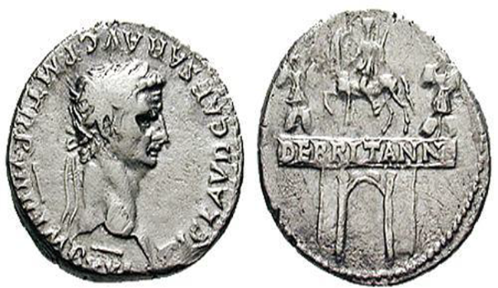
Literature and Culture in the Reign of Nero
CLCS5010
Britain under the Julio-Claudians
Claudius and Britannia – Aphrodisias (Caria)
Claudius Denarius. 49-50 AD. TI CLAVD CAESAR AVG P M TR P VIIII IMP XVI

Slide 2
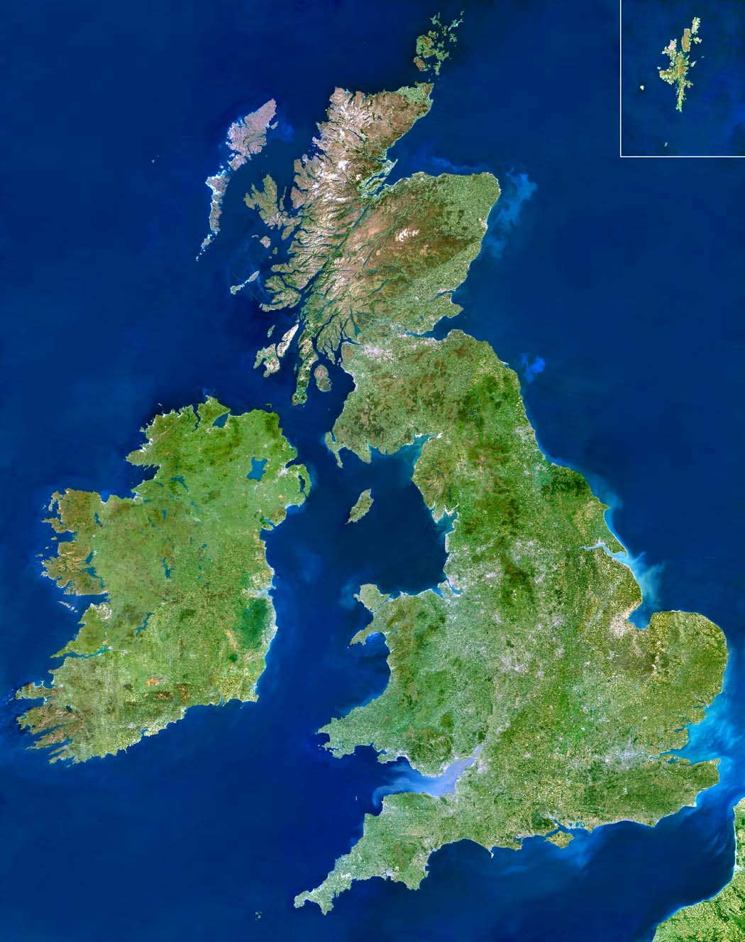
Earlier Roman interaction with Britain
Brigantes
Deceangli
Coritani
Ordovices
Iceni
Catuvellauni
Demetae
Silures
Dobuni
Trinovantes
Atrebates
Canti
Belgae
Dumnonii

Slide 3
Caesar’s Forays – 55 and 54 BC
Belgae [Belgium / northeast France] and Veneti [Brittany] received helps from Britons:
  in August 55 BC Caesar sailed with 2 legions [10,000 men] and 500 cavalry, landing in Kent.
Second expedition in 54 BC, sets out in July with 800 ships, carrying 5 legions [25,000 men], and 2,000 cavalry.
  Confederation of Britons under Cassivellaunus, king of the Catuvellauni – Caesar makes an alliance with the Trinovantes.
  “Cassivellaunus… [hear reports of] so many losses… and his territories laid waste, being alarmed most of all by the desertion of the states, sends ambassadors to Caesar [to treat] about a surrender… Caesar, since he had determined to pass the winter on the continent, on account of the sudden revolts of Gaul…” - Caesar Gallic War 5.22.

Slide 4
Augustus and Britain
At present, however, some of the chieftains there, after procuring the friendship of Caesar Augustus by sending embassies and by paying court to him, have not only dedicated offerings in the Capitol, but have also managed to make the whole of the island virtually Roman property. Further, they submit so easily to heavy duties, both on the exports from there to Gual and on the imports from Gaul (these latter are ivory chains and necklaces, and amber-gems and glass vessels and other petty wares of that sort), that there is no need of garrisoning the island; for one legion, at the least, and some cavalry would be required in order to carry off tribute from them, and the expense of the army would offset the tribute-money; in fact, the duties must necessarily be lessened if tribute is imposed, and, at the same time, dangers be encountered, if force is applied. – Strabo Geog. 4.5.3.

Slide 5
Invasion of Britain

Slide 6
Caligula – Intended British Invasion?
“All that he accomplished in this expedition was to receive the surrender of Adminius, son of the British king Cunobellinus, who had been banished by his father and come over to the Romans with a few followers.” – Suetonius Gaius Caligula 44.
“The emperor Gaius [Caligula] unquestionably planned an invasion of Britain; but his impulsive ideas shifted like a weathercock, and his grandiose efforts against Germany had come to nothing.” – Tacitus Agricola 13.
“And when he reached the Ocean, as if he were going to conduct a campaign in Britain, and had drawn up all the soldiers on the beach, he embarked on a trireme, and then, after putting out a little from the land, sailed back again… then all of a sudden he ordered them to gather up the shells.” – Dio Cassius 59.25.1-2.

Slide 7
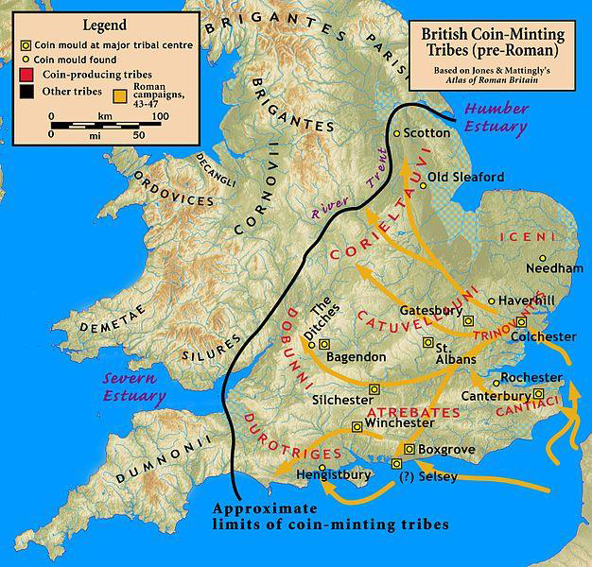
Claudius – Conquest of Southeast Britain
AD 43 – four legions under the command of Aulus Plautius and auxiliary troops are sent to Britain – paper strength 40,000.
  II Augusta (Rhine)
  XIV Gemina
  XX Valeria Victrix
  IX Hispana (Pannonia).
Defeat of Caratacus, chieftain of the Catuvellani tribe, at Medway.
Claudius established the capitol of the new province of Britannia at Camulodunum (Colchester).
Claudius receives the submission of the southern Tribes.

Slide 8
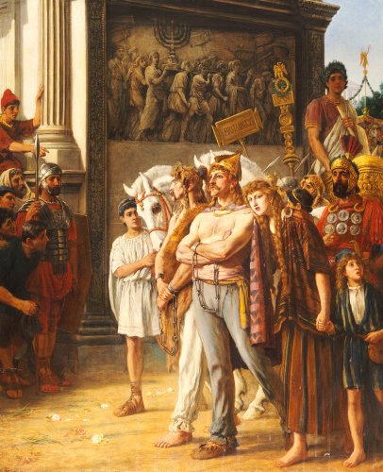
Fighting Against Caratacus
Caratacus, royal member of the Catuvellaunian tribe.
Governor Aulus Plautius (AD 43-47) replaced by Publius Ostorius Scapula (AD 47-52).
Allied Iceni engage Ostorius in battle – simmering among the Brigantes.
Warfare with the Silures, encouraged by Caratacus as preeminent leader of resistance – fights Ostorius in territory of the Ordovices.
Caratacus after fleeing is handed over to the Romans by Cartimandua, queen of the Brigantes.
Arts by Thomas Davidson

Slide 9
Neronian Expansion in Britain?

Slide 10
Governors of the Province
Aulus Didius Gallus – governor from AD 52-57 (latter years of Claudius reign and first few of Nero’s).
Quintus Veranius – governor in AD 57 (started campaigns against Silures).
Gaius Suetonius Paulinus – governor from AD 58-62.
“… Didius Gallus, the next governor, merely held what this predecessors had won, establishing a few forts in more advanced positions, so that he could claim the credit of having made some annexations. Veranius succeeded Didius only to die within the year. After him Suetonius Paulinus enjoyed two years of success, conquering fresh tribes and strengthening the forts.” – Tacitus Agricola 14.

Slide 11
Suetonius on Nero’s Military Ambition
“Nero felt no ambition to extend the Roman Empire; he even considered withdrawing his forces from Britain, yet kept them there because such a decisions might have reflected on the glory won by his adopted father Claudius. The sole additions made during his reign to the list of provinces were the kingdom of Pontus (NE Turkey), ceded to him by Polemon, and that of the Cottian Alps (SW Alps) on the death of Cottius.” – Nero 18.

Slide 12
Revolt of Boudicca

Slide 13
Causes of the Rebellion (1)
“An excuse for the war was found in the confiscation of the sums of money that Claudius had given to the foremost Britons; for these sums, as Decianus Catus, the procurator of the island, maintained, were to be paid back. This was one reason for the uprising; another was found in the fact that Seneca, in the hope of receiving a good rate of interest, had lent to the islanders 40,000,000 sesterces that they did not want, and had afterwards called in this loan all at once and had resorted to severe measures in exacting it. But the person who was chiefly instrumental in rousing the natives and persuading them to fight the Romans, the person who was thought worthy to be their leader and who directed the conduct of the entire war, was Boudicca, a British woman of the royal family and possessed of greater intelligence than often belongs to women.” – Dio Cassius 62.2.1-2.

Slide 14
Causes of the Rebellion (2)
“The king of the Iceni Prasutagus, renowned for his long prosperity, had named the emperor his heir, together with his two daughters; an act of respect which he thought would place his kingdom and household beyond the risk of injury. The result was different — so much so that his kingdom was pillaged by centurions, his household by slaves… As a beginning, his wife Boudicca was subjected to the lash and his daughters violated: all the chief men of the Iceni were stripped of their family estates, and the relatives of the king were treated as slaves… incited to rebellion the Trinovantes and others, who, not yet broken by servitude, had entered into a secret and treasonable compact to resume their independence.” – Tacitus Annals 14.31.

Slide 15
Causes of the Rebellion (3)
“…a colony was settled on conquered lands at Camulodunum by a strong detachment of veterans, who were to serve as a bulwark against revolt and to familiarize the friendly natives to their legal obligations.” – Tac. Ann. 12.32.
“More than this, the temple raised to the deified Claudius continually met the view, like the citadel of an eternal tyranny; while the priests, chosen for its service, were bound under the pretext of religion to pour out their fortunes like water.” – Tac. Ann. 14.31.

Slide 16
Boudicca’s Speech in Dio (62.3-5)
Main points:
- Property seized and forced to pay taxes.
- Worse off than slaves.
- We failed to force the Roman’s out like we had done with Julius Caesar.
- One island with one common name, remember what freedom is.
- Pours scorn on Roman armour and Roman defences, they have neither numbers or bravery.
- We know our island they do not.

Slide 17
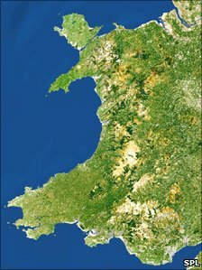
Campaign at Mona
The main bulk of the Roman forces with the governor Gaius Suetonius Paulinus on Mona (modern Anglesey) – Dio 62.7; Tac. Ann. 14.29-30.
“On the beach stood the adverse array, a serried mass of arms and men, with women flitting between the ranks… In the style of Furies, in robes of deathly black and with dishevelled hair, they brandished their torches; while a circle of Druids, lifting their hands to heaven and showering swearwords… a band of females and fanatics… to demolish the groves consecrated to their savage cults: for they considered it a duty to consult their deities by means of human entrails.” (Tac. Ann. 14.30).
Mona
Ordovices
Demetae
Silures

Slide 18
Outbreak and Roman Setbacks
Two hundred men sent to by the procurator Catus Cecianus to defend the veteran colony at Camulodunum (Colchester), troops held out in two day siege at temple of Claudius. The ninth legion sent in relief is routed by British forces, Catus flees to Gaul - Tac. Ann. 14.32.
Paulinus having put down Mona [Anglesey], marches his army to face Boudicca’s but does not immediately engage them, later forced to due to shortage of supplies - Dio 62.8.
Paulinus feels he does not have sufficient forces to protect London so the town is abandoned, Verulamium (St Albans) also suffers the same fate -Tac. Ann. 14.33.
Mona
Camulodunum
Verulamium
Londinium

Slide 19
British Brutality
“The worst and most bestial atrocity committed by their captors was the following. They hung up naked the noblest and most distinguished women and then cut off their breasts and sewed them to their mouths, in order to make the victims appear to be eating them; afterwards they impaled the women on sharp skewers run lengthwise through the entire body.” – Dio Cassius 62.7.2.

Slide 20
Size of Armies and Tactics (1)
Boudicca’s had forces of 230,000 men, rides in a chariot herself – Dio 62.8.
Roman forces considerably smaller – 10,000 men – Fourteenth Legion, a detachment of the Twentieth, and auxiliary forces from the surrounding areas - Tac. Ann. 14.34.
Paulinus decides to spilt his forces into three divisions, in order to fight at different points simultaneously - Dio 62.8.

Slide 21
Size of Armies and Tactics (2)
Paulinus chooses a position in a narrow defile, with woodland in the rear – light infantry and cavalry on the wings - Tac. Ann. 14.34.
Roman’s wait until enemy gets within javelin throwing distance, unleash them and then charges at the Britons in a wedge formation. Roman archers used to fight against chariots. - Dio 62.12; Tac. Ann. 14.37.
400 Roman dead to 80,000 Britons - Tac. Ann. 14.37.
Boudicca feel sick and died - Dio 62.12.6; contra Tacitus (Ann. 14.37) who says she killed herself with poison.

Slide 22
Aftermath
The whole army is concentrated and 2,000 legionnaires, eight cohorts of auxiliary and 1,000 cavalry are sent over from Germany.
Julius Classicianus sent to replace Catus, but has poor relations with Paulinus. – Julius reports to Nero of Paulinus cruelty.
Polyclitus, a freedman of Nero, is sent to inspect affairs in Britain, Paulinus initial left in place but then replaced in command by Petronius Turpilianus.

Slide 23
Bibliography
Potter, T. W. and Jones, C. 1992. Roman Britain. London. British Museum Press.
Scullard, H. H. 1979. Roman Britain: Outpost of Empire. London: Thames and Hudson.
Dudley, D. R. and Webster, G. 1962. The Rebellion of Boudicca. London: Routledge & Kegan Paul.
Roberts, M. 1988. The Revolt of Boudicca (Tacitus, Annals 14.29-39) and the Assertion of Libertas in Neronian Rome, The American Journal of Philology 109 (1): 118-132.

