Slide 1
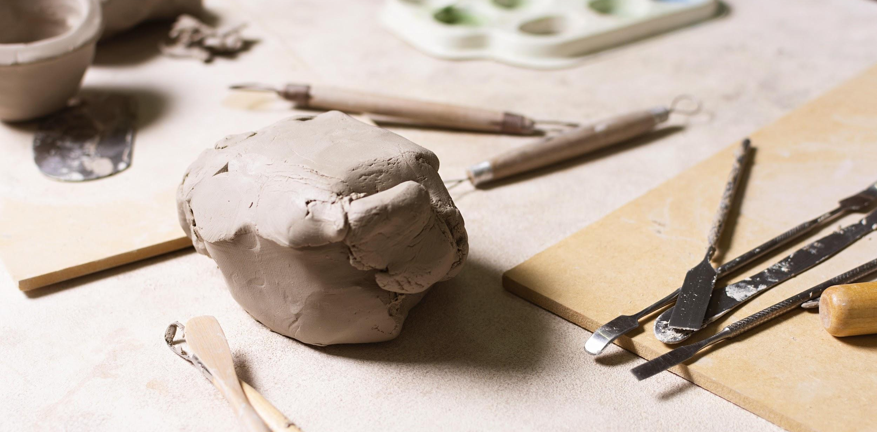
Expressive Arts
Art
@DBPrendergast d.wilson@uwtsd.ac.uk

Slide 2
Y Celfyddydau Mynegiannol
Celf
@DBPrendergast d.wilson@uwtsd.ac.uk

Slide 3
Session aims:
- Aim to understand how art can be used to develop learning across all AoLE's
- Know how the 'what matters' statements underpin the learning
- Be able to plan and deliver a purposeful Art project
Nodau'r sesiwn:
​
- Nod i ddeall sut y gellir defnyddio celf i ddatblygu dysgu ar draws pob MDaP's
- Gwybod sut mae'r datganiadau 'beth sy'n bwysig' yn sail i'r dysgu
- Gallu cynllunio a chyflwyno prosiect Celf pwrpasol
@DBPrendergast d.wilson@uwtsd.ac.uk

Slide 4
—Sir Ken Robinson
“Creativity is as important as literacy, and we should treat it with the same status.”
@DBPrendergast d.wilson@uwtsd.ac.uk

Slide 5
—Sir Ken Robinson
"Mae creadigrwydd mor bwysig â llythrennedd, a dylen ni ei drin gyda'r un statws."

Slide 6
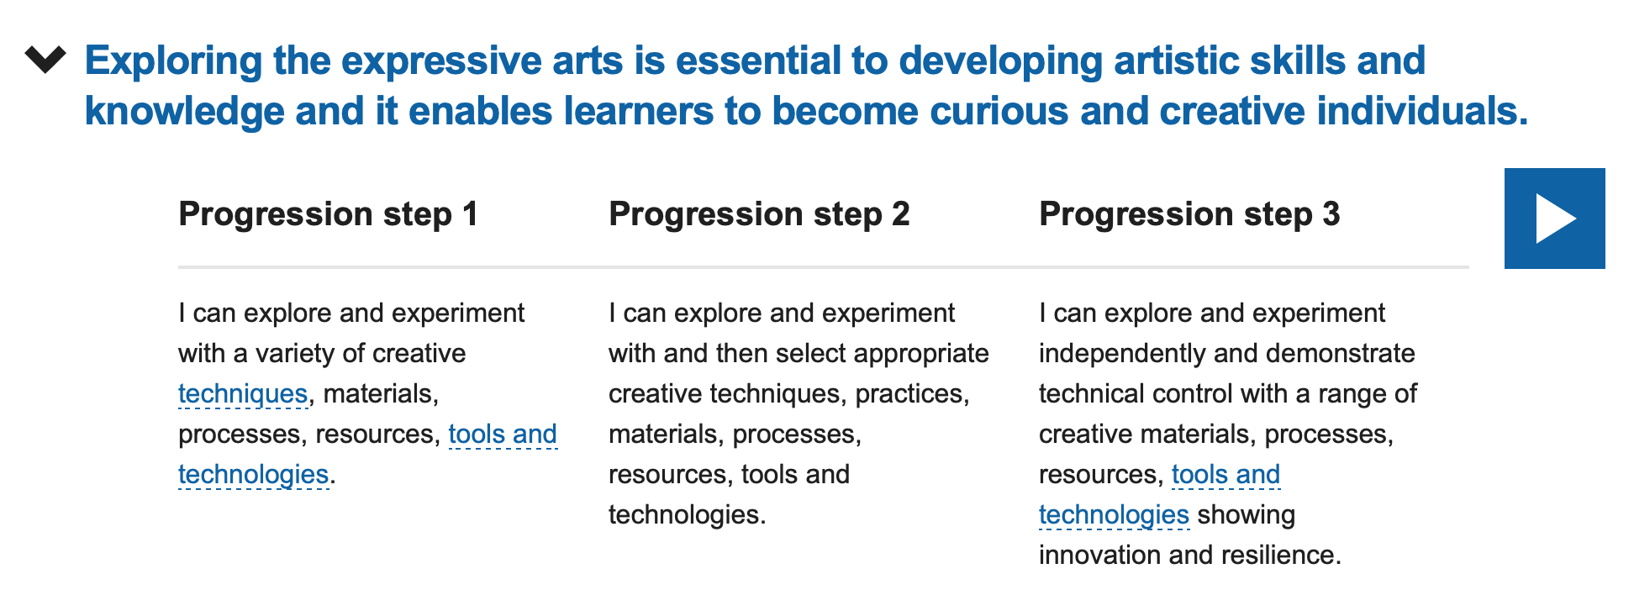
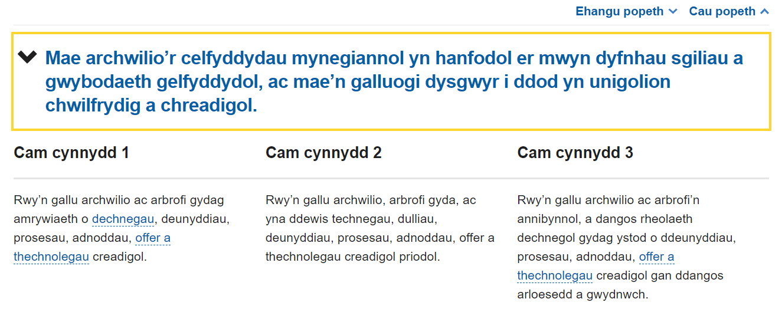
Statements of what matters
Datganiadau o’r hyn sy’n bwysig

Slide 7
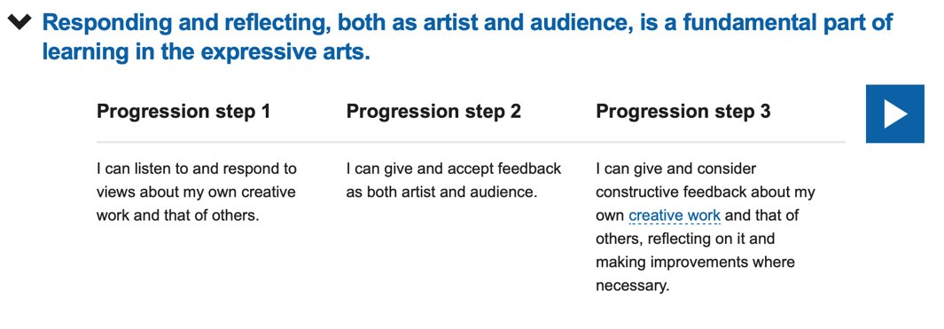
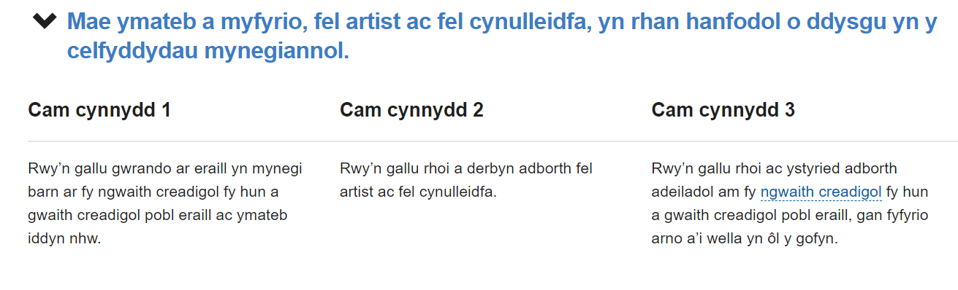

Slide 8
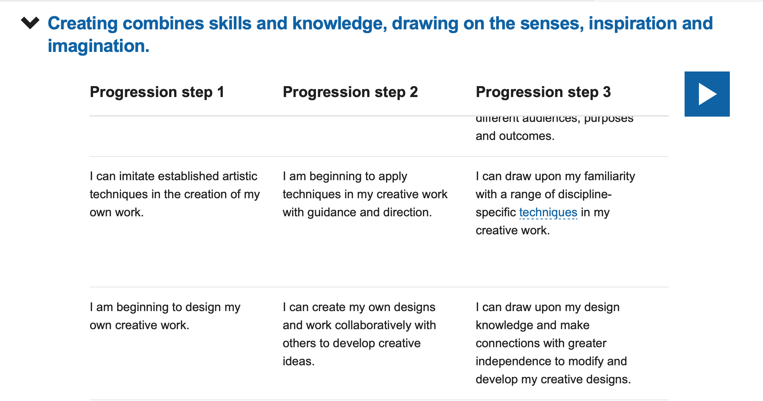

Slide 9
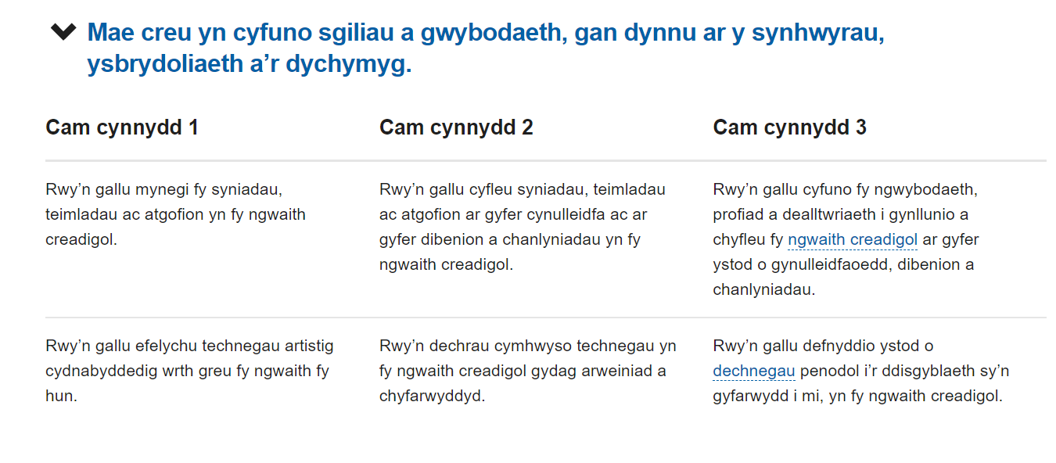

Slide 10
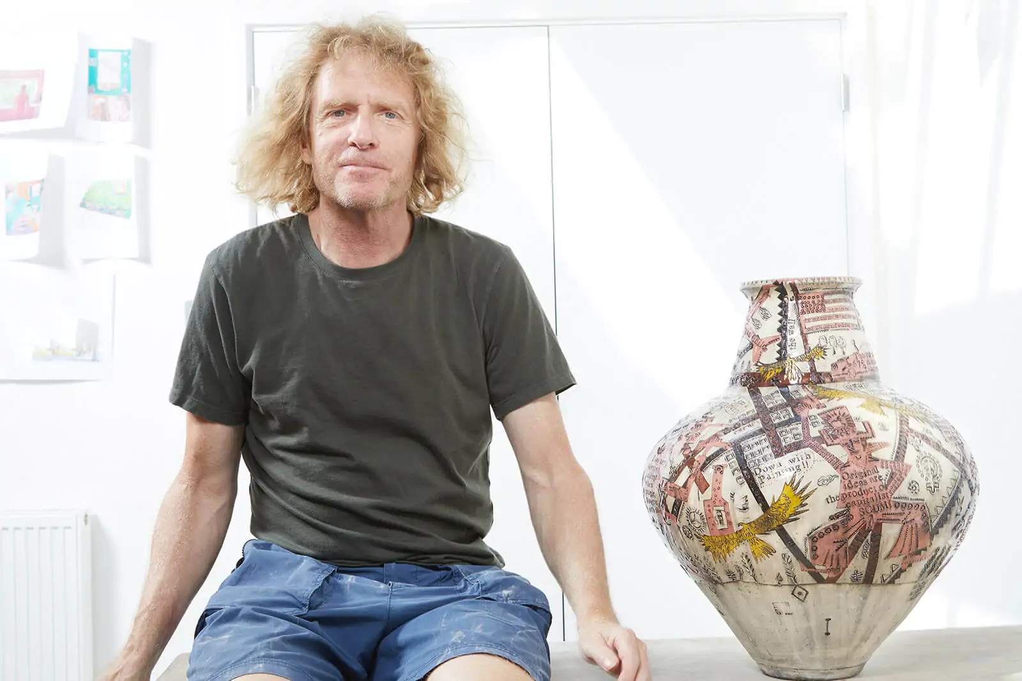
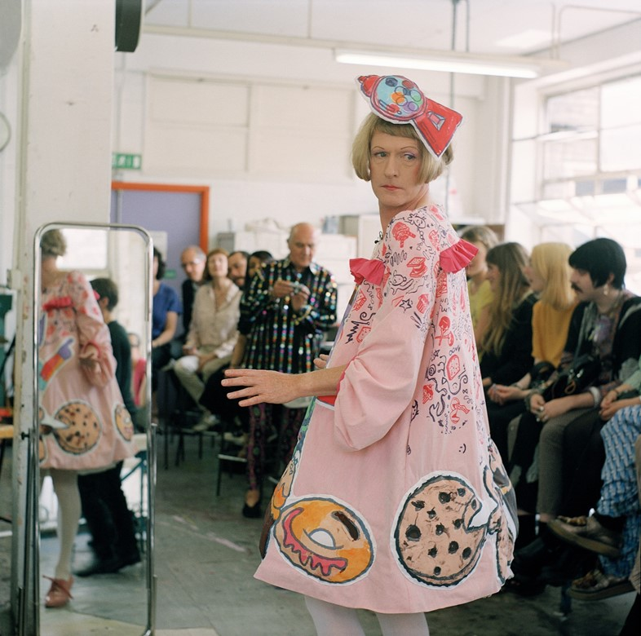
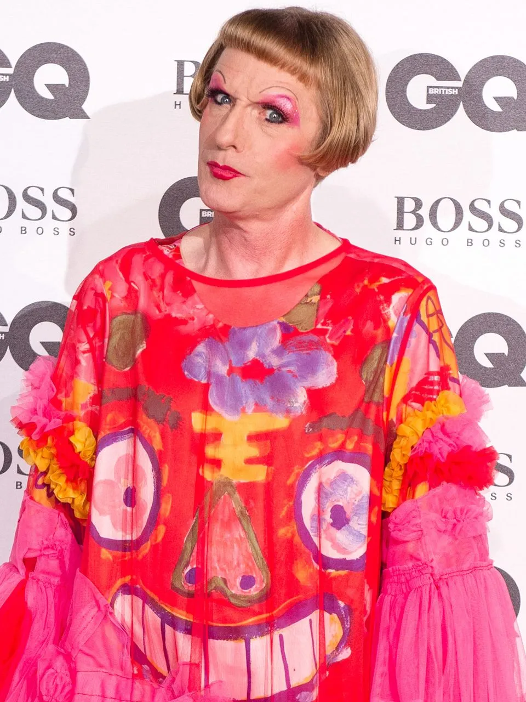
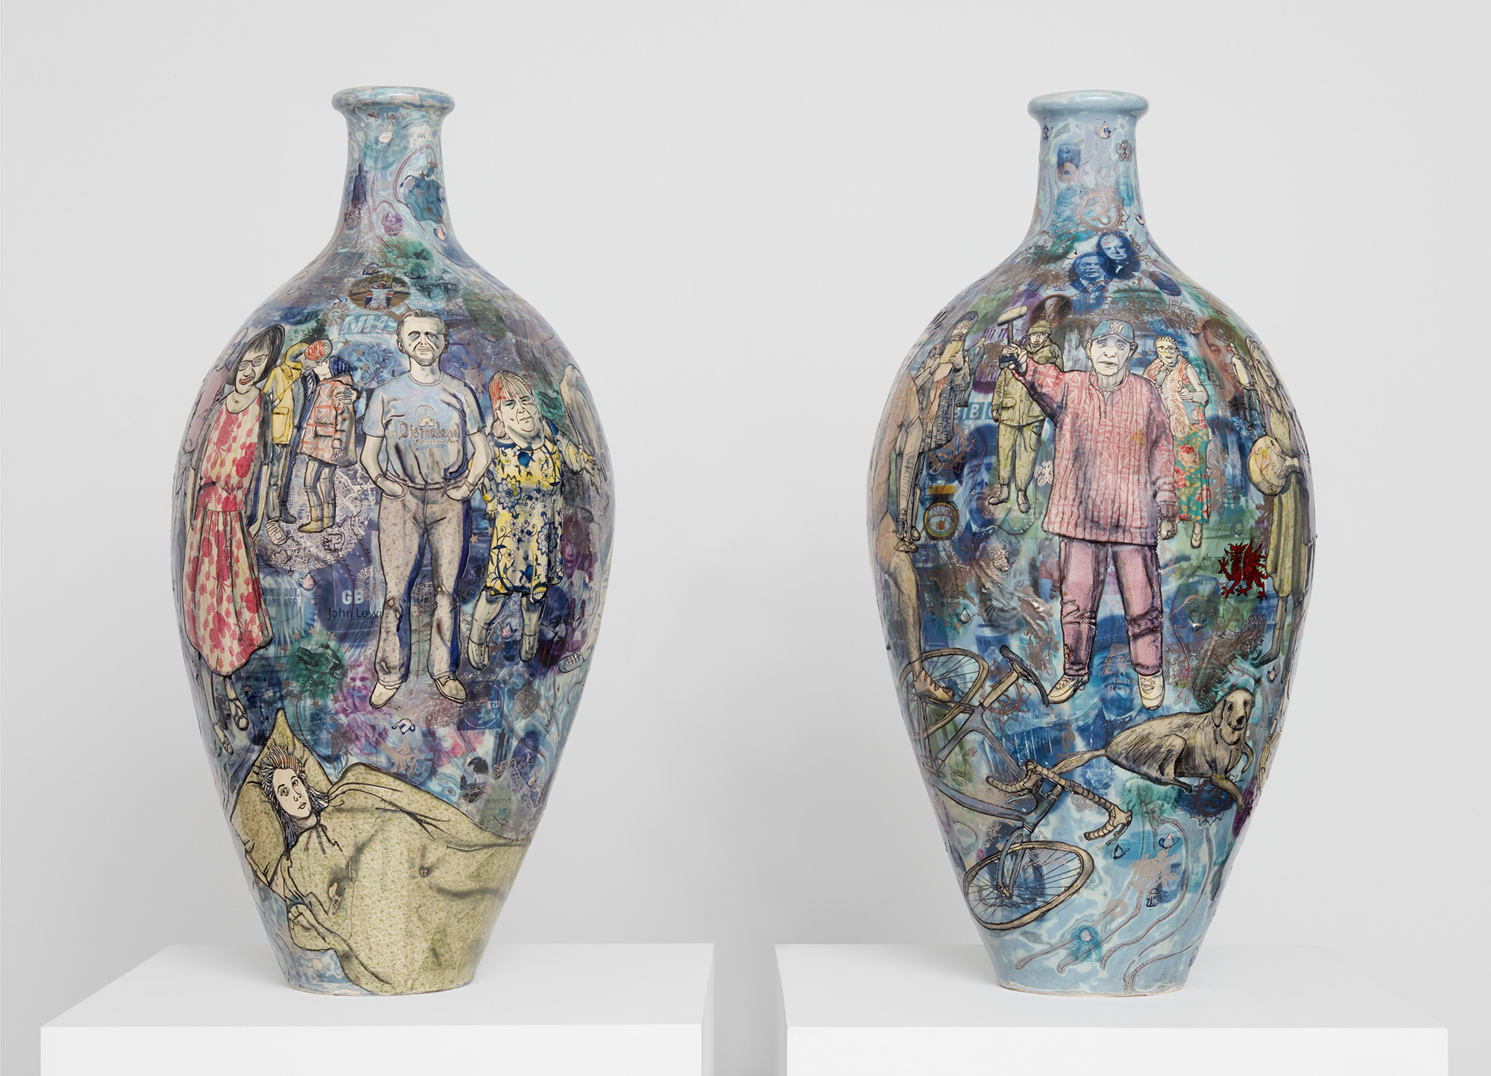
@DBPrendergast d.wilson@uwtsd.ac.uk

Slide 11
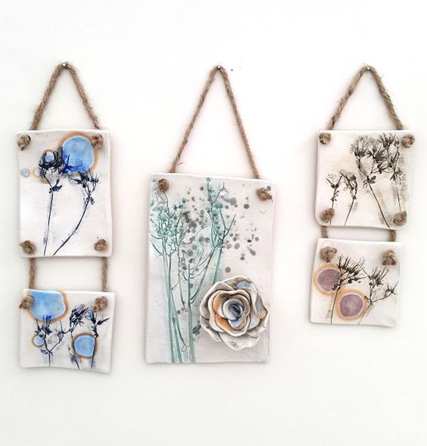
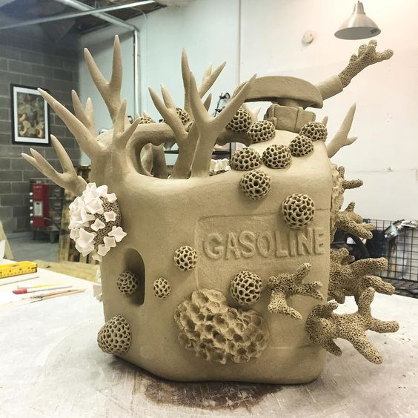
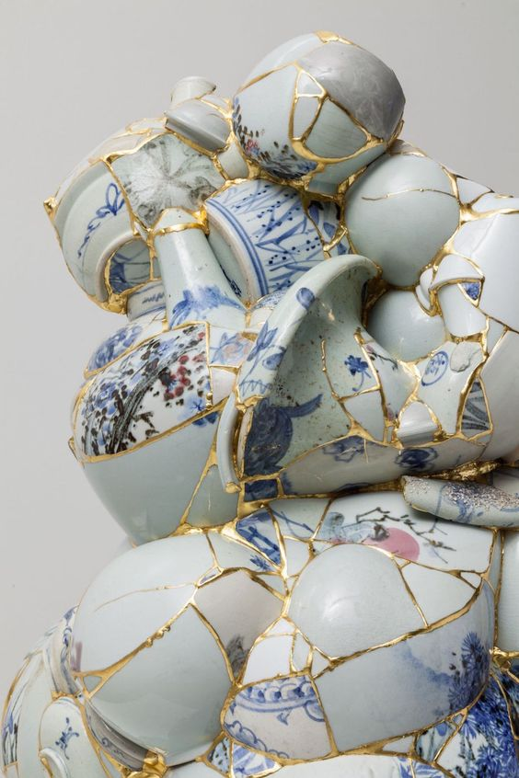

Jane Samuel
@DBPrendergast d.wilson@uwtsd.ac.uk
Pinterest Board

Slide 12
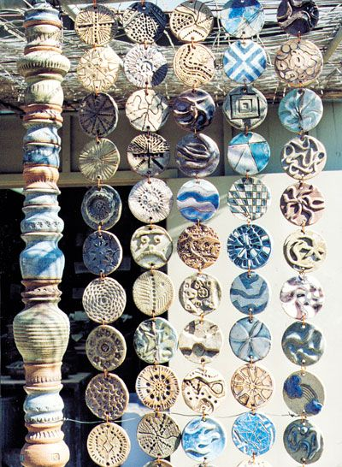
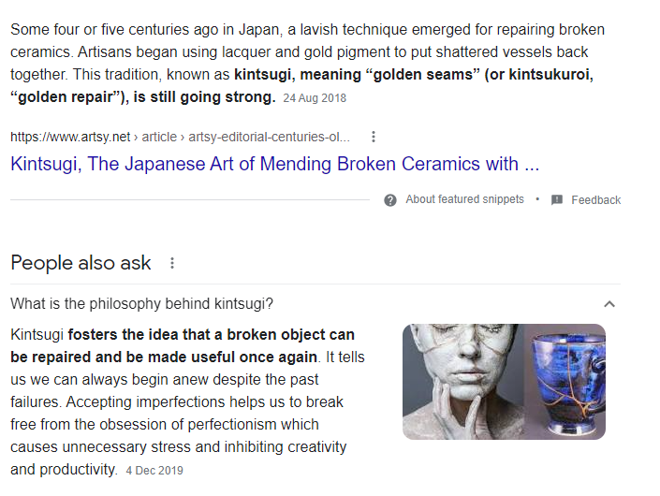

Slide 13
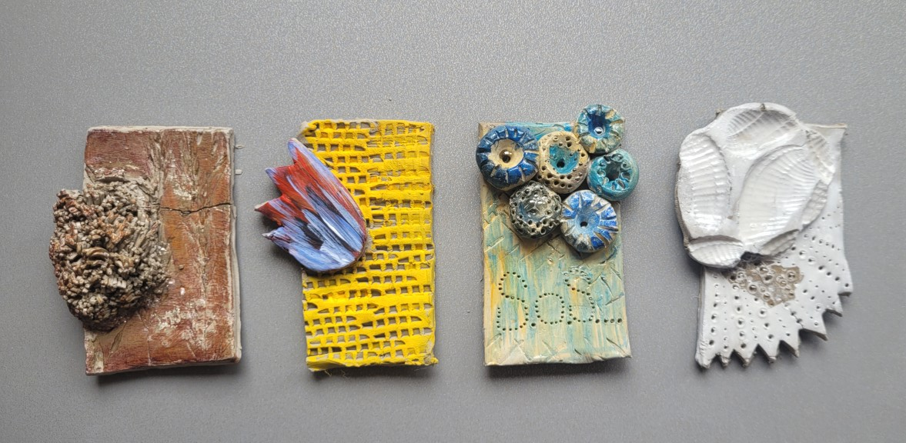
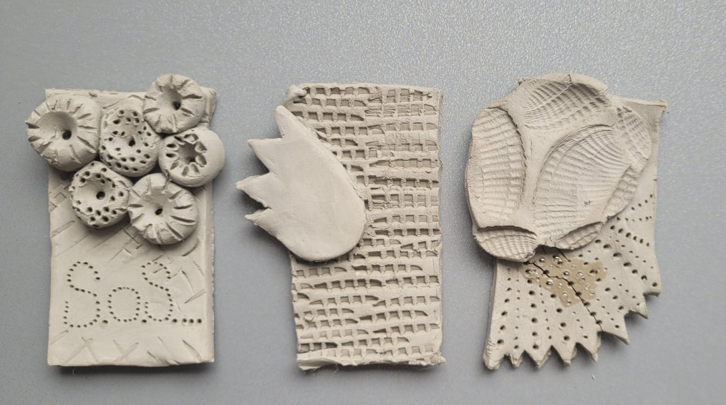
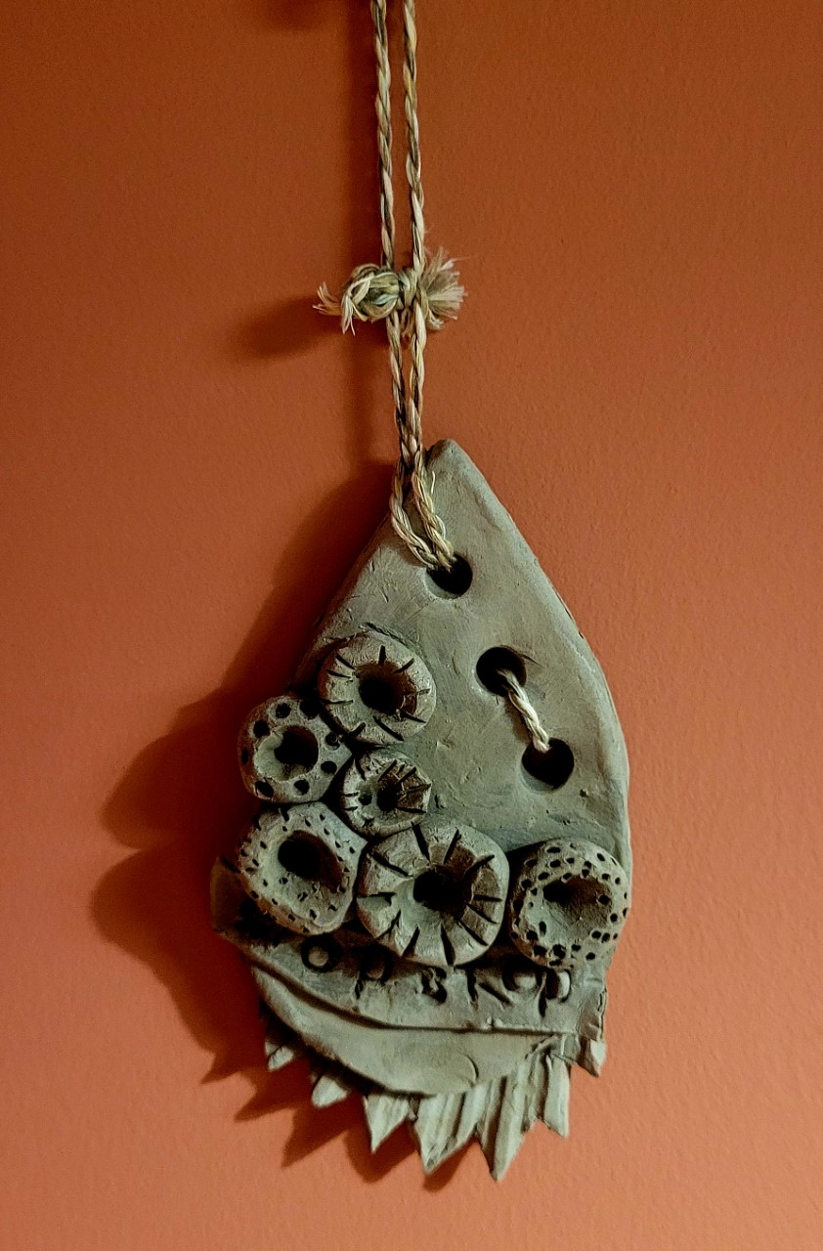
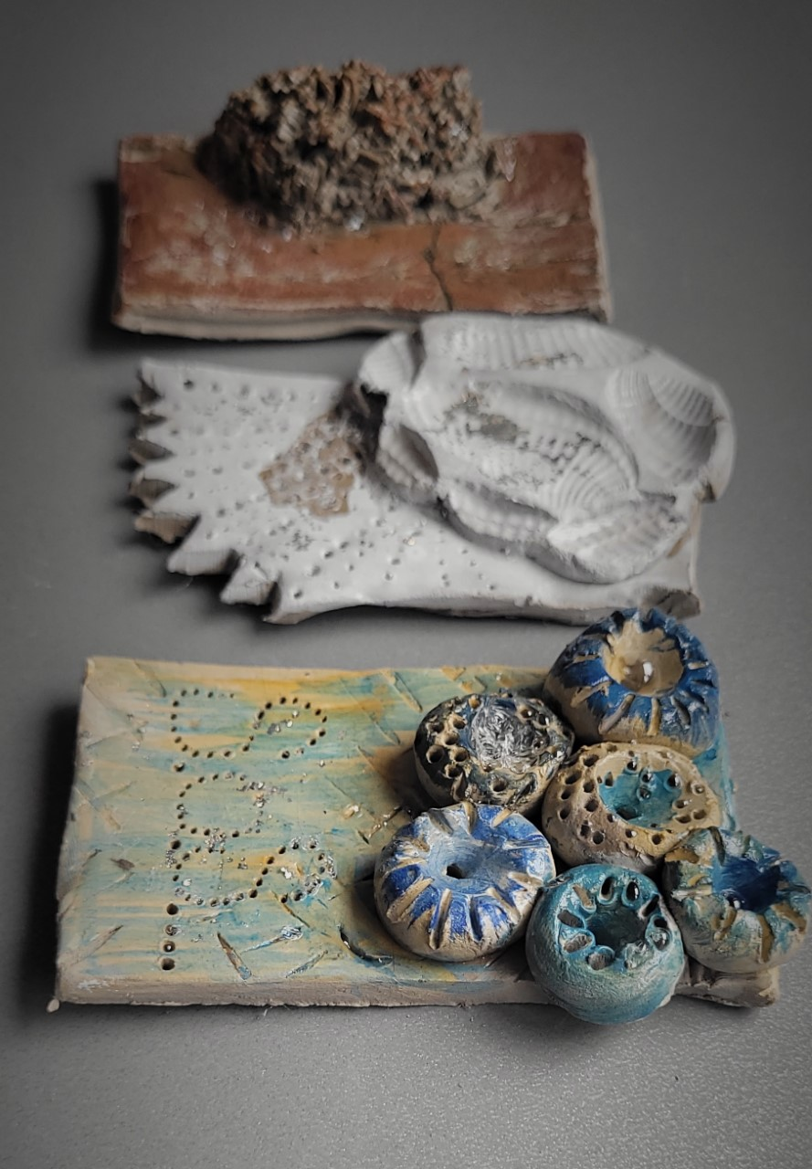
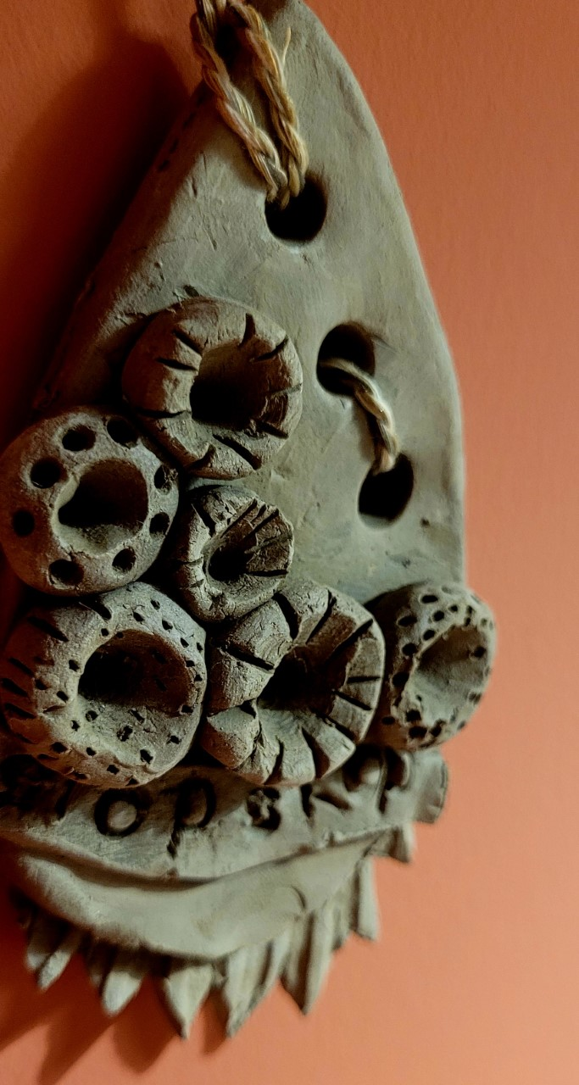
@DBPrendergast d.wilson@uwtsd.ac.uk

Slide 14
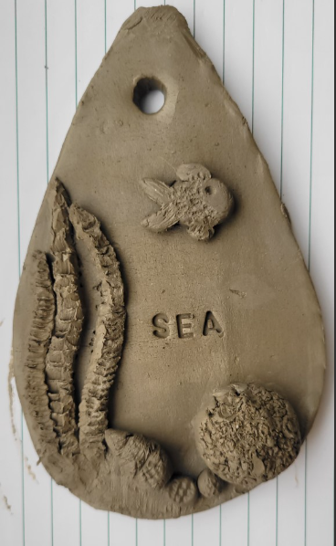
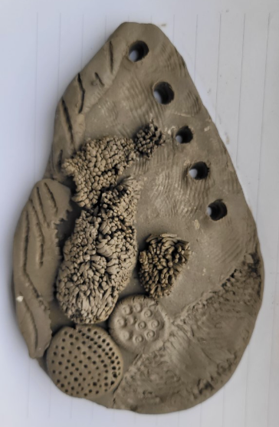
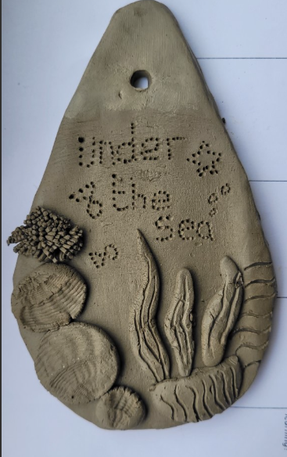
@DBPrendergast d.wilson@uwtsd.ac.uk

Slide 15


