Slide 1
How Carl Rogers contribute to our understanding of the role of ‘helping’ and support, especially in an educational setting.
Amy Drewett
2009939

Slide 2
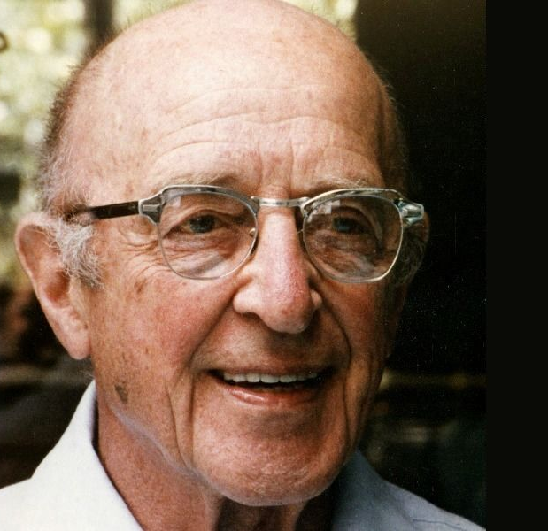
Who was Carl Rogers?
Born in 1902.
Illinois USA.
High achiever from a young age.
1922 started a major in agriculture.
Changed to major in history and graduated in 1924 before going onto his masters in 1926.
Created and developed person centered approach and worked on it up until his passing in 1987.
(Source: Bing images, No date).

Slide 3
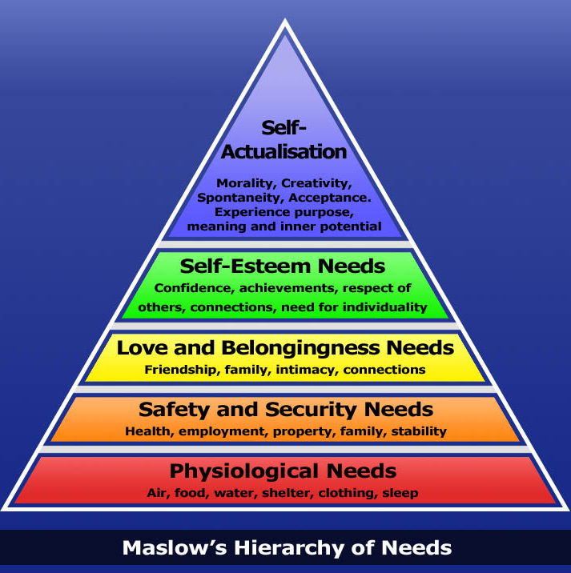
Maslows Hierarchy of Needs
(Source: Bing Images, No date).

Slide 4
Self Actualisation
“Self-actualization needs - realizing personal potential, self-fulfilment, seeking personal growth and peak experiences. A desire “to become everything one is capable of becoming”(Maslow, 1987, p. 64).
Self actualisation occurs when all basic and lower needs are met.
It is a continuous process.
It allows a person to grow and build on them selves.
It can be a lengthily, time consuming process and may seem impossible if people are not able to meet the needs lower down the table.

Slide 5
Client Centered Approach
Rogers own unique approach
Learner centered education
Student centered Learning
Three core conditions
Client not Patient to place importance on person

Slide 6
3 Core conditions
“Accepting and loving others simply for who they are. This feeling is not affected by how people act and is not withdrawn if a person makes a mistake or does something wrong”. (Mississippi College 2018).
“To understand the thoughts and the feelings as the client experiences them, sometimes referred to as ‘walking in someone else’s shoes’” (Counselling Tutor 2020).
Unconditional Positive Regard
Empathy
Congruence
“Genuineness, realness, or congruence. The more the therapist is himself or herself in the relationship, putting up no professional front or personal facade, the greater is the likelihood that the client will change and grow in a constructive manner” (Martin, G. 2017)

Slide 7
Learner Centered Education
A development of client centered approach for education purposes.
“A person cannot teach another person directly; a person can only facilitate another's learning.
A person learns significantly only those things that are perceived as being involved in the maintenance of or enhancement of the structure of self.
Experience which, if assimilated, would involve a change in the organization of self, tends to be resisted through denial or distortion of symbolism.
The structure and organization of self appears to become more rigid under threats and to relax its boundaries when completely free from threat.
The educational situation which most effectively promotes significant learning is one in which (a) threat to the self of the learner is reduced to a minimum and (b) differentiated perception of the field is facilitated” (Rogers, C. 1951).

Slide 8
Rogers Theories in Practice
A recent Estyn report into Effective school support for disadvantaged and vulnerable pupils - case studies of good practice shows a wide range of different approaches that have a positive effect within schools.
The approaches being used can be linked back to Rogers’ approaches. Below are 3 of the main findings,
“In most schools, leaders understand the importance of supporting disadvantaged and vulnerable pupils to overcome barriers to learning. In the most effective schools, staff do not just focus on the challenges that pupils face, but identify individual pupils’ interests and talents, and build on these positives.
Schools that best support disadvantaged and vulnerable pupils place the wellbeing of every child at the heart of their work. In these schools, there is a strong focus on providing a safe and nurturing environment where pupils and staff feel secure.
In many successful schools, staff have designed a curriculum that meets pupils’ interests and engages vulnerable and disadvantaged pupils effectively in their learning.” (Estyn 2020).

Slide 9
Conclusion
Rogers contributes to our understanding of the role of helping and supporting especially within an educational setting with the different theories and processes outlined within this presentation. Rogers provides clear reasoned and well researched evidence to support his theories and they have been the basis of various programs across the world. Such as the Nurture Group UK putting unconditional positive regard as the most important factor for change. Up until his passing Rogers’ was working on a book along with Harold Lyon titled ‘On becoming an effective teacher’. Providing more tools and resources to help us help and support in an educational setting.
Not only does Rogers core conditions contribute to the way in which we help learners in an educational setting but with humans as a whole. Treating people with empathy, congruence and unconditional positive regard. Allowing a person to grow and be themselves.
“Learning of all kinds goes on best, lasts best, and tends to lead itself on more when it grows out of a real focus of interest in the learner.” Carl Rogers.

Slide 10
References
All Answers. (2018). CARL ROGERS PERSON-CENTRED APPROACH. Available at: https://nursinganswers.net/essays/carl-rogers.php?vref=1. (Accessed: 22 December 2020).
Bing Images. (No date). Available at: https://images.saymedia-content.com/.image/c_limit%2Ccs_srgb%2Cfl_progressive%2Cq_auto:good%2Cw_700/MTc0NjQ0NTI4MDQ0MTg5NDU1/death-a-wall-or-a-door-and-what-do-psychologists-think-about-this.jpg (Accessed: 18th December 2020).
Bing Images. (No date). Available at: https://www.bing.com/images/search?view=detailV2&ccid=eBcTc6Yh&id=210CA9BE94B4614D3CC439CFDA2832D1926D4C0C&thid=OIP.eBcTc6YhNTeVNoBfBtPt3wHaGo&mediaurl=http%3a%2f%2flifeasimprov.files.wordpress.com%2f2013%2f01%2fmaslows-hierarchy-of-needs.jpg&exph=716&expw=800&q=maslows+heirachey+of+needs&simid=608019717133698487&ck=6EEB99DDB099255135A89B43CE958FB5&selectedIndex=3&FORM=IRPRST&ajaxhist=0 (Accessed: 18th December 2020).
Cherry, K. (2020) Carl Rogers Psychologist Biography. Available at: www.verywellmind.com/carl-rogers-biography-1902-1987-2795542. (Accessed: 18th December 2020).
Counselling Tutor. (2020). Carl Rogers’ Core Conditions. Available at: https://counsellingtutor.com/counselling-approaches/person-centred-approach-to-counselling/carl-rogers-core-conditions/#:~:text=%20The%20core%20conditions%20are:%20%201%20Empathy,and%203%20Unconditional%20Positive%20Regard%20(UPR)%20More (Accessed: 20th December 2020).
Counselling Tutor. (2020) How Maslow’s Hierarchy of Needs Influenced Person-Centred Counselling. Available at: http:counsellingtutor.com/counselling-approaches/person-centred-approach-to-counselling/maslow-hierarchy-of-needs/#:~:text=During%20the%20time%20when%20Carl%20Rogers%20was%20first,has%20become%20known%20as%20‘Maslow’s%20hierarchy%20of%20needs’. (Accessed: 22nd December 2020).

Slide 11
References Continued
Estyn. (2020) Effective school support for disadvantaged and vulnerable pupils – case studies of good practice. p.3. Available at: https://www.estyn.gov.wales/system/files/202007/Effective%2520school%2520support%2520for%2520disadvantaged%2520and%2520vulnerable%2520pupils%2520en_0.pdf. (Accessed: 3rd December 2020).
Martin, G. (2017). Person Centred Counselling and the core conditions. Available at: https://discover.hubpages.com/education/The-core-conditions-which-Carl-Rogers-considered-essential-for-effective-counselling#:~:text=%20The%20three%20main%20core%20conditions%20that%20Carl,Regard.%20(UPR)%202%20Empathy.%203%20Congruence.%20More (Accessed: 22nd December 2020).
Maslow, A. H. (1987). Motivation and personality (3rd ed.). Delhi, India: Pearson Education.
Mississippi College. (2018). The Importance of Positive Regard in Education. Available at https://online.mc.edu/degrees/education/med/leadership/importance-of-positive-regard-in-education/#:~:text=In%20the%20school%20setting%2C%20unconditional%20positive%20regard%20begins,make%20a%20different%20in%20the%20lives%20of%20students (Accessed 20th December 2020).
Nurtureuk. (No date) Nurture Groups for all educational settings. p. 3. Available at: www.nurtureuk.org/sites/default/files/images/nurture_groups_booklet_online.pdf. (Accessed 28th November 2020).
Rogers, Carl (1951). Client-centered therapy: Its current practice, implications and theory. London: Constable.
Stevens-Fulbrook, (2019). 15 learning theories in education (a complete summary). Available at: https://teacherofsci.com/learning-theories-in-education/ (Accessed 28th December 2020).
The Person Centre Approach. (2020). The Approach, Carl Rogers. Available at: https://www.the-pca.org.uk/about/carl-rogers.html. (Accessed: 27th December 2020).
Welsh Government. (2015) Free Breakfast In Primary Schools. Available at gov.wales/sites/default/files/publications/2018-03/free-breakfast-in-primary-schools.pdf. (Accessed: 20th December 2020).

