Slide 1

Assessment
Viva
Student name: Kristina Koleva
Student ID: 1812788
Module name: Community Care and Development
Module code: (BMHP6022_LON)
Lecturer name: Bianca Sanfilippo
Date: Tuesday, 30th November 2021

Slide 2
Introduction
Main concepts:
To describe definitions and the importance of developing community
To present borough of Hounslow as a one of the most diversity borough in London
To develop project which help young people to have healthy live by helping to reduce obesity

Slide 3

Definition of community
Meaning of community(Gov.uk,2018)
Feeling of belonging to neighbourhood- statistics(Gov.uk,2020)
What is community development?! (SDCD.uk, 2021)
Notes:
The word community is one of the most influential in the language but very often it is used in the wrong context. It is quite emotional word that has been used as a keyword even in political life today. The community in the political life in Great Britain is an inter- party agreement. The state is believed to play a role in supporting community and protecting it from decay.
According to NHS ‘Community’ is used to describe the connections, links, individualities and hobbies that brings society together or allow them to share part in a place, service, culture or activity. Different communities differ according to latitude, common interests, affinity or identity and like each of their participants is attracted through a different strategy. Communities are different, diverse, multifaceted and people’s beliefs change over time and depending of the different situations (Gov.uk, 2018)
In simple words community is a group of people who accommodate same area, who share same religion, race, age, religion, etc (Cambridge Dictionary, 2021).
According to the national statistics in 2020 more than half of the immature population in England think they have very strong connection to their neighbourhood. The same statistics said that around frothy four precent of Other ethnic group have strong sense of belonged to their neighbourhood (Gov.uk, 2020).
Community development is a procedure when a group of people with common interests begin to achieve their visions, beliefs, etc. The main point of the community development that all members should have access to health, wellbeing, wealth, justice and opportunity. (SDCD.uk, 2021)

Slide 4
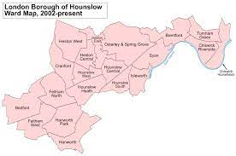
Recognising the diversity of Hounslow
Living and working in Hounslow (Hounslow, 2021).
Equality (Hounslow, 2021).
Notes:
Borough of Hounslow is one of the richest Borough in London. There are some areas which a vey rich, but others abound in various Casos. The community here is ethnically divorced.
Hounslow has a resident population of approximately 244,000 (Census 2012) of which less than 8% are aged under 5 years. Less than 50% of the people of Hounslow classify themselves as from a Black and Minority Ethnic family and the ethnic minority people is estimated to increase fast.
When the migration increase and birth rate is coming up the schools have big number of students in class which first language is English but the cultural believes and values are different. The students in Hounslow are different from each other and each has different needs. Some are talented and other are not so much talented, Some face various disabilities or are part of the vulnerable group.
The Borough of Hounslow are feeling proud because of the diverse classrooms and believe in supporting all children and providing education which takes account of their individual needs and circumstances. The Borough thinks this social, economic and ethnic diversity should be celebrated and that a classroom full of pupils from a wide variety of backgrounds provides plenty of opportunities for learning, growth and success (Hounslow, 2021).
At the heart of the Hounslow’s vision for equalities communities rank first in importance.
Borough of Hounslow aims to improve the quality of life of all those who living and working in the borough by encouraging citizens to be actively involved in all aspects improving Houlower’s lives.
The council's equality aims to help and support Hounslow residents who need it most, to safe borough, to improve the lives of residents and works in a transparent way.
We have focussed on publishing public sector equality data that will enable people to compare the current performance against future performance” (Hounslow, 2021).

Slide 5
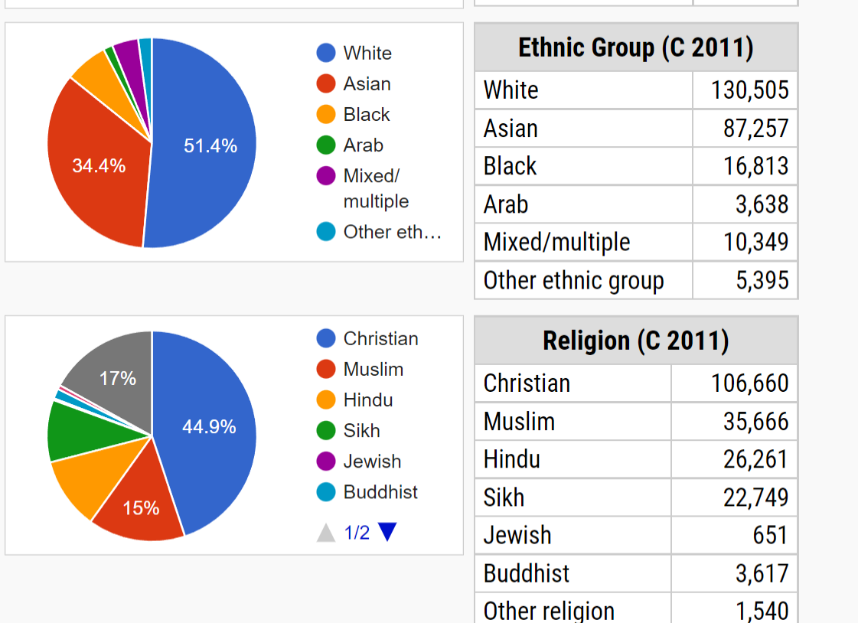
Recognising the diversity of Hounslow
(Citypopulation.de, 2020)
Notes:
Analysing the graphs, it could be said that there are different ethnic groups with even richer religious views live in the Borough.

Slide 6
A project within our community
Problems related to obese in Borough of Hounslow- statistics (Hounslow, 2019).
Healthy lifestyle project
Notes:
Currently over one third of Hounslow’s children are overweight at age 10/11 and this is posing a threat to current and future health. In some parts of the borough such as Bedfont, Cranford and Feltham North wards, over 42 per cent of 10/11 year olds are overweight . In these wards, at least les than 30 per cent of this age group are officially obese. Children’s obesity leads to diseases such as asthma, type two diabetes, it can leads to depression , low self esteem and behavioural problems. Unhealthy lifestyle is quite popular in the borough. But it can cause to obesity in the adulthood and that leads to many healthy problems in people’s live (Hounslow, 2019).
The reason to decided to take action on this project is because the young people need of change. They need to be healthy. It is very important to find what cause children’s obesity and how we all can help to provide a healthy pathway to the young generation in Borough of Hounslow. The another benefits of creating this project is to develop community which will bring together more people of the borough. The social media’s help or in particular on several platforms accessible and preferred by young people will be made culinary series where all young people from the community will participate and learn from a guest chef. Young people like to be part of challenges. Steps competition can be one of them.

Slide 7
Benefits of creating a community and theories supporting it
Positive impact on the mental health and wellbeing
Sense of belonging
(Gov.uk, 2021)
Maslow’s theory (Tripathi, N. and Moakumla, 2018).
Attachment theory (Ein-Dor, T. and Hirschberger, G., 2016).
Bandura’s Psychosocial Theory (Deming, P., & Johnson, L., 2021).
Notes:
To be part of the communality can influence positive on the mental health and wellbeing
Being part of community gives you sense of belonging and people feel more connected to others(gov.uk, 2021).
Relying on this statements, a healthy lifestyle project would achieve positive results. Young people need support of society , of their peers to fight overweight.
Abraham Maslow's theory of "self-actualization" can be an tool to motivate and encourage community to be healthy and to achieve a better quality of life because a individual is here in this world to improve himself, to find meaning in this life. Maslow high point the need for "self-actualization" as the crucial need and one of the inspiring part to understand one's own maximum potential (Tripathi, N. and Moakumla, 2018).
Bowlby’s attachment theory has inspired study cover a variety of themes linked to personal and social well-being, such as dating, friend choice, emotional responses, motivations, values, cognitions, dreams and psychopathology. The connection between mother and baby is very important because it provide the child’s social and emotional development (Ein-Dor, T. and Hirschberger, G., 2016).
In the same way when the teenager get older they are interested to be attached to their mentors, teachers, caregivers, etc.
The psychosocial learning theory (Bandura, 1977) suggests that the learning based on observation can impact positive, and that effect can be improved when the observers think that the person proving the certain behaviour has similar attitude as themselves (Deming, P., & Johnson, L., 2021).
In our case, if we invite a chef to show healthy meals it will contributes to children’s healthy development.

Slide 8
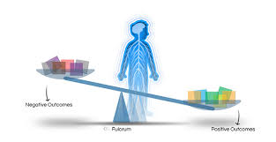
Positive and negative impact of community development
(PHS, 2021)
Notes:
Positive:
Feel safety
opportunity to get a job
Ability to access affordable goods and services
having places to meet people and socialise
social networks and relationships with neighbours
sense of belonging to the community and having influence and control.
Negative
loneliness
feeling unsafe
lack of street life and sociability
lack of a sense of control or purpose
sense of feeling disconnected from community life (PHS, 2021).
(PHS, 2021)
Using social media as part of everyday routine and responding to content that others share is positively associated with all three health outcomes. Emotional connection to social media—for example, checking apps excessively out of fear of missing out, being disappointed about or feeling disconnected from friends when not logged into social media—is negatively associated with all three outcomes.

Slide 9

Digital support for young people
Snapchat
Instagram
Facebook
Notes:
These three platforms are very popular platforms for teenagers. Only 5% of the young people have access to smartphones and less than half of them said that they are almost 24/7 online (PerSearchCenter, 2018).
Using these three platforms our ideas can reach more people faster. We can post pictures from some competition or culinary lesson. It could be created a live broadcast where young people can express their culinary skills.

Slide 10
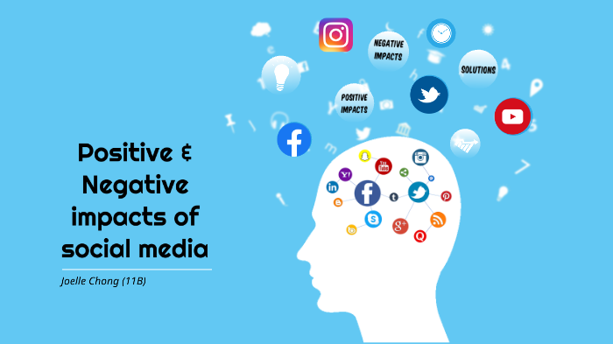
Positive and negative impact of using digital platforms within community
(Siddiqui, S., 2016)
Notes:
Positive:
Allows to people from all over the world to meet each other in real time.
It always provides up-to-date information so that people are aware of the new things.
It provides open opportunity for all writers and bloggers to connect with the others.
Negative
One of the negative effect of social media is that it make people addicted. People spend lots of time in social networking sites which can divert the concentration and focus from the particular task.
Social media can easily effect the kids, the reason is sometimes people shares photos, videos on media that contain violence and negative things which can affect the behaviour of kids or teenagers. It also abuses the society by invading on people’s privacy.
Social lies like family ones also weaken as people spend more time connecting to new people. • Some people uses their images or videos in social sites that can encourage others to use it false fully (Siddiqui, S., 2016).

Slide 11
Relevant legislation and policy in community development.
Safeguarding Vulnerable Groups Act 2006 (DBS Enhanced)
Equality Act 2010
Human Rights Act 1998
Confidentiality Policy
Whistleblowing Policy
Notes:
Regulated activity provides an action that is forbidden to be performed by individual. It is sharps in the Safeguarding Vulnerable Groups Act 2006 (SVGA) which has been updated by the Protection of Freedoms Act 2012 (PoFA). When an employer hire an employee in an organization closely related to children, people with disabilities or any vulnerable individual, it is obligatory to require a DBS check (gov.uk, 2021).
The importance of non –discriminatory practice and support of equality, diversity and inclusion
Equality describes recognition and support equally the needs of people and individualities of all others. It delivers opportunity for all children to get their full potential and have an equal chance to live their life as they choose. Equality also refers to the way we handle cases of prejudice and discrimination to ensure there is equality in the process and outcome.
The Equality Act 2010 provides a legal framework to protect the rights of individuals and advance equality for all. It provides a single, consolidated source of discrimination law, covering all the types of discrimination that are unlawful. Everything that we do in early years needs to be non-discriminatory and this requires regular reviews of practice, policies and procedures to ensure we do not discriminate against anyone without exception (Anonymous, 2020).
The Human Rights Act provides you legal protection of your human rights, such as your right to life, or your right to a fair trial. You are protected under the Human Rights Act if you live in the UK. This includes if you are a foreign national, detained in hospital or in prison. All public authorities and all public organizations must to follow the Human Rights Act. If the human rights haven’t been respected, the person should first try to resolve it informally, then use a formal complaints procedure, and if that fails he/she can take legal action by going to court. People need to get an advice before to go to the court . If a court agrees that somebody's human rights have been breached, it can leads to compensation.(Mind, 2020).

Slide 12
Barriers to community development and recommendations
Lack of fundings
Low engagement opportunities’ awareness, structures and rights
Limited view of community improvement determining who is involved , what to do, quality of work and experience
Confrontation within engaging groups to distributing control and power.
Lack of leadership
(NICE,2015)
Notes:
In order to implement the project it is necessary to seek funds from local companies or from participants with better financial opportunities.
For the good realization of the project it is essential to have precise instructions for implementation and people to lead but also and participants who gives ideas and active participate in the team work. The communication is essential.

Slide 13
Conclusion
It is necessary to know the diversity of the community in order to meet everybody’s needs
Social media is a powerful tool to support the younger generation
Using it we have a great chance to attract more young people to have a healthy lifestyle and reduce the obesity rate.

Slide 14
References
Anonymous(2020) Reflecting on Equality, Diversity and Inclusion in the Early Years. Available at: <https://www.entrust-ed.co.uk/insights/reflecting-equality-diversity-and-inclusion-early-years> (Accessed 9 December 2021).
Cambridge Dictionary, 2021. community. [online] Dictionary.cambridge.org. Available at: <https://dictionary.cambridge.org/dictionary/english/community> [Accessed 28 November 2021].
Citypopulation.de (2021) Hounslow (Borough, United Kingdom) - Population Statistics, Charts, Map and Location.Available at: <https://www.citypopulation.de/en/uk/london/wards/E09000018__hounslow/> (Accessed 22 November 2021.
Deming, P., and Johnson, L. (2021). An application of Bandura’s social learning theory: A new approach to deafblind support groups, Vol.42, Available at: https://westcollections.wcsu.edu/bitstream/handle/20.500.12945/1419/stamped.pdf?sequence=3
Ein-Dor, T. and Hirschberger, G. (2016) Rethinking Attachment Theory: From a Theory of Relationships to a Theory of Individual and Group Survival, Current directions in psychological science : a journal of the American Psychological Society, Vol.25(4), pp. 223–227. doi:10.1177/0963721416650684.

Slide 15
References
gov.uk(2021) Regulated activities with children in England. Available at: <https://assets.publishing.service.gov.uk/government/uploads/system/uploads/attachment_data/file/739154/Regulated_Activity_with_Children_in_England.pdf> (Accessed 9 December 2021).
Gov.uk (2018) Health matters: community-centred approaches for health and wellbeing. Available at: <https://www.gov.uk/government/publications/health-matters-health-and-wellbeing-community-centred-approaches/health-matters-community-centred-approaches-for-health-and-wellbeing> (Accessed 21 November 2021).
Gov.uk (2020) Feeling of belonging to a neighbourhood. Available at: <https://www.ethnicity-facts-figures.service.gov.uk/culture-and-community/community/feeling-of-belonging-to-a-neighbourhood/latest#main-facts-and-figures> (Accessed 21 November 2021).
Hounslow (2021) Equality | Equality | London Borough of Hounslow. Available at: <https://www.hounslow.gov.uk/info/20111/about_the_council/1380/equality> (Accessed 21 November 2021).

Slide 16
References
Hounslow (2021) London Borough of Hounslow. Available at: <https://www.workinhounslowschools.org.uk/recruitment/working-here/living-and-working-in-hounslow/> (Accessed 21 November 2021).
Mind (2020) Human Right Act 1998. Available at: <https://www.mind.org.uk/media-a/4125/hra98-2020.pdf> (Accessed 10 December 2021).
NICE (2015) Review 5: Evidence review of barriers to, and facilitators of, community engagement approaches and practices in the UK. Available at: https://www.nice.org.uk/guidance/ng44/evidence/evidence-review-5-community-engagement-barriers-and-facilitators-pdf-2368403681> (Accessed 29 November 2021).
Owen, M.(2009) Losing Touch With the Changing Definition of "Community“. Available at: <https://www.newgeography.com/content/001045-losing-touch-with-changing-definition-community> (Accessed 21 November 2021).
PewSearchCenter(2018) Teens, Social Media & Technology 2018. Available at: <https://www.pewresearch.org/internet/2018/05/31/teens-social-media-technology-2018/> (Accessed 4 December 2021).

Slide 17
References
Siddiqui, S. (2016) Social Media its Impact with Positive and Negative Aspects, International Journal of Computer Applications Technology and Research, Vol.5(2), pp. 71–75.
Tripathi, N. and Moakumla (2018) A valuation of Abraham Maslow’s theory of self-actualization for the enhancement of quality of life, Indian journal of health and wellbeing, Vol.9(3), pp. 499–504

