Slide 1



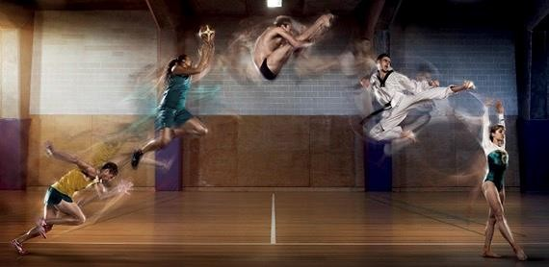


Sports Trauma Management
Exposure, Environment & Everything Else
c. Medical Emergencies
  Asthma
16 Royal Terrace, Glasgow, G3 7NY, T: 0845 600 2613, F: 0141 332 5335, W:www.society-of-sports-therapists.org, E: admin@society-of-sports-therapists.org

Slide 2
Medical Emergencies
Asthma
  Episodic, reversible, wheezing, breathlessness, chest tightness with cough.
  Reversible airway narrowing (bronchospasm) & excess mucus secretion

Slide 3
Asthma
Life Threatening
Any 1 of the following
  Silent chest & feeble respiratory effort
  Cyanosis
  O₂ sat <92%
  PEFR <33%
  Exhaustion
  Confusion
  Altered consciousness
Moderate
  Normal speech
  PEFR >50% of predicted best
Acute Severe
  Any 1 of the following
    Talk in broken sentences
    PEFR 33-50%
    Pulse >110bpm
    Respiration: >25 Breaths per minute

Slide 4
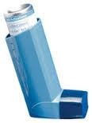

Management of Acute Asthma Exacerbation
SAFE?
Airway
  Consider 0₂
Breathing
  Check Resp Rate
  Auscultation
    Wheeze with equal air entry
Circulation
Disability
  AVPU
Environment
  Inhaler

Slide 5
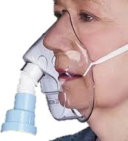
Call for Help (ED)
Sit Patient Up
O₂ 10-15L/min via NRBM
NEBULISE
  Salbutamol
    5mg Ventolin
  & Ipratropium
    500mg Atrovent
  Repeat Back to Back with O2
STEROIDS
Delayed effect (4-6hrs)
  Prednisolone
    40-50mg Orally
  OR
  Hydrocortisone
    100mg IV

