Slide 1

Strategies for Effective Communication in a Business Setting
Students name and ID number: Irina-Roxana Ioana 2130080
Ana-Maria Ioana 2130078
Alexandru Ioana 2130079
Florentin-Daniel Ciobanu 2127866
Lecturer name: Hafiz Rahmani
Module title: Effective Team Working and Communication
Module code: BMSW4002

Slide 2
Table of contains
Introduction........................................................................3
Benefits of communication................................................4
Effective communication theories.....................................5
Barriers in communication................................................6
Channels of communication..............................................8
Conclusion.........................................................................9
References.........................................................................10

Slide 3
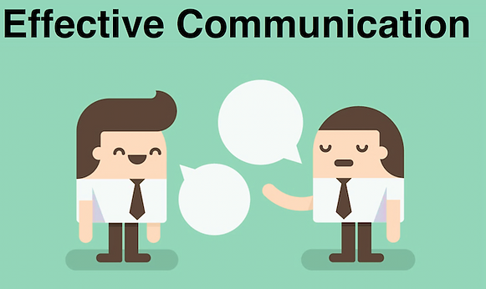
Introduction
Amazon has set an ambitious target of opening three large warehouses in London, Berlin and Paris. Tom is leading the project and he is required to build a team and divide the tasks and obligation for all members to achieve but there is no suitable channel of communication between members and some aspects of interaction between them and Tom is flawed.
In the following presentation is mentioned the importance of communication.
It will also mention the benefits of communication and the models Tom should apply to improve his interaction with the employees
It will discuss the barriers that can impact business operations.
Source: (Vogel, 2022).
Notes:
Introduction
Communication is important for an organisation to operate its business seamlessly and make sure everyone in the organisation is working towards the benefit of the company.
Good communication reduces confusion and misunderstanding among employees which improves the productivity of the company.
Lack of interaction can impact the performance of the employees and they might not be able to focus on the work.

Slide 4
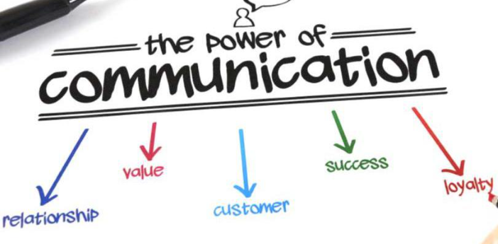
Benefits of communication
Mitigate conflict
Due to work pressure, employees often make mistakes that create conflict with customers or other employees and that impact the work environment.
Effective communication can resolve the problem between employees and help to mitigate the conflict between them (Sherman, 2019).
Encourages innovation
Through good communication, Amazon and Tom can find new strategies to solve the issues.
While conveying messages people come up with new ideas that can help the Amazon to resolve the issues.
Motivating employees
A good HR manager can talk them through to motivate them and help them focus on the work.
Through good communication, managers can understand the unique talents of their employees that they can use to improve their business (Vogel, 2022).
Source: (Sherman, 2019). ​
Notes:
Benefits of communication
Effective communication plays a very important role in all business operations because it can not only help the TOM but also the employees or even his project team in understanding their duty to the companies. The benefits of effective interaction can help the Amazon company to run smoothly but also to use the skills of employees
Mitigate conflict
There is sometimes a confusion among Amazon employees that affects the company's productivity. Due to work pressure, employees of this company often make mistakes that create conflicts with customers and affect the work environment.
Encourages innovation
The organization experiences problems during operations or that slow down business operations. Through good communication, the Amazon organization as well as Tom can find new strategies to solve problems. While delivering messages, people come up with new ideas that can help the organization solve problems.
Motivating employees
Communication helps improve employee motivation and Amazon employees often feel demotivated but also disinterested in focusing on their work. Good communication, Tom can understand the unique talents of their employees and that they can use in improving Amazon's business (Vogel, 2022).

Slide 5
Effective communication theories
The classical theory of communication, human reaction theory of communication and open system theory of communication are three types of models that can be used by organisations.
The theory of ‘who’ said ‘what’ and using the ‘which’ channel impacts the process of communication.
According to the theory the message has to be formal, hierarchical and planned which will help contain all the important points that employees need to focus on.
The model follows the hierarchical method, Tom will not have to communicate directly to the employees, but rather divide the work among respective managers who will pass the information to their team members (businessjargons, 2022).
Notes:
Effective communication theories
There are different theories that can be adopted by organisations to improve communication at the workplace. The classical theory of communication, human reaction theory of communication and open system theory of communication are three types of models that can be used by organisations. However, Tom can use the classic theory of communication to effectively convey messages to the employees. The theory of ‘who’ said ‘what’ and using the ‘which’ channel impacts the process of communication. This method is used by the leaders for effective communication with their employees to pass information that is well scripted and helps employees to understand the message. According to the theory the message has to be formal, hierarchical and planned which will help contain all the important points that employees need to focus on. This way Tom will be able to share important information in a better way and it will reduce the misunderstanding between the management and the employees. The model follows the hierarchical method, Tom will not have to communicate directly to the employees, but rather divide the work among respective managers who will pass the information to their team members (businessjargons, 2022).

Slide 6
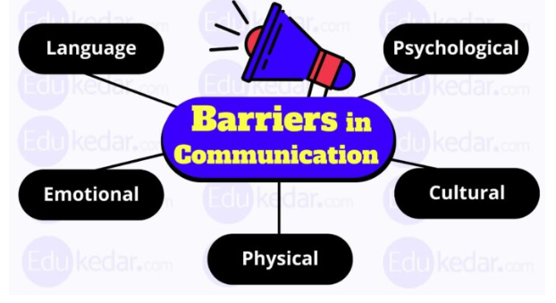
Barriers in communication
Language barrier
Language barriers are one of the biggest issues that negatively impact the organisation and slow the production process.
They often face problems while taking orders or passing information to other employees at the office.
Physical barriers
Physical barriers are most of the time because of the distance between the receivers and the speaker.
This problem comes during remote working as the network varies from place to place (Pehar, 2022).
Source: (businessjargons, 2022). ​
Notes:
Barriers in communication
There are some barriers in communication that can impact negatively the workplace, hence need special notice by the management on solving the problems. These barriers are language barriers, cultural barriers, psychological barriers, organisational barriers, physical barriers, and technological barriers.
Language barrier
Language barriers are one of the biggest issues that negatively impact the organisation and slow the production process which can impact the project. Many people from different backgrounds work in the organisation and use different languages in their daily life or they have different accents. They often face problems while taking orders or passing information to other employees at the office.
Physical barriers
Physical barriers are most of the time because of the distance between the receivers and the speaker. Although communication is possible through technology, sometimes disruptions in the network can impact the interaction. This problem comes during remote working as the network varies from place to place (Pehar, 2022).

Slide 7
Contd...
Technological barriers
Often organisations do not invest in the technology needed for the work, thus it creates a barrier between the work and the employees.
Failure in technology can disrupt communication and slow down production. Amazon and Tom must take this into account and the improvement of technology must be something necessary.
Organisational barriers
This barrier arises when the employees of Amazon do not have a good understanding of the business and they are not able to process the information passed on to them.
They are not able to work efficiently which impacts business operations. This also happens when there is a miscommunication between the management and the employees (grammarly, 2021).
Notes:
Technological barriers
Many companies do not invest in this technology, creating a barrier between work and employees. The failure of technology can greatly disrupt communication but also slow down production and Amazon and Tom must take this into account and the improvement of technology must be something necessary.
Organisational barriers
This barrier occurs when Amazon employees do not have a good understanding of the business and the capabilities to process the information that is being fed to them. Therefore, they are not able to work effectively, which affects business operations. This also happens when there is miscommunication between management and employees.
They are the important barriers that can affect the business and Tom must try to avoid such problems in the workplace for effective communication (Grammarly, 2021).

Slide 8

Channels of communication
Electronic communication
It is a process of communicating with the help of emails, messages, the internet or intranet to pass on the information to the employees.
Electronic communication is a formal method as well as the most effective way of communication that can be modified for individuals working in the organization.
Written communication
Although this is an old way of transferring information, it is still the most formal approach to conveying information.
Notes, memos, and notices are some examples of written communication that can be shared with multiple people at the same time (Williams, 2019).
Source: (Williams, 2019).
Notes:
Channels of communication
Effective interaction can be done with the help of some communication channels that can be adopted by organisations to communicate with their employees.
Electronic communication
While using classical communication theory, then Tom has to use the electric communication method to communicate with the employees. It is a process of communicating with the help of emails, messages, the internet or intranet to pass on the information to the employees. Electronic communication is a formal method as well as the most effective way of communication that can be modified for individuals working in the organisation.
Written communication
Although this is an old way of transferring information, it is still the most formal approach to conveying information. Notes, memos, and notices are some examples of written communication that can be shared with multiple people at the same time (Williams, 2019).

Slide 9

Conclusion
The above presentation has discussed the communication methods that can be used by Tom in the organisation for making it more effective and efficient.
the presentation has explained the communicational model that Tom can adopt for the organisation making conveying information more effective.
There are some barriers while communicating that also have been mentioned in the presentation.
Lastly, it described the communication channel that can be used by Tom for communicating with the employees.
Source: (Pehar, 2022).
Notes:
Conclusion
The above presentation has discussed the communication methods that can be used by Tom in the organisation for making it more effective and efficient. While mentioning the communication system it has included the benefits of effective interaction in the organisation. Further, the presentation has explained the communicational model that Tom can adopt for the organisation making conveying information more effective. There are some barriers while communicating that also have been mentioned in the presentation. Lastly, it described the communication channel that can be used by Tom for communicating with the employees.

Slide 10
References
businessjargons, (2022). Classical Theory. [Online] Available at: https://businessjargons.com/classical-theory.html
grammarly, (2021). barriers to effective communication in the workplace. [Online] Available at: https://www.grammarly.com/business/learn/barriers-to-effective-communication/
Pehar, P., (2022). Five Communication Barriers In Business And How To Fix Them. [Online] Available at: https://www.forbes.com/sites/forbescommunicationscouncil/2022/04/05/five-communication-barriers-in-business-and-how-to-fix-them/?sh=629b5352780f
Sherman, F., (2019). What Are the Benefits of Effective Communication in the Workplace?. [Online] Available at: https://smallbusiness.chron.com/benefits-effective-communication-workplace-20198.html
Vogel, K., (2022). What are the benefits of workplace communication?. [Online] Available at: https://www.ringcentral.com/us/en/blog/top-7-benefits-of-workplace-communication/
Williams, O., (2019). What Are Communication Channels Within an Organization?. [Online] Available at: https://smallbusiness.chron.com/communication-channels-within-organization-61447.html
Notes:
References
businessjargons, (2022). Classical Theory. [Online] Available at: https://businessjargons.com/classical-theory.html
grammarly, (2021). barriers to effective communication in the workplace. [Online] Available at: https://www.grammarly.com/business/learn/barriers-to-effective-communication/
Pehar, P., (2022). Five Communication Barriers In Business And How To Fix Them. [Online] Available at: https://www.forbes.com/sites/forbescommunicationscouncil/2022/04/05/five-communication-barriers-in-business-and-how-to-fix-them/?sh=629b5352780f
Sherman, F., (2019). What Are the Benefits of Effective Communication in the Workplace?. [Online] Available at: https://smallbusiness.chron.com/benefits-effective-communication-workplace-20198.html
Vogel, K., (2022). What are the benefits of workplace communication?. [Online] Available at: https://www.ringcentral.com/us/en/blog/top-7-benefits-of-workplace-communication/
Williams, O., (2019). What Are Communication Channels Within an Organization?. [Online] Available at: https://smallbusiness.chron.com/communication-channels-within-organization-61447.html

Slide 11
Teamwork Evaluation
Teamwork Evaluation | Responses
Who was in your team? | In my team was Ana-Maria Ioana, Alexandru Ioana and Florentin-Daniel Ciobanu.
What were the key strengths of your team? | The key strengths of my team were:communication,, accepting opinions and informations even if wrong ones ,together as a team we came up at the end with right answers after doing more research, each of us completed our task
What were the challenges that you overcame as a team? | The challenges were the meetings as some of them worked and sometimes we couldn’t agree the day or the hour when to work at the slides or sometimes they wouldn’t pick up the phone to set an hour to work at the presentation
What would you do differently if you worked as a team again? | I would set an exact date and time to meet up and would try to do it also online in group chat but my opinion is that it’s better in person because online can be difficult and will have to wait to send you the information or to rate yours
How would you rate your team working? Out of 10? | I would rate 9 because of the dates and times

