Slide 1
Understanding Film Technique
Cinematography and Editing #2

Slide 2
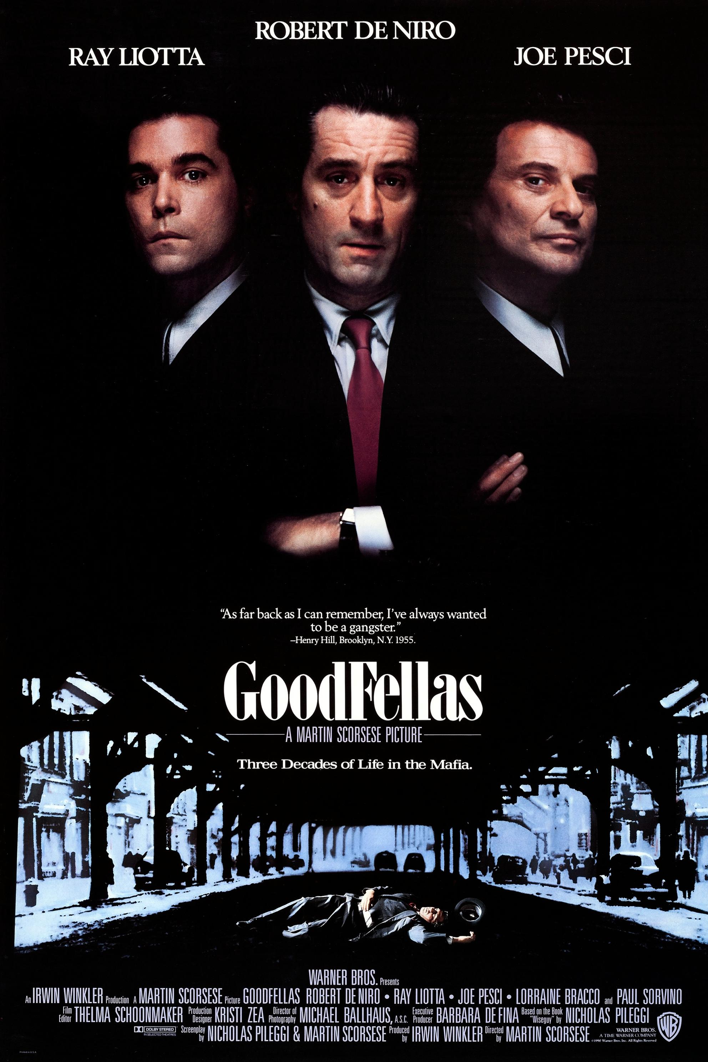
Goodfellas
Scorsese, 1990
Cinematography
‘THE FAMILY’
Groups and individuals
Long, medium, medium-close, and close-up
Exteriors – the context of environment
Tracking shots
Dolly zoom
Editing
Shot-reverse-shot (50:50)
Freeze Frames

Slide 3
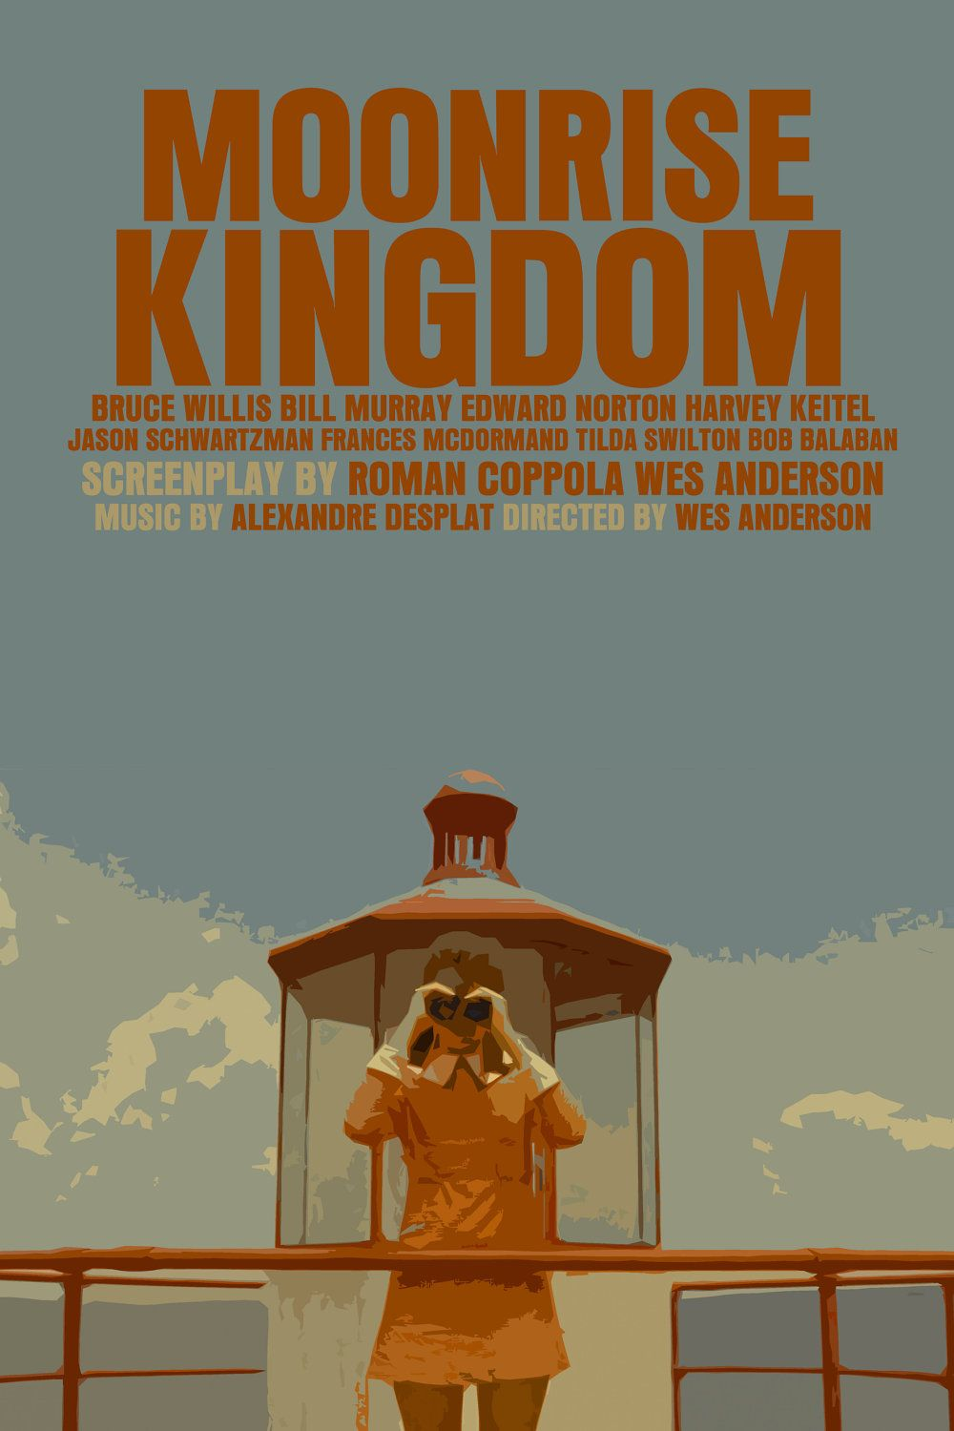
Moonrise Kingdom
Anderson, 2012
Cinematography
‘THE FAMILY’
Groups and individuals
Tracking and panning
Zoom
Deep focus
Symmetry
Editing
Cutting to music
Production design:
Use of colour
‘Storybook’ effect

Slide 4
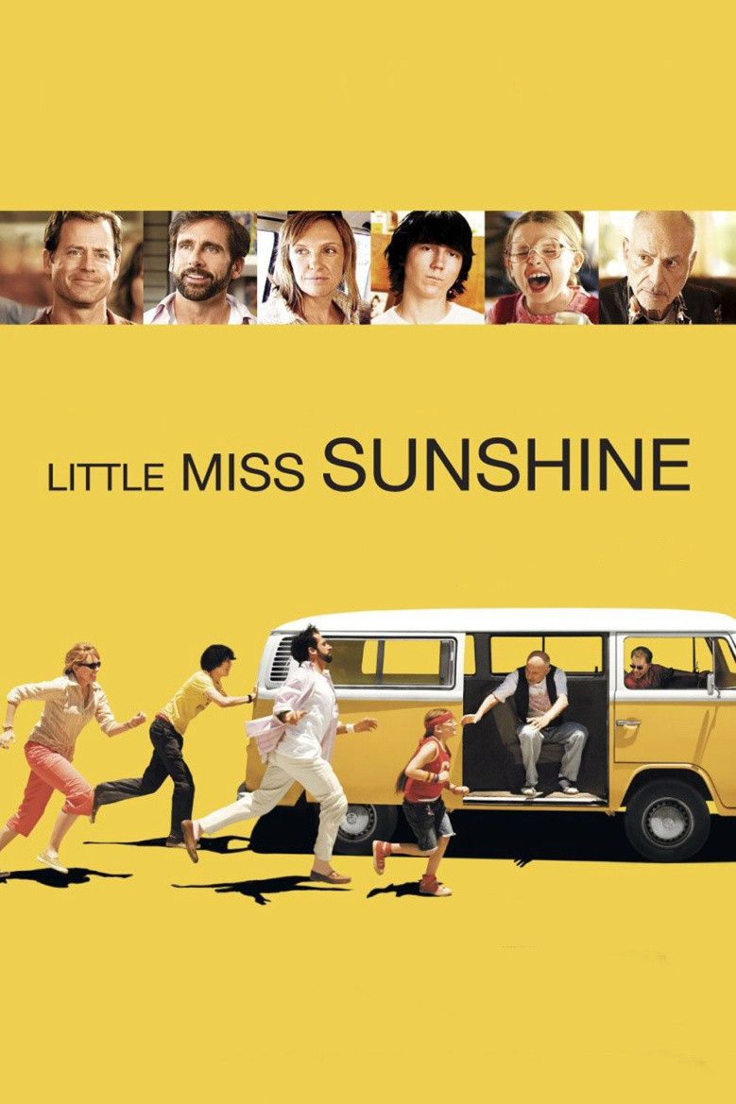
Little Miss Sunshine
Dayton/Farris, 2006
Cinematography
‘THE FAMILY’
Groups and individuals
Deep focus
Interiors
Exteriors
‘Road movie’
Wide angle interiors
Production design:
Use of colour

