Slide 1
Culture
Entrepreneurship
LAI Jiming
1703905

Slide 2
Contents
Entrepreneurship and International Entrepreneurship
Culture and Its Implications
Comparison Cases: China and Canada

Slide 3
Entrepreneurship
1
Entrepreneurship is considered as the process of pursuing business opportunities without regard to the resources currently controlled.
----Professor Howard Stevenson
International entrepreneurship is the evolution form of entrepreneurship in an economy globalization world----the pursuit of business without the boundaries of nations.

Slide 4
Culture
2
Culture is perceived as the way of life, especially the general customs and beliefs, of a particular group at a particular time
---The Cambridge English Dictionart
Culture is the environment where we were born and raised, and it includes religion, language, conventions, gender recognition, education and so on.

Slide 5
China
1
2
Sufficient Population
3
High Recognition of Entrepreneurship
Collectivism
3
Highlight team spirits and value the process of working together.
A bigger possibility of talents who can be entrepreneurs.
The public perceive entrepreneurs of high status and are willing to engage in this career.
4
Declining Barriers of Gender Discrimination
5
A Wider Learning of English
6
An EncouragedSpirit of Independence
Women are starting to share equal rights as men
Nearly all positions in China highlight the learning of English, and schools emphasize the English teaching increasingly.
The Government actively processes the entrepreneurship activities by means of capitals support and beneficial policies.

Slide 6
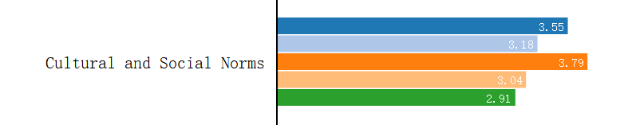
Canada
The Indicator | The Global Average | Canada
Perceived Opportunities Rate | 43.43 | 60.23
Perceived Capacities Rate | 48.86 | 55.59
Fear of Failure Rate | 36.97 | 43.84
Entrepreneurs Intention Rate | 21.66 | 14.13
3
Canada 2017
The Global Average 2017

Slide 7
References
Stevenson,C.(2013). What is Entrepreneurship. Havard Business Review.
GEM, http://www.gemconsortium.org/country-profile/49
GEM, http://www.gemconsortium.org/country-profile/51
The Cambridge English Dictionary. https://dictionary.cambridge.org/dictionary/english/culture

Slide 8
Thanks

