Slide 1
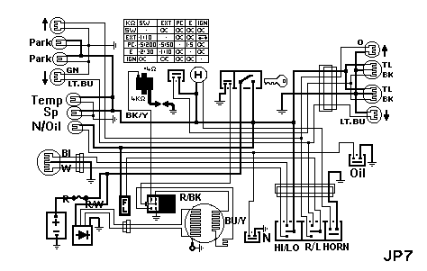
Engineering Science
Electronics
Level : Foundation
Lecturer :Tim Tudor
Email : timothy.tudor@smu.ac.uk
Year : 2011

Slide 2
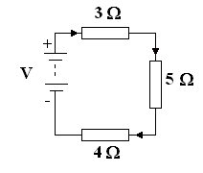
Topic 1 – DC Theory
Kirchoff’s Voltage Law
The battery drives a current of 0.5 A around the circuit as shown. What is the voltage of the battery?
Solution
Noting that the positive terminal of the battery is at the top, the current must be clockwise.
The p.d. across each resistor is - I R
V - (3 x 0.5) - (5 x 0.5) - (4 x 0.5) = 0 V – 1.5 – 2.5 – 2 = 0 V = 6V

Slide 3
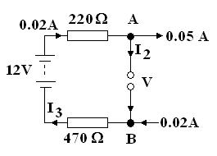
Topic 1 – DC Theory
Kirchoff’s Voltage Law
Calculate the currents I₂ and I₃ in the circuit and the voltage V.
NB. The currents are not necessarily in the direction indicated.
Solution
Applying Kirchoff's current law to junction A:
0.02 - 0.05 + I₂ = 0
I₂ = 0.03A (into junction)
Applying Kirchoff's current law to junction B (I₂ is into junction A):
I₂ + 0.02 + I₃ = 0
-0.03 + 0.02 + I₃ = 0
I₃ = 0.01A (into junction)

Slide 4
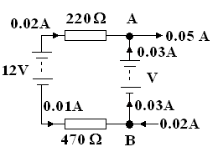
Topic 1 – DC Theory
Kirchoff’s Voltage Law
Calculate the currents I₂ and I₃ in the circuit and the voltage V.
NB. The currents are not necessarily in the direction indicated.
Solution
Apply Kirchoff's voltage law to the loop
Remember the p.d. is –ve if the current is
flowing clockwise.
12 – (I₁ x 220) + V + (I₃ x 470) = 0.
12 – (0.02 x 220) +(0.01 x 470) + V = 0
+ V - 4.4 + 4.7 = 0
V = -12.3 V

Slide 5
Topic 1 – DC Theory
Some Questions
1. Calculate the resistance if a voltage of 10 V produces a current of 0.2 Amperes. Also calculate the power dissipated.
(50Ω , 2 W)
2. Calculate the current which flows in a resistor 5 Ω when 240 V is applied to it. Also calculate the power dissipated.
(48 A and 11520 W)
3. Calculate the voltage needed to make 20 mA flows in a resistor of 470k Ω .
(9400 V)

Slide 6
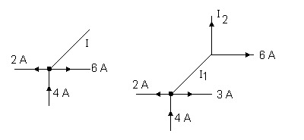
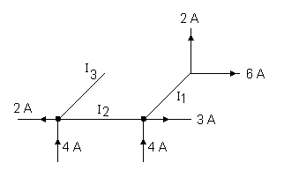
Topic 1 – DC Theory
Some Questions
1 Find the unknown current for each case shown.

Slide 7
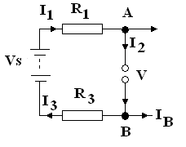
Topic 1 – DC Theory
Some Questions
Given the following values, calculate the voltage V and currents I₂ and I₃ in the circuit below..
Vs = 10V R₁ = 50 Ω R₂ = 70 Ω
I₁ = 0.2 (clockwise)
I_{A} = 0.15 A into the junction
I_{B} = 0.25A out of junction
(Ans: V = 7V, I₂ = 0.35A clockwise, I₃ = 0.1A Clockwise)

Slide 8
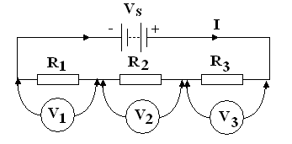
Topic 1 – DC Theory
Resistors in series
Consider 3 resistors in series as shown.
The same current I flow through each of them.
The voltage drop on each is given by Ohms' Law ;
V₁ = I R₁ V₂ = I R₂ V₃ = I R₃

Slide 9
Topic 1 – DC Theory
Resistors in series
The voltage is divided according to the resistors.
If the resistors were all equal, the voltage would be divided equally across each.
The three voltages must add up to the supply voltage
V_{s} = V₁ + V₂ + V₃
V_{s} = I R₁ + I R₂ + I R₃
V_{s} = I ( R₁+ R₂ +R₃ )

Slide 10
Topic 1 – DC Theory
Resistors in series
If the 3 resistors were replaced by a single total resistor R_{T} then the supply voltage would be
V_{s} = I R_{T}
Comparing the two equations it is apparent that R_{T} = R₁+ R₂ + R₃
V_{s} = I ( R₁+ R₂ +R₃ ) = I R_{T}
Thus R_{T}= R₁+ R₂ + R₃

Slide 11
Topic 1 – DC Theory
Resistors in series
In general for resistors in series

Slide 12
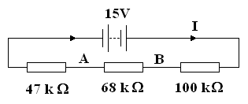
Topic 1 – DC Theory
Resistors in series
Calculate the current drawn from the battery and the voltage at A, and B in the circuit below.

Slide 13
Topic 1 – DC Theory
Resistors in series
R_{T} = 47 + 68 + 100 = 215 x 10³ Ω = 215 kΩ
I = V/ R_{T} = 15 / 215 x 10³ = 0.0697674 x10⁻³ A = 0.0697674 mA
p.d across the 47 K Ω resistor is 47 x 0.0697674 = 3.279 V
p.d. across the 68 k Ω resistor is 68 x 0.0697674 = 4.744 V
p.d. across the 100 k Ω resistor is 100 x 0.0697674 = 6.976 V
Check total p.d. = 3.279 +4.744 + 6.976 = 15 V
The voltage at A is 15 – 4.744 – 6.976 = 3.279 V
The voltage at B is 15 – 6.976= 8.023 V

