Slide 1

Strategies for Resilience and Prosperity
(BMSP60006)
Samsung
Sophie Evans (2108843)

Slide 2
What is Strategy?
Kenton (2023)
Johnson et al., (2008)
Moore (2011)

Slide 3
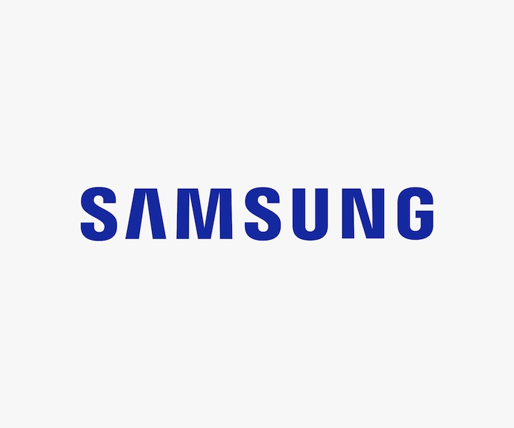
Who Created Samsung?
Key to its Success
Accomplishments

Slide 4
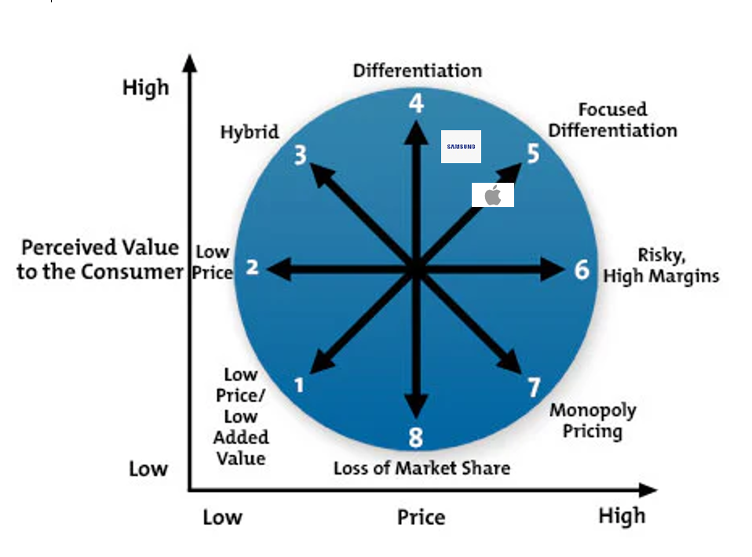
Bowman's strategic cLOCK

Slide 5
SWOT ANALYSIS OF SAMSUNG
STRENGHTHS | WEAKNESSES
Dominates the smartphone market Stronghold in the Asian Markets Eco friendly innovations Award winning Brand | Dependence on American Markets Dependence on Android Os Decline in smartphone sales Hereditary Leadership
OPPORTUNITIES | THREATS
Introduce Innovative Products Growing Demand for Smartphones Strategic Partnerships HR Management Diversification & Acquisitions | Increased Competition Patent Infringement Controversies Legal & Regulatory Threats

Slide 6
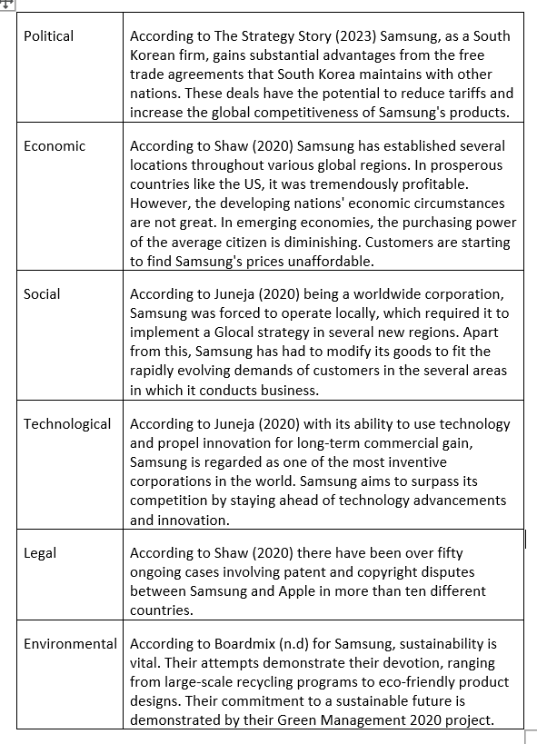
Samsung
PESTLE
ANALYSIS

Slide 7
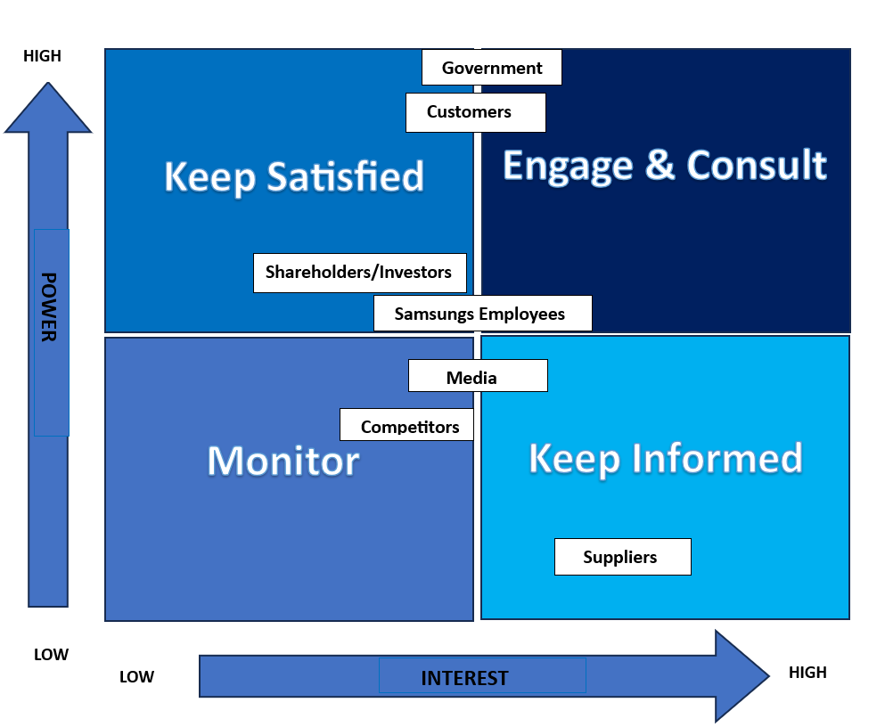
STAKEHOLDER ANALYSIS

Slide 8
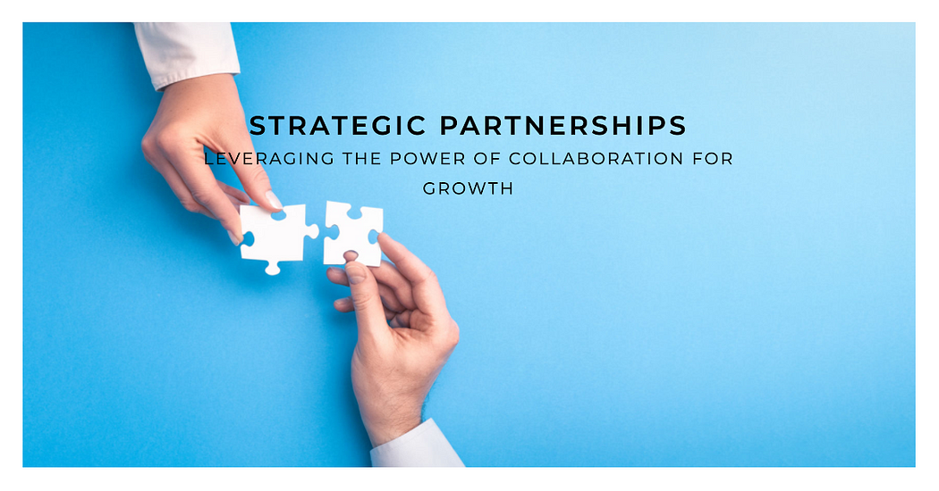
Recommendation 1
@changemaker (2021)

Slide 9

Recommendation 2
Gabbatis (2019)

Slide 10
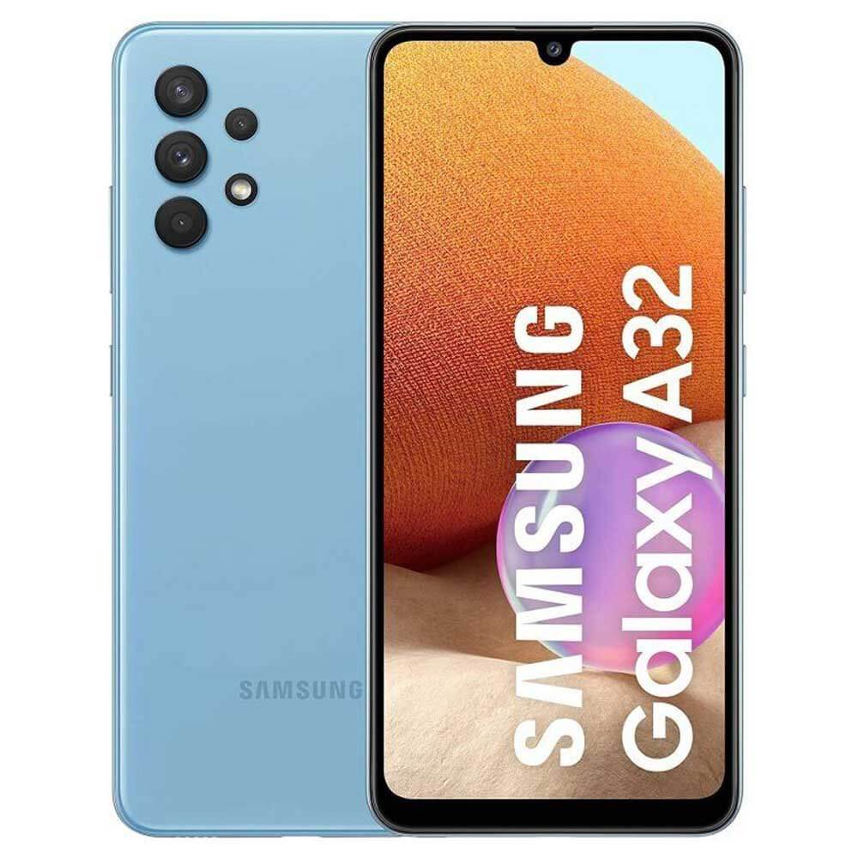

Recommendation 3
(Nash, n.d) (Vota, 2011)
Nash (n.d)
Vota (2011)

Slide 11
Thank You

Slide 12
References
@Changemaker. (2021). Medium. Retrieved from Strategic Partnerships [IMAGE]: https://medium.com/@azeemsquest/strategic-partnerships-8081dd3d596a
Bhasin, H. (2023, May 03). Marketing 91. Retrieved from SWOT Analysis of Samsung 2023: https://www.marketing91.com/swot-analysis-samsung/
BoardMix. (n.d). BoardMix. Retrieved from Samsung PESTLE Analysis: A Comprehensive Overview: https://boardmix.com/analysis/samsung-pestle-analysis/
Bondarenko, P. (2023, October 28). Britannica. Retrieved from Samsung: https://www.britannica.com/topic/Samsung-Electronics
Burris, M. (2020, December 2). Lifewire. Retrieved from The History of Samsung (1938-Present): https://www.lifewire.com/history-of-samsung-818809
CIPD. (2023, March). CIPD. Retrieved from Pestle Analysis: https://www.cipd.org/uk/knowledge/factsheets/pestle-analysis-factsheet/#what-is-a-pestle-analysis
Cuofano, G. (2023). Four Week Mba. Retrieved from What Is Bowman’s Strategy Clock And Why It Matters In Business: https://fourweekmba.com/bowmans-strategy-clock/#:~:text=Bowman%E2%80%99s%20Strategy%20Clock%20is%20a%20marketing%20model%20concerned,a%20product%20based%20on%20price%20and%20perceived%20value.
Foley, J. (2022). Creative Blog. Retrieved from The Apple Logo: a history [IMAGE]: https://www.creativebloq.com/news/apple-logo-history
Gabbatiss, J. (2019). Independent. Retrieved from ‘Endangered’ elements used to make mobile phones are running out quickly, scientists warnn [IMAGE]: https://www.independent.co.uk/news/science/mobile-phones-elements-periodic-table-endangered-chemicals-st-andrews-a8739921.html
Gerry Johnson, K. S. (2008). Exploring Corporate Strategy Text & Cases (8th ed.). Financial Times Prentice Hall. Retrieved from https://books.google.co.uk/books?hl=en&lr=&id=8KS4gKNgLysC&oi=fnd&pg=PA1&dq=Johnson+%26%C2%A0Scholes+(2006)%C2%A0definition+of+strategy&ots=ZHSLP39BVw&sig=eZtXYVPicDFjIEedw7chKw7J4nc#v=onepage&q=Johnson%20%26%C2%A0Scholes%20(2006)%C2%A0definition%20of%20s
Indeed Editorial Team. (2022, October 22). Indeed. Retrieved from What is the Mendelow stakeholder matrix? Plus how to use it: https://uk.indeed.com/career-advice/career-development/mendelow-stakeholder-matrix
Indeed Editorial Team. (2022). Indeed. Retrieved from What is the Mendelow stakeholder matrix? Plus how to use it: https://uk.indeed.com/career-advice/career-development/mendelow-stakeholder-matrix#:~:text=The%20benefits%20may%20include%3A,with%20them%20throughout%20the%20project.
Juneja, P. (2020). Management Study Guide. Retrieved from Pestle Analysis of Samsung: https://www.managementstudyguide.com/pestle-analysis-of-samsung.htm
Jurevicius, O. (2023, March 30). Strategic Managemnt Insights. Retrieved from SWOT Analysis of Samsung (6 Key Strengths in 2023): https://strategicmanagementinsight.com/swot-analyses/samsung-swot-analysis/
Kenton, W. (2023, May). Investopedia. Retrieved from What Is Strategic Management?: https://www.investopedia.com/terms/s/strategic-management.asp
Kenton, W. (2023, October 30). Investopedia. Retrieved from SWOT Analysis: How To With Table and Example: https://www.investopedia.com/terms/s/swot.asp
Martin, V. (2023, September 24). Panmore Institute. Retrieved from Samsung Swot Analysis: https://panmore.com/samsung-swot-analysis-internal-external-factors-recommendations
Mind Tools Concept Team. (n.d.). Mindtools. Retrieved from Bowman's Strategy Clock: https://www.mindtools.com/a2rq300/bowmans-strategy-clock
MindTools. (2022). Mindtools. Retrieved from Stakeholder Analysis: https://www.mindtools.com/aol0rms/stakeholder-analysis
Mindtools Concept Team. (n.d). Mindtools. Retrieved from Bowman's Strategy Clock: https://www.mindtools.com/a2rq300/bowmans-strategy-clock
Moore, K. (2011). Ivy Business Journal. Retrieved from The Emergent Way: How to achieve meaningful growth in an era of flat growth: https://iveybusinessjournal.com/publication/the-emergent-way-how-to-achieve-meaningful-growth-in-an-era-of-flat-growth/
Nash, A. (n.d). Mobilke Trans. Retrieved from Best Samsung Phones for You: High-end, Mid-range and Low-budget Ones [IMAGE]: https://mobiletrans.wondershare.com/phone-info/best-samsung-mobile-phones.html
Parker, B. (2023, April 03). Business Strategy Hub. Retrieved from Samsung SWOT Analysis 2023 | SWOT Analysis of Samsung: https://bstrategyhub.com/swot-analysis-of-samsung-2019-samsung-swot-analysis/

Slide 13
References
Pereira, D. (2023, May 10). The Business Model Analyst. Retrieved from Samsung Swot Analysis: https://businessmodelanalyst.com/samsung-swot-analysis/
Pratap, A. (2022). Medium. Retrieved from A few reasons why Samsung is successful: https://abhijeetpratap.medium.com/a-few-reasons-why-samsung-is-successful-86c8db6afb59#:~:text=the%20biggest%20reason%20Samsung%20found,its%20focus%20on%20innovation%20fall.
Proffesional Academy. (n.d.). Proffesional Academy. Retrieved from Mendelow's Matrix - Marketing Theories: https://www.professionalacademy.com/blogs/mendelows-matrix-marketing-theories/#:~:text=Mendelow%27s%20Matrix%20was%20created%20in,on%20a%20big%20business%20decision.
Ramirez, M. (2023). Pitchgrade. Retrieved from Samsung: Business Model, SWOT Analysis, and Competitors 2023: https://pitchgrade.com/companies/samsung
Raven 360 Team. (2023). Raven 360 Team. Retrieved from Customer engagement strategies: https://www.raven360.com/blog/proven-ways-to-increase-customer-engagement#:~:text=Keeping%20people%20engaged%20throughout%20the,CLV%20(customer%20lifetime%20value).
Rees, K. (2021, May 18). Make Use Of. Retrieved from Origins, Growth, and Success: The History of Samsung: https://www.makeuseof.com/origins-growth-and-success-the-history-of-samsung/#:~:text=Samsung%20was%20founded%20in%20January%20of%201969%2C%20under,founder%2C%20Lee%20Byung-Chul%2C%20was%20a%20South%20Korean%20businessman.
Samsung Electronics Company Overview & News. (n.d.). Forbes. Retrieved from Samsung Electronics: https://www.forbes.com/companies/samsung-electronics/#:~:text=Samsung%20Electronics%20inspires%20the%20world,LSI%2C%20foundry%20and%20LED%20solutions.
Samsung. (n.d). Samsung. Retrieved from Simple, iconic, timeless [IMAGE]: https://www.samsung.com/uk/about-us/brand-identity/logo/
Samsung Newsroom. (2022). Samsung Newsroom. Retrieved from International Design Excellence Awards 2022: https://news.samsung.com/global/samsung-electronics-wins-42-awards-at-the-international-design-excellence-awards-2022
Samsung. (n.d.). Samsung. Retrieved from Stakeholder Engagement: https://www.samsung.com/global/sustainability/media/pdf/Stakeholder%20Engagement.pdf
Shaw, A. A. (2020). Business Management & Marketing. Retrieved from Swot Analysis of Samsung: https://swotandpestleanalysis.com/swot-analysis-of-samsung/
Shaw, A. A. (2020). Business Management & Marketing. Retrieved from PESTLE Analysis of Samsung (Smartphones).
Study Smarter. (n.d). Study Smarter. Retrieved from Bowman's Strategic Clock theory: https://www.studysmarter.co.uk/explanations/business-studies/strategic-direction/bowmans-strategic-clock/#:~:text=Bowman's%20Strategic%20Clock%20was%20invented,first%20published%20in%201997%20in%E2%80%A6
The Strategy Story. (2023). The Strategy Story. Retrieved from Samsung Swot Analyusis: https://thestrategystory.com/blog/samsung-swot-analysis/#:~:text=Intense%20competition%3A%20Samsung%20faces%20fierce,share%2C%20pricing%2C%20and%20innovation.
The Strategy Story. (2023). The Strategy Story. Retrieved from Samsung Pestel Analysis: https://thestrategystory.com/blog/samsung-pestel-analysis/#google_vignette
Vota, W. (2011). ICT works. Retrieved from What are Affordable Technologies for Supporting Learning and Collaboration in Africa? [IMAGE]: https://www.ictworks.org/what-are-affordable-technologies-supporting-learning-and-collaboration-africa/

