Slide 1

“A child’s experience between the ages of 0 to 5 years can affect the rest of their lives”.

Slide 2

Introduction
This presentation will explore that parenting plays an important role in personality development.
This presentation will describe two theories such as Ericson’s theory and Piaget’s theory, related to development.
Source; Cherry, K., 2020
Notes:
Notes;
Introduction
This presentation will explore that parenting plays an important role in personality development. Positive parenting leads to develop a good personality while any mistake in parenting can create dissatisfaction within the child. This presentation will describe two theories such as Ericson’s theory and Piaget’s theory, related to development. Moreover, the presentation will provide two practical examples of these theories.

Slide 3
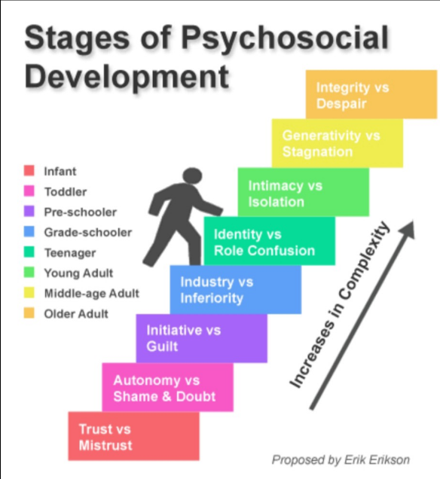
Erikson’s theory
Erikson showed in his theory how the social interaction of a person plays an important role in the personality development of human beings.
For ages 0-5 years, the first three stages from Erikson's theory can be applied.
Source; (Svetina, 2015).
Notes:
Notes;
Erikson’s theory
Famous psychologist Erikson established his most popular and effective theory of development that described the effects of social experiences across the whole lifetime of an individual.. Erikson's theory contains 8 stages and in each stage, child faces a conflict that acts as a turning point in life. Ericson believed that these conflicts may either establish a psychological quality or fail to create that quality (Cherry, 2021).
The eight stages of Erikson’s theory are
1. Infancy (birth to 18 months): It is the most fundamental stage of life. In this stage, child remains totally dependent on their caregivers. They need food, security, love, warmth from the caregivers. If the caregivers or parents fail to these needs, then in future the child will not trust anyone easily and will believe that the world is unpredictable and inconsistent. On the other hand, if the child gets appropriate love and care then it will develop a sense of trust, love and affection within the child.
2. Early childhood (2 years to 3 years): In this stage, a sense of personal control is developed within the child. At this stage the children start their activities, a little decision making power starts to improve. For this, a sense of freedom is developed within the child.
3. Preschool (3years to 5 years): In this stage of development, the child tries to lead and control the world through their social interactions and play. If the child is allowed to do such then a leadership quality is developed but if parents do not allow the child to do so, then a feeling of self-guilt, or self-doubt is to develop within the child (Svetina, 2015).
4. Scholl age (6 years to 11 years): In this stage, a feeling of pride is going to be developed. The children who are encouraged by their parents and teachers feel that they are successful. On the other hand, those who do not get any appraisals or get little of it start to doubt their abilities.
5. Adolescence (12 years to 18 years): It is the most effective stage of development which develops a feeling of confidence and establishes personal identity. The persons who get proper reinforcement become self-confident and self-assured but those who do not get appraisal feel confused and become depressed.
6. Young adulthood (18 years to 40 years): At this stage of life human beings want to create a steady intimate and loving relationship with other people. Failure in forming such a relationship creates a feeling of loneliness within the individual.
7. Middle Adulthood (40 years to 65 years): In this stage, people want to be productive and try to contribute positively to society and their families. Successful people become satisfied and feel happy while unsuccessful people suffer from anxiety.
8. Maturity (65 years to death): In this stage, people look back on their achievement; people who have successfully completed the previous stages successfully experience happiness whereas unsuccessful people become frustrated (healthline, 2021).

Slide 4
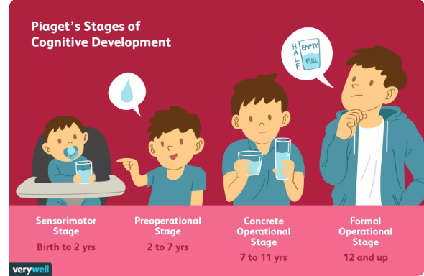
Piaget’s theory
Piaget’s theory stated that the mental development of human being contains four stages
For ages 0-5 years, the first two stages from Piaget’s theory can be applied.​
The sensorimotor stage (Birth to 2 years):
The preoperational stage (2 years to 7 years)
Concrete operational stage (7 to 11 years)
Formal operational stage (12 years and up)
Source; (Cherry, 2020.)
Notes:
Notes;
Piaget’s theory
Piaget’s theory stated that the mental development of human being contains four stages such as;
1. The sensorimotor stage (Birth to 7 years): In the early stage of development children start to observe the world by basic reflexes such as by looking, sucking, listening and others. They gain knowledge about the environment and world.
2. The preoperational stage (2 years to 7 years): In this stage, children learn the uses of words and pictures (Huitt, and Hummel, 2016).
3. Concrete operational stage (7 to 12 years): In this stage of cognitive development, children start to think logically and systematically.
4. Formal operational stage (12 years and up): At this point, human beings become able to think more logically and scientifically and can understand abstract ideas and situations (Cherry, 2020).

Slide 5

Examples of two theories
Example of Piaget’s theory: Example of the preoperational stage; The child learns to calculate and learn to solve an arithmetic problem.
1. Always give proper attention to child
2. Always encourage children to solve problem by themselves
Source;(healthline, 2021)
Notes:
Notes;
Always give proper attention to child: The parents should give proper attention and care to their child. It will help to ensure the feeling of security, and the child will be familiar about how to love others and how to take care of others. The child will successfully enter in the next stage of his life.
Always encourage child to solve problem by them: After analysing the Piaget’s theory it can be stated that the parent should always encourage their children to solve their problems by them, by this way the child will be more confident and will be self depended. Moreover, it will help them to be self assured in near future and will enhance their problem solving skill.

Slide 6
Conclusion
This presentation has described two theories of development.
In addition, two practical examples have been included in this presentation.
Notes:
Notes;
Conclusion
This presentation has described two theories of development. Ericson's theory and Piaget's theory has been discussed in this presentation. In addition, two practical examples have been included in this presentation.

Slide 7
References
Books and Journals
Huitt, W. and Hummel, J., (2016). Piaget's theory of cognitive development. Educational psychology interactive, 3(2), pp.1-5.
Svetina, M., (2015). Resilience in the context of Erikson’s theory of human development. Current Psychology, 33(3), pp.393-404.
Websites
Cherry, K., 2020. The 4 Stages of Cognitive Development. [Online] Available at: https://www.verywellmind.com/piagets-stages-of-cognitive-development-2795457.
Cherry, K., 2021. Erik Erikson's Stages of Psychosocial Development. [Online] Available at: https://www.verywellmind.com/erik-eriksons-stages-of-psychosocial-development-2795740.
healthline, 2021. Erikson’s 8 Stages of Psychosocial Development, Explained for Parents. [Online] Available at: https://www.healthline.com/health/parenting/erikson-stages.

