Slide 1
Module Name : Electronics II
Module Code : ACDA6001
Topic : State Reduction Example
Lecture : 13
Lecture By,
Mrs. Jenifer Prince Devaraj,
Lecturer - Embedded Electronics,
Faculty of Applied Computing,
UWTSD
Email:j.prince-devaraj@uwtsd.ac.uk

Slide 2
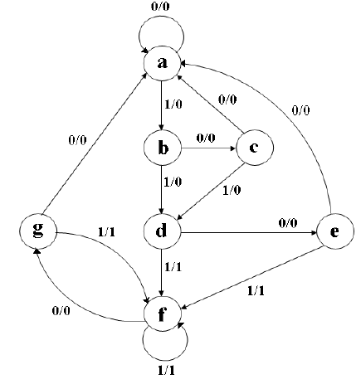
Determine the reduced state diagram for the state diagram given below.
Also, for the obtained reduced state diagram answer the following
State Reduction - Example
Show its state Assignment.
Obtain the State Table.
Obtain Excitation Table using any Flip- flop.
Output Expressions
Logic Circuit
UWTSD Lectures / ACDA6001 – Electronics 2

Slide 3
To draw the Reduced State Diagram
Step 1: State Table
State Reduction - Example
 | Next State |  | Output
Present State | x = 0 | x = 1 | z = 0 | z =1
a | a | b | 0 | 0
b | c | d | 0 | 0
c | a | d | 0 | 0
d | e | f | 0 | 1
e | a | f | 0 | 1
f | g | f | 0 | 1
g | a | f | 0 | 1
UWTSD Lectures / ACDA6001 – Electronics 2

Slide 4
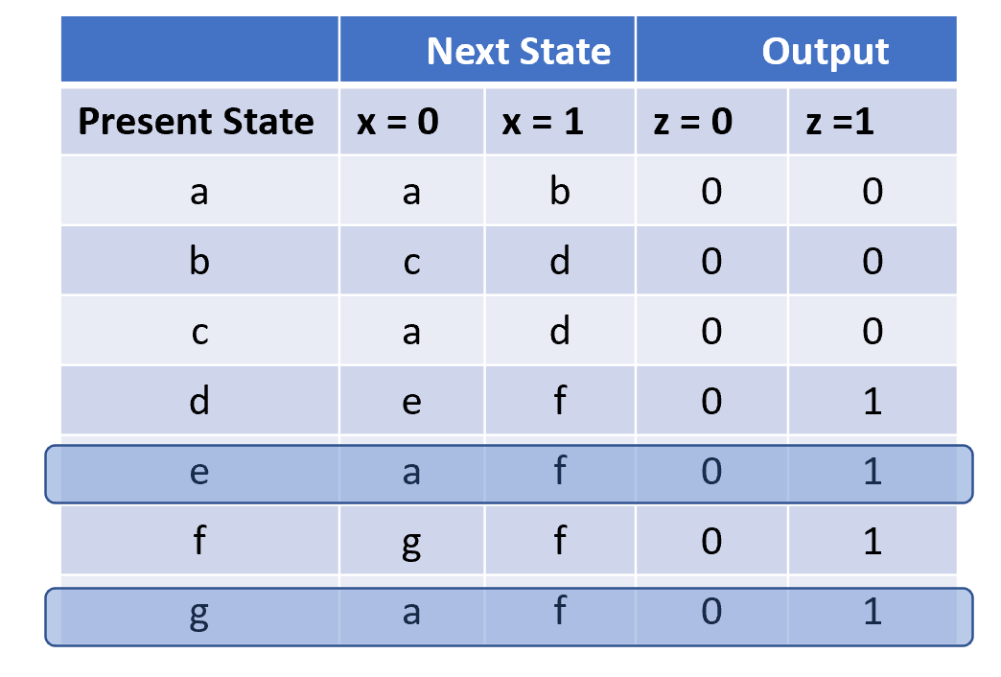
To draw the Reduced State Diagram
Step 2: Reduced State Table
State Reduction - Example
 | Next State |  | Output
Present State | x = 0 | x = 1 | z = 0 | z =1
a | a | b | 0 | 0
b | c | d | 0 | 0
c | a | d | 0 | 0
d | e | f | 0 | 1
e | a | f | 0 | 1
f | e | f | 0 | 1
UWTSD Lectures / ACDA6001 – Electronics 2

Slide 5
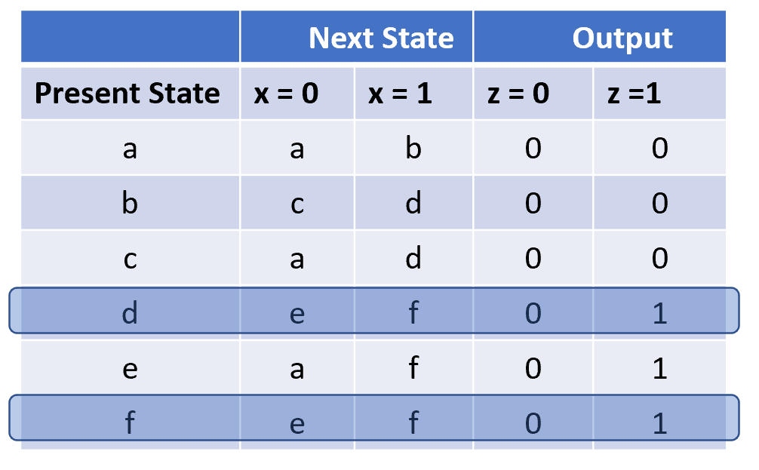
To draw the Reduced State Diagram
Step 2: Further Reduced State Table
State Reduction - Example
 | Next State |  | Output
Present State | x = 0 | x = 1 | z = 0 | z =1
a | a | b | 0 | 0
b | c | d | 0 | 0
c | a | d | 0 | 0
d | e | d | 0 | 1
e | a | d | 0 | 1
UWTSD Lectures / ACDA6001 – Electronics 2

Slide 6
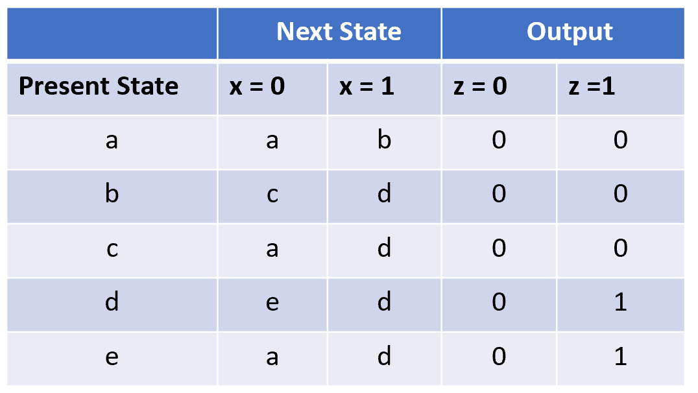
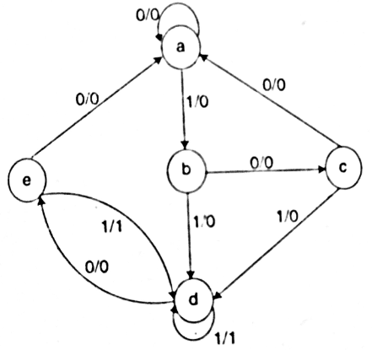
To draw the Reduced State Diagram
Step 3: Reduced State Diagram
State Reduction - Example
UWTSD Lectures / ACDA6001 – Electronics 2

Slide 7
From Reduced State Diagram
Step 1: Show its state Assignment
State Reduction - Example
a ---> 000
b ---> 001
c ---> 010
d ---> 011
e---> 100
UWTSD Lectures / ACDA6001 – Electronics 2

Slide 8
From the Reduced State Diagram
Step 2: Obtain the state Table
State Reduction - Example
Present State | Input | Next State | Output
P Q R | X | P Q R | Z
0 0 0 | 0 | 0 0 0 | 0
0 0 0 | 1 | 0 0 1 | 0
0 0 1 | 0 | 0 1 0 | 0
0 0 1 | 1 | 0 1 1 | 0
0 1 0 | 0 | 0 0 0 | 0
0 1 0 | 1 | 0 1 1 | 0
0 1 1 | 0 | 1 0 0 | 0
0 1 1 | 1 | 0 1 1 | 1
1 0 0 | 0 | 0 0 0 | 0
1 0 0 | 1 | 0 1 1 | 1
1 0 1 | 0 | d d d | d
1 0 1 | 1 | d d d | d
1 1 0 | 0 | d d d | d
1 1 0 | 1 | d d d | d
1 1 1 | 0 | d d d | d
1 1 1 | 1 | d d d | d
a ---> 000
b ---> 001
c ---> 010
d ---> 011
e---> 100
UWTSD Lectures / ACDA6001 – Electronics 2

Slide 9
From the Reduced State Diagram
Step 2: Obtain Excitation Table using any Flip- flop.
State Reduction - Example
Present State | Input | Next State | Output | D Flip-flop
R S T | X | R S T | Z | D1 D2 D3
0 0 0 | 0 | 0 0 0 | 0 | 0 0 0
0 0 0 | 1 | 0 0 1 | 0 | 0 0 1
0 0 1 | 0 | 0 1 0 | 0 | 0 1 0
0 0 1 | 1 | 0 1 1 | 0 | 0 1 1
0 1 0 | 0 | 0 0 0 | 0 | 0 0 0
0 1 0 | 1 | 0 1 1 | 0 | 0 1 1
0 1 1 | 0 | 1 0 0 | 0 | 1 0 0
0 1 1 | 1 | 0 1 1 | 1 | 0 1 1
1 0 0 | 0 | 0 0 0 | 0 | 0 0 0
1 0 0 | 1 | 0 1 1 | 1 | 0 1 1
1 0 1 | 0 | d d d | d | d d d
1 0 1 | 1 | d d d | d | d d d
1 1 0 | 0 | d d d | d | d d d
1 1 0 | 1 | d d d | d | d d d
1 1 1 | 0 | d d d | d | d d d
1 1 1 | 1 | d d d | d | d d d
UWTSD Lectures / ACDA6001 – Electronics 2

Slide 10
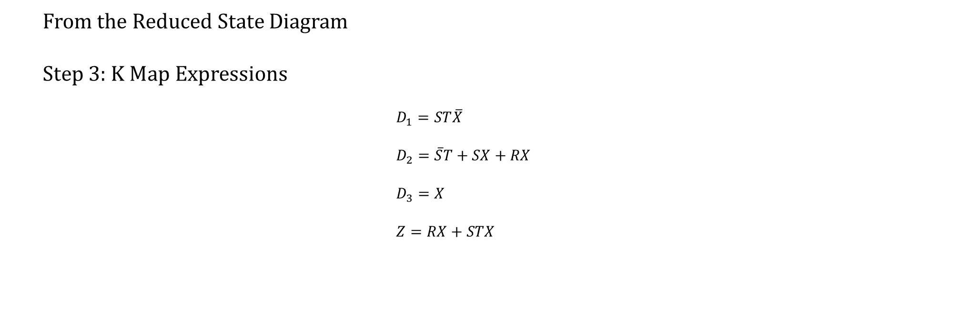
From the Reduced State Diagram
Step 3: K Map Expressions
$$D_{1}=ST\overline{X} \\ D_{2}=\overline{S}T+SX+RX \\ D_{3}=X \\ Z=RX+STX$$
State Reduction - Example
UWTSD Lectures / ACDA6001 – Electronics 2

Slide 11
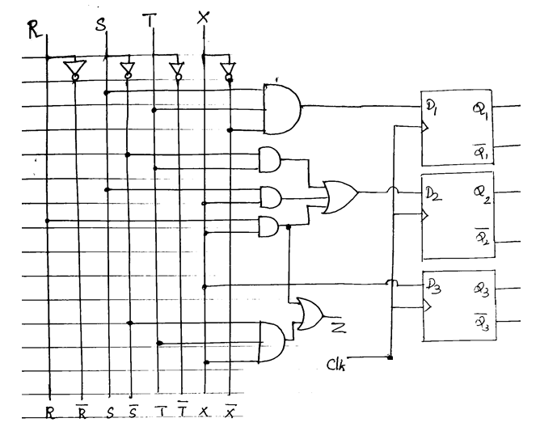
From the Reduced State Diagram
Step 4: Logic Diagram
State Reduction - Example
UWTSD Lectures / ACDA6001 – Electronics 2

Slide 12
Thank you

