Slide 1

Advanced Coaching
&
Mentoring
https://www.youtube.com/watch?v=2FKPDOpKzDo

Slide 2
Mentoring Aims-
1- Giving feedback
2- Completing the competency checklist
3- Planning for the LC

Slide 3
How to achieve your grade:
Task 1- Complete 5 mentee assessment forms (40%)
Task 2- Practical mentoring competency checklist (completed by your lecturer) demonstrate / evidence each of the competencies on at least 3 occasions (10%) a further (10%) awarded for reflection. (20% total)

Slide 4
Practical mentoring competence checklist:
1/2/4-As a group we will agree these today and you will be automatically passed each session
3/5/6/7/8/9/10 you will need to evidence when giving feedback to your mentee. (do not try and stage this, it will be achieved if you mentor well)
Write a reflection after completing all mentoring

Slide 5
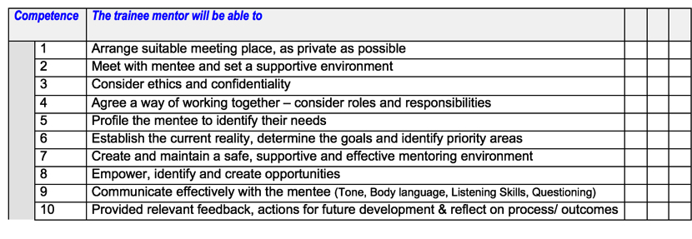

Slide 6
Why Should we give feedback
To develop weak areas
To go away and reflect on what to work on
To improve a player
To help a coach develop and improve
Our focus is developing the coach when
Mentoring each other.
To highlight good practice and to improve
Motivation and confidence

Slide 7
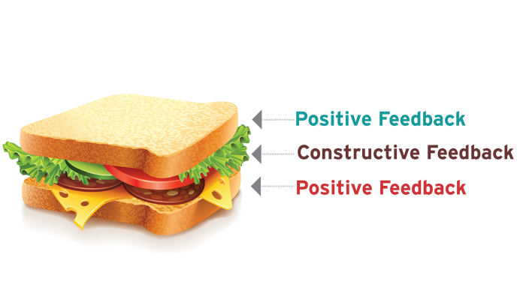
Feedback Considerations
The “Praise sandwich” (Hinchliff 1999)

Slide 8
How not to give feedback
Angrily / aggressive / abusive
Unconstructive criticism
Negative
Shouting / raising voice
Arguing
In the wrong position
Anything that will demotivate someone
Don’t be too positive (if it was poor)
By not providing any
(you may use the above but it should be
Avoided at all costs)
https://www.youtube.com/watch?v=wujTSELwsPA
https://www.youtube.com/watch?v=iajz7Stq3ZY 26 minutes in talking about exposing players

Slide 9

Balanced- Focus not only on areas for development, but also on strengths.
Observed- Provide feedback only upon behaviours that you have observed.
Objective- Avoid judgements and relate your feedback to the observed behaviour.
Specific- Back up your comments with specific examples of the observed behaviour.
Timely- Give the feedback soon after the activity. This allows the learner to reflect.

Slide 10
https://www.youtube.com/watch?time_continue=80&v=USO4KFcz2Mo&feature=emb_logo

Slide 11
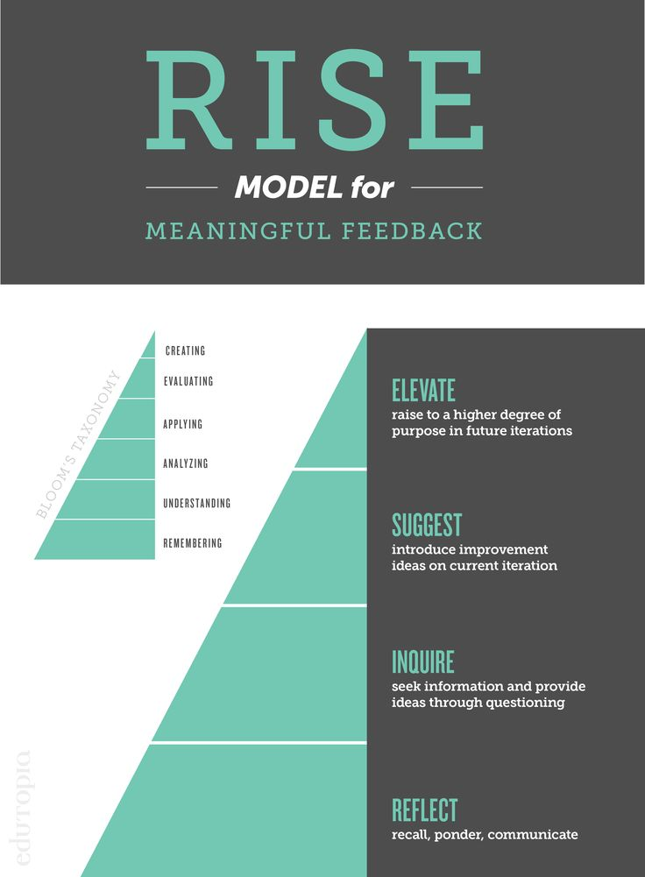
Providing Feedback

Slide 12
Providing Feedback
The coaching Feedback Model- Performance coach training
Asking people to give themselves the feedback
instead of, or before, giving yours
What did you like about what you did?
What did you think about your performance?
How did you think that went?
Did you meet your outcomes?
What would you do differently?
If you could of changed anything what would it be?
https://www.youtube.com/watch?v=s1DZHImMXY0
Notes:
More comfortable for you and more powerful for them. Make sure they give positive feedback.

Slide 13
Explanations and Instructions
May call group in close / sat down / in a place if necessary. Gains attention of the group
Introduction- Brief intro outlining the purpose of the session, introduced themselves and health and safety check.
Questioned group to check for understanding
Explains the key points / coaching points
The information given is the correct amount (not to much / to little)
The group clearly understands instructions
Used Demonstrations
Voice is clear and loud enough for everyone to hear
Uses different pitches & tones is animated to engage group
Uses movement when necessary to engage the group

Slide 14
Demonstrations
Is it the correct technique!
Can all see and hear (is it in the right position) away from distraction
Focus attention on 1-2 simple key points
Is there an easy way to remember the skill? (Mickey Mouse)
Repeat the demo more than once (for a skill)
Invite questions and check for understanding
Is a member / members of the group being used (if possible / suitable)
Is the group able to perform it? (Goals that are within the ability of the player?)
Appropriate pace / tempo?
Are there simple verbal instructions?

Slide 15
Observation And Analysis
Observing the way the coach has planned and organised the session to achieve the learning outcomes the types of drills/games used
Has the coach highlighted / praised good technique /play / skill
Is the coach referring back to the key points?
Has the coach identified a fault and corrected it ?
Has the session flowed?
Has it progressed well?
Are all participants challenged?
Are some over challenged?
Is the coaching style right ?
Is there a child/participant centred approach?

Slide 16
Providing Feedback As A Coach
Ask questions to generate self-feedback / check for understanding
Limit information to one or two key points
Give specific simple information
Keep it positive
Highlight positive and share with the group (reinforcement)
Provide some feedback as the group is on task
Take members out to correct and provide personal feedback
Use participants to provide feedback to each other (when appropriate)
Use videos / ICT – point out specific features (hudl, coaches eye)

Slide 17

Example- Basketball coach
Action plan-
In the next 5 week block of sessions to continue to engage participants by planning a variety of skill drills and transferring these skills into game / game sense situations.
Look to plan in 2 times (during the next session on the 27th March) for participants to discuss tactical situations to give them more ownership of the session. A short stoppage in the game or in a game sense game should be planned in for this.

Slide 18
The plan for the LC:
We will have 30 pupils approximately for 1 hour. Each group will have 15 pupils for half hour on half the hall. 4 groups of coaches. 2 delivering and 2 mentoring am and pm. Everyone must take the lead at some point.
Coach a 30 minute session coaching a skill and reinforcing this with a game year 5
Follow the plan created to ensure coaching points are reinforced
Must finish with some sort of competitive game
Make the session competitive and varied with small games and challenges
After the session you will have a discussion with your partner and then they will have the opportunity to discuss with you as mentors.

Slide 19
Next week:
Lecture at 9am- disability sport and recap assignment info
LC-Year 4 / same plan with improvements

Slide 20
Last week:
Lecture at 9am- Tennis preparation / assignment support
LC-Year 3

