Slide 1

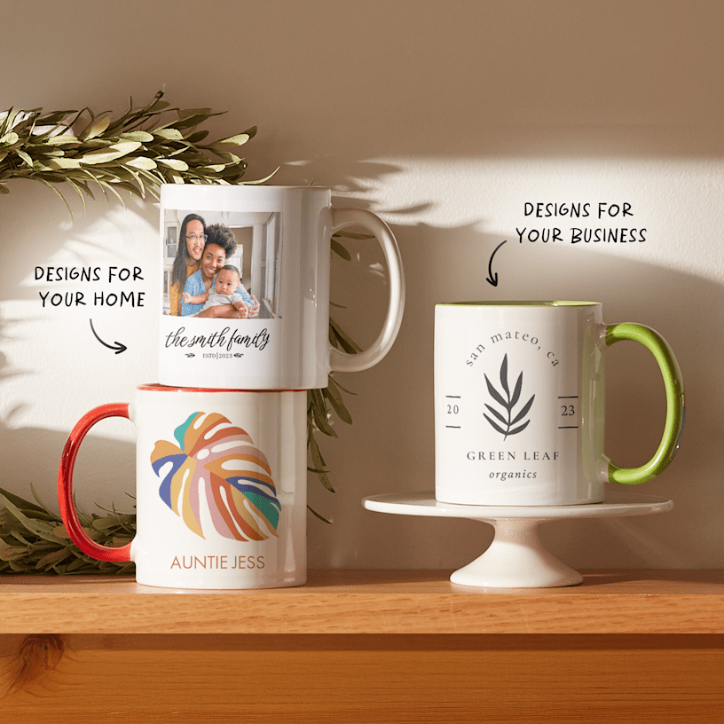
STUDENT NAME: DELIA MARINA CIURARU
STUDENT ID: 2226588
TASK 2
PRESENTATION (10 MIN)
BUSINESS IDEA HANDMADE

Slide 2
Business Concept HANDMADE
The proposed business specialises in handmade personalised photo gifts that transform customer photographs into premium handcrafted keepsakes. The concept responds to increasing consumer demand for meaningful and customised products that reflect emotional value and personal identity (Pine and Gilmore, 2011).

Slide 3

Market Opportunity
The UK personalised gift market demonstrates strong growth, driven by rising preference for individualisation and experiential consumption (Mintel, 2023). Expansion of e-commerce platforms enables small creative enterprises to access national and international markets efficiently (Laudon and Traver, 2021).

Slide 4
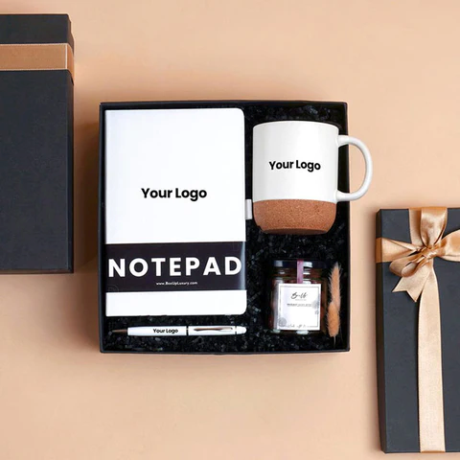
Target Market
The primary target market includes consumers aged 25–55 who purchase meaningful gifts for special occasions. Segmentation is based on demographic, psychographic and behavioural factors, emphasising emotionally driven purchasing behaviour (Kotler et al., 2022; Solomon et al., 2019).

Slide 5
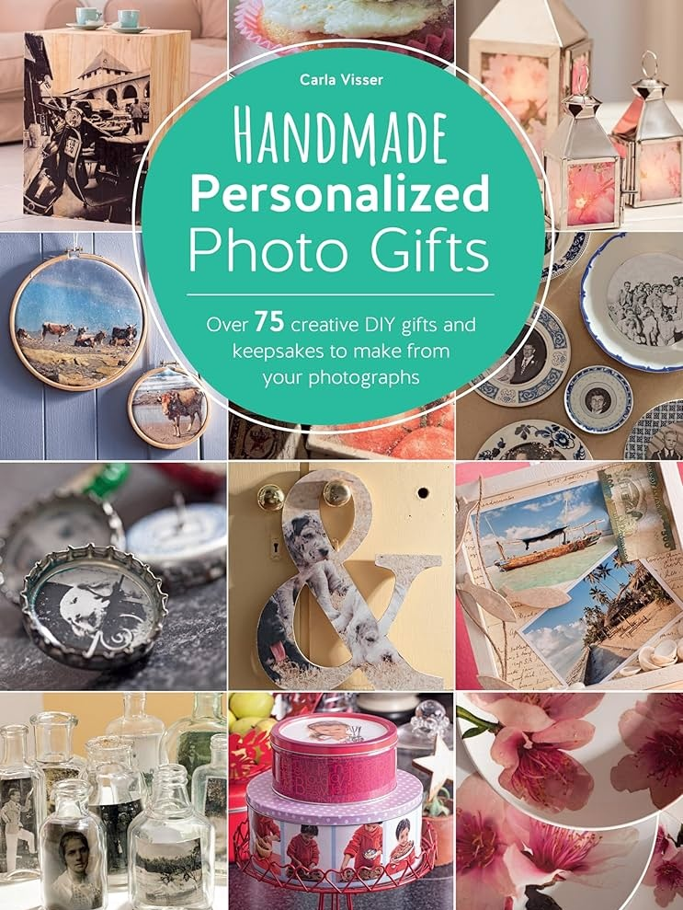
Value Proposition
The business offers artisanal craftsmanship combined with emotional storytelling, differentiating itself from mass-produced personalised products. Competitive advantage is achieved through differentiation strategy rather than cost leadership (Porter, 2008).

Slide 6

Product Strategy
Products integrate customer photographs into handcrafted decorative items using quality and sustainable materials. This approach enhances authenticity, perceived value and ethical positioning within the personalised gift sector (Beverland, 2005; Peattie and Crane, 2005).

Slide 7
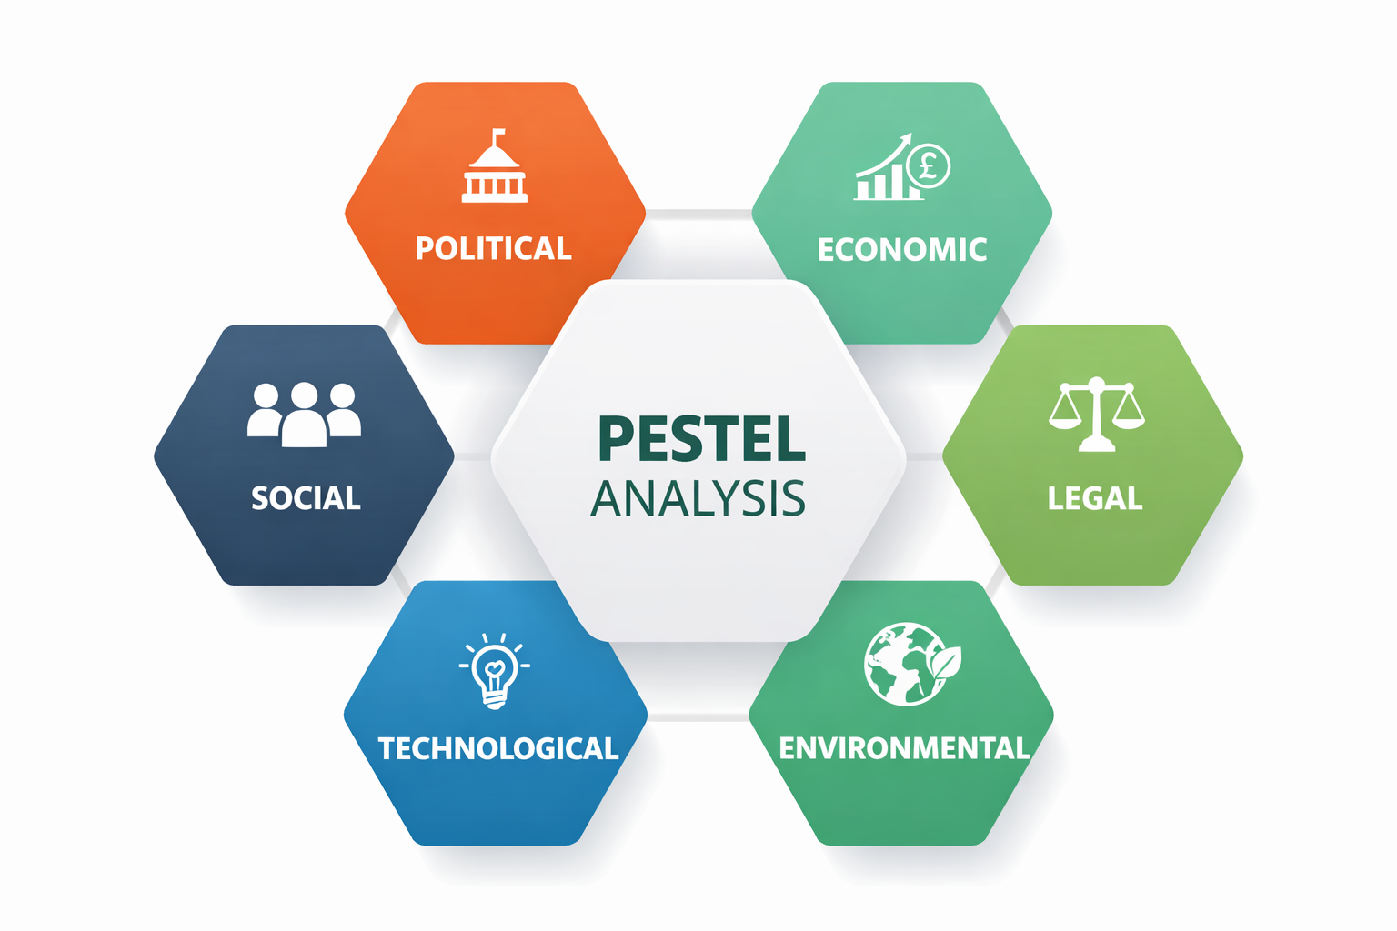
PESTEL ANALYSIS
The PESTEL analysis evaluates the external macro-environment influencing the handmade personalised photo gifts business, including political, economic, social, technological, environmental and legal factors. Social trends toward personalisation and technological advances in e-commerce create opportunities, while economic uncertainty and regulatory compliance represent potential challenges (Johnson, Scholes and Whittington, 2020).

Slide 8

Distribution Strategy (Place)
Distribution Strategy (Place) CINDERFORD
The enterprise operates primarily as an online business through its dedicated website and digital marketplaces. Online distribution reduces overhead costs while expanding geographic reach and operational efficiency (Chaffey and Ellis-Chadwick, 2019).

Slide 9
Promotion Strategy
Promotion focuses on social media marketing, influencer collaboration, SEO and relationship-based email marketing. Digital engagement enhances brand visibility and customer retention (Tuten and Solomon, 2020; Grönroos, 2004).

Slide 10
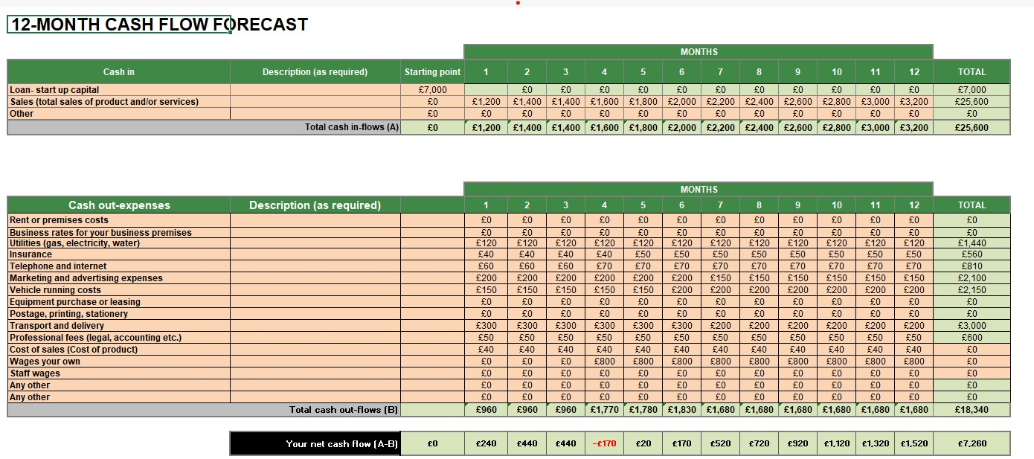
CASH FLOW OF MY BUSINESS IDEA
Financial Overview
The business requires approximately £7,000 start-up capital. Cash flow projections indicate progressive sales growth and improving net cash position, supporting financial sustainability and operational stability (Atrill and McLaney, 2019).

Slide 11

Conclusion
The handmade personalised photo gifts enterprise demonstrates strategic alignment with contemporary consumer trends, effective differentiation and viable financial planning. The integrated marketing and operational strategy supports long-term sustainable competitive advantage (Johnson, Scholes and Whittington, 2020).

Slide 12
Reference List :
Atrill, P. and McLaney, E. (2019) Accounting and finance for non-specialists. 11th edn. Harlow: Pearson.
Beverland, M.B. (2005) ‘Crafting brand authenticity: The case of luxury wines’, Journal of Management Studies, 42(5), pp. 1003–1029.
Chaffey, D. and Ellis-Chadwick, F. (2019) Digital marketing: Strategy, implementation and practice. 7th edn. Harlow: Pearson.
Grönroos, C. (2004) ‘The relationship marketing process: Communication, interaction, dialogue, value’, Journal of Business & Industrial Marketing, 19(2), pp. 99–113.
Johnson, G., Scholes, R. and Whittington, R. (2020) Exploring strategy. 12th edn. Harlow: Pearson.
Kotler, P., Armstrong, G., Harris, L.C. and He, H. (2022) Principles of marketing. 9th European edn. Harlow: Pearson.
Laudon, K.C. and Traver, C.G. (2021) E-commerce: Business, technology, society. 16th edn. Harlow: Pearson.
Mintel (2023) UK personalised gifts market report. London: Mintel Group Ltd.
Peattie, K. and Crane, A. (2005) ‘Green marketing: Legend, myth, farce or prophecy?’, Qualitative Market Research: An International Journal, 8(4), pp. 357–370.
Pine, B.J. and Gilmore, J.H. (2011) The experience economy. Updated edn. Boston: Harvard Business Review Press.

