Slide 1
HPHI 4008 ‘WARFARE IN HISTORY’
MILITARY REVOLUTION PART II
FRENCH REVOLUTIONARY WARS AND THE RISE OF NAPOLEON

Slide 2
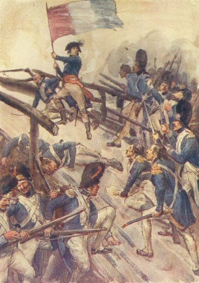
FRENCH REVOLUTIONARY WARS
Aim – to maintain popularity of the Revolution
Little heed paid to state of French army - many officers became Emigres
French interests look north to Austrian Netherlands and east to Prussian lands
Austria and Prussia pre-occupied with partition of Poland

Slide 3
FRENCH REVOLUTIONARY WARS
Appeals made in France for a new Citizens Army; also element of conscription and general mobilisation (aspects of Total War?) – central here was Lazare Carnot (1753-1823)
Opportunities in new atmosphere for ambitious and talented officers e.g Napoleon, to make headway
1795 – France under control in Austrian Netherlands and occupy the Rhineland

Slide 4
FRENCH REVOLUTIONARY WARS
Revolutionary principles coupled with ‘Glorious’ victories sustained the French campaign
Also ‘living off the land’ in conquered territories maintained ambitions of officers and fed and paid the expanding army
All = ‘self-sustaining’ system of warfare
‘Every citizen must be a soldier, every soldier a citizen’ (report to French Assembly 1789)
1796 onwards – able to look east towards Austrian Habsburg territory

Slide 5
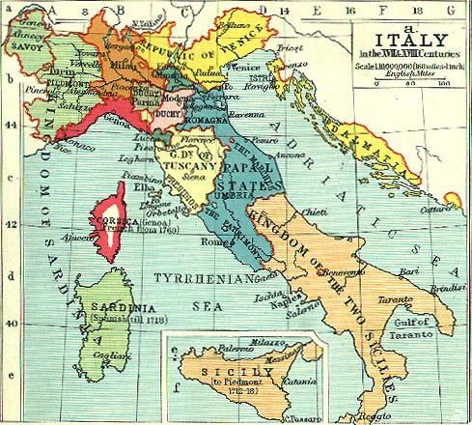
ITALY
Napoleon invades Piedmonte-Sardinia lands – plunder and ‘Glory’ on Italian soil
Covets Austrian Habsburg lands in Italy, including Lombardy and Milan
Napoleon’s skills as tactician emerge – concentration of forces

Slide 6
TACTICS
1800s – coalition emerging against Napoleon – Russians, Austrians, British threaten French gains in Italy and the Rhineland
Returns from campaigning in Egypt to defeat Austrians at Marengo (June 1800) and consolidate gains in Italy . Austria make peace
1801-05 Napoleon reorganises during lull
Strong and experienced army at his command
Marshal-led and Corps based, able to move independently and rapidly (without peers), with competent General Staff
Self sufficient without the need for a supply train

Slide 7
EASTWARDS!
August 1805 – new alliance emerges between Austria , Russia, and Sweden; Napoleon (now Emperor) invades Austro-Hungary and occupies Vienna
Problems – combined forces of Austria and Russia are a formidable foe; winter approaching, living off the land more precarious
Answer – quick and decisive campaign – Austerlitz (December 1805). Austria defeated but Prussia declare war on France

Slide 8
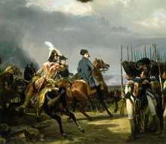
EASTWARDS!
Battle of Jena (October 1806) – Napoleon’s decisive victory sees Berlin occupied and subjects Prussia to French hegemony until 1812
Battle of Wagram (July 1809) France finally defeats Austria, but cost of war begins to impact on French finances

Slide 9
AIMS AND WEAKNESSES
Territorial aggrandisement and military glory
Creation of a ‘Continental System’ aimed at stifling British overseas power
Personal status
Revolutionary fervour and zeal?
Opposition in conquered lands e.g German states
Inherent weakness of ‘Client-states’ with relatives in charge e.g. brother Joseph, King of Naples and Sicily 1806-08
Diminishing effectiveness of French army

Slide 10
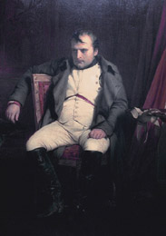
DOWNFALL
Grand Duchy of Warsaw (Napoleon’s Polish settlement) threatens Russian lands; war ensues
Summer 1812 – Napoleon with an army of 600kinvades Russia

Slide 11
DOWNFALL
Napoleon’s army of 1812 = half French; the rest troops from ‘client’ states, his reluctant allies!:
German Confederation of the Rhine
Kingdom of Italy
Duchy of Warsaw
Russians draw Napoleon deeper into their territory; Battle of Borodino (September 1812 – 70k casulaties!) hollow victory for the French; Moscow occupied but culminates in ‘epic retreat’

Slide 12
DOWNFALL
French now faced new alliance of Prussia, Austria, Sweden, Russia, Britain, Sweden
Battle of Leipzig (16th- 19th October 1813) – over 500k troops involved in decisive defeat for Napoleon ; casualties range from 80k-110k
Despite skilled rear guard action during retreat, Paris occupied and Napoleon abdicates to Elba (April 1814)
Bourbons re-instated in France under Louis XVIII

Slide 13
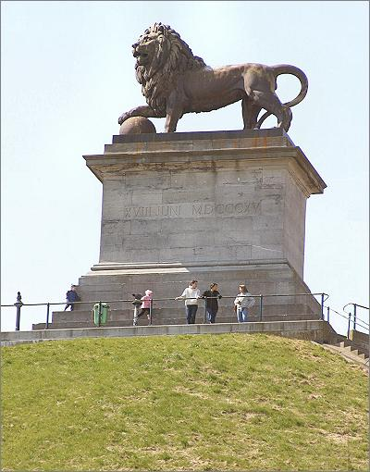
WATERLOO
18TH June 1815 near Brussels
Culmination of Napoleon’s ‘Hundred Days’ after his return from exile in Elba
Napoleon went on the offensive before the Allies could unite on the battlefield

Slide 14
WATERLOO
Belligerents:
1. France with army of 72k (casualties 52k)
2.Allies, totalling 118k (24k) under Duke of Wellington:
Britain;
Netherlands;
Hanover;
Nassau;
Brunswick
Prussia under von Blucher

Slide 15
POST-NAPOLEON
Congress of Vienna 1814-15
Return of old dynasties – e.g. Bourbon restoration in France
Spheres of influences created in Europe
Russia attains the Duchy of Warsaw
Prussia attains Saxony and parts of Duchy of Warsaw, and Rhineland Westphalia
German Confederation set up – loose association of 38 German states; a buffer between Prussia and Austria

Slide 16
POST-NAPOLEON
United Kingdom of the Netherlands created out of the Netherlands and southern Netherlands (Belgium)
Kingdom of Bavaria recognised
Austria gain the Tyrol, Lombardy and Venetia
Habsburg regain Tuscany and Modena
Papal States restored to Pope
Kingdom of Sardinia restored in Piedmonte, Nice, and Savoy
Kingdom of Naples restored to Bourbons

Slide 17
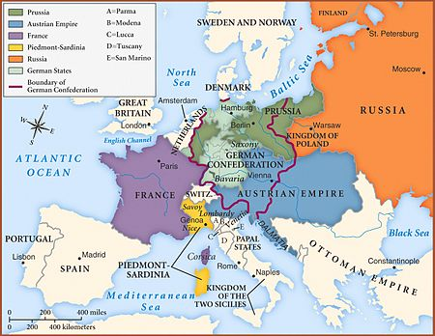
POST- NAPOLEON

Slide 18
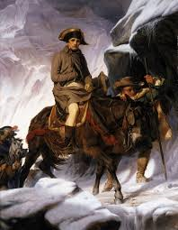
NAPOLEON

