Slide 1
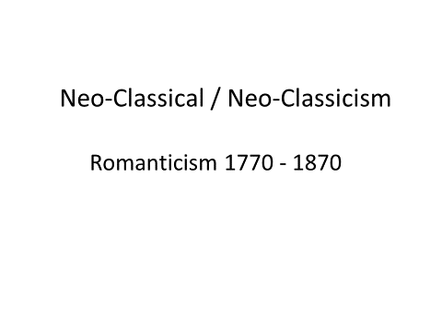

Slide 2


Slide 3
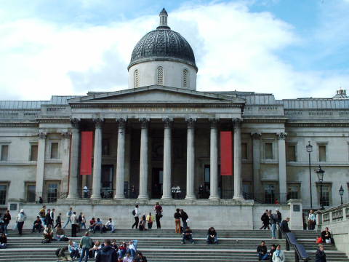

Slide 4
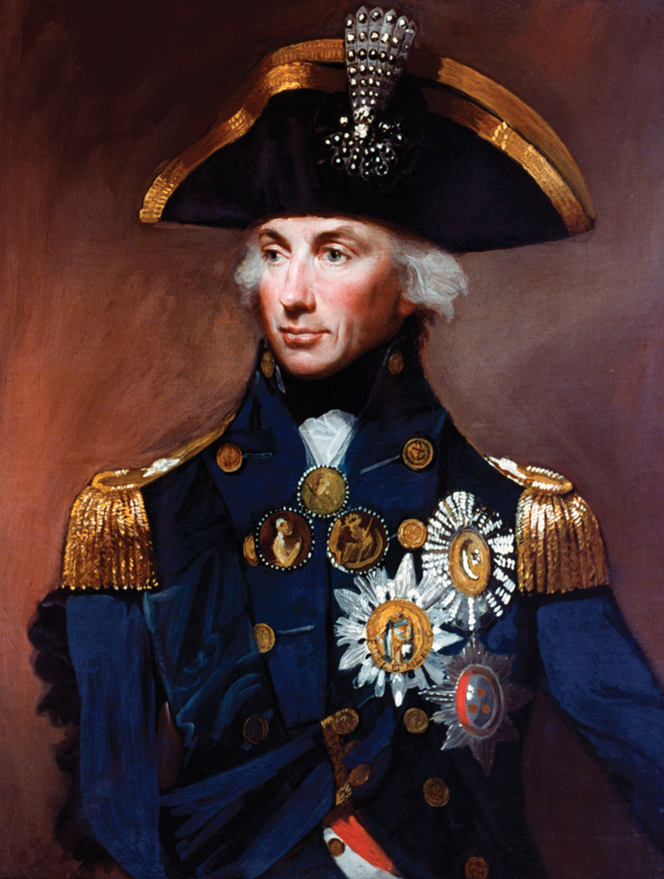

Slide 5
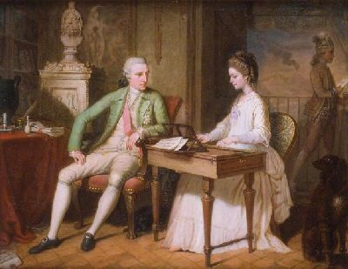

Slide 6
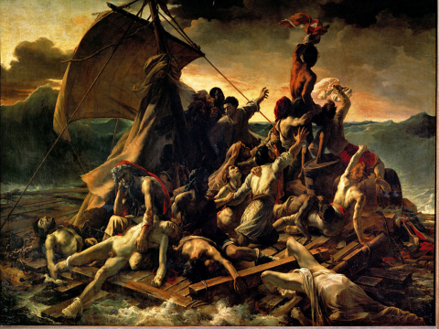

Slide 7
Characteristics of Romanticism
Characteristics of Romanticism :
(i) A mixture of genres
(ii) Realistic language
(iii) Symbolic imagery
(iv) A belief in the quality/ spirit of Shakespeare

Slide 8
Both Neo-Classicism and Romanticism are NOT Realism and Naturalism.
By knowing that fact, we can begin to explore what R & N is. ‘Why did R & N happen?’

Slide 9
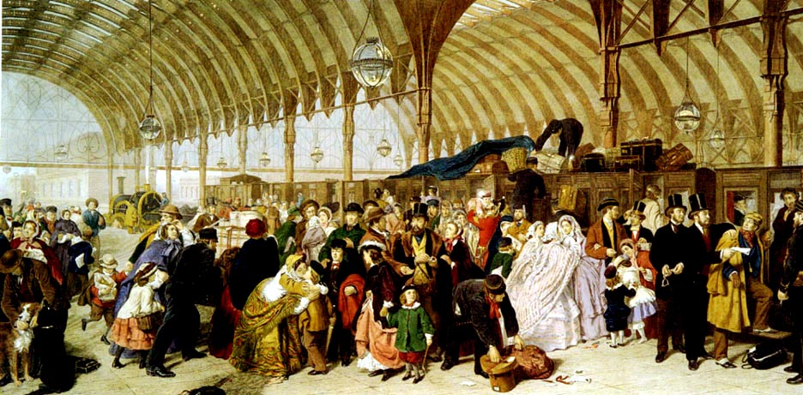

Slide 10
William Powell Frith (1819 – 1909)

Slide 11
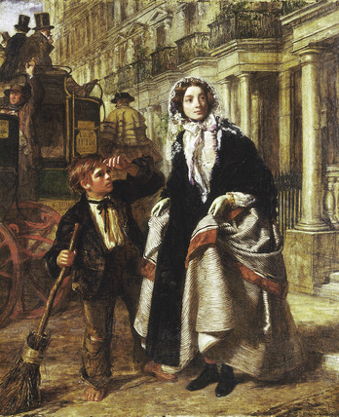

Slide 12
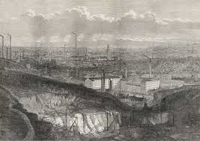

The Industrial Revolution 1760 - 1850

Slide 13
Emile Zola
(1840 – 1902)

Slide 14
Charles Dickens
(1812 – 1870)

Slide 15


