Slide 1
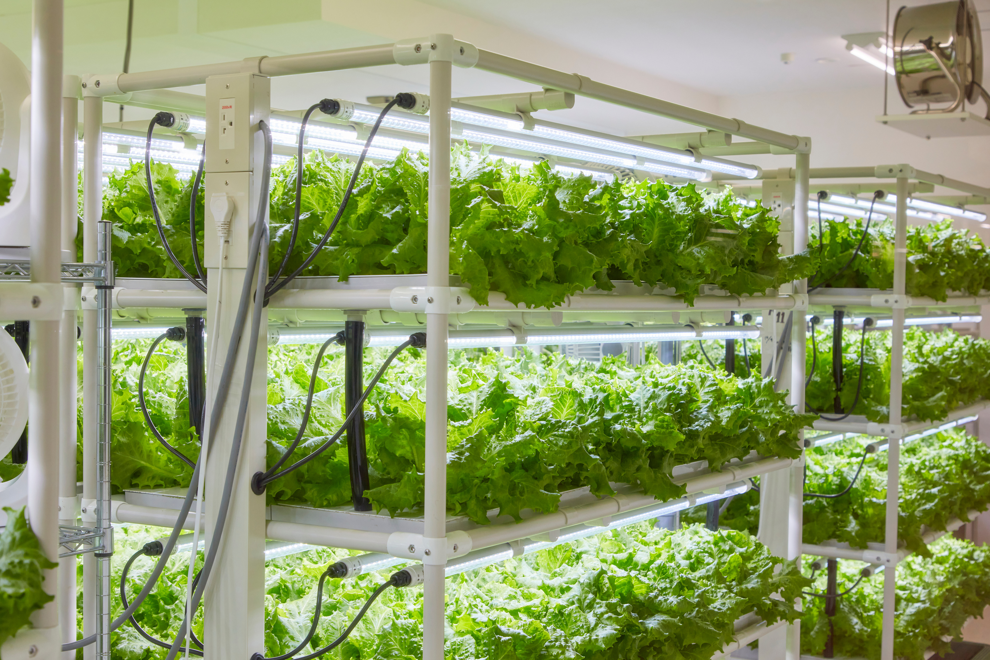



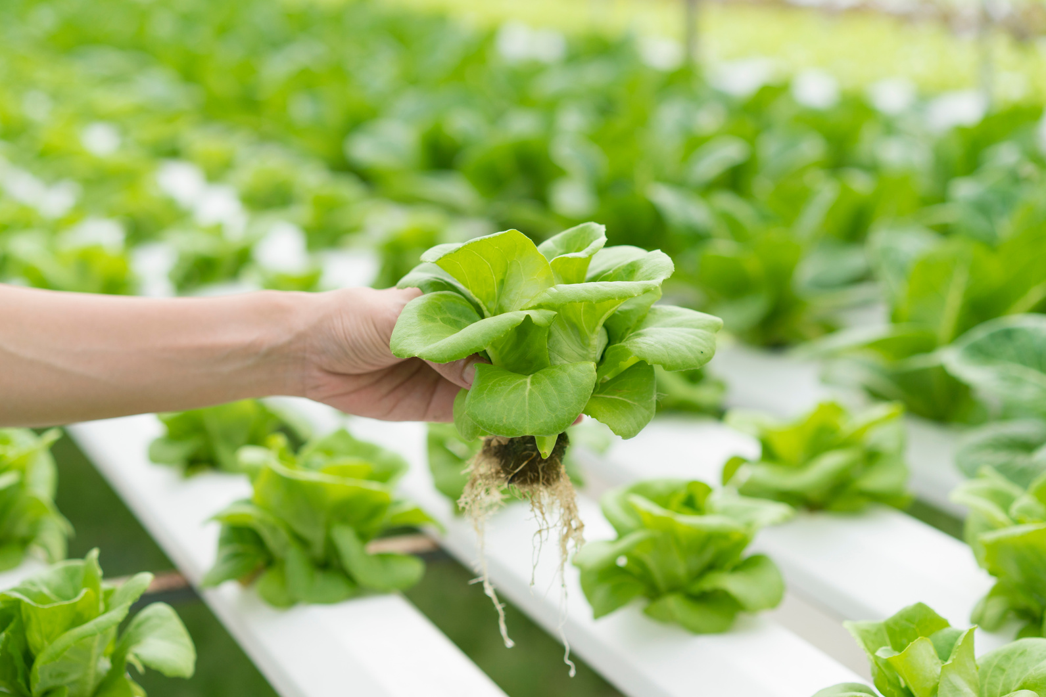
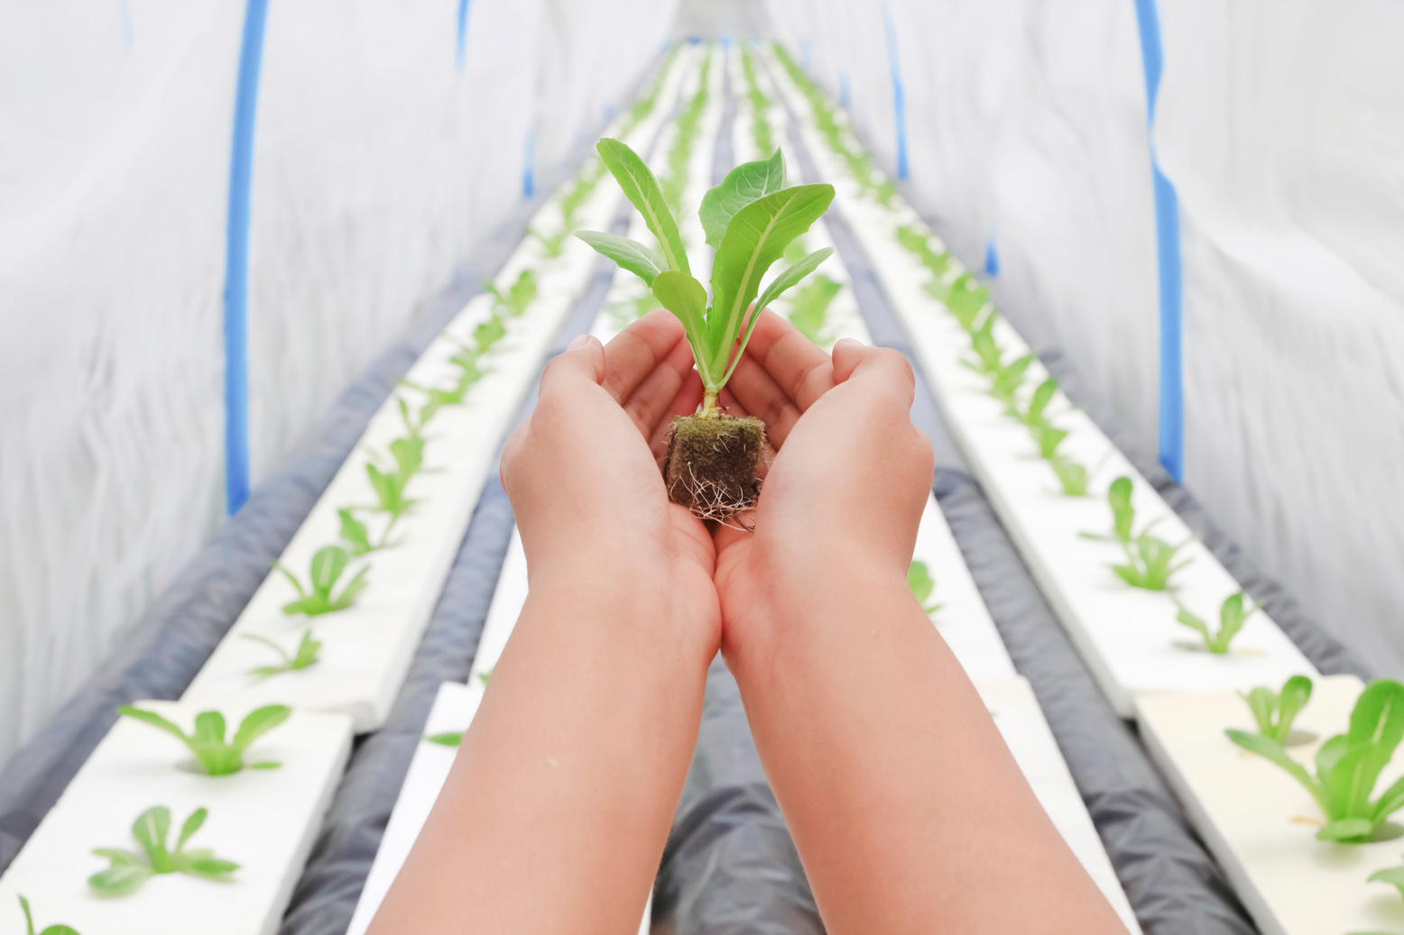
Vertical Farming at Home
Interim Viva Presentation
Presenter: Alexei Nica
ID: 2232919

Slide 2
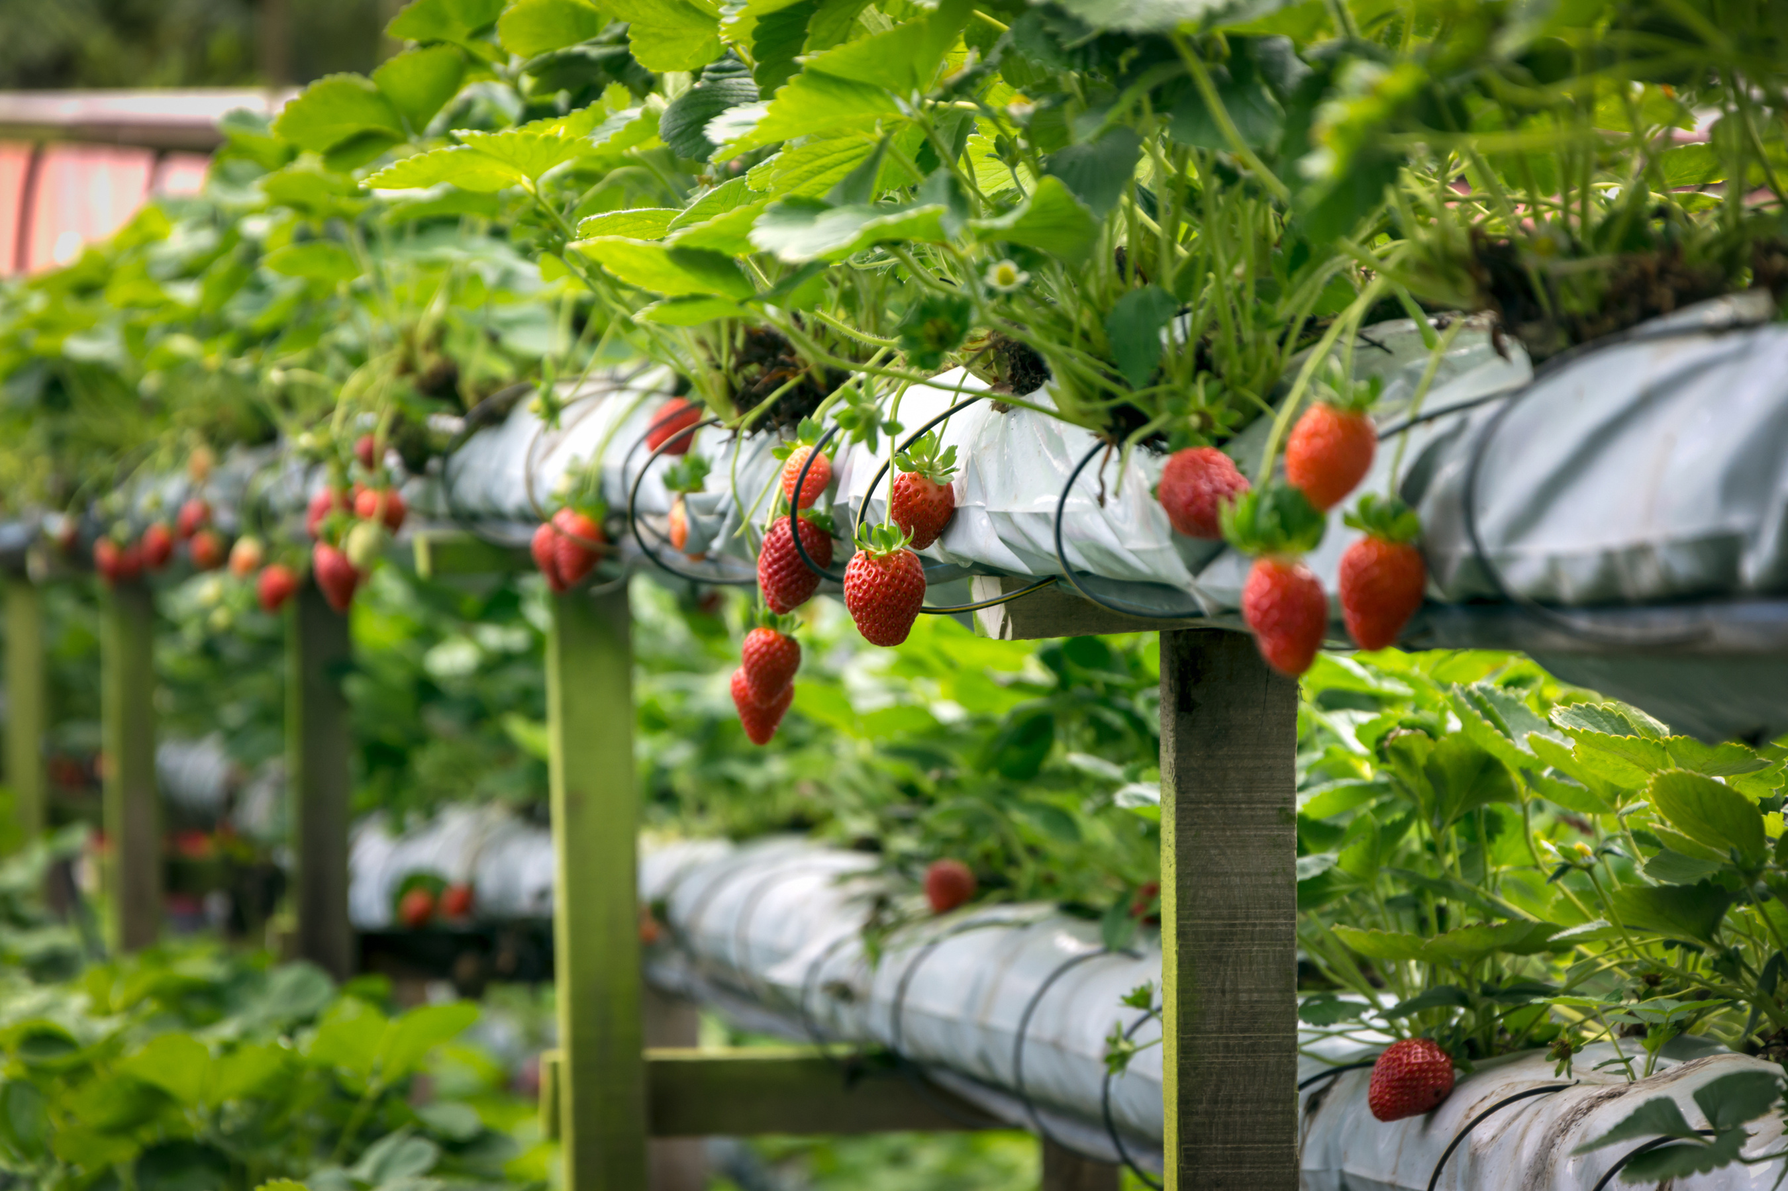
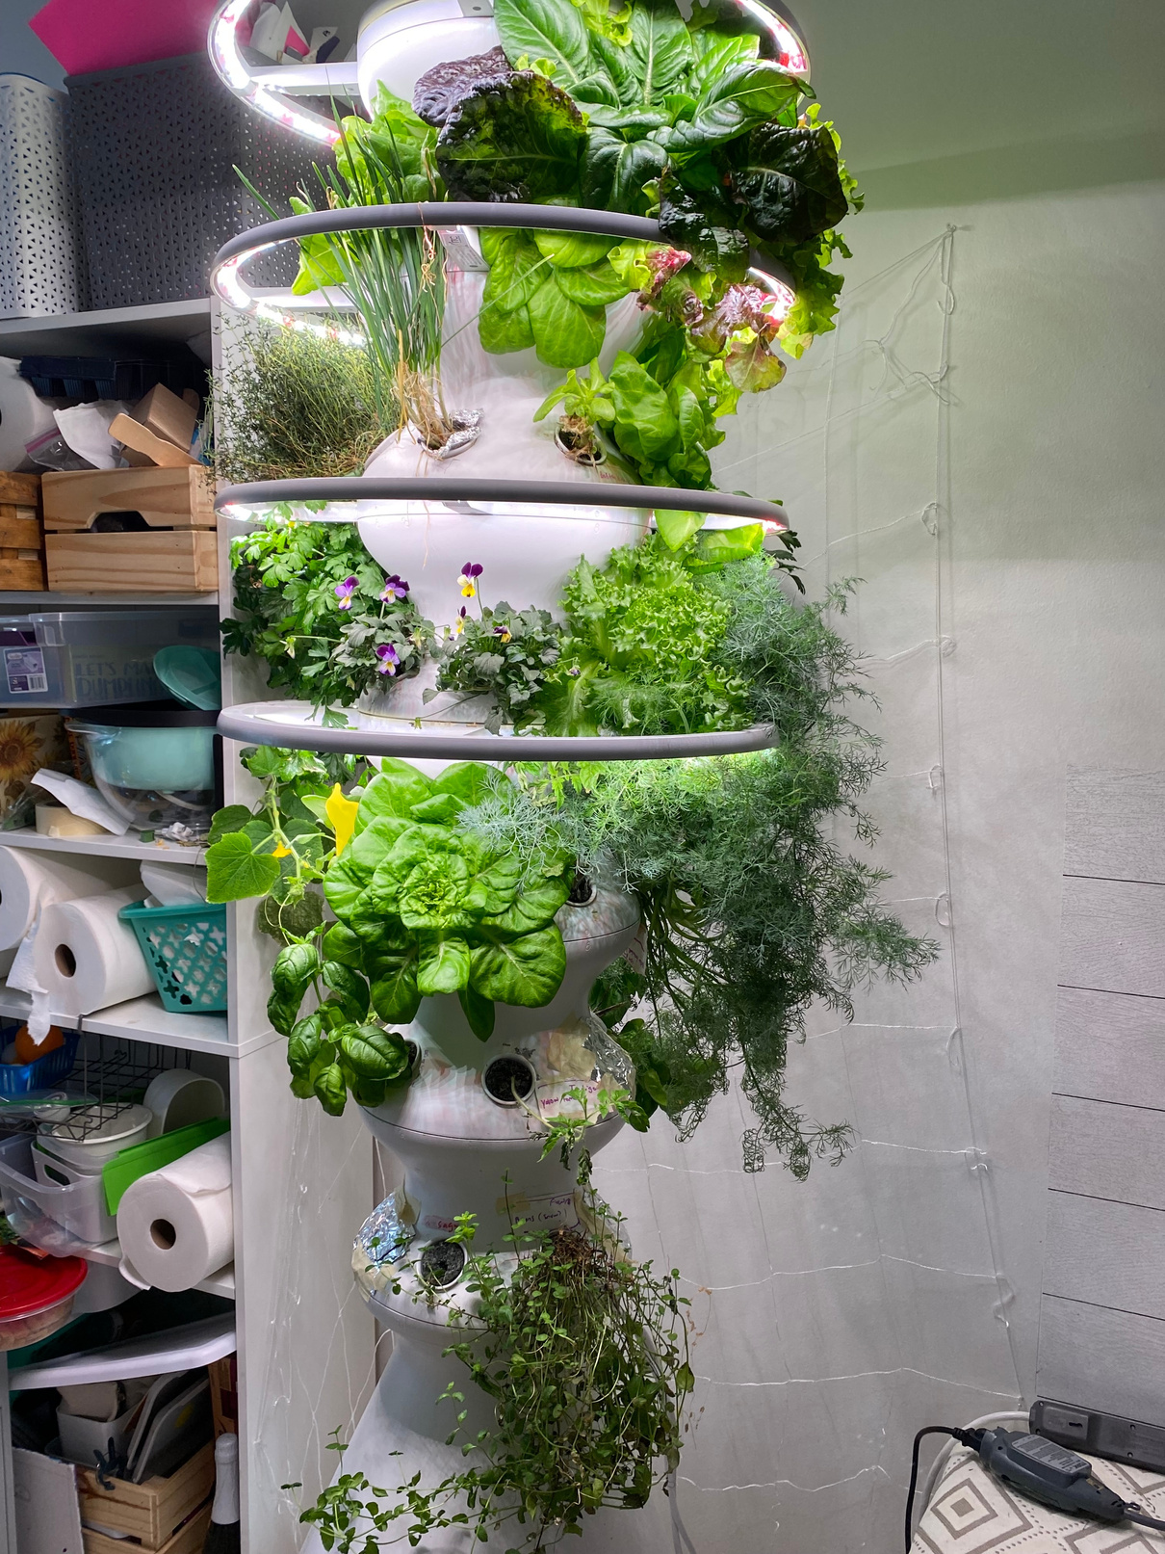
Content
Introduction
Problem Statement
Project Aim & Objectives
Methodology
Literature Review
Design Overview
Project Timeline
Conclusion
References

Slide 3
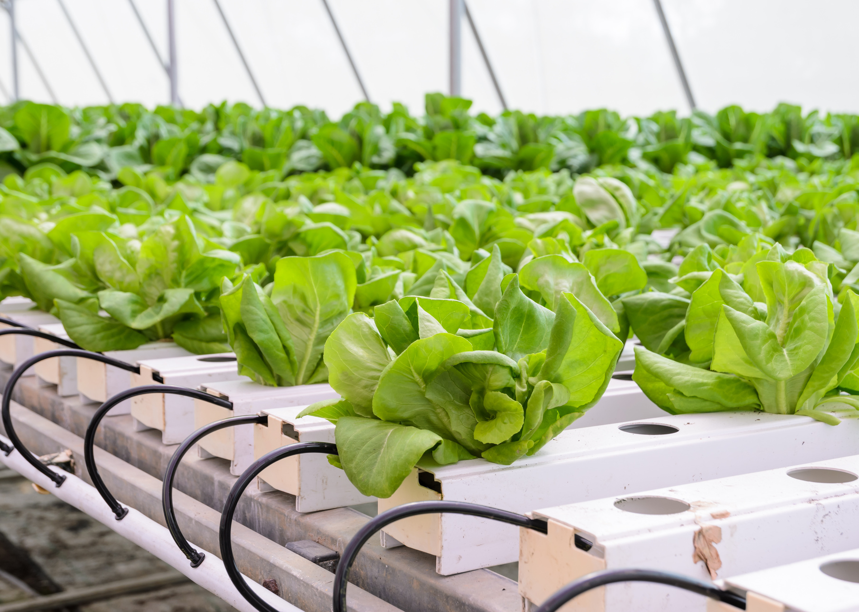
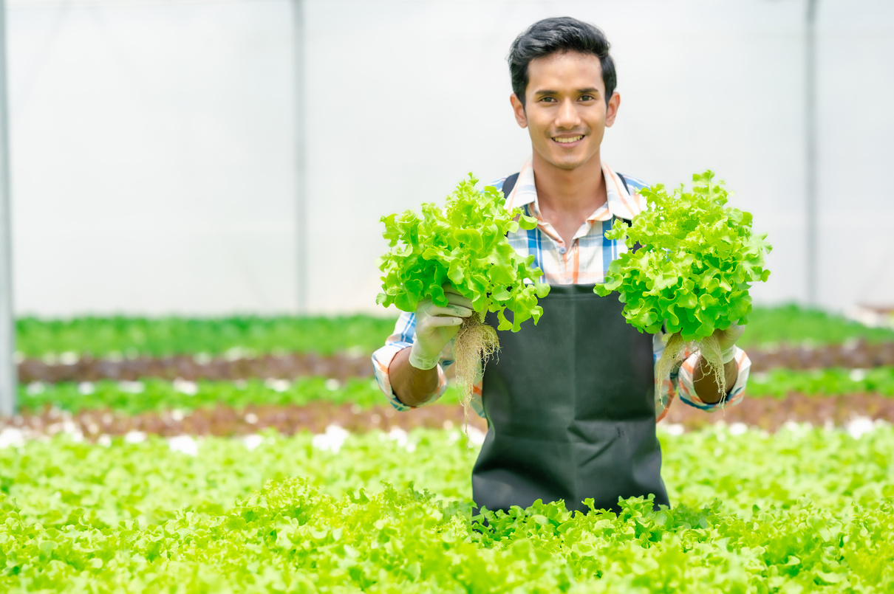
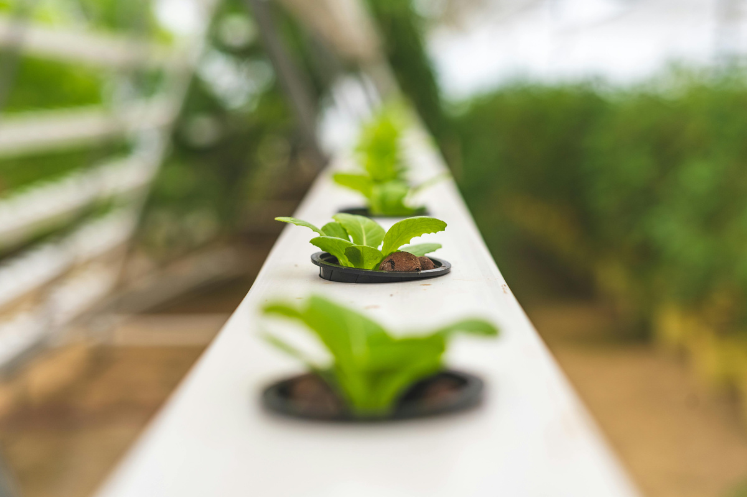
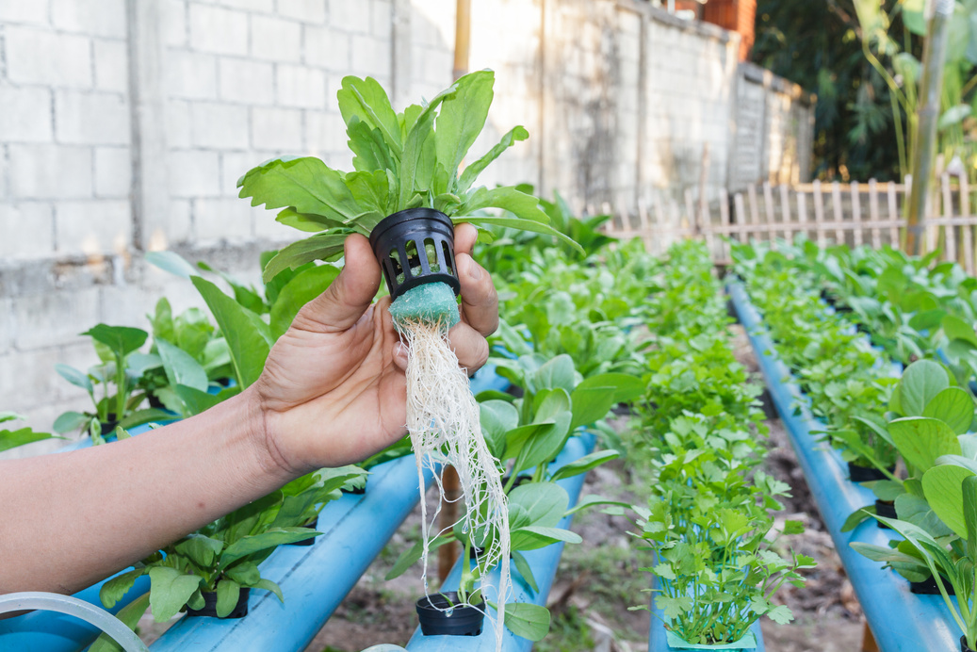
Introduction
Growing food at home is becoming very popular, especially in small spaces.
Vertical farming is practical because it saves space, uses less soil, and allows year-round production [1].
However, most current research focuses on large-scale systems, while few tools are designed for beginners or small households [3].

Slide 4
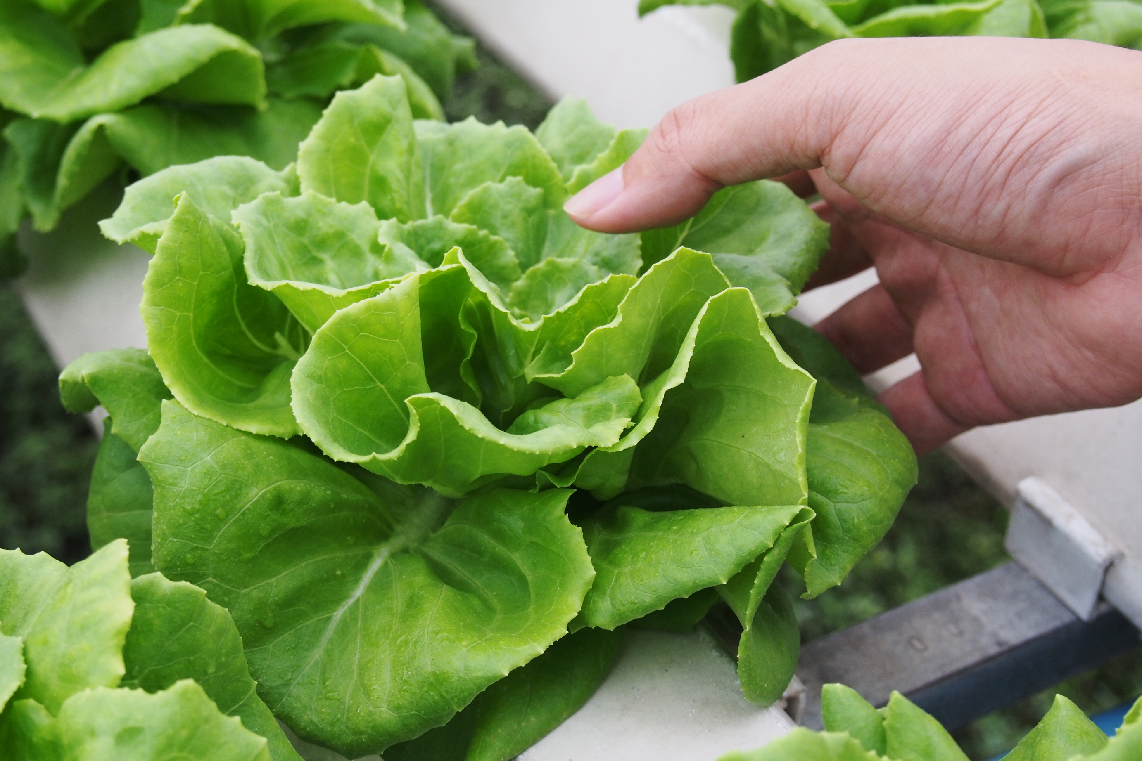


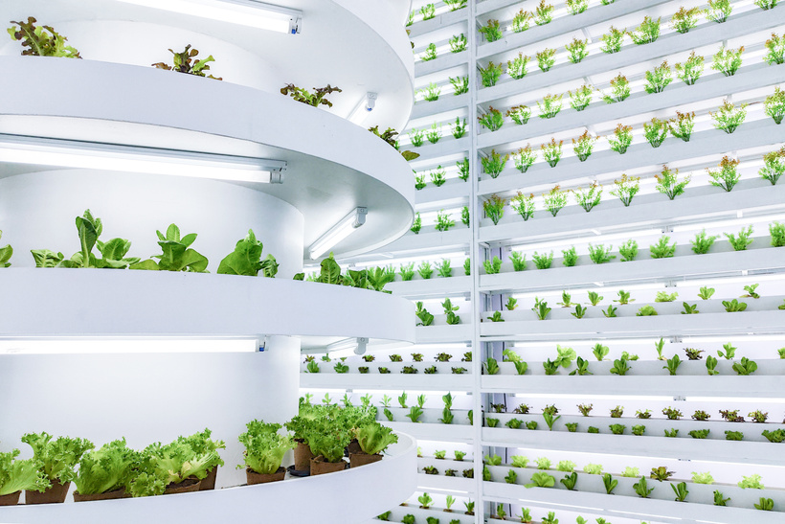



Problem
Statement
Information Scattered
Focus on Commercial
Guides are spread across blogs, forums, and videos. They are often vague, inconsistent, or too technical for beginners.
Most platforms and resources promote large vertical farms or expensive equipment, not household-level solutions [4].
Most online information is scattered and too technical. Current platforms focus on commercial farms, lack interactivity, and do not support small home users [3].
This creates a clear need for a simple, step-by-step solution.
Existing tools usually miss interactive planning, login functions, and personalization. This limits user engagement.
There is no simple platform guiding home users through building and managing their own vertical farm.
Lack of Interactivity
No Step-by-Step Guidance

Slide 5





Project Aim & Objectives
Aim
To design and develop a user-friendly web platform that enables individuals to plan and personalize their vertical farming systems at home, using interactive features and stored user profiles.
Objectives
To analyse existing digital tools and literature related to home-based vertical farming, identifying usability gaps and common user challenges.
To design and develop a web-based system with user login functionality and an interactive planning tool for vertical farming layouts.
To integrate a database for securely storing user accounts and save farm configurations.
To evaluate the platform through user feedback, focusing on usability, relevance, and satisfaction.

Slide 6
Methodology
Development, login, layout planner, database integration
Research & requirements gathering
Design with wireframes and
mock-ups [5]
Testing and evaluation with user feedback
Iterative development process

Slide 7

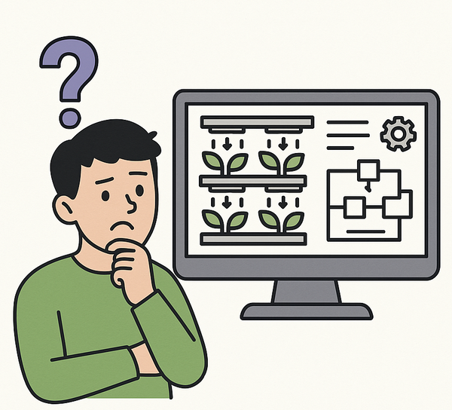

Literature
Review
No home-based solution for vertical farming
Most research focuses on large-scale vertical farming, leaving home-based models less explored [6]. Studies show clear benefits but also a lack of simple, beginner-friendly tools. This gap motivated my project, aiming to create a practical and accessible solution.
Lack of simple, beginner-friendly tools

Slide 8
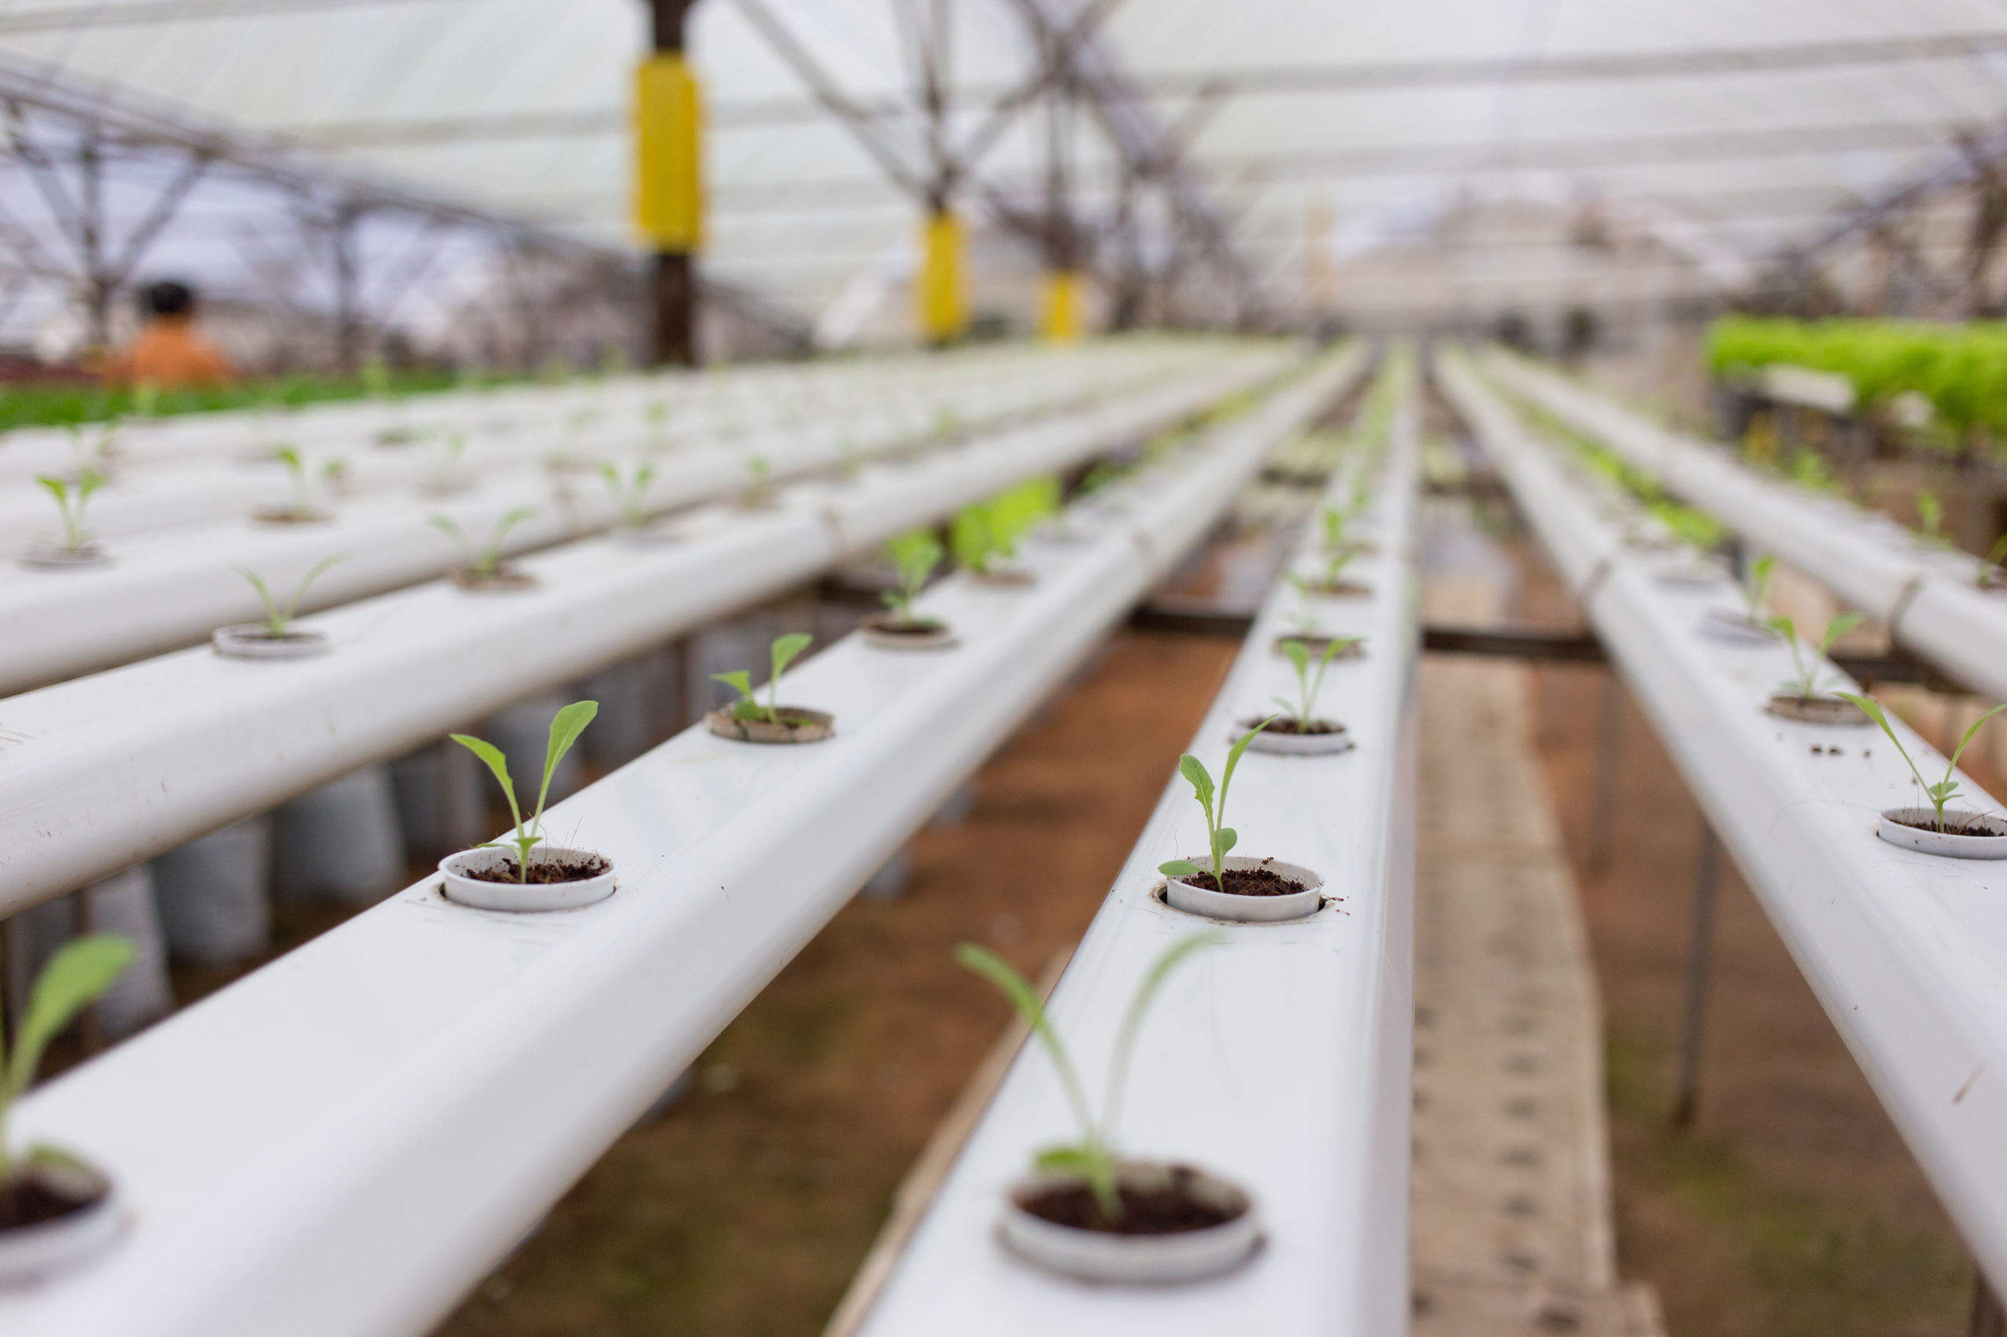
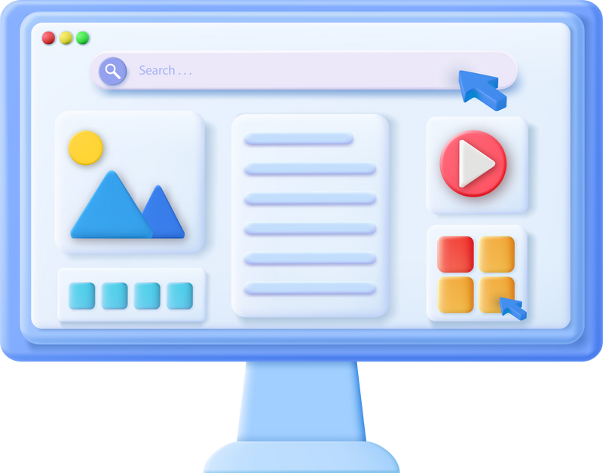
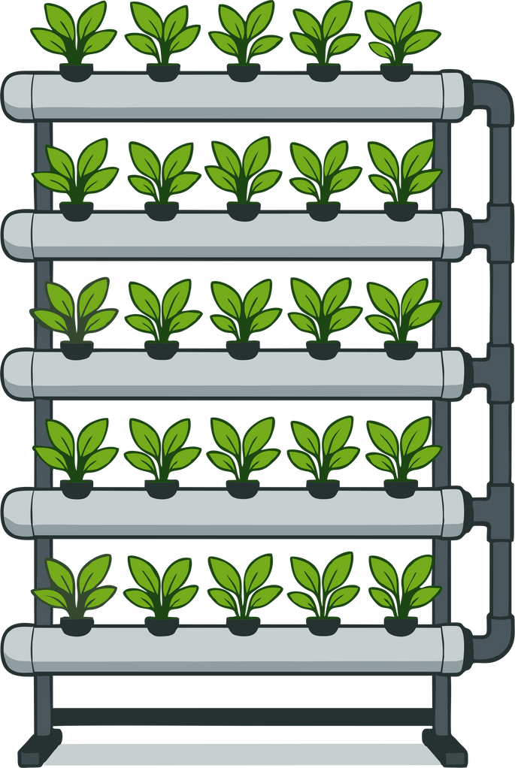

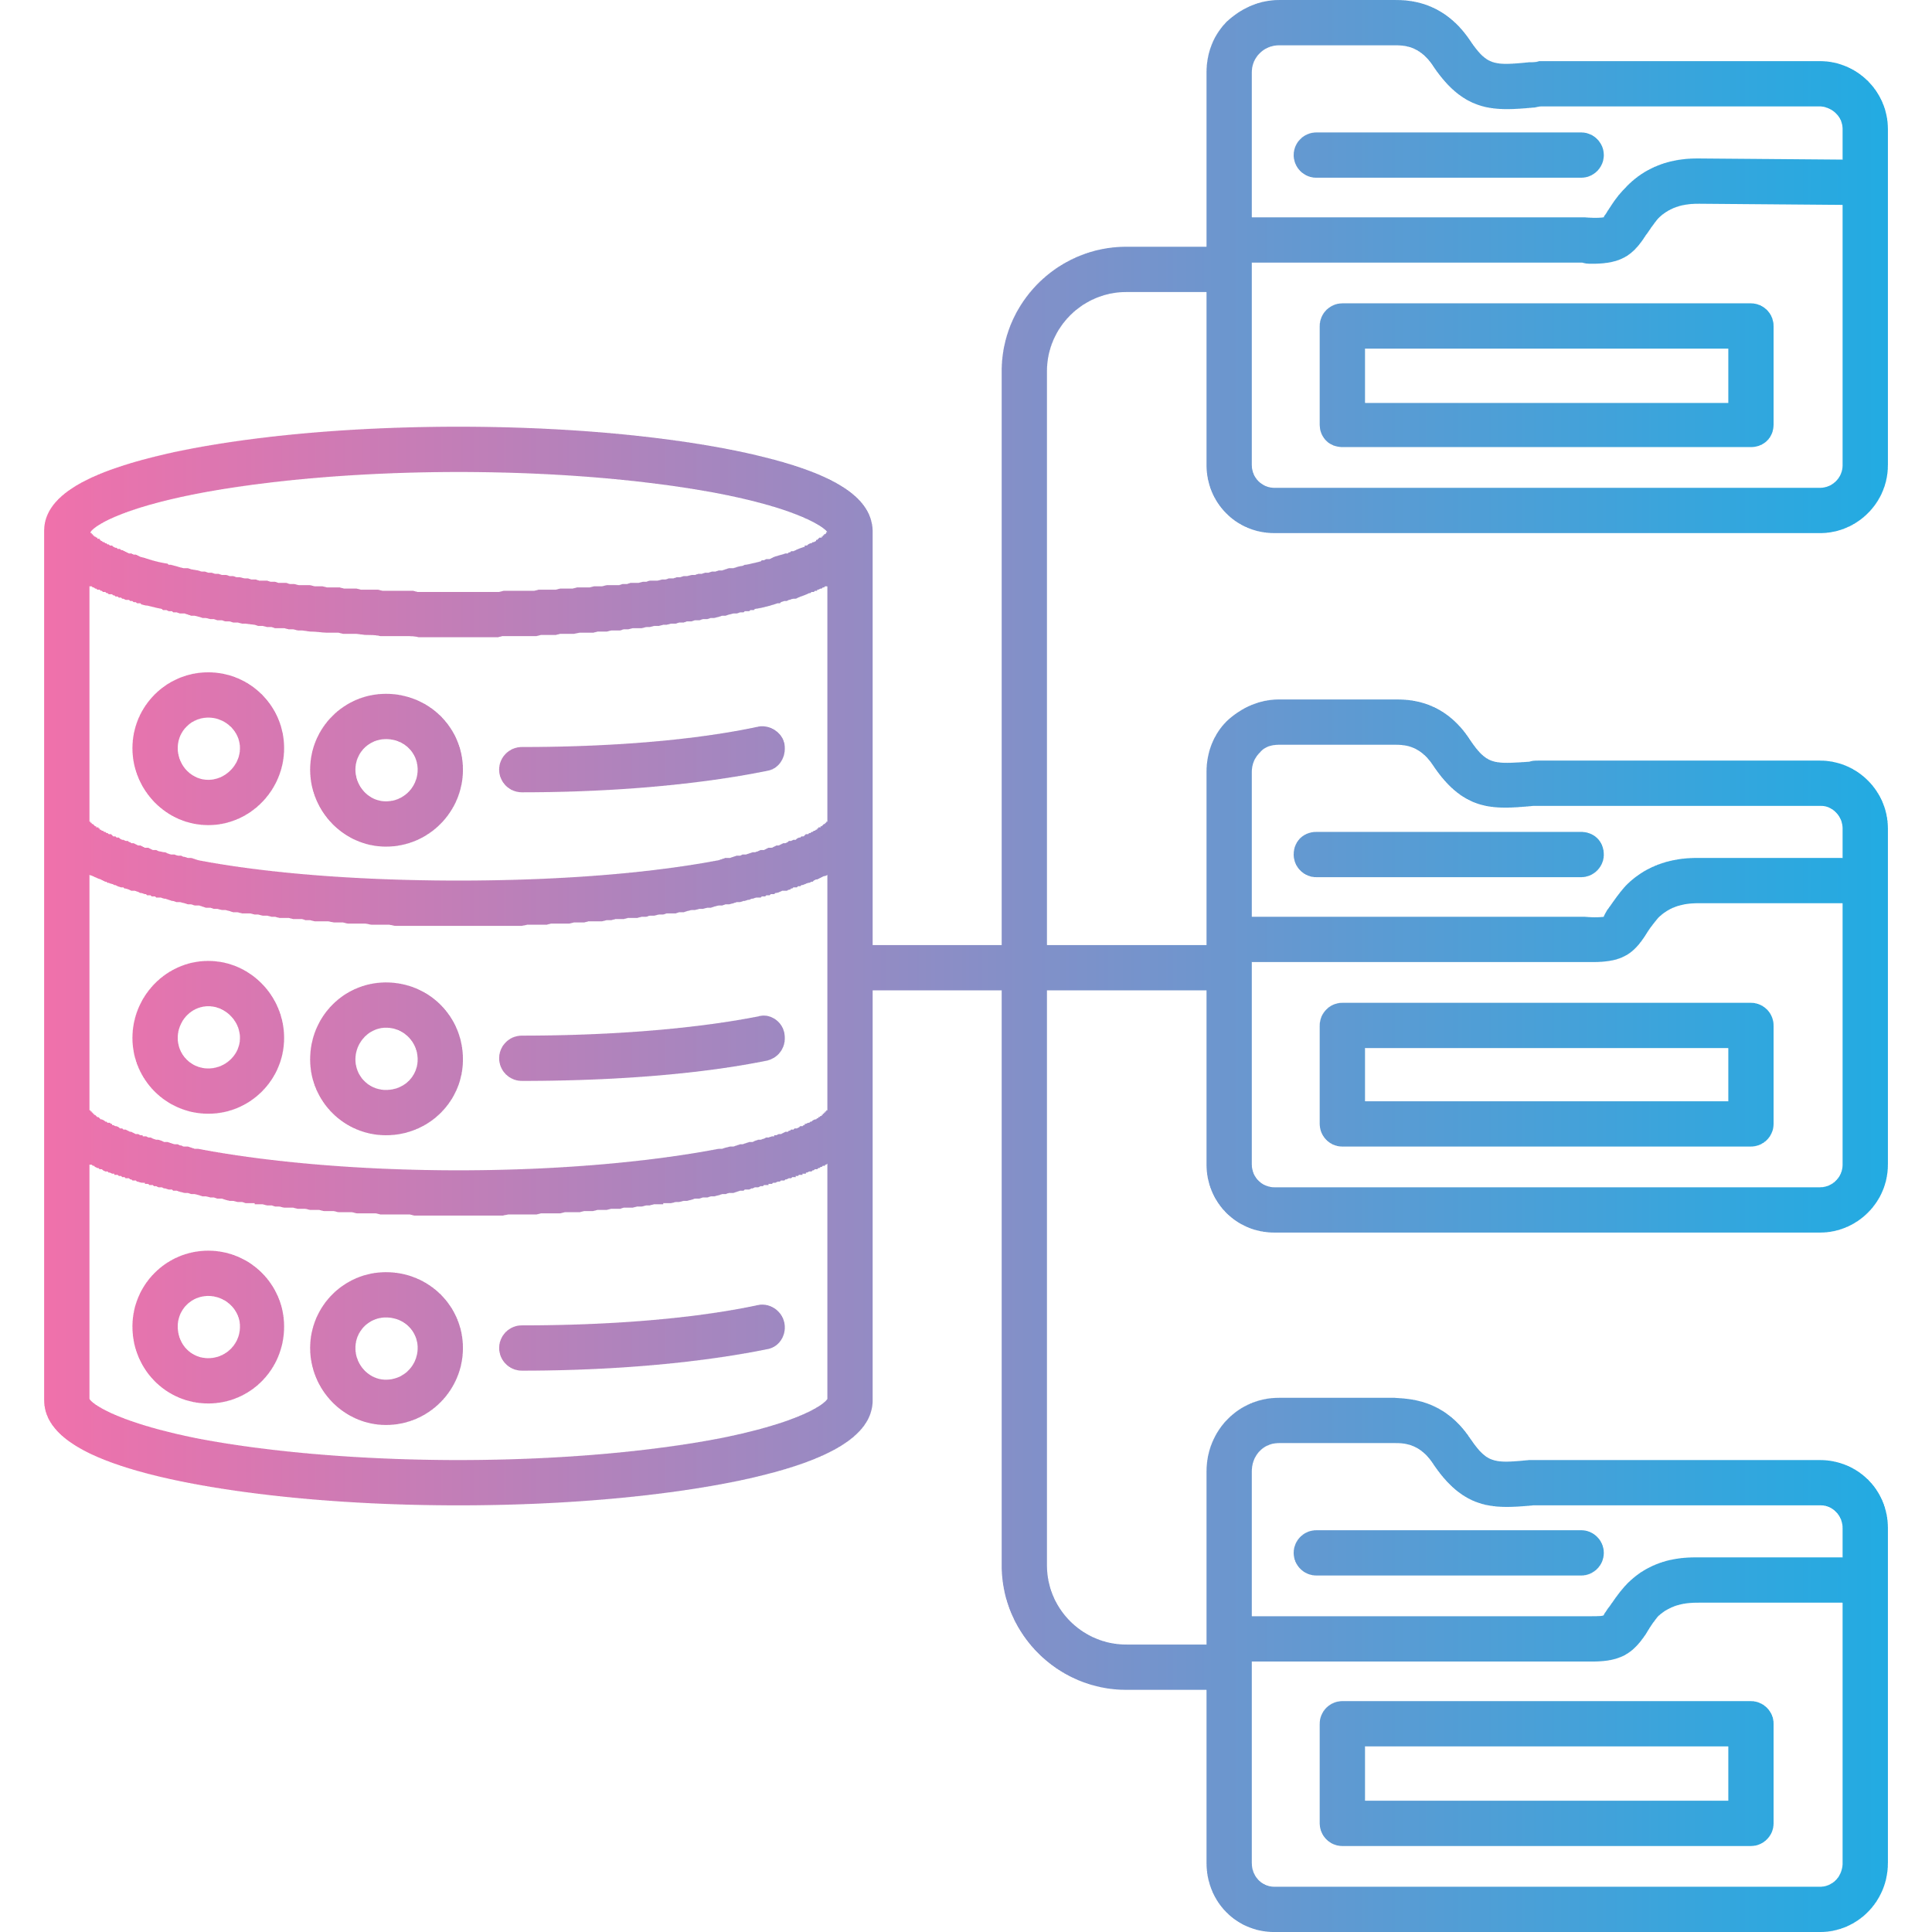

Design Overview
The platform is designed with simplicity and accessibility in mind
Web-based platform for home vertical farming [7].
Interactive layout planner (shelves, lights, water flow)
User login and saved configurations
Database support for storing designs
Simple, responsive interface across devices [8].

Slide 9


  PROJECT TIMELINE
  7. Documentation & Submission
  Final report written
  Project submitted
Phases and Milestones
  1. Planning & Ethics
  Current stage
  4. Development Phase
  Proposal submitted
  Ethics approval obtained
  First prototype built
  Database integrated
  6. Evaluation & Final Review
  Evaluation report completed
  2. Research & Analysis
  Literature review completed
  Project requirements defined
  3. Design Phase
  5. Testing & Feedback
  Wireframes finalised
  System architecture designed
  User journey mapped
  Usability testing conducted
  Feedback implemented

Slide 10
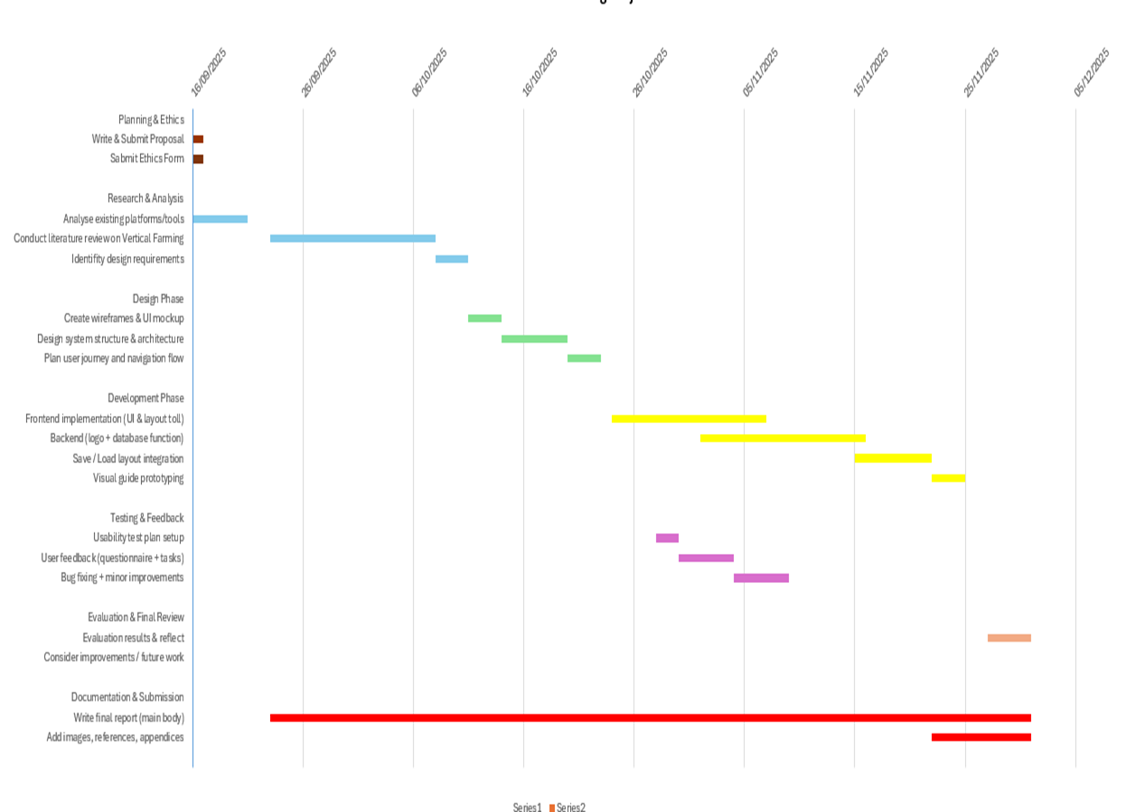
  PROJECT TIMELINE
  Gantt chart

Slide 11
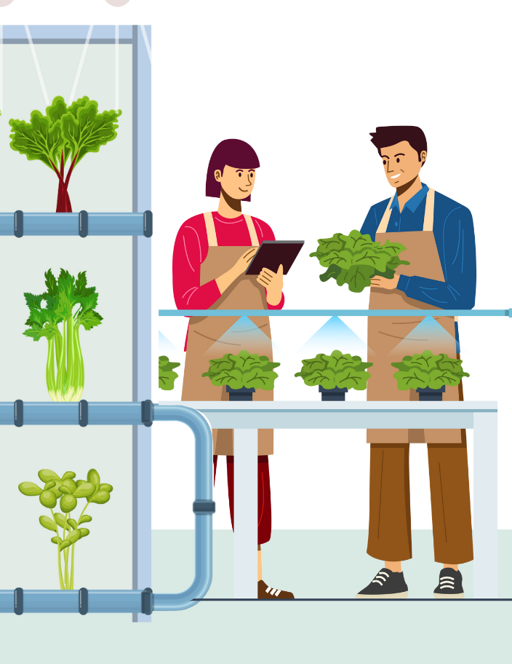
Conclusion
The main challenge is that beginners who want to grow food at home lack simple guidance and tools.
My project offers an easy-to-use digital platform that helps people design and manage their own vertical farms.
It’s not only about technology, but about giving individuals the confidence to grow fresh food in their own space.

Slide 12
References
[1] O. B. Akintuyi, "Vertical farming in urban environments: a review of architectural integration and food security," Open Access Research Journal of Biology and Pharmacy, vol. 10, no. 2, pp.114–126, 2024.
[2] S. Oh and C. Lu, "Vertical farming-smart urban agriculture for enhancing resilience and sustainability in food security," The Journal of Horticultural Science and Biotechnology, vol. 98, no. 2, pp.133–140, 2023.
[3] M. Martin and M. J. Bustamante, "Growing-service systems: new business models for modular urban-vertical farming," Frontiers in Sustainable Food Systems, vol. 5, pp.787281, 2021.
[4] N. Setiyawati, H. D. Purnomo and E. Mailoa, "User Experience Design on Visualization of Mobile-Based Land Monitoring System Using a User-Centered Design Approach." Int.J.Interact.Mob.Technol., vol. 16, no. 3, pp.47–65, 2022.
[5] V. Janstova, "Developing an Educational Mobile App for Sustainable Agriculture: Promoting Sustainable and Ethical Farming Practices," 2025.
[6] T. Van Gerrewey, N. Boon and D. Geelen, "Vertical farming: The only way is up?" Agronomy, vol. 12, no. 1, pp.2, 2021.
[7] N. Iannuzzi, et al., "Usability and transparency in the design of a tool for automatic support for web accessibility validation," Universal Access in the Information Society, vol. 23, no. 1, pp.435–454, 2024
[8] A. Sarioğlu, "Accessibility in web modelling tools: Systematic review and conceptualization of a keyboard-only prototype," 2023.

Slide 13
Thank You!

