Slide 1
ECAD4003/C
Mathemateg – Mathematics 2
17-01-2019 (2)

Slide 2
Croeso - Welcome
By the end of this session, you should be able to:
understand the subject knowledge requirements for mathematics and numeracy
reflect on your own knowledge and identify areas for improvement
understand how mathematics subject knowledge can be used effectively in the primary classroom

Slide 3

Different people feel differently about mathematics and numeracy.
What are your beliefs about mathematics and numeracy?
How could these impact on the way you teach mathematics and numeracy to children?
https://www.nationalnumeracy.org.uk/research-and-resources?field_etile_keyword_tags_tid[]=106

Slide 4
What are your beliefs about mathematics and numeracy learning?
For each row of the table, highlight/circle one statement that best fits for view
Where are most of your views?

Slide 5

Askew, M., Brown, M., Rhodes, V., Wiliam, D and Johnson’ D.(1997) Effective Teachers of Numeracy http://musicmathsmagic.com/page4/files/EffectiveTeachersofNumeracy.pdf
Measured pupil outcomes in numeracy
Found that effective numeracy teaching linked with teachers’ conceptual understanding (but not qualification)
Found that teachers’ beliefs about numeracy affected their teaching
Teachers with predominantly connectionist views had the most successful pupils, followed closely by discovery teachers
Notes:
5

Slide 6
How does a teacher use what they know about mathematics and mathematics learning in the classroom?

Slide 7

The Knowledge Quartet
A model for how teachers use their mathematics knowledge in the classroom
http://www.knowledgequartet.org/
http://www.maths-ed.org.uk/skima/Rowland%20Palermo%20paper.pdf

Slide 8
Gwylio ac Adfyfyrio – Watch and Reflect
Sut mae’r athrawes yn trawsnewid ei dealltwriaeth hi i ffurf mae’r plant yn ei ddeall?
Sut mae’r athrawes yn adeiladau ar wybodaeth flaenorol a gwneud cysylltiadau?
Beth yw’ch sylwadau am gredoau’r athrawes am y modd mae plant yn dysgu mathemateg?
Reflect on how the teacher transforms her understanding in a meaningful way to her pupils?
How does the teacher build on prior knowledge and make connections?
What would you say are the teacher’s beliefs about how children learn mathematics?
https://www.youtube.com/watch?v=YPWmOVt8vgw
https://www.youtube.com/watch?v=VGkjjVfnGYI

Slide 9
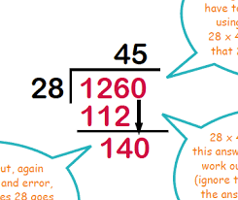
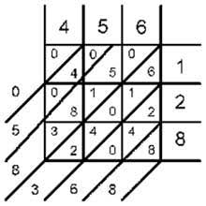

What areas of mathematics might you need to work on?

Slide 10
Mathematics Audit
Two parts:
Functional (a bit like the interview test)
Subject Knowledge and Understanding (things you need to know that are in the primary mathematics curriculum)

Slide 11
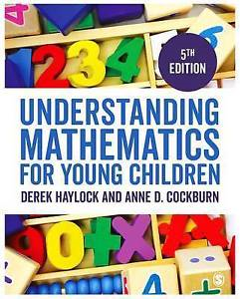
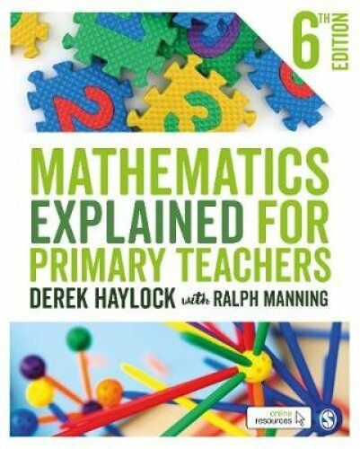
Useful books to support knowledge for teaching

Slide 12
Dysgu Cyfeiriedig – Directed Study
Darllenwch yr erthygl fer‘Making Connections’ https://studysites.uk.sagepub.com/haylock/Making%20Connections.pdf
Gwyliwch y ddwy fideo fer eto:
https://www.youtube.com/watch?v=YPWmOVt8vgw
https://www.youtube.com/watch?v=VGkjjVfnGYI
Gwnewch sylwadau ar sut mae’r athrawes yn defnyddio pob agwedd o’r model cysylltiadau (connections model) i gefnogi dealltwriaeth.
Dewch â hwn i sesiwn yr wythnos nesaf.
Read the short article ‘Making Connections’ https://studysites.uk.sagepub.com/haylock/Making%20Connections.pdf
Watch the two short videos again
https://www.youtube.com/watch?v=YPWmOVt8vgw
https://www.youtube.com/watch?v=VGkjjVfnGYI
Comment on how the teacher uses each aspect of the connections model to support understanding.
Bring this to next week’s session.

