Slide 1
Week 6
Entitlement to act and Personnel
(see Chapter 8)

Slide 2
Aims: to understand ……
Appointment of personal representatives and authority to act
Grants of representation
Who is entitled to sell a property?
Powers of attorney; and
Parties who are not clients of the firm.

Slide 3
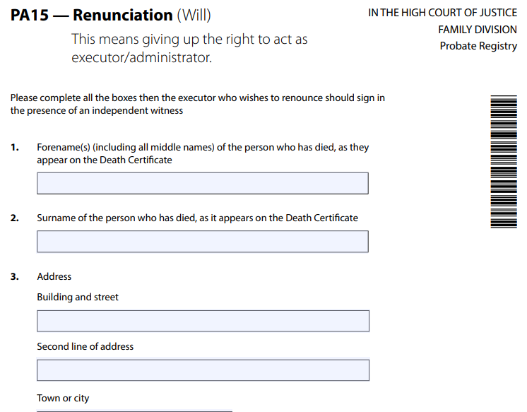
Personal representatives:
Appointment under the will - executors
Accepts office of executor by applying to Registry for grant of probate
Does not have to accept – can renounce under s 5 Administration of Estates Act 1925 ( AEA)
Can remain a Trustee – even if renounces as Executor
If renounces – cannot and should not do anything in relation to winding up of the estate ( avoid ‘intermeddling’ as can incur personal liability if they do)
PA 15 (PA15_0421_save.pdf (publishing.service.gov.uk)

Slide 4
Intermeddling … or not intermeddling?
May depend on intention
See Long and Fever v Symes and Hannam [1832] – placed ad for claims against estate but failed to apply for probate (= intermeddling)
Making funeral arrangements/humanitarian acts ( NOT intermeddling)
A non Executor who intermeddles = executor de son tort
Where more than one executor, one of them could have power reserved (reserve right to step up later on)

Slide 5
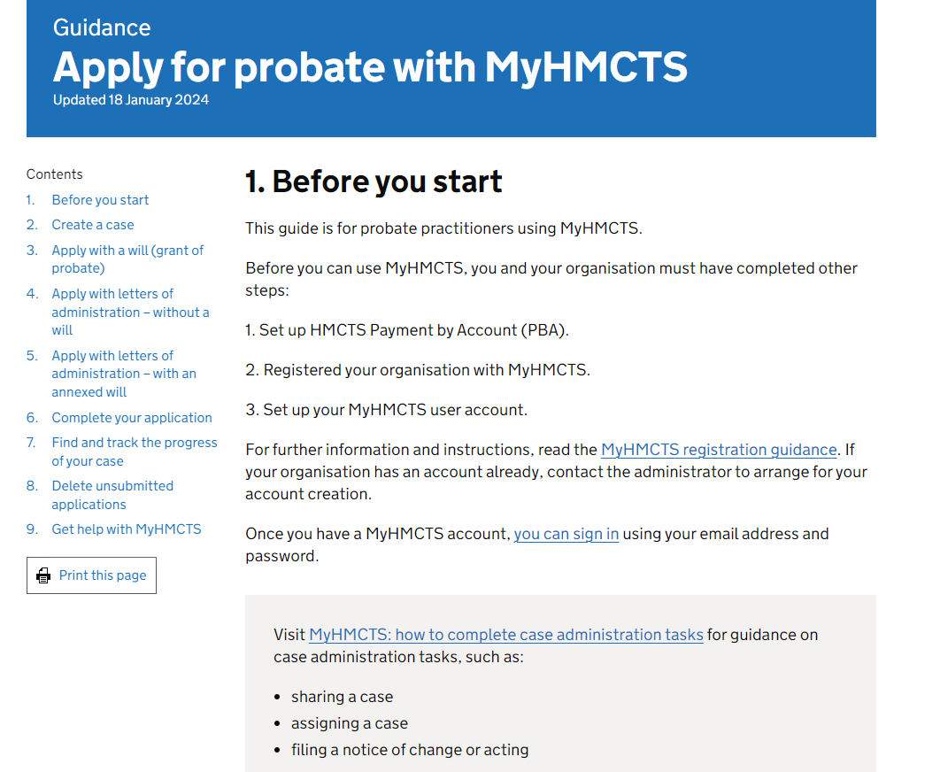
Application by legal professionals to act as Executors
Apply for probate with MyHMCTS - GOV.UK (www.gov.uk)

Slide 6
Where no will? - Intestacy
Personal representatvies = ADMINISTRATORS
Appointed by Court
Grant of letters of administration provide authority to act/administer
Persons entitled to apply = those entitled to inherit/have a beneficial interest under rules of instestacy
Strict order of priority (1. spouse, 2. children, 3. parents, 4. siblings, 5. grandparernts, 6. uncles/aunts…)
Categories are ‘cleared off’ if they can’t act or won’t act
If person has right to apply but doesn not wish to do so they can renounce
Maximum of 4 administrators, minimum of 2 if there are beneficiaries under 18 (minors)
Application made online by legal professionals

Slide 7
Administration with will annexed
i.e if there is a Will but:
Authority to act is obtained by applying for grant of letters of administration with will annexed
Person appointed = ADMINISTRATOR
Persons entitled to apply for grant of probate or grant of letters of administration with will annexed ( order or priority1. Executor named in will, 2.Trustees or residuary estate, 3. residuary beneficiary, 4. PR of a residuary beneficiary 5. other legatee or creditor of deceased, 6. PR or any other legatee or creditor of deceased)
Application for a grant of letters of administration with will annexed by legal professionals must be made online.

Slide 8
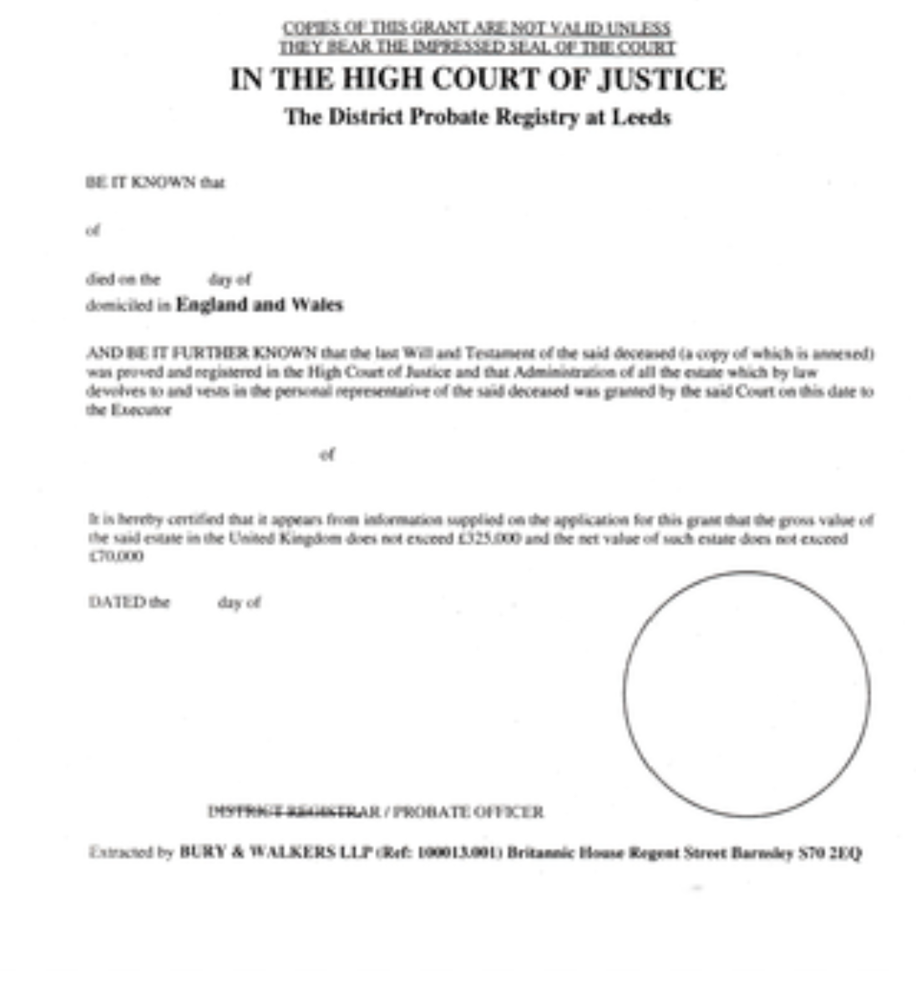
Executor’s authority to act
Derives from Will itself and arises immediately on death of testator
Grant of probate is the ‘evidence’ of the Executor’s authority to act so that this evidence can be produced to banks, companies etc.

Slide 9
Different types of grant
Grant of probate
Grant of letters of administration
Grant of letters of administration with will annexed
Other types of grant
Significant of the grant – where the main asset of an estate is property which will need to be sold, contract cannot be drafted until grant of probate obtained so that seller can be identified.

Slide 10
Note… post March 2019 digital grant of probate
Since March 2019 grants of probate will only be issued in new form
However, old grants will still be in circulation and will still be valid

Slide 11
Seller in a conveyancing transaction
– Registered Land
Conveyancer must be satisfied person instructing is the person entitled to sell the property
Registered Land – inspection of the Register
Contents of the Register:
  Property register (title plan, boundaries, freehold or leasehold and interests benefitting the land (easements/covenants)
  Proprietorship register ( who owns the land and grade/ class of title, address of registered owner – for service) – if different person named as seller further enquiries will be necessary. This is also where Restrictions will be noted e.g Form A restriction
  Charges register (notice of 3rd party rights e.g. restrictive covenants, easements)

Slide 12
Seller in a conveyancing transaction – Unregistered Land
Title is proved by Deeds ( either held by owner or mortgagee)
Must deduce title/show good title going back 15 years
See example in section 8.3.2 of your manual
Chain should be unbroken
Unregistered land will be registered when a ‘triggering’ event happens:
  Conveyance of freehold or leasehold with > 7 years to run ( purchase or transfer or by assent, or by gift)
  Grant of a new lease for >7 years
  Grant of a future lease ( >3 months in the future) irrespective of length of lease
  Grant of a first legal mortgage

Slide 13
First registration of unregistered land
Application to be made within 2 months of date of sale/transfer etc
Application must be accompanied by all title deeds

Slide 14
Co -owners
Instructions must be obtained from all co-owners to sell a property – to ensure all are happy to sell and for the agreed price
Once this is done, then one co-owner may take the lead and be the main point of contact if all others are amenable to this
At any point, the situation might change and create a risk of conflict of interest and conveyancer needs to be alert to this
Can be an issue on property sale as part of separation/divorce. If a conflict arises, conveyancer should cease to act for both

Slide 15
Surviving co-owners
Proprietorship Register will indicate who owns legal estate – if 2 or more names then there is co-ownership of some kind
Is there a Form A restriction? What would this indicate?
If sole surviving co-owner then death of the other needs to be confirmed by provision of death certificate
Application to HMLR on form DJP (death of joint proprietor) + death certificate to remove name of deceased.
If property was held as JT then no further steps necessary
If property was held as TiC then deceased’s share may be going elsewhere than the survivor
To ‘overreach’ buyer needs to pay purchase monies to 2 trustees so an additional trustee may need to be appointed ( this can be done in the transfer document – don’t need to register the 2nd trustee with HMLR)

Slide 16
Attorneys
An ‘attorney’ is appointed to ‘step into the shoes’ of an individual ( the donor) and make decisions and act on their behalf
Enduring Power of Attorney pre October 2007 – simple process and could be used when donor still had mental capacity.
Since 1 October 2007, no more EPA and replaced by Lasting Powers of Attorney ( LPA)
  A health and welfare LPA; and/or
  A property and financial affairs LPA
Other forms of power of attorney exist but are not studied here
Conveyancer acting for attorney will need proof that appointment is valid and will keep a certified copy of the original document
Buyer’s conveyancer will also want proof of attorney’s power to act
Note of caution: on registration HMLR needs proof that identities of both Seller and Seller’s attorney have been checked and verified and so Buyer’s conveyancer should also obtain proof/confirmation/undertaking that this as been done.

Slide 17
Parties who are not ‘clients’ of the firm
Beneficiary of an estate: firm may be instructed by the PR of the deceased but beneficiaries will want information. Duty of confidentiality is to the PR who may permit beneficiaries to be informed periodically of progress. Care to be taken when PR is also beneficiary.
Non-owning occupier on a sale: to avoid conflict no advice to should be given to this person when acting for the owner who is selling e.g. when obtaining confirmation of vacant possession
Parents or family members gifting a deposit on a purchase: this is acceptable but conveyancer needs to be satisfied where all the money is coming from – as will the lender. Again, no advice should be given to the gifting parent due to risk of conflict of interest
The lenders: where a mortgage is part of the transaction, the conveyancer is also acting for the lender. Must be alert to any possibility of conflict of interest
Family members, elderly and vulnerable clients: must ensure any client has sufficient mental capacity and is not acting under pressure or undue influence ( see content on Mental Capacity in the lecture for Week 3.
Also note the following guidance: 12-Recognising-and-Responding-to-Consumer-Vulnerability.pdf (cilexregulation.org.uk)

Slide 18
3rd parties asking for information
Clients on the other side – who can’t get hold of their own solicitor
Mortgage brokers
Estate Agents
Anyone else who might have an interest in how the conveyance is progressing
Care needs to be taken with all of the above to ensure that the duty of confidentiality to the client is maintained.

Slide 19
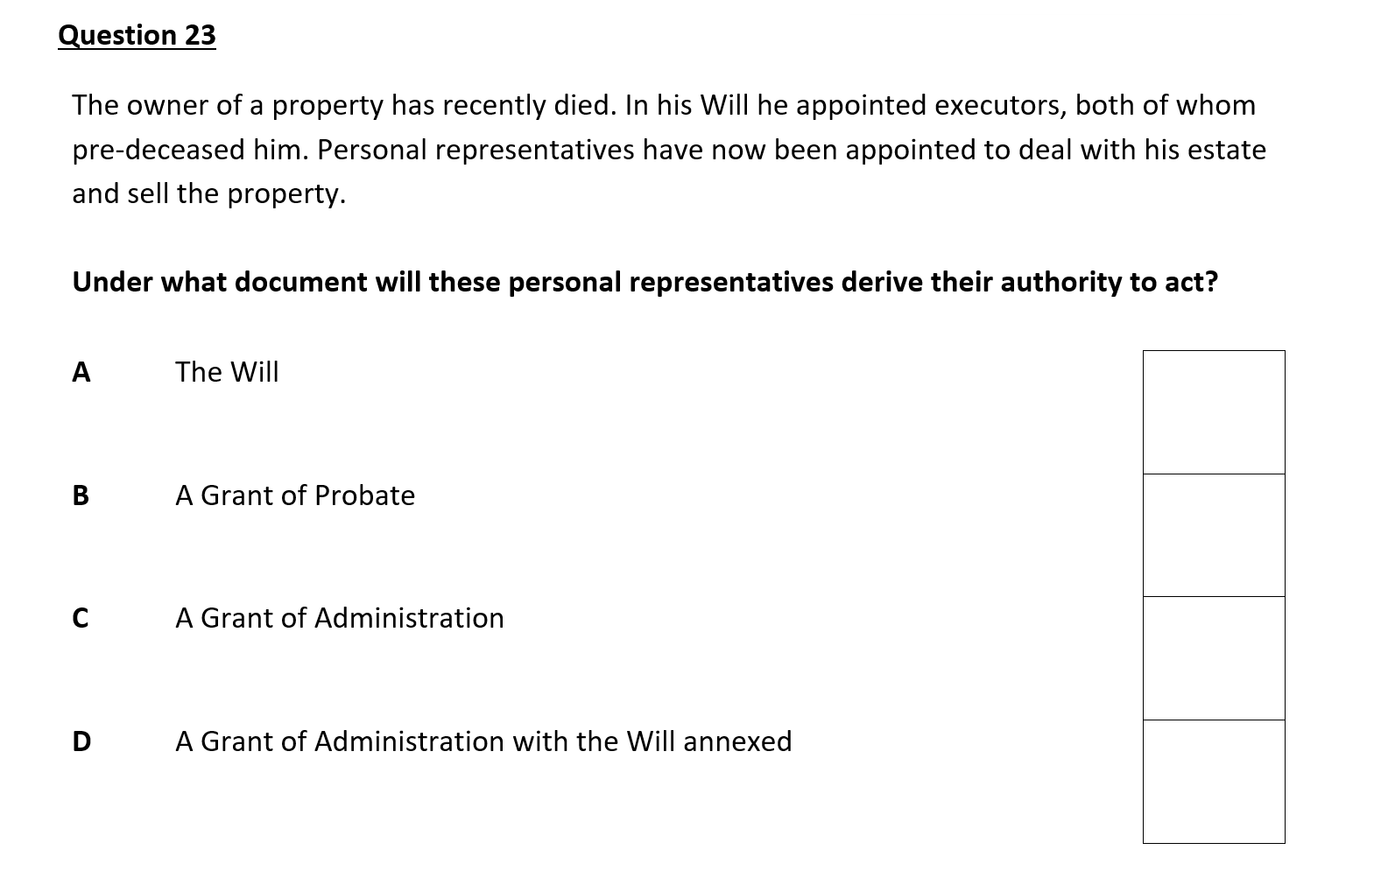

Slide 20


