Slide 1


Green Haven Florists Case Study
Student Name: Hafeezur Rehman
Student ID: 2435516
Module Code: LCLM 4004
Module Name: Problem Solving and Decision-Making
Component 1: Green Haven Florists

Slide 2

Presentation Overview
  I will introduce Green Haven Florists and its challenges.
  I will explain the nature and scope of the problem using the 5W2H method.
  I will examine external factors through a PESTEL analysis.
  I will identify the root causes using a Cause-and-Effect analysis.
  Finally, I will summarize the key findings and implications.

Slide 3

Background of Green Haven Florists
  Founded in 2016 in Norwich by Liam and Priya Patel, Green Haven Florists is known for eco-friendly floral arrangements.
  The business gained popularity for sustainable packaging and community engagement.
  Recently, it has faced a 30% decline in sales, rising costs, and growing competition from online florist.

Slide 4

Insight into the Problems
  The main problem is a decline in revenue and customer footfall.
  Internal issues include limited digital marketing and an outdated website.
  External issues include increased competition, inflation, and supply chain disruptions (KPMG, 2023).
  Factors within control: marketing, online platform, customer engagement.
  Factors beyond control: market inflation, competition intensity.

Slide 5
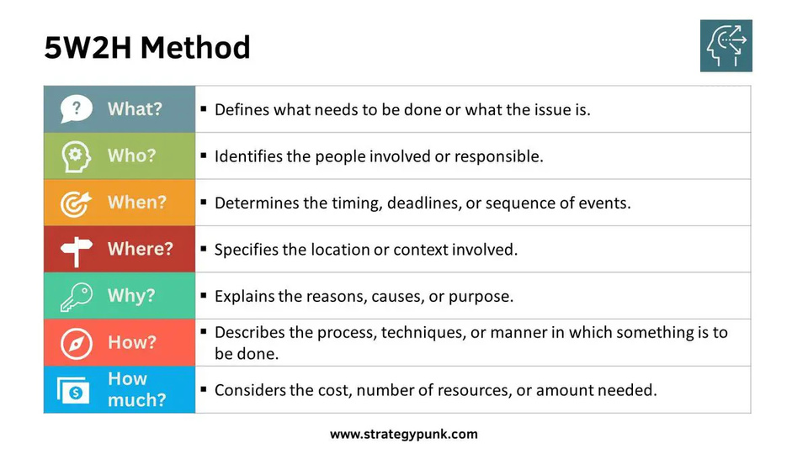
5W2H Model
  The 5W2H model identifies key questions: Who, What, Where, When, Why, How, and How Much (Ohno, 1988).
  It helps structure problem-solving and supports decision-making (Mehedihas, 2023).
  Applied to Green Haven Florists:
  Who: Liam and Priya Patel (owners).
  What: Decline in revenue and customers.
  Where: Norwich high street shop.
  When: Over the last 12 months.
  Why: Online competition and rising costs.
  How: Limited digital adaptation.
  How Much: 30% decline in sales.
5W2H (StrategyPunk, 2023)

Slide 6
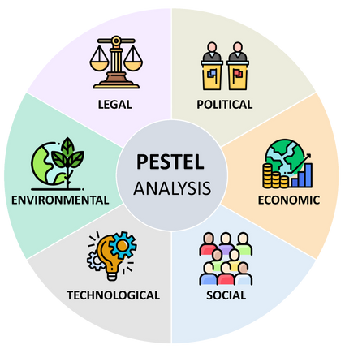
PESTEL Analysis
  PESTEL analyses external macro-environmental factors: Political, Economic, Social, Technological, Environmental, and Legal (Johnson et al., 2017).
  Benefits: Provides strategic insights into external forces and helps in planning (Yüksel, 2012).
  Limitations: Lacks focus on internal capabilities and may oversimplify dynamic changes.
  Useful for identifying opportunities and threats for Green Haven’s survival strategy.
PESTEL Analysis (Segura et al., 2023)

Slide 7


Application of PESTEL
  Political: Import regulations affect flower sourcing, especially after Brexit (Gov.UK, 2024).
  Economic: Inflation and supply chain issues raise costs and make small businesses less competitive (KPMG, 2023).
  Social: Rising consumer interest in sustainability and willingness to pay more (McKinsey, 2023).
  Technological: Shift to e-commerce and digital marketing for small businesses.
  Environmental: Demand for eco-friendly packaging and increasing environmental regulations. (McKinsey, 2023).
  Legal: Compliance with environmental and trading regulations.

Slide 8
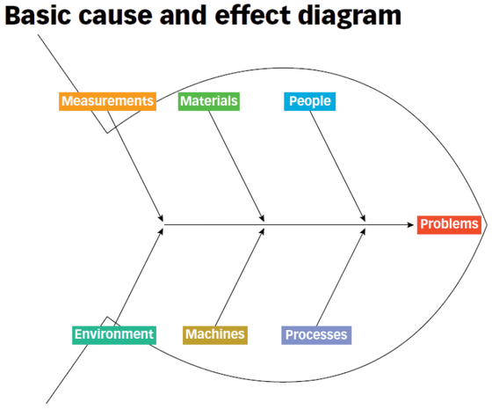
Cause-and-Effect
  The Cause-and-Effect (Ishikawa) diagram identifies root causes of complex problems (Ishikawa, 1986).
  Strengths: Encourages teamwork, visualises problem relationships, and improves understanding (Antony, 2014).
  Limitations: Subjective interpretations and limited quantitative depth.
  Effective in exploring operational and managerial weaknesses in Green Haven Florists.
Fishbourne Diagram (ASQ, 2024)

Slide 9

Application of Cause-and-Effect
  Root causes identified:
  People: Limited digital skills of owners.
  Process: Outdated website and lack of online promotions.
  Materials: High cost of sustainable supplies.
  Environment: Reduced foot traffic in the area.
  Technology: Insufficient use of digital tools.
  These interlinked causes explain declining sales and brand reach.

Slide 10

Key Findings
  Declining sales mainly result from limited digital adaptation and increased online competition.
  Rising costs of sustainable materials are affecting profitability.
  A stronger digital strategy and process innovation are vital for business sustainability.
  Adopting technology-driven marketing could rebuild Green Haven’s market position.

Slide 11
Reference List
  Antony, J. (2014). Readiness factors for the Lean Six Sigma journey in the higher education sector. International Journal of Productivity and Performance Management, 63(2), pp.257–264. doi:https://doi.org/10.1108/ijppm-04-2013-0077.
  ASQ (2024). What is a Fishbone Diagram? Ishikawa Cause & Effect Diagram | ASQ. [online] Asq.org. Available at: https://asq.org/quality-resources/fishbone?srsltid=AfmBOoqNbsh2M9ay5iAfdcvV0ia5KjONMsSrPAi1xBSynq93eVeZurIB [Accessed 11 Oct. 2025].
  Gov.uk (2024). Import plants and plant products from non-EU countries to Great Britain. [online] GOV.UK. Available at: https://www.gov.uk/guidance/import-plants-and-plant-products-from-non-eu-countries-to-great-britain.
  Ishikawa, K. (1986). Guide to quality control. [online] Asian Productivity Organization. Available at: https://books.google.com.pk/books?id=POEeAQAAIAAJ.
  KMPG (2023). Christmas trading review and retail outlook for 2023. [online] KPMG. Available at: https://kpmg.com/uk/en/insights/strategy/christmas-trading-review.html [Accessed 11 Oct. 2025].
  McKinsey & Company. (2023). Consumers care about sustainability—and back it up with their wallets. [online] Available at: https://www.mckinsey.com/industries/consumer-packaged-goods/our-insights/consumers-care-about-sustainability-and-back-it-up-with-their-wallets?stcr=DCA7D436BA08453A869FE9EAF41801C4&cid=other-eml-mtg-mip-mck&hlkid=6b34510231df47e2af72413d4adb72f7&hctky=1926&hdpid=fe84a887-4bce-42cd-b36c-baab8dd55163.
  Mehedihas (2023). Case Study Concept Using 5W2H Problem Solving Technique. [online] Medium. Available at: https://mehedihas.medium.com/case-study-concept-using-5w2h-problem-solving-technique-222cfff1ca50 [Accessed 11 Oct. 2025].
  Ohno, T. (1988). Toyota Production System. [online] Productivity Press. doi:https://doi.org/10.4324/9780429273018.
  Segura, E., Belmonte, L., Morales, R. and Somolinos, J. (2023a). A Strategic Analysis of Photovoltaic Energy Projects: The Case Study of Spain. Sustainability, 15, p.12316. doi:https://doi.org/10.3390/su151612316.
  Segura, E., Belmonte, L., Morales, R. and Somolinos, J. (2023b). A Strategic Analysis of Photovoltaic Energy Projects: The Case Study of Spain. Sustainability, 15, p.12316. doi:https://doi.org/10.3390/su151612316.
  StrategyPunk (2023). The 5W2H Method: A Simple Framework for Asking the Right Questions (Free PPT). [online] StrategyPunk. Available at: https://www.strategypunk.com/the-5w2h-method-a-simple-framework-for-asking-the-right-questions-free-ppt/.
  Yüksel, İ. (2012). Developing a MultiCriteria Decision Making Model for PESTEL Analysis. International Journal of Business and Management, 7, pp.52–52. doi:https://doi.org/10.5539/ijbm.v7n24p52.

Slide 12

Thank You
  Thank you for listening.
  Questions are welcome.

