Slide 1
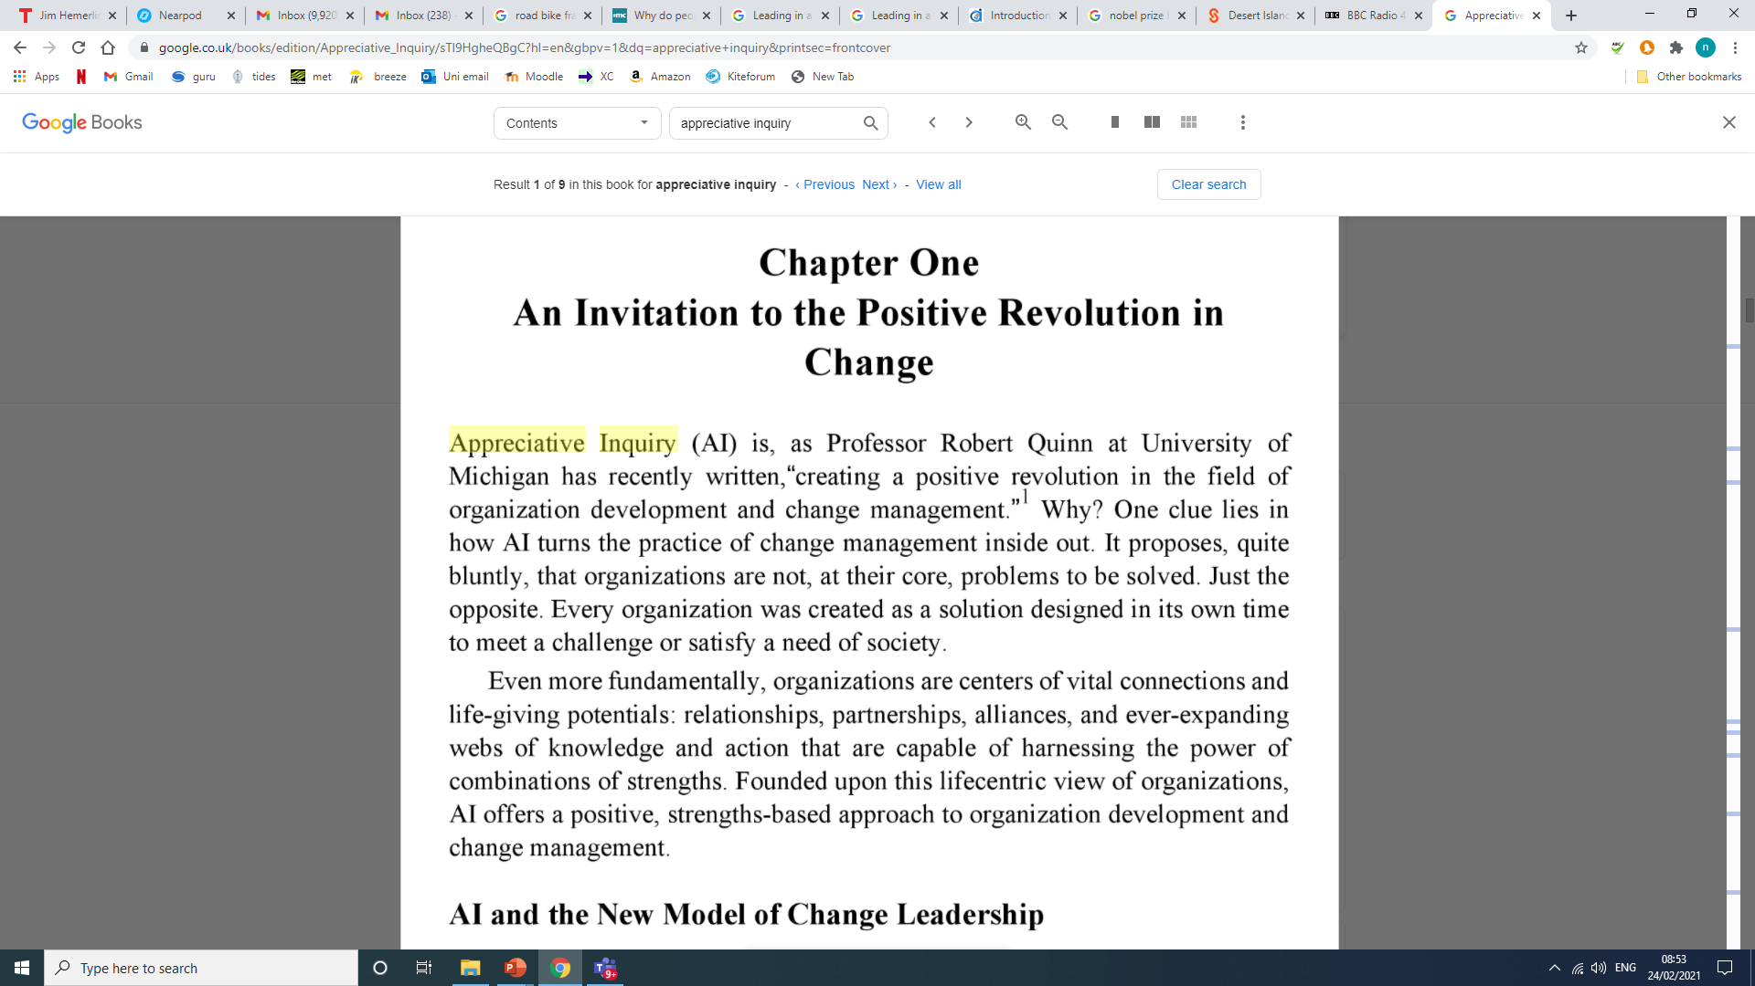
Appreciative inquiry
Cooperider & Whiteney 2015 pg 6

Slide 2
Types of change
1 – Incremental change, this is continuous and is building on what is currently being done. This is the least disruptive and can be driven by service users, staff at all levels or policy change. This change often happens ‘on the fly’ and isn’t pre-meditated.
2 – Step change, this is a more significant change and requires a leap from one place to another. This might take the form of redesigning a system and way of working, or organisational structure, in order to make savings and/or deliver better results. This will be strategic and planned process.
3 – Transformational change, this is about transforming services, this process involves challenging established norms and pushing organisation right out of their comfort zone. It requires a very thorough process of challenge and creative thinking to ascertain the changes to come, and then an exceptionally well implemented and delivered process of change, measure, challenge, evaluate.

Slide 3
“in a crisis . . . we call for someone with answers, decision, strength, and a map of the future, someone who knows where we ought to be going—in short someone who can make hard problems simple. . . . Instead of looking for saviours, we should be calling for leadership that will challenge us to face problems for which there are no simple, painless solutions—problems that require us to learn new ways” (Fullen p21 2001)

Slide 4
Process – culture, culture, culture!
Reassure – psychological safety
Educate
Inspire – look for positives
Plan
Challenge & manage expectations?
And repeat above!

Slide 5
https://www.cypnow.co.uk/other/article/change-management-seven-steps-to-change

Slide 6
7 Steps to managing change
1. Highlight the benefits
"There's always resistance to change so you need to point out the benefits, and show staff how it's going to enhance their work," says Rachel Shaw, head of child and adolescent nursing at Conway and Denbighshire NHS Trust.

Slide 7
2. Create a shared vision
Keeping staff on your side can be tough if the process of change does not meet their expectations. This is why it is essential to create a shared vision through close consultation with colleagues, believes Jackie O'Brien, family therapist with Newham's central early start team.
This central team, which was created 18 months ago, offers strategic support to staff working in the borough's eight Early Start programmes (formerly Sure Start). "Staff were keen on our roles and valued them - but it was important for us to be clear about what we could realistically offer," admits O'Brien. "So we had to continually clarify the roles' boundaries."
For O'Brien, it is vital to keep connected with colleagues, to hear what they want and to make them feel listened to. "You can't always implement what people want," she adds, "but you can create a sense of shared responsibilities and accountability where people feel part of a bigger picture."

Slide 8
3. Keep it practical
In the process of change it can be the small details that upset the apple cart. As a result, focusing on practical issues and looking for common-sense solutions can be the key to keeping everyone on board.
"It's about having transparency and creativity, so the workforce sits down as a team and looks at ways of improving the system," advises Carl Whalley, service manager for the RU-OK? team in Brighton.

Slide 9
4. Break into bite-sized pieces
"We're trying to see it as work in progress and break it into bite-sized pieces," explains Pat Clewer, children's services development manager for Devon, who is co-ordinating the development of the county's children's trust.
Clewer feels that it is better to tackle change in stages so that there are no overriding goals but interim arrangements. In this way, staff can pilot new ways of working, then evaluate and build on these for the next stage. "People think that change has to be structural but that needn't be the case," says Clewer.
"Change is best driven by staff looking at the outcomes they want to achieve for children, and then making suggestions about how to get there.

Slide 10
5. Include patients and service users ideas
How can you be sure change really meets children's needs? In East Riding, Yorkshire, consultation with young people has been core in setting up a central enquiry line, to be provided by the Children's Trust. Launching this month, the line will be a referral point for any child parent or professional wanting information or access to relevant services.
Richard Vickers, manager for the trust, explains how staff have been holding workshops at Children's Fund consultation days. "The children wanted it friendly and not too formal, and explanations of issues such as why staff might consult with another colleague about their enquiry. The information they gave us was very basic, but important," he continues. "So we videoed it, and we're using it for staff training."

Slide 11
6. Prioritise communication
According to Isobel MacDougall, integrated children's services manager in South Lanarkshire, good communication is key to bringing about positive changes in children's services. Scotland has its own agendas around integrating children's services, and South Lanarkshire has pioneered work in this area.
"Communication and interpersonal skills are key to the work of our team," says MacDougall, "and having a multi-disciplinary perspective so you can bring together a holistic approach."
MacDougall understands change can frighten people, so she advises managers: "Reassure staff that you recognise they have skills and experience, and give them opportunities to be consulted to express concerns and opinions."

Slide 12
Fullan, Michael. 2001. Leading in a Culture of Change. San Francisco: Jonsey Bass
By Vivien Martin. 2003. Leading Change in Health and Social Care. Routledge
Children and Young People Now, 2004, 7 steps to manage change: https://www.cypnow.co.uk/other/article/change-management-seven-steps-to-change (Accessed 22/2/21)
Cooperider and Whitney 2005, Appreciative Inquiry, Sanfrancisco, BK

