Slide 1
Leadership Module 2
Leadership in Planning and Motivation
Day 1

Slide 2
Welcome/Croeso
Module Aim
To enable learners to plan and prioritise in the workplace, in order to promote efficiency and to engage, motivate and develop the team.
Aim of today: To examine the various motivational approaches and theoretical perspectives relevant to leading teams effectively.

Slide 3
Topics/themes
Intrinsic and extrinsic motivation
Motivational theories: Content and Process
Relationship of leadership studies to motivational theories and models

Slide 4
Motivation

Slide 5

What is motivation?

Slide 6

Motivation defined
  Motivation—the forces within the individual that account for the level, direction, and persistence of effort expended at work.

Slide 7
Definitions of motivation
“Motivation is the creation of working environments and incentives that enable people to perform to the best of their ability. The aim of motivation is to engage people with the work they are doing, in order to achieve the best possible outcomes for individuals and the organisation as a whole.”
CMI (2015)

Slide 9

Motivation and rewards
  Reward—a work outcome of positive value to the individual
  Extrinsic rewards—valued outcomes given to someone by another person.
  Intrinsic rewards—valued outcomes that occur naturally as a person works on a task.
Notes:
EXTRINSIC REWARDS Extrinsic Rewards -- Something given as a recognition of good work. Kinds of Extrinsic Rewards:  Pay Raises  Promotions  Awards
INTRINSIC REWARDS Intrinsic Rewards -- Personal satisfaction you feel when you perform well and complete goals. Examples of Intrinsic Rewards: The Value of Motivation  Pride in your performance

Slide 10
Types of motivation theories
  Content theories
    How people with different needs may respond to different work situations.
  Process theories
    How people give meaning to rewards and make decisions on various work-related behaviours.

Slide 11

Content theories of motivation
The emphasis placed upon what motivates individuals:
Maslow
Alderfer
Herzberg
McClelland

Slide 12
Process theories of motivation
Process theories of motivation:
How and why people make choices to work hard/or not
  Choices are based on:
    Individual preferences, available rewards and possible work outcomes
Types of process theories:
  Adams’ Equity theory
  Vroom’s Expectancy theory
  Locke’s Goal-setting theory

Slide 13
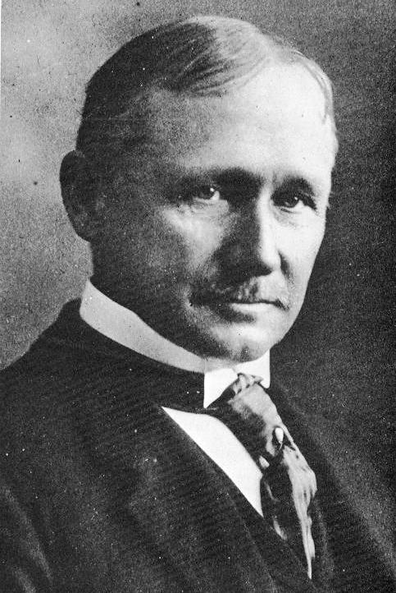
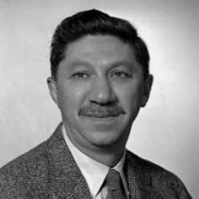
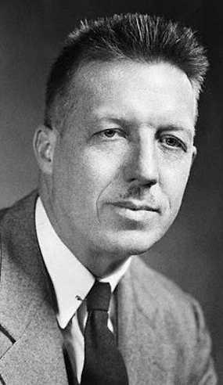
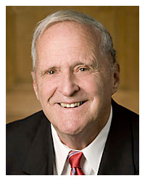

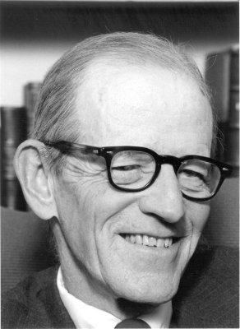
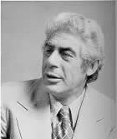
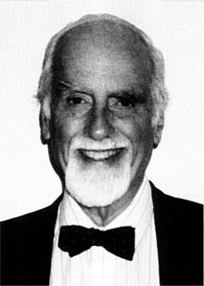
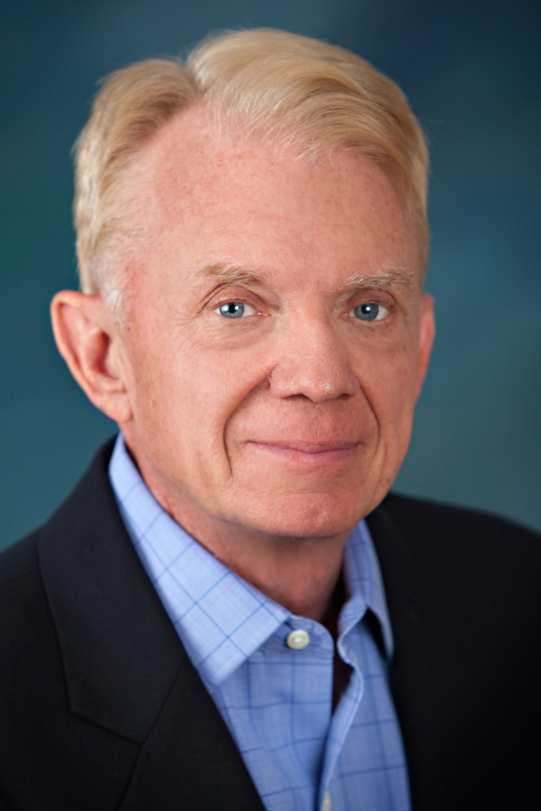
Timeline of Motivation Theorists
Taylor
Maslow
McGregor
Vroom
1911
1943
1960
1964
1932
1959
1961
1968
Mayo
Herzberg
McClelland
Locke

Slide 14
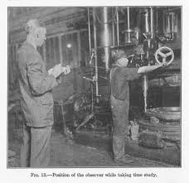
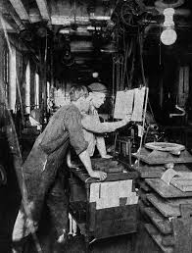
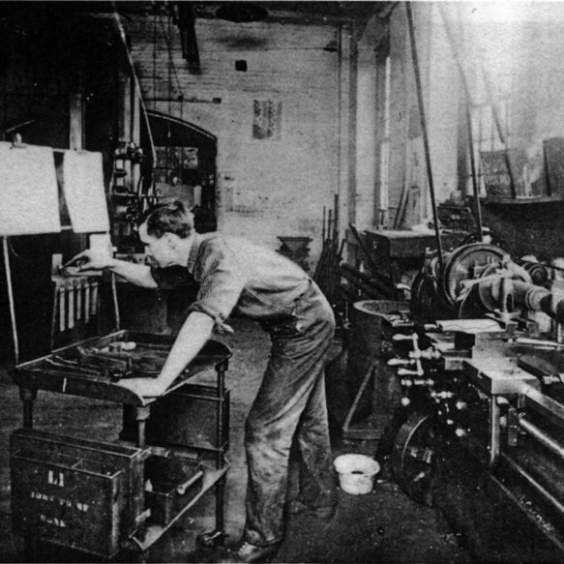
Scientific Management
Time and motion studies
Written tasks and methods
Job analysis

Slide 15
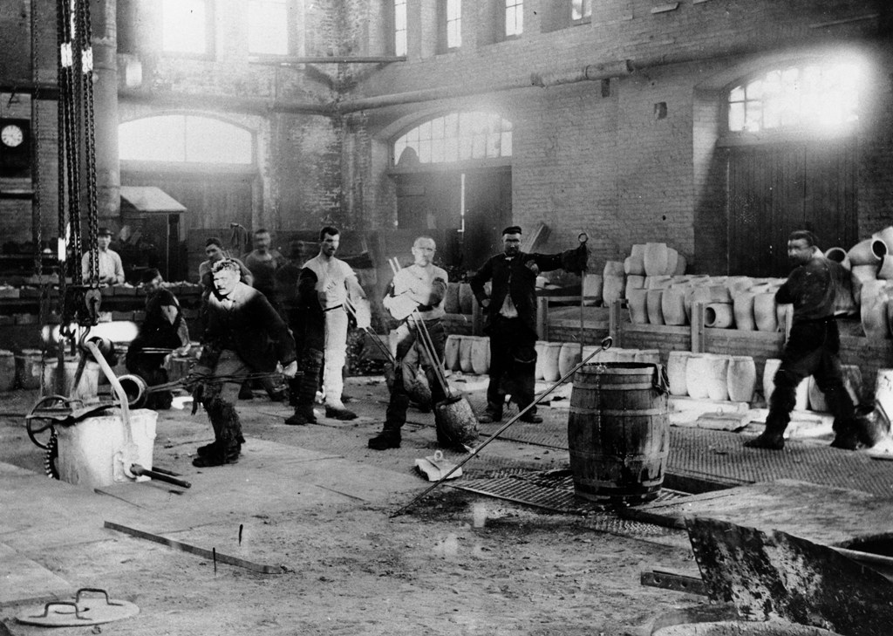
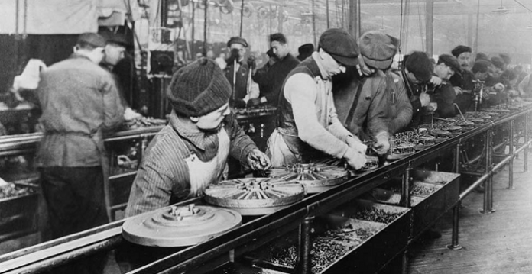
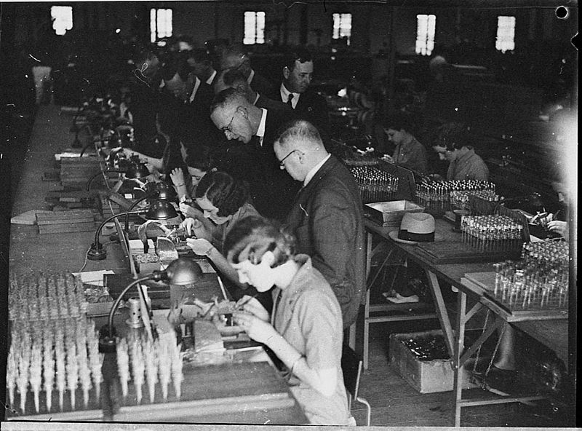
Scientific Management
Individualisation of work
Motivation through ‘high wages’
The ‘one best way’

Slide 16
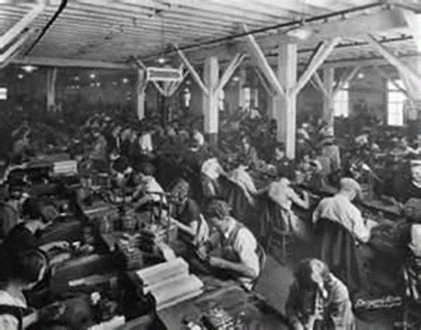
Leadership and management in context:
Human Relations approach
A focus on the needs of the workers
1920s-1930s
Notes:
Frederick Taylor´s Scientific management theory's research showed people worked purely for money. In the car assembly industry, work on a production line was based on high productivity and was repetitive. Workers were paid 'piece rate', that is, paid for every item produced. This approach of paying workers by results would be good for the business. The outcome would be greater production but gave little opportunity, encouragement or time for employees to think for themselves or be creative in what they did. This limited people's development and their use within the company.
"One of the dangers to be guarded against, when the pay of the man or woman is made in any way to depend on the quantity of the work done, is that in the effort to increase the quantity the quality is apt to deteriorate."(Taylor, 1911)
This concludes that if only pay is manipulated by workers receiving more money for higher productivity the quality of the service or product will decrease.
Frederick Taylor (1856-1915)

Slide 17
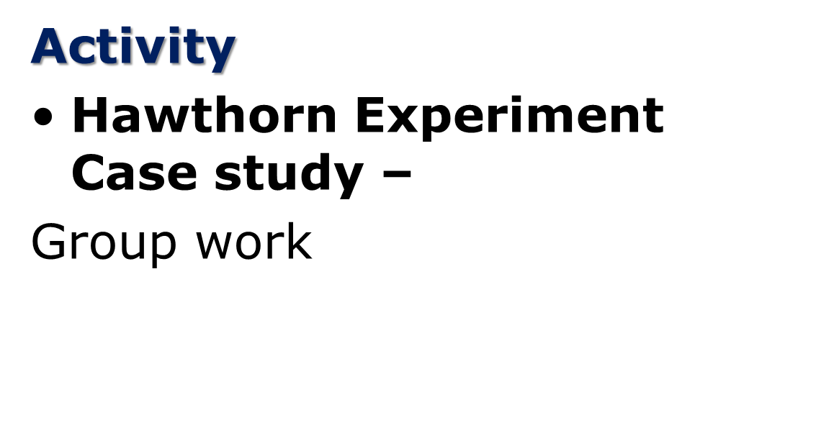

Human Relations approach

Slide 18
Human Resources approach
  Popular in the late 1950s through the 1960s
  Based on the work of Douglas McGregor (The Human Side of Enterprise, 1960), Rensis Likert (New Patterns of Management, 1961), and Chris Argyris (Personality and Organization, 1957)

Slide 19

Human Resources approach:
Douglas McGregor
  McGregor proposed that managers come in two types:
  Theory X managers who believe that workers are generally lazy and must be forced to be productive
  The Theory Y manager believes that staff want to better themselves, to develop new skills and gain knowledge.
  This, of course, was the example of the ‘one best way’ to lead

Slide 20
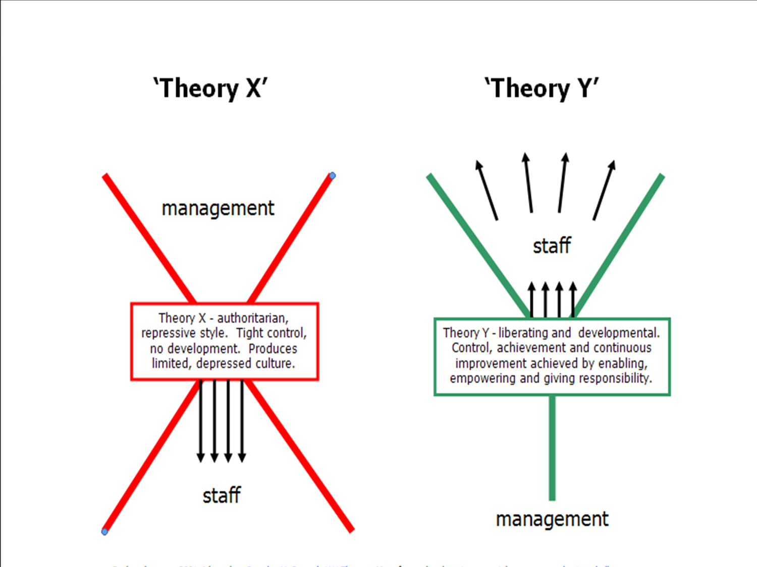
McGregor’s Theory X Theory Y (1960)

Slide 21
Comparison between Human Relations and Human Resources approach
  Human relations approach
  - Improve the worker-manager relationship. This will lead to a satisfied worker.
  - A satisfied worker will be a more productive worker.
  Human resources approach
    - When managers treat their workers as valuable resources and help them improve their skills and knowledge, this helps the worker perform better. This in turn increases worker job satisfaction.

Slide 22
Motivation and its role in supporting individuals
‘You don’t motivate individuals. You provide them with an environment to be self-motivated. It is a personal decision, but it’s managements job to provide the right environment’
Source: Kathy Scholfield, Director of Human Resources, HCF Bank, US

Slide 23
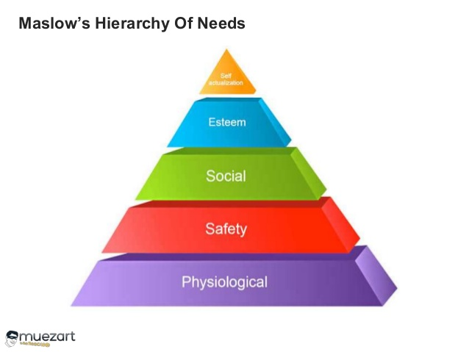
Maslow’s Hierarchy of Needs

Slide 24
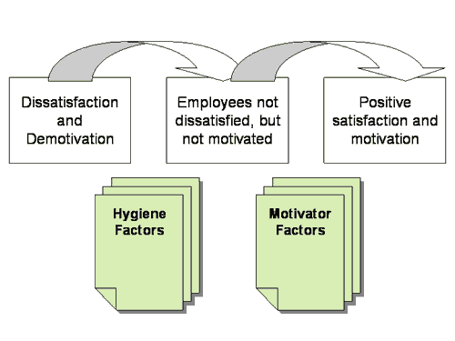
Herzberg’s 2 Factor Theory

Slide 25
Herzberg’s 2 Factor Theory
Hygiene Factors
Job Security
Working Conditions
Salary
Relationships with colleagues
Company Policy and Administration
Level and Quality of Supervision
Notes:
Sirota's Three-Factor Theory - The three factors, which together build enthusiasm, are as follows:
Equity/Fairness – People want to be treated fairly at work.
Achievement – People want to do important, useful work, and be recognized for this.
Camaraderie – People want to enjoy good relationships with their co-workers.
The equity factor is very similar to the hygiene factors described by Frederick Herzberg in his Motivation-Hygiene Theory

Slide 26
Herzberg’s 2 Factor Theory
Motivators
Sense of achievement
Recognition
Responsibility
Nature of the work
Personal growth and advancement
Notes:
Frederick Herzberg (1923-2000)
Frederick Herzber's Motivation-Hygiene theory was created to modify Abraham Maslow's Hierarchy of Needs theory. Herzberg decided that there were certain things that were satisfying and unsatisfying, Herzberg's research was based on the question "What do people want from their jobs?".
"The factors that lead to positive job attitudes do so beacause they satisfy the individuals need for self-actualization in his work ."(Herzberg, 1959)
They 5 strong determent's of
job Satisfaction were:
•achievement
•recognition
•work itself
•responsibility
•advancement
This showed that the satisfiers/motivators are centralized around the employees relationship with their job and the dissatisfiers/de-motivators happen to be the environment or what the job involves.

Slide 27
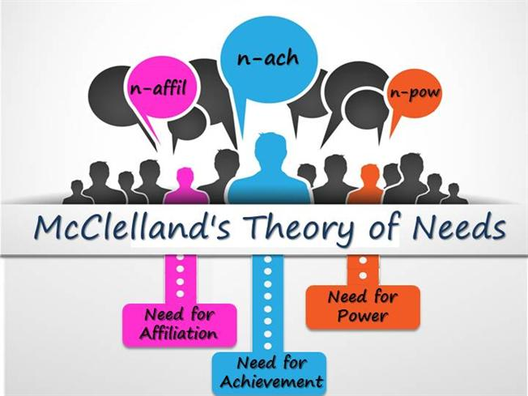
McClelland
Notes:
David McClelland's theory of needs was built up showing that there are three types of motivating needs, the need for Power, Affiliation and Achievement.(McClelland, 1961)
Workers who have a need for "power" can be motivated to perform if they are given key positions or power positions. Workers who have a need for "affiliation" are motivated by social recognition as they like to have a good social group in the workplace. Finally workers who have a need for Achievement are motivated by the concept of success but also by the fear of failure.

Slide 28
McClelland

Slide 29
Vroom’s Expectancy Theory
Vroom’s Expectancy Theory: He believes that people can be motivated if they believe that:
There is a positive correlation between efforts and performance
Favourable performance WILL result in a desirable reward
The reward will satisfy an important need
The desire to satisfy the need is strong enough to make the effort worthwhile.
Notes:
Victor Vroom
(1932-Present)
Victor Vroom's Expectancy theory showed that the sum of "valency x expectancy is motivation".(Vroom, 1964)
To explain this in simple terms expectancy theory says that an employee can be motivated to perform better when their is a belief that the better performance will lead to good performance appraisal and that this shall result into realization of personal goal in form of some reward. This leads us to the realisation that motivation causes an action which causes results which means there will be satisfaction in form of a reward.

Slide 30
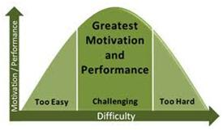
Locke’s Goal Setting Theory
Notes:
“The basic premise being that people’s goals play an important part in determining behaviour. Locke accepts the importance of perceived value, as indicated in expectancy theories…these values give rise to the experience of emotions and desire. People strive to achieve goals in order to satisfy their emotions and desires. Goals direct work behaviour and performance…Locke subsequently pointed out that ‘goal-setting is more appropriately viewed as a motivational technique rather than a formal theory of motivation’.” Mullins: 277 (9th edition 2010)
Edwin Locke was the main advocate of Goal –setting theory and has established 4 propositions which are well-supported by research:
Challenging goals - lead to higher levels of performance. Also called ‘stretch’ goals because they encourage us to try harder,
Specific goals – lead to higher levels of performance than vague goals. Easier to adjust our behaviour when we know precisely what is required of us. Should be SMART.
Participation in goal setting. Increases commitment to these goals.
Knowledge of results of past performance. FEEDBACK. Necessary for effective goal achievement.
This theory has mainly been tested in situations where short-term goals exist.

Slide 31



Motivation and performance
Motivation is individual
Motivation is intentional
Motivation is multifaceted
Motivation influences behaviour
Result in
Driving force
(behaviour or action)
To achieve
Needs
or expectations
Desired goals
Feedback
Fulfilment
Which provide

Slide 32
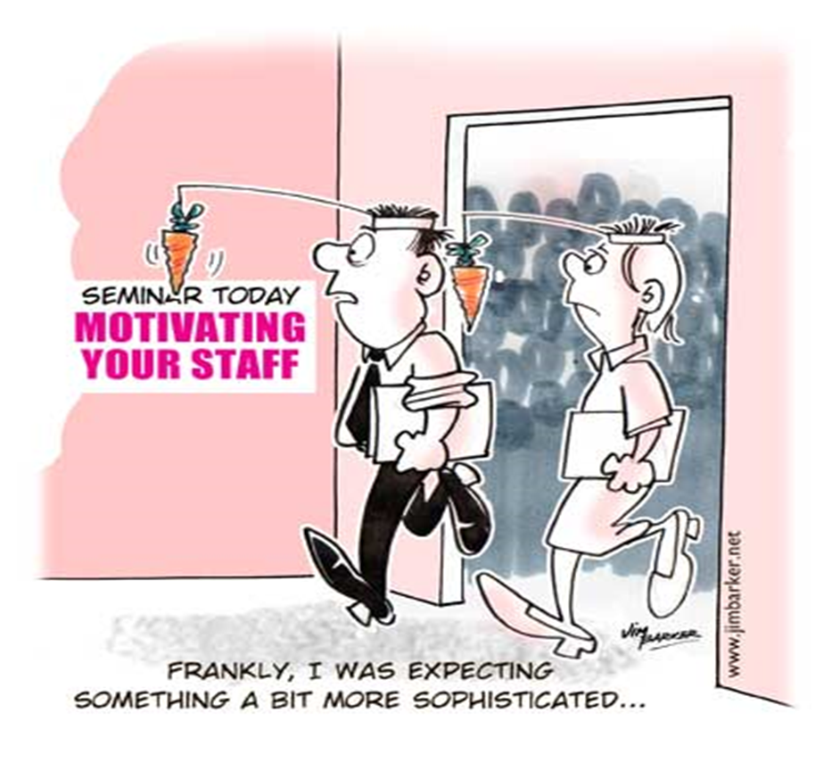

Slide 33

What are the common causes of demotivation?

Slide 34
What happens when motivation is blocked?

Slide 35
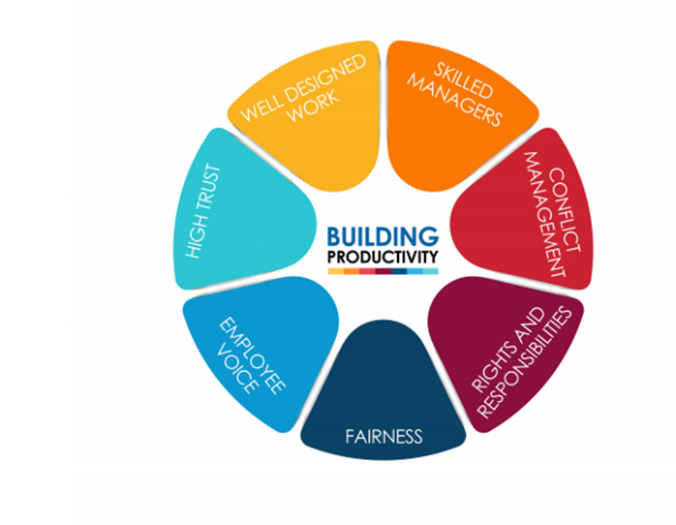
ACAS – Building productivity in the workplace

Slide 36
References
Chartered Management Institute, 2015. /Motivating the Demotivated. [Online]
Available at: http://mde.managers.org.uk/members/content.aspx?id=1126622
[Accessed 6th April 2016].

