Slide 1

Welcome
Business plan on Maxtin DJ
Student name:Nedelin Mihalev
ID:2029603
Module: Entrepreneurship
Lecturer:Vasilios Tavlaridis

Slide 2
Table of Content
Introduction
Overview of the business idea
Ownership of the business
Legal format and management of the firm
SWOT analysis
4Ps of the marketing mix
The target market
The marketing strategies
Conclusion
References list

Slide 3
Introduction
This is an entrepreneur's strategy to establish a new firm and endeavour. To create another business, one must first define its goals and strategies. Field-tested approaches in nuances balance costs. Top-level management and the CEO may use strategy to think carefully about the organisation, debate its objectives, develop a strong foundation, and streamline the planning process.

Slide 4
Overview of the business idea
Strategy is to create an effective business system, attract investors and pioneers, and forecast future financial demands.
Marketing should drive long-term company success. DJ shop planned for London's north roundabout street.
Maxtin DJ accepts and ships orders through its website. They sell a range of DJ equipment and accessories.
Notes:
If a firm wants to be taken seriously, it requires a good marketing strategy that explains its objectives and techniques, how it aims to accomplish them, and when (Mckeever,2018). A field-tested technique helps determine its likely layout. This section describes firms' target consumers, goods, and value. Strategy is to create an effective business system, attract investors and pioneers, and forecast future financial demands (Mckeever,2018). Marketing should drive long-term company success. DJ shop planned for London's north roundabout street.Company name: Maxtin DJ. It accepts and ships orders through its website. They sell a range of DJ equipment and accessories. Maxtin's cutting-edge goods provide enjoyment, entertainment, and intuitiveness. Maxtin's recorded goods include Digital DJ regulators, Digital vinyl framework (DVS), DJ sound points of interaction, DJ earphones, DJ Mixers, DJ bundles/groups, DJ speakers, Dynamic amplifier, Performance regulators, and Pioneer DJ bundles.

Slide 5
Ownership of the business
First, choose the business's legal structure.
Sole proprietorship is the best company form for a startup. This is the easiest way to start a company.
A sole proprietorship requires less paperwork to start and has simplified tax procedures. Fewer registration costs are needed
Notes:
Starting a company requires several considerations. First, choose the business's legal structure (Asman et all,2020). Each company’s incorporation method has pros and cons. A sole proprietorship is the best company form for a startup. This is the easiest way to start a company (Thakur,2020). Because running a company requires no registration or application. A sole proprietorship requires less paperwork to start and has simplified tax procedures. Fewer registration costs are needed. Maxtin DJ is better as a single proprietorship, considering all benefits.

Slide 6
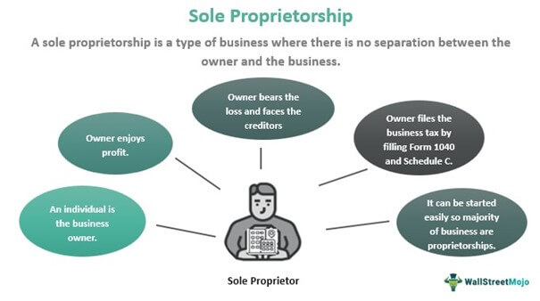
Legal format and management of the firm
Notes:
It refers to corporate activists working together. Supervisors and leaders are responsible for evaluating an initiative (Gryshova,2019). A project may have one or several administrators. Maxtin DJ's owner should be the admin. He must decide how to do the task. Adding a new leader if the project grows. The CEO executes the strategy set by the board of directors. Maxtin DJ can initially handle two salesmen. The board tries to bring people together and use existing resources effectively and efficiently to fulfil a project's goals and objectives.

Slide 7
SWOT analysis
Strengths Relaxed and friendly atmosphere in the store. Enjoy and try out the finest products we offer. Opportunity to receive expert advice in a relaxed and friendly atmosphere. Delivery the product to the required destination. Warranty of the product. Provide after-sales services. | Weaknesses Lack of innovative design. Lack of providing premium products at a reasonable price. Lack of services.
Opportunities Already have existing customers in the market. Younger people are more involving in Brand and Music which can increase the sales of DJ equipment. Brand and Music are in trend. People always follow trends. | Threats There is a lot of competition. Competitors also offer the same types of products. They already have some fixed customers.

Slide 8
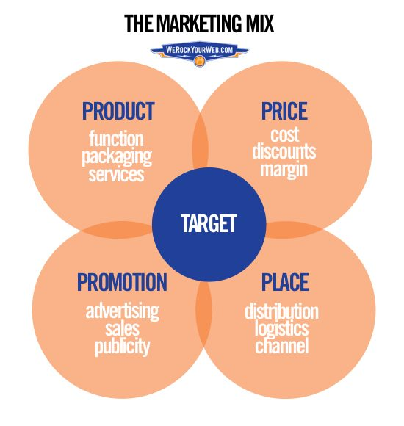
4Ps of the marketing mix
Notes:
Product:
Its products, services, and consultancy. Maxtin DJ manufactures DJ gear. It describes exceptional and distinctive products. We emphasise usability and features. Even though we're in a saturated market, our company wishes to design for a new market.
Price:
The product's price. Product pricing is difficult (Chen,2018). Many companies provide high-quality, low-cost items. To decide the pricing, the corporation should examine the lowest price it will sell the goods for and the most customers will pay.
Place: Place is the business's location. So, choose a site near target consumers. To locate the correct location for business, the company must analyse where the clients are (Chen, 2018), which distribution methods are operating, and whether it sells directly to end customers or uses a middleman.
Promotion:
Promotion is communicating a product, activity, or brand to target consumers. It attracts consumers. Advertising, PR, digital marketing, direct selling, personal selling, sales promotion, and event marketing are promotional methods. We advertise our goods via event marketing.

Slide 9
The target market
Target markets assist companies to locate new clients and establishing marketing strategies to reach corporate goals. Target marketing involves employing marketing methods to target a certain market segment, which may help attract new consumers, increase company prospects, and grow the distribution network. Young people are the target market of Maxtin DJ as they are fond of music.

Slide 10
The marketing strategies
For a project to succeed, the administration must consistently lower expenses at every level. Cost systems may grab a large portion of the industry and draw consumers' attention.
A corporation may provide its consumers with something fresh, unusual, and unique by using a separation approach.
If a corporation can isolate its services, it won't have to compete on pricing and will appeal to more customers.
Notes:
An expenditure initiative method tries to win by lowering costs for services, interactions, and goods. For a project to succeed, the administration must consistently lower expenses at every level. Cost systems may grab a large portion of the industry and draw consumers' attention.(Morgan,2019). Substandard work and inadequate profit margins will lead to unhappiness. To market this method, a company's labour and commodities must be proper and well-defined for its target audience and considerably cheaper and more serious than other similar firms.A corporation may provide its consumers with something fresh, unusual, and unique by using a separation approach. This technique greatly affects business and competitiveness (Smith, 2018). It's competitive. Without a large financial return, a corporation can't use this strategy for long. If a corporation can isolate its services, it won't have to compete on pricing and will appeal to more customers.

Slide 11
Conclusion
This company has done primary and secondary research. Initial and secondary research is promising. Maxtin DJ has a good chance of success with its company concept in the target market based on client feedback.

Slide 12
References list
Asman, M.A.A.B.Z., Kee, D.M.H., Yun, G.F., Xun, H.Z., Thakur, T. and Mehta, D., 2020. Business idea for KFC Malaysia: A study of potential business idea for KFC Holdings (Malaysia) Berhad. Journal of the Community Development in Asia (JCDA), 3(1), pp.63-69.
Chen, H.J., 2018. What drives consumers’ mobile shopping? 4Ps or shopping preferences?. Asia Pacific Journal of Marketing and Logistics.
Gryshova, I., Petrova, M., Tepavicharova, M., Diachenko, A.P. and Gutsul, T., 2019. A model for selection of a management team to ensure the sustainability and development of the business organizations. Entrepreneurship and Sustainability issues, 7(1), p.690.
McKeever, M.P., 2018. How to write a business plan. Nolo.
Morgan, N.A., Whitler, K.A., Feng, H. and Chari, S., 2019. Research in marketing strategy. Journal of the Academy of Marketing Science, 47(1), pp.4-29.

