Slide 1
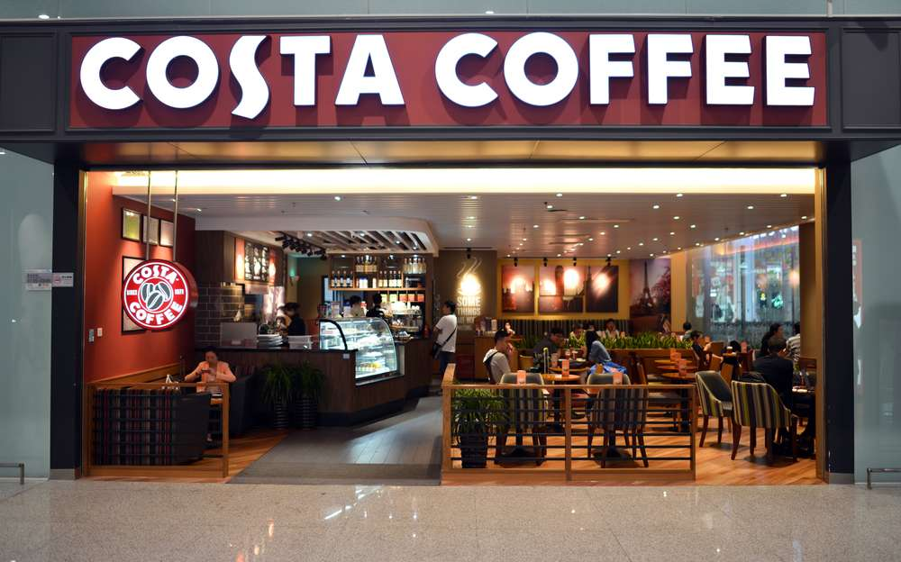

The neighbourhood hub
_strategy proposal_
TAYLOR-JAYNE ROWE 2507302_
Notes:
Good morning. Today I present a sustainable growth strategy for Costa Coffee, designed to address the significant challenges the company currently faces. In 2023, Costa reported a pre-tax loss of £9.6 million, despite revenues increasing from £1.1 to £1.2 billion in the previous year - though this remains below the £1.3 billion recorded in 2018 before Coca-Cola's acquisition (World Coffee Portal, 2025). The proposed strategy will demonstrate how Costa can rebuild resilience, restore profitability, and create genuine competitive advantage through sustainability-focused community integration.
References:
Costa Coffee. (2024). Annual report and accounts 2023. Companies House. https://find-and-update.company-information.service.gov.uk/
World Coffee Portal. (2025, May 9). Costa Coffee fell back into the red in 2023 despite robust sales growth. https://www.worldcoffeeportal.com/news/costa-coffee-fell-back-into- the-red-in-2023-despite-robust-sales-growth/

Slide 2
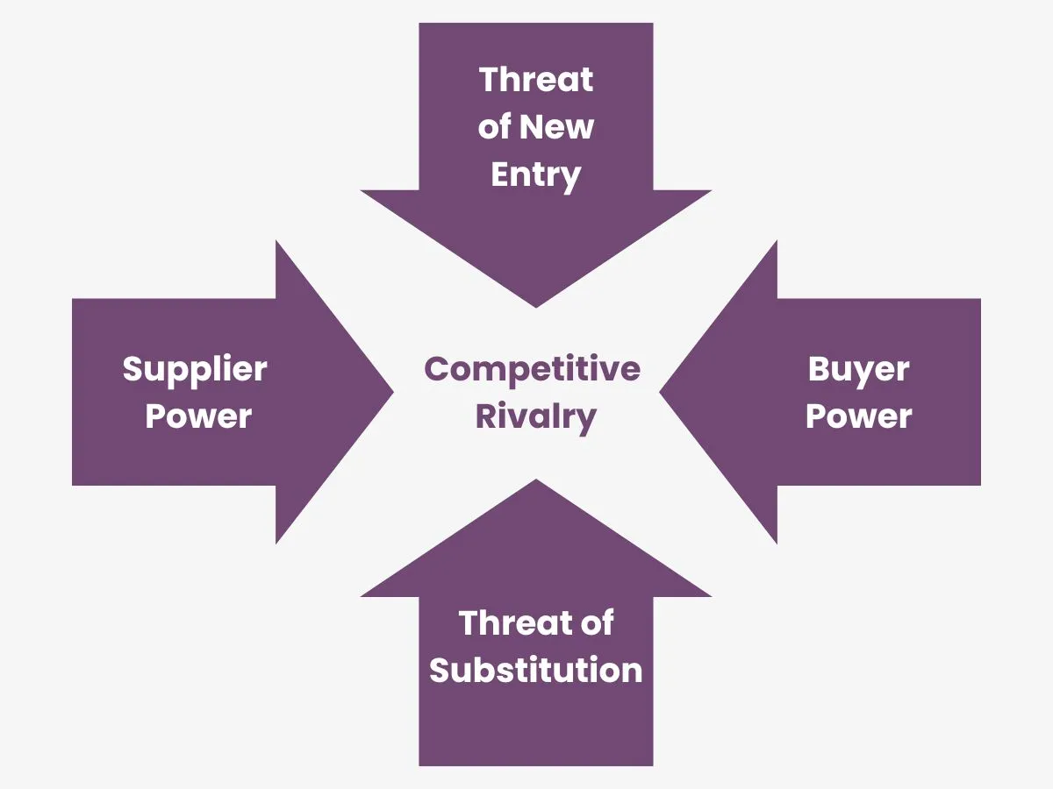
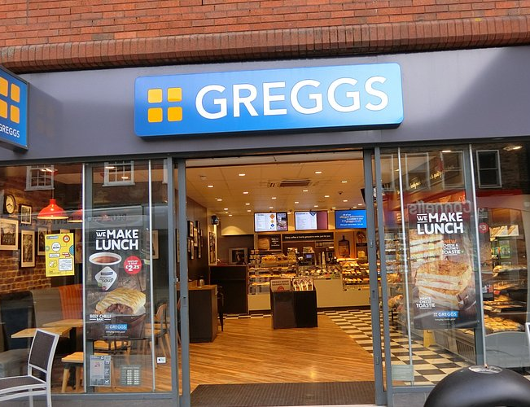
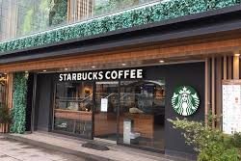
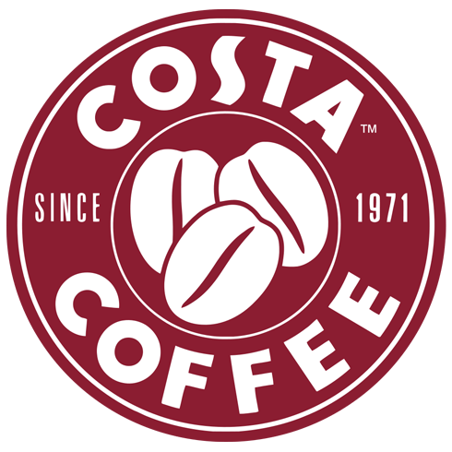
CURRENT STRATEGIC analysis
UK Coffee Market
_worth £6.2 billion_
UK Coffee Market shows _4% year-on-year growth_
Porter’s Five Forces
(Porter, 1979)
Notes:
Costa operates in an intensely competitive environment. Internal analysis reveals high buyer power, with price-sensitive consumers easily switching between alternatives. The threat of substitutes remains significant, particularly from supermarket coffee offerings and independent cafés. The UK coffee market, valued at £6 billion in 2024/25, demonstrates robust 4% year-on-year growth, yet Costa's market share has declined by 1 percentage points to 38% by outlet count, with the company closing a net six UK locations in 2024 (Lumina Intelligence, 2025). Costa faces what Williams et al. (2017) describe as organisational adversity requiring integrated crisis management responses.
Let's compare. Greggs exceeded £2 billion in turnover for the first time in 2024, representing 11% growth from 2023's £1.8 billion, and achieved 20% growth to reach this milestone (Greggs, 2025; Statista, 2024). Costa's premium positioning became vulnerable during economic stress. Organisational decline often stems from strategic rigidity rather than external factors alone, suggesting Costa's challenges reflect deeper strategic inadequacies beyond market conditions (Carmeli and Markman, 2011) . The company's 38% market share by outlet count has not translated into financial success, indicating fundamental misalignment between strategy and execution.
References:
Carmeli, A., & Markman, G. D. (2011). Capture, governance, and resilience: Strategy implications from the history of Rome. Strategic Management Journal, 32(3), 322–341. https://doi.org/10.1002/smj.880
Costa Coffee. (2024). Annual report and accounts 2023. Companies House.
Greggs. (2025). Annual report and accounts 2024. https://corporate.greggs.co.uk/
Lumina Intelligence. (2025, July 25). UK coffee market: Size, growth and share statistics 2025. https://www.lumina-intelligence.com/blog/foodservice/uk-coffee-market-size-growth- share-statistics-2025/
Oldenburg, R. (1989). The great good place: Cafes, coffee shops, bookstores, bars, hair salons, and other hangouts at the heart of a community. Paragon House.
Porter, M. E. (2008). The five competitive forces that shape strategy. Harvard Business Review, 86(1), 78–93.
Statista. (2024, April 3). Annual turnover of Greggs in the United Kingdom from 2006 to 2023. https://www.statista.com/statistics/630684/greggs-turnover-united-kingdom-uk/
Williams, T. A., Gruber, D. A., Sutcliffe, K. M., Shepherd, D. A., & Zhao, E. Y. (2017). Organizational response to adversity: Fusing crisis management and resilience research streams. Academy of Management Annals, 11(2), 733–769. https://doi.org/10.5465/annals.2015.0134

Slide 3

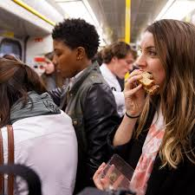
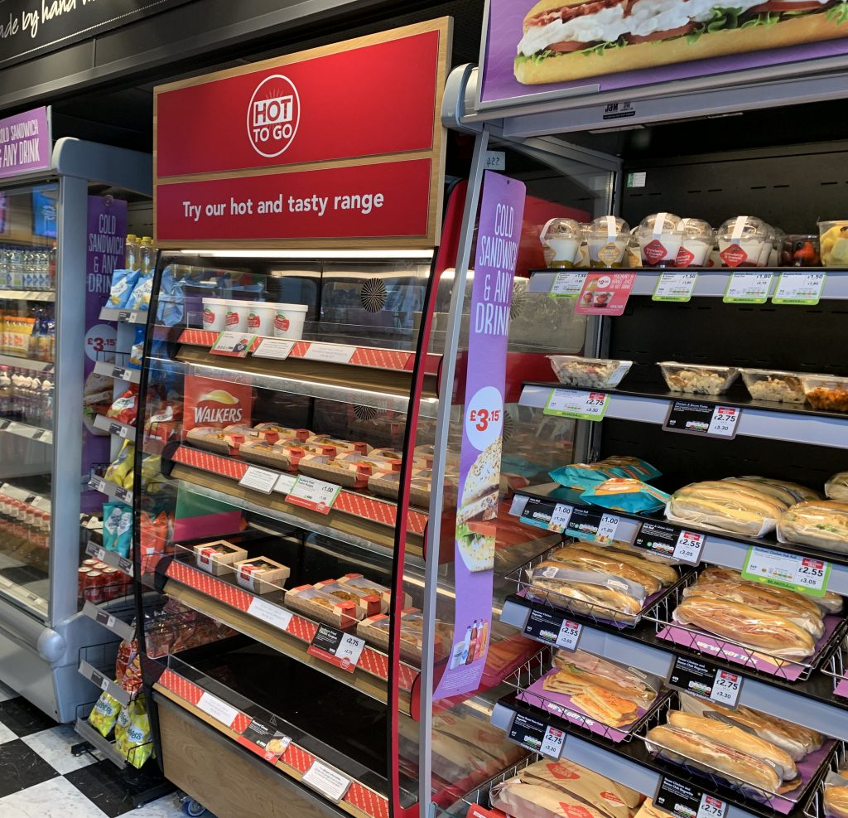
OPPORTUNITY ANALYSIS
SWOT Analysis of Costa Coffee
Strengths | Weaknesses
Market leadership position in UK coffee shop sector - Costa Vertical integration through coffee roasting capabilities – Extensive product portfolio diversification beyond traditional coffeehouse offerings Established international presence with strong franchise | Premium pricing strategy limits accessibility during economic downturns Store concentration in saturated UK market creates growth constraints Limited differentiation from primary competitor Starbucks in customer experience Sustainability credentials not up to emerging consumer expectations
Opportunities | Threats
Expansion of digital ordering and loyalty program capabilities Accelerated international expansion in emerging markets Strategic partnerships with workplace and transit locations Plant-based and functional beverage innovation addressing health-conscious consumers | Intensifying competition from value-positioned competitors Rising operational costs from labor shortages and commodity price inflation Regulatory intervention regarding single-use plastics and waste reduction Shifting consumer preferences toward experiential independent coffee shops
Notes:
Portfolio analysis reveals substantial strategic potential. Costa possesses significant strengths, including UK market leadership with 38% market share, vertical integration through coffee roasting operations and international presence across 50 markets (World Coffee Portal, 2025).
These strengths create opportunities for digital capability enhancement, accelerated international expansion and strategic partnerships with workplace and transit locations. Consumer research demonstrates that convenience and accessibility drive coffee purchasing decisions, with many purchases occurring during commuting or workplace breaks (Allegra World Coffee Portal, 2023).
Costa's greatest weakness is its premium positioning which is not resilient against economic stress, alienating price-sensitive consumers. During inflationary periods, 40% of consumers actively trade down from premium brands to value alternatives, which directly impacts premium coffee chains' customer bases (Mintel, 2024). Companies with strong sustainability performance achieve superior stock performance and profitability (Eccles et al. (2014), with Nielsen (2021) reporting that 73% of millennials willingly pay premiums for sustainable products - so, as long as Costa is 'giving back' to the planet and its inhabitants, their customer base is happy to pay the premium.
External threats intensify these challenges. Greggs reported 28% year-on-year coffee sales growth in select markets by capturing customers trading down from premium chains, whilst independent specialty coffee operators like WatchHouse achieved 38% turnover growth between December 2024 and December 2025, demonstrating consumer appetite for differentiated experiences (Lumina Intelligence, 2025), whilst shifting consumer preferences toward experiential independent establishments threaten long-term market position.
References:
Allegra World Coffee Portal. (2023). Project café UK 2023. Allegra Group.
Eccles, R. G., Ioannou, I., & Serafeim, G. (2014). The impact of corporate sustainability on organizational processes and performance. Management Science, 60(11), 2835–2857.
https://doi.org/10.1287/mnsc.2014.1984
Lumina Intelligence. (2025, July 25). UK coffee market: Size, growth and share statistics 2025. https://www.lumina-intelligence.com/blog/foodservice/uk-coffee-market-size-growth-share-statistics-2025/
Mintel. (2024). UK cafés and coffee shops market report 2024. Mintel Group. https://store.mintel.com/report/uk-coffee-shops-market-report
Nielsen. (2021). The sustainability imperative: New insights on consumer expectations. Nielsen Company.
World Coffee Portal. (2025, May 9). Costa Coffee fell back into the red in 2023 despite robust sales growth. https://www.worldcoffeeportal.com/news/costa-coffee-fell-back-into- the-red-in-2023-despite-robust-sales-growth/

Slide 4
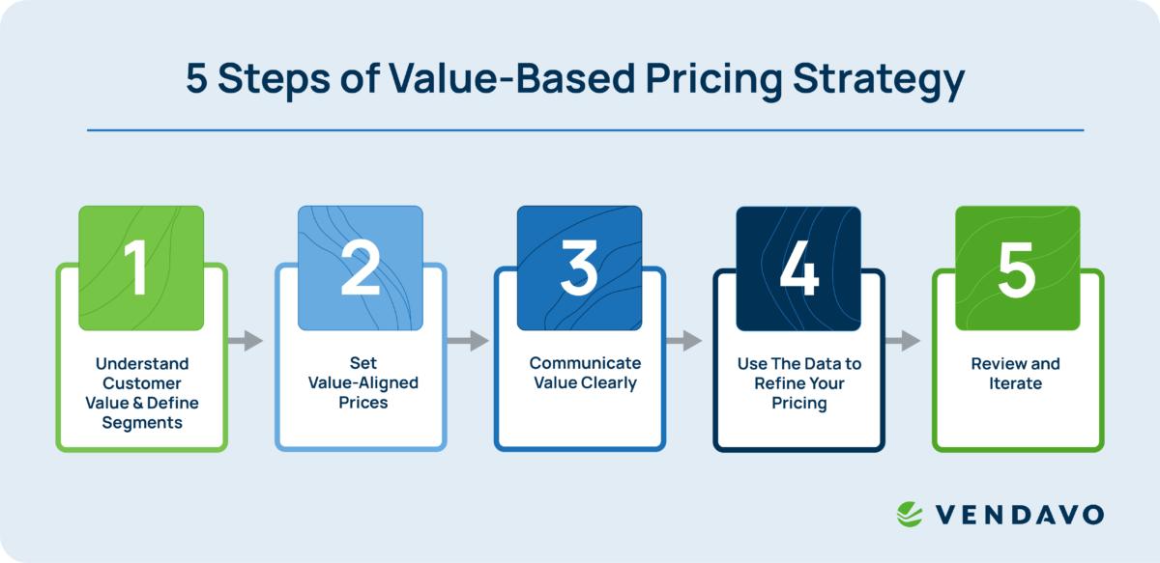

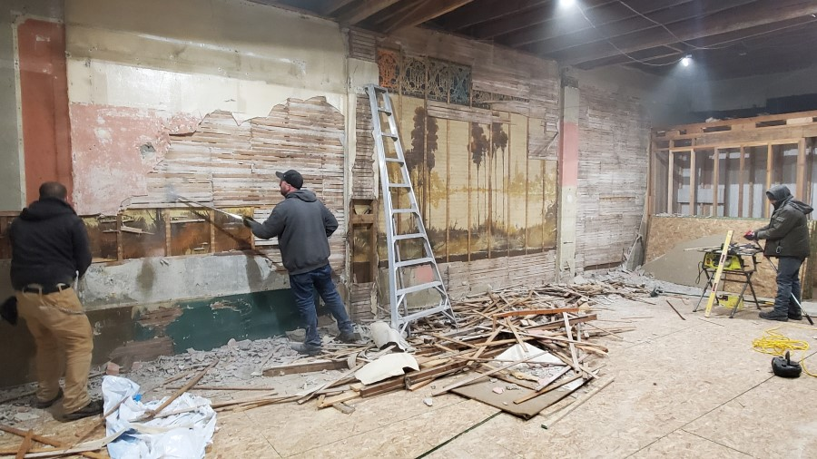

‘NEIGHBOURHOOD HUB’ STRATEGY
OPERATION | PURPOSE
1. Physical space transformation | Add multiple purposes to one shop location to maximise community value.
2. Sustainable operations redesign | Create SMART goals to achieve measurable environmental improvements.
3. Community partnership programs | Inviting the local community to use the new, redesigned space to create a loyal customer base
4. Value-based pricing | Make Costa products accessible to lower-income community members whilst maintaining quality and reputation
SMART Goals
(Doran, 1981)
5 Steps of Value-Based Pricing Strategy
(Nagle, T. 1987)
Notes:
I propose the Neighbourhood Hub Strategy, repositioning Costa stores as community-centred spaces that integrate environmental sustainability, social value creation, and economic viability. This represents fundamental operational transformation, not simply rebranding.
The strategy comprises four interconnected pillars.
- First, physical space transformation converts underperforming locations into flexible community venues.
Second, sustainable operations redesign achieves measurable environmental improvements.
Third, community partnership programmes create genuine local connections.
Fourth, value-based pricing architecture makes Costa accessible while maintaining quality.
The Neighbourhood Hub Strategy addresses Costa’s weaknesses and threats by leveraging existing strengths. By integrating genuine sustainability commitments and community partnerships, Costa can differentiate beyond price competition whilst maintaining market leadership. Sustainability creates business value only when genuinely integrated into core strategy rather than treated as peripheral corporate responsibility (Schaltegger et al., 2019) . Freeman et al. (2020) argue for stakeholder-centric value creation that moves beyond shareholder primacy to genuine community partnership. Reichheld and Sasser (1990) show that increasing customer retention rates by just 5% can boost profits by 25% to 95%, highlighting how addressing weaknesses through community engagement directly supports financial objectives.
This addresses Costa's core problem. The company possesses resources and infrastructure yet lacks the community integration that creates resilience. Duchek (2020) defines organisational resilience through three stages: anticipation, coping, and adaptation. Costa's current strategy fails at anticipation because it has not recognised how economic pressures and consumer values have fundamentally shifted. Alternative strategic options, including aggressive cost-cutting or premium repositioning, fail to address the underlying disconnect between Costa's offering and evolving consumer expectations for community-embedded businesses that create social value beyond transactions (Austin & Seitanidi, 2012).
References:
Austin, J. E., & Seitanidi, M. M. (2012). Collaborative value creation: A review of partnering between nonprofits and businesses. Nonprofit and Voluntary Sector Quarterly, 41(5), 726– 758. https://doi.org/10.1177/0899764012454685
Doran, G. T. (1981). There’s a S.M.A.R.T. way to write managements’s goals and objectives. Management Review, 70(11), 35. Image retrieved from https://illumtori.com/blog/goals/unlocking-the-power-of-smart-goals-a-comprehensive-guide on 8/1/25
Duchek, S. (2020). Organizational resilience: A capability-based conceptualization. Business Research, 13(1), 215-246. https://doi.org/10.1007/s40685-019-0085-7
Freeman, R. E., Phillips, R., & Sisodia, R. (2020). Tensions in stakeholder theory. Business & Society, 59(2), 213–231. https://doi.org/10.1177/0007650318773750
Luo, X., & Bhattacharya, C. B. (2006). Corporate social responsibility, customer satisfaction, and market value. Journal of Marketing, 70(4), 1–18. https://doi.org/10.1509/jmkg.70.4.1
Nagle, T., & Holden, R. (1998). The Strategy and Tactics of Pricing. Image retrieved from https://www.vendavo.com/glossary/value-based-pricing/ on 8/1/26
Reichheld, F. F., & Sasser, W. E. (1990). Zero defections: Quality comes to services. Harvard Business Review, 68(5), 105–111.
Schaltegger, S., Hörisch, J., & Freeman, R. E. (2019). Business cases for sustainability: A stakeholder theory perspective. Organization & Environment, 32(3), 191–212. https://doi.org/10.1177/1086026617722882

Slide 5

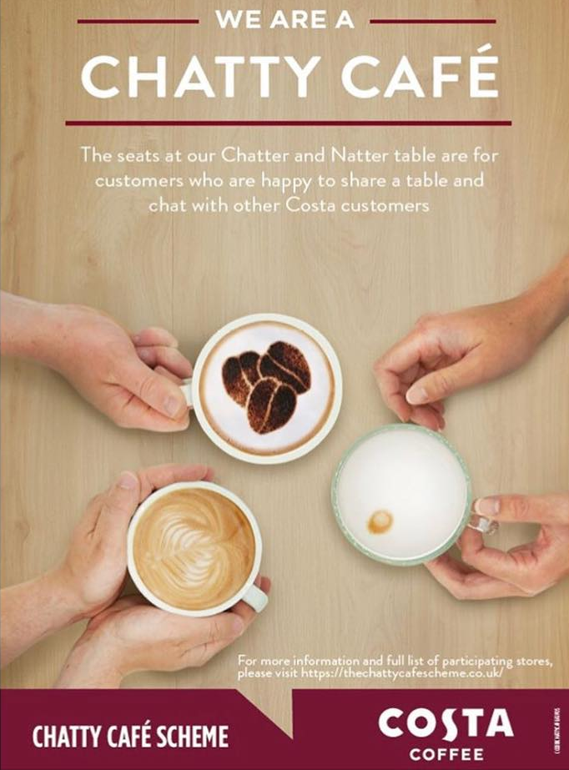
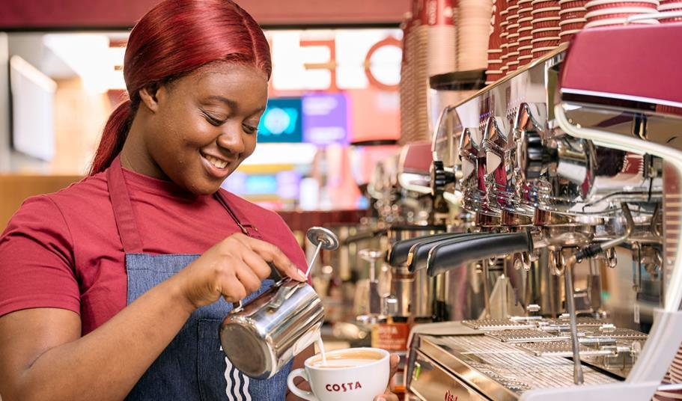
STEP 1 – SPACE TRANSFORMATION
- Café peak hours: 7am – 10am and 2pm – 4pm
- Convert 40% of seating areas in targeted locations into bookable community spaces during off-peak hours
Notes:
Physical transformation begins with redesigning store layouts. Barasa et al. (2018) demonstrate that organisational resilience requires structural flexibility. We convert 40% of seating areas in targeted locations into bookable community spaces, available free or at minimal cost to local groups, schools, and charities during off-peak hours.
This creates multiple value streams. Industry data shows café peak hours occur between 7am and 10am, with secondary peaks between 2pm and 4pm, accounting for 60–70% of daily traffic (Rafter, 2016). Morning commuters receive premium service during these peak periods, while afternoons and evenings, experiencing lower customer demand, become community resources. The strategy targets locations experiencing declining footfall, turning potential liabilities into community assets. By transforming underperforming retail spaces into what Oldenburg (1989) identified as "third places"—essential community infrastructure facilitating social interaction outside home and work environments—Costa converts underutilised capacity into stakeholder value.
Implementation requires modest capital investment funded by Coca Cola, Costa's parent company, generating significant goodwill and brand differentiation through authentic community engagement.
The approach draws on stakeholder theory (Freeman, 1984) by creating value for multiple stakeholder groups simultaneously. By serving community needs, Costa builds relationships that extend beyond transactions, mirroring the model that strengthens Greggs' market position.
References:
Barasa, E., Mbau, R., & Gilson, L. (2018). What is resilience and how can it be nurtured? A systematic review of empirical literature on organizational resilience. International Journal of Health Policy and Management, 7(6), 491–503. https://doi.org/10.15171/ijhpm.2018.06
Choi, J., Guzman, J., & Small, M. (2022). Third places and neighborhood entrepreneurship: Evidence from Starbucks [Working paper]. Columbia Business School. https://business.columbia.edu/research-brief/research-brief/starbucks-startups
Freeman, R. E. (1984). Strategic management: A stakeholder approach. Pitman Publishing.
Oldenburg, R. (1989). The great good place: Cafes, coffee shops, bookstores, bars, hair salons, and other hangouts at the heart of a community. Paragon House.
Rafter, A. (2016). Coffee shop industry trends and customer behavior analysis. Square Data Report. https://sprudge.com/square-collecting-coffee-shop-data-62118.html

Slide 6
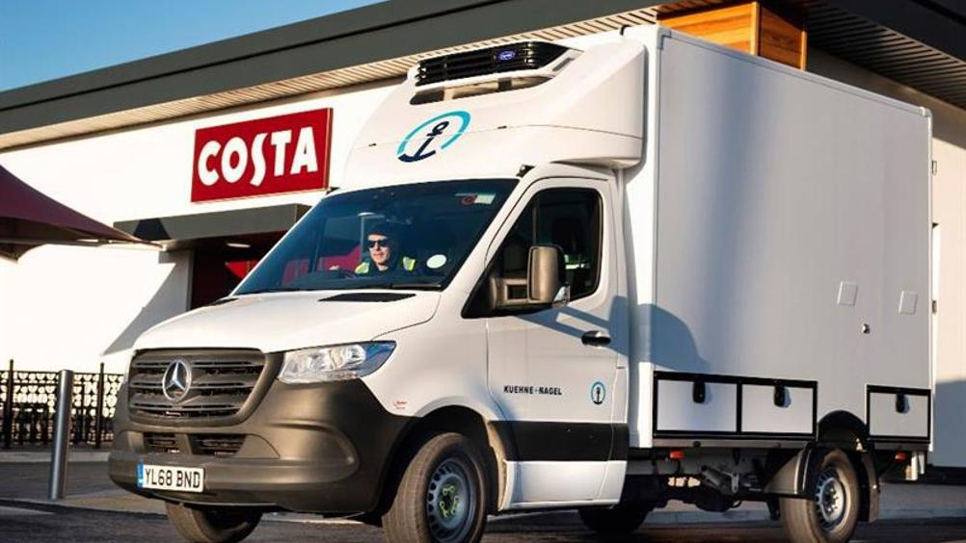
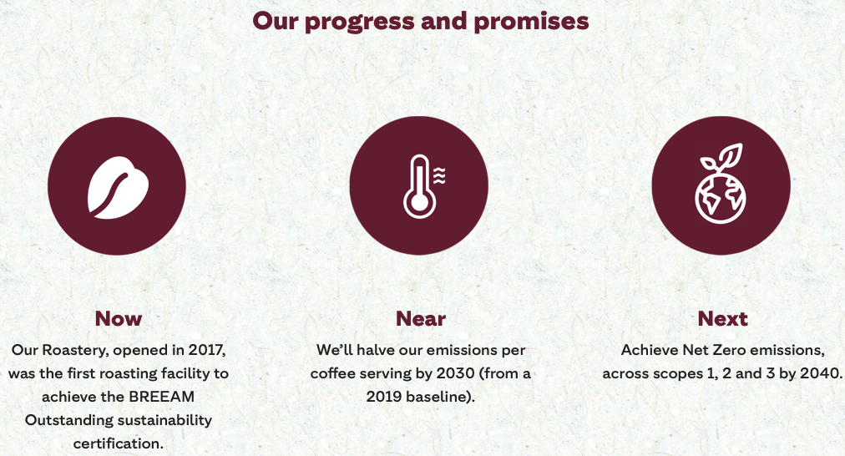
STEP 2 – SUSTAINABLE OPERATIONS
📈
Sustainability (Costa Coffee, 2025)
Notes:
Environmental sustainability must be measurable and genuine. Costa will commit to the following sustainability goals: 50% carbon intensity reduction by 2027, 100% recyclable or compostable packaging by 2026, and zero waste to landfill by 2028.
Operational changes include transitioning delivery fleets to electric vehicles, installing renewable energy systems in owned properties, and partnering with suppliers on regenerative agriculture. These commitments receive independent verification with quarterly public reporting, ensuring accountability.
Environmental investments reduce operational costs through efficiency gains, while creating differentiation in an increasingly conscious market - with Eccles et al. (2014) showing that companies with strong sustainability performance demonstrate superior stock performance and profitability, suggesting that financial markets reward genuine environmental commitment. Conz and Magnani (2020) demonstrate that firms who build dynamic resilience through sustainability capabilities outperform competitors during disruption, and Costa's premium positioning supports this strategy because sustainability justifies quality perceptions.
References:
Conz, E., & Magnani, G. (2020). A dynamic perspective on the resilience of firms: A systematic literature review and a framework for future research. European Management Journal, 38(3), 400–412. https://doi.org/10.1016/j.emj.2019.12.004
Costa Coffee. (2025). Climate. https://www.costa.co.uk/sustainability/climate
Costa Coffee. (2025). Coffee. https://www.costa.co.uk/sustainability/coffee
Costa Coffee. (2025). Communities. https://www.costa.co.uk/sustainability/communities
Costa Coffee. (2025). Cups and Packaging. https://www.costa.co.uk/sustainability/cups-and-packaging
Eccles, R. G., Ioannou, I., & Serafeim, G. (2014). The impact of corporate sustainability on organizational processes and performance. Management Science, 60(11), 2835–2857. https://doi.org/10.1287/mnsc.2014.1984
Greggs. (2025). Annual report and accounts 2024. https://corporate.greggs.co.uk/

Slide 7

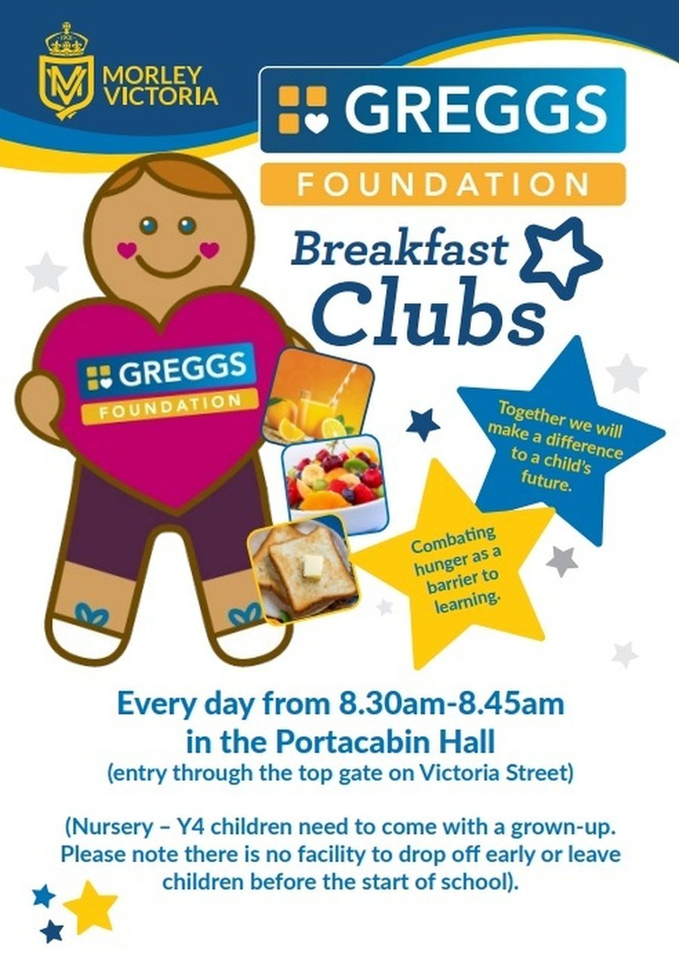
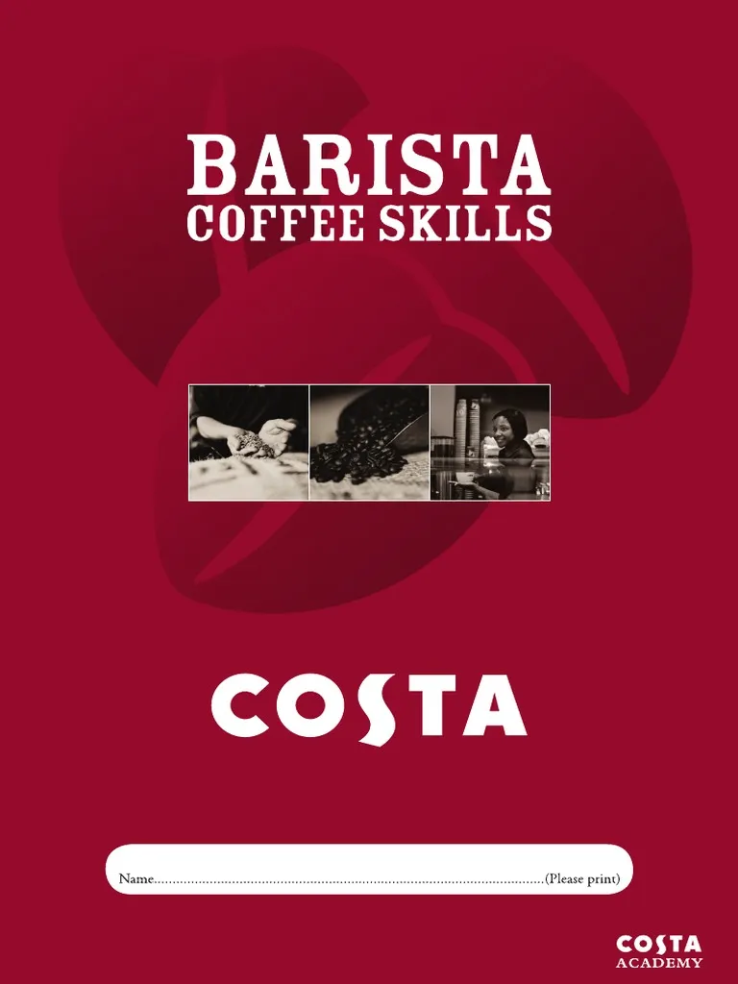
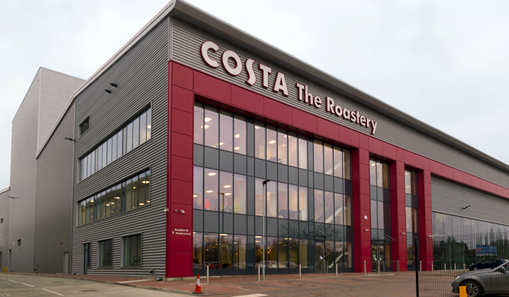
STEP 3 – COMMUNITY PARTNERSHIP
ORGANISATIONAL RESILIENCE_
Notes:
Community partnerships create sustainable competitive advantage. Three flagship programmes launch the initiative. The Costa Community Fund provides grants to local organisations, managed through community boards rather than corporate committees, ensuring genuine local ownership. The Costa Skills Academy offers free barista training and hospitality qualifications to unemployed youth and career changers, creating employment pathways while building talent pipelines. The Local Supplier Initiative prioritises procurement from local bakeries and food producers, keeping economic value in communities.
These programmes address what Tasic et al. (2020) identify as resilience factors: social capital, resource diversity, and adaptive capacity. By embedding Costa in community networks, we create switching costs that transcend price competition. When a Costa store provides employment training, hosts community meetings, and sources from local suppliers, it becomes infrastructure rather than just another coffee shop.
The model mirrors Greggs Foundation's approach, which operates over 1,000 breakfast clubs serving approximately 75,000 children daily (Greggs, 2025), adapted to Costa's urban focus and different customer base. Austin and Seitanidi (2012) demonstrate that cross-sector partnerships create shared value when structured for genuine collaboration rather than philanthropic donation, supporting the governance model proposed here.
References:
Austin, J. E., & Seitanidi, M. M. (2012). Collaborative value creation: A review of partnering between nonprofits and businesses. Nonprofit and Voluntary Sector Quarterly, 41(5), 726– 758. https://doi.org/10.1177/0899764012454685
Greggs. (2025). Annual report and accounts 2024. https://corporate.greggs.co.uk/
Tasic, J., Amir, S., Tan, J., & Khader, M. (2020). A multilevel framework to enhance organizational resilience. Journal of Risk Research, 23(6), 713–738. https://doi.org/10.1080/13669877.2019.1617340

Slide 8
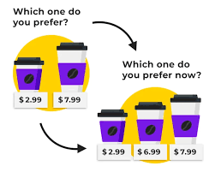
STEP 4 – VALUE-BASED PRICING
Political
Food retail operations face regulation through food safety standards, labelling requirements, and employment laws.
Economic
Premium-positioned operators like Costa Coffee experience greater vulnerability during economic stress, evidenced by rising costs in energy, ingredients, and labour squeeze margins – contributing to declining revenues and venue closures in 2025.
Social
Time scarcity, urbanisation, and changing household structures fuel food-to-go growth as convenience replaces home cooking, while health consciousness demands balanced menus combining indulgent and healthy options.
Technological Factors
Mobile ordering apps enhance customer convenience and enable personalised marketing through data analytics, creating switching costs through customisation.
Legal Factors
Employment legislation, including minimum wage increases, workplace pension obligations, and gender wage gap compensation, systematically raises labour costs across the sector.
Environmental Factors
Environmental risks include supply chain disruptions and transition obligations requiring capital investment in low-carbon operations. Costa Coffee opened a BREEAM Outstanding Roastery that supplies coffee to all Costa cafes.
PRICE LEVEL | DESCRIPTION
3 - Premium | Food and drink made with high quality ingredients and made fresh to order. Targeted at high-income working individuals and coffee connoisseurs.
2 - Quality | Current food and drink offered by Costa Coffee in 2026, at its current price. Targeted at working individuals and coffee enjoyers.
1- Community | Food and drink that is simpler (or made with cheaper ingredients) at a slightly lower price point than Quality. Targeted at low-income consumers and regular users of the Costa Community Spaces.
Notes:
Pricing requires complete restructuring. I'm introducing a three-tier architecture. The Core range offers quality essentials at competitive prices, directly addressing affordability concerns. The Premium range maintains Costa's traditional positioning for customers valuing speciality drinks. The Community range provides simplified offerings at low prices to make nutritious light snacks and drinks accessible to low-income consumers.
This approach recognises current economic conditions revealed through environmental analysis. Macroeconomic pressures demand value, though different customer segments define value differently, with research demonstrating that consumer satisfaction with value-for-money has fallen 9% year-on-year despite strong underlying coffee market demand (World Coffee Portal, 2024). Raetze et al. (2022) show that resilient organisations maintain strategic flexibility, adjusting to environmental conditions without abandoning core capabilities.
The strategy protects margin through volume and loyalty rather than premium pricing alone (Nagle & Holden, 1998). By serving broader market segments, Costa reduces vulnerability to economic cycles. Community programme participants become ambassadors, generating word-of-mouth marketing that traditional advertising cannot achieve. Research demonstrates that customer lifetime value increases 25–95% when firms successfully implement tiered pricing strategies that serve multiple market segments without diluting brand equity (Kumar & Reinartz, 2016).
References:
Kumar, V., & Reinartz, W. (2016). Creating enduring customer value. Journal of Marketing, 80(6), 36–68. https://doi.org/10.1509/jm.15.0414
Nagle, T., & Holden, R. (1987). The Strategy and Tactics of Pricing.
Raetze, S., Duchek, S., Maynard, M. T., & Wohlgemuth, M. (2022). Resilience in organization-related research: An integrative conceptual review across disciplines and levels of
analysis. Journal of Applied Psychology, 107(6), 867–897. https://doi.org/10.1037/apl0000952
World Coffee Portal. (2024, January). £5.3bn UK branded coffee shop market rallies to exceed 10,000 stores despite headwinds. https://www.worldcoffeeportal.com/Latest/News/2024/January-(2)/£5-3bn-UK-branded-coffee-shop-market-rallies-to-ex
PESTLE Analysis Summary: Food-to-Go Sector
Political Factors
Food retail operations face significant regulation through food safety standards, labelling requirements, and employment laws, while Brexit complications in supply chains and labour markets increase costs without revenue benefits. Government support for sustainable business practices aligns with companies like Greggs, potentially providing competitive advantages as environmental standards tighten.
Economic Factors
Macroeconomic conditions drive consumer behaviour shifts, with value-positioned operators like Greggs benefiting from downturns as consumers trade down from premium options, while rising costs in energy, ingredients, and labour squeeze margins. Premium-positioned operators like Costa Coffee experience greater vulnerability during economic stress, evidenced by declining revenues and venue closures in 2025.
Social Factors
Time scarcity, urbanisation, and changing household structures fuel food-to-go growth as convenience replaces home cooking, while health consciousness demands balanced menus combining indulgent and healthy options. Sustainability commitments differ between operators, with Greggs' community-focused approach through The Greggs Pledge potentially creating stronger stakeholder engagement than Costa's corporate social responsibility model.
Technological Factors
Mobile ordering apps enhance customer convenience and enable personalised marketing through data analytics, creating switching costs through customisation, while delivery partnerships expand market reach despite commission pressures on margins. Manufacturing automation improves production consistency and labour productivity, helping offset rising wage costs.
Legal Factors
Compliance requirements span food safety, employment law, health and safety standards, and consumer protection, with nutritional labelling and potential marketing restrictions on high-fat, salt, and sugar products creating cost burdens. Employment legislation, including minimum wage increases and workplace pension obligations, systematically raises labour costs across the sector.
Environmental Factors
Environmental risks include supply chain disruptions and transition obligations requiring capital investment in low-carbon operations. Greggs demonstrates sector leadership with science-based emission targets for net-zero by 2040, achieving 97.1% renewable electricity, converting the Enfield depot to hydrotreated vegetable oil, and targeting 100% recyclable, reusable, or compostable packaging by 2025.

Slide 9
IMPLEMENTATION
YEAR | ACTION
1 | Pilot rollout in 50 stores.
2 | Scale to 200 locations, refining operations based on pilot
3 | Full network integration across 500+ stores after successful pilot.
Notes:
Implementation follows a phased approach. Year one focuses on pilot locations in 50 underperforming stores, testing and refining the model with clear success metrics including 15% revenue growth, 20% improvement in customer retention, and 30% increase in community engagement scores. Year two scales to 200 locations, building operational capabilities and refining processes based on pilot learnings. Year three achieves full network integration across 500+ stores, creating market-leading differentiation.
This strategy builds sustainable competitive advantage through what Lengnick-Hall et al. (2011) describe as strategic human resource management for resilience. Training Costa's approximately 17,800 UK employees (Costa Coffee, 2024) in community engagement creates organisational capabilities competitors cannot easily replicate. Physical investments in community spaces create exit barriers, making locations valuable beyond coffee sales.
Pilot stores targeting 15% revenue growth and improved customer retention justify expansion. Community partnerships generate operational efficiencies through shared resources and local supplier relationships. Most significantly, the strategy repositions Costa from commodity coffee retailer to community infrastructure provider, fundamentally changing competitive dynamics and creating barriers to imitation through accumulated social capital and embedded relationships.
References:
Costa Coffee. (2024). Annual report and accounts 2023. Companies House.
Lengnick-Hall, C. A., Beck, T. E., & Lengnick-Hall, M. L. (2011). Developing a capacity for organizational resilience through strategic human resource management. Human Resource Management Review, 21(3), 243–255. https://doi.org/10.1016/j.hrmr.2010.07.001

Slide 10
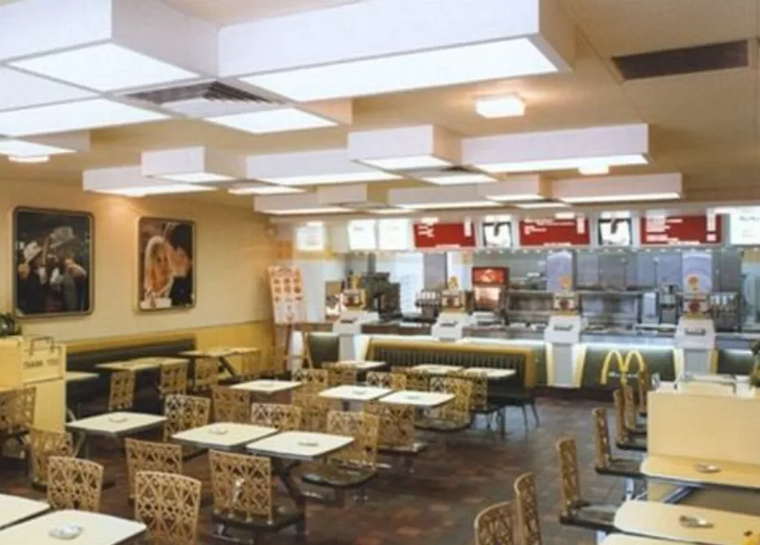
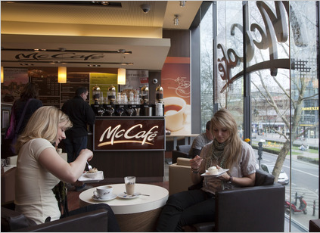
PROJECTED OUTCOMES
Societal Benefit | Economic Benefit
✅ Supporting Social Enrichment - Aiding the community by creating third spaces necessary for healthy social enrichment | ✅ Incentivises spending through extended stays in comfortable physical spaces, which also creates brand loyalty. Comparison – Starbucks.
✅ Achieving sustainability goals - Protecting the planet by reducing carbon emissions, waste to landfill and maximising sustainable sourcing. | ✅ Improves brand reputation and makes the portfolio more accessible to planet-conscious consumers.
✅ Supporting Local Community Programmes and Entrepreneurship - Aiding local schools, entrepreneurs and organisations through use of space and financial aid, as a social enterprise. | ✅ By providing barista training programmes, children’s activity spaces and discounted goods, Costa creates lifelong customers and improve brand reputation.
✅ Three-tiered Pricing Scheme | ✅ Makes the a limited portfolio accessible to a wider demographic, particularly low-income consumers who were previously alienated by Costa’s premium positioning.
BETTER SOCIETY = BETTER ECONOMY_
Notes:
Projected outcomes draw on comparable transformations in the sector. Financial targets include returning to profitability within 18 months and achieving revenue growth of 4–6% by year three, based on McDonald's "Experience of the Future" (EOTF) initiative launched in 2015. This transformation converted fast-food restaurants into modern café-style community spaces, and the 2,000 U.S. locations refitted achieved sales increases of 4–6%, with McDonald's subsequently reporting its largest comparable sales increase in ten years (THRIVE, 2019).
Operating margin improvements of 2–3 percentage points are projected for Costa Coffee through efficiency gains and higher average transaction values. Sustainability targets include 50% carbon reduction, zero waste to landfill, and 100% sustainable sourcing, mirroring Greggs' science-based commitments.
Stakeholder value creation extends beyond shareholders. Research by Choi et al. (2022) demonstrates that community-focused café spaces increase local entrepreneurship by 2.3–11.8% in previously underserved neighbourhoods, validating the economic multiplier effects of the community hub model. Employees gain enhanced training, customers receive better value and community spaces, local communities benefit from economic investment and suppliers develop long-term partnerships rather than transactional relationships.
This strategy transforms Costa's crisis into opportunity. Hollands et al. (2024) demonstrate that organisational resilience emerges from proactive adaptation rather than reactive crisis management. By genuinely integrating sustainability into core operations and embedding the business in community networks, Costa builds the resilience that Greggs demonstrates. The Neighbourhood Hub Strategy does not simply restore Costa's financial performance. It creates a business model capable of thriving through future disruption, turning strategic vulnerability into distinctive competitive advantage. Thank you.
References:
Choi, J., Guzman, J., & Small, M. (2022). Third places and neighborhood entrepreneurship: Evidence from Starbucks [Working paper]. Columbia Business School. https://business.columbia.edu/research-brief/research-brief/starbucks-startups
Hollands, L., Haensse, L., & Lin-Hi, N. (2024). The how and why of organizational resilience: A mixed-methods study on facilitators and consequences of organizational resilience throughout a crisis. Journal of Business Ethics, 189(1), 177–201. https://doi.org/10.1177/00218863231165785
Thrive. (2019). McDonald's Experience of the Future: Global customer insights research. https://thrivethinking.com/case-studies/mcdonalds-global-customer-insights-research/

Slide 11
references
Allegra World Coffee Portal. (2023). Project café UK 2023. Allegra Group.
Austin, J. E., & Seitanidi, M. M. (2012). Collaborative value creation: A review of partnering between nonprofits and businesses. Nonprofit and Voluntary Sector Quarterly, 41(5), 726–758. https://doi.org/10.1177/0899764012454685
Barasa, E., Mbau, R., & Gilson, L. (2018). What is resilience and how can it be nurtured? A systematic review of empirical literature on organizational resilience. International Journal of Health Policy and Management, 7(6), 491–503. https://doi.org/10.15171/ijhpm.2018.06
Carmeli, A., & Markman, G. D. (2011). Capture, governance, and resilience: Strategy implications from the history of Rome. Strategic Management Journal, 32(3), 322–341. https://doi.org/10.1002/smj.880
Choi, J., Guzman, J., & Small, M. (2022). Third places and neighborhood entrepreneurship: Evidence from Starbucks [Working paper]. Columbia Business School. https://business.columbia.edu/research-brief/research-brief/starbucks-startups
Conz, E., & Magnani, G. (2020). A dynamic perspective on the resilience of firms: A systematic literature review and a framework for future research. European Management Journal, 38(3), 400–412. https://doi.org/10.1016/j.emj.2019.12.004
Costa Coffee. (2025). Climate. https://www.costa.co.uk/sustainability/climate
Costa Coffee. (2025). Coffee. https://www.costa.co.uk/sustainability/coffee
Costa Coffee. (2025). Communities. https://www.costa.co.uk/sustainability/communities

Slide 12
references
Costa Coffee. (2025). Cups and Packaging. https://www.costa.co.uk/sustainability/cups-and-packaging
Costa Coffee. (2024). Annual report and accounts 2023. Companies House. https://find-and-update.company-information.service.gov.uk/
Doran, G. T. (1981). There’s a S.M.A.R.T. way to write managements’s goals and objectives. Management Review, 70(11), 35. Image retrieved from https://illumtori.com/blog/goals/unlocking-the-power-of-smart-goals-a-comprehensive-guide on 8/1/25
Duchek, S. (2020). Organizational resilience: A capability-based conceptualization. Business Research, 13(1), 215–246. https://doi.org/10.1007/s40685-019-0085-7
Eccles, R. G., Ioannou, I., & Serafeim, G. (2014). The impact of corporate sustainability on organizational processes and performance. Management Science, 60(11), 2835–2857. https://doi.org/10.1287/mnsc.2014.1984
Freeman, R. E. (1984). Strategic management: A stakeholder approach. Pitman Publishing.
Freeman, R. E., Phillips, R., & Sisodia, R. (2020). Tensions in stakeholder theory. Business & Society, 59(2), 213–231. https://doi.org/10.1177/0007650318773750
Greggs. (2025). Annual report and accounts 2024. https://corporate.greggs.co.uk/
Hollands, L., Haensse, L., & Lin-Hi, N. (2024). The how and why of organizational resilience: A mixed-methods study on facilitators and consequences of organizational resilience throughout a crisis. Journal of Business Ethics, 189(1), 177–201. https://doi.org/10.1177/00218863231165785
Kumar, V., & Reinartz, W. (2016). Creating enduring customer value. Journal of Marketing, 80(6), 36–68. https://doi.org/10.1509/jm.15.0414

Slide 13
references
Lengnick-Hall, C. A., Beck, T. E., & Lengnick-Hall, M. L. (2011). Developing a capacity for organizational resilience through strategic human resource management. Human Resource Management Review, 21(3), 243–255. https://doi.org/10.1016/j.hrm
Nagle, T., & Holden, R. (1987). The Strategy and Tactics of Pricing.
Porter, M. E. (2008). The five competitive forces that shape strategy. Harvard Business Review, 86(1), 78–93.
Raetze, S., Duchek, S., Maynard, M. T., & Wohlgemuth, M. (2022). Resilience in organization-related research: An integrative conceptual review across disciplines and levels of analysis. Journal of Applied Psychology, Volume 107, Issue 6, 867-897. https://doi.org/10.1037/apl0000952
Rafter, A. (2016). Coffee shop industry trends and customer behavior analysis. Square Data Report. https://sprudge.com/square-collecting-coffee-shop- data-62118.html
Schaltegger, S., Hörisch, J., & Freeman, R. E. (2019). Business cases for sustainability: A stakeholder theory perspective. Organization & Environment, 32(3), 191–212. https://doi.org/10.1177/1086026617722882
Tasic, J., Amir, S., Tan, J., & Khader, M. (2020). A multilevel framework to enhance organizational resilience. Journal of Risk Research, 23(6), 713–738. https://doi.org/10.1080/13669877.2019.1617340
Thrive. (2019). McDonald's Experience of the Future: Global customer insights research. https://thrivethinking.com/case- studies/mcdonalds-global- customer-insights-research/
Williams, T. A., Gruber, D. A., Sutcliffe, K. M., Shepherd, D. A., & Zhao, E. Y. (2017). Organizational response to adversity: Fusing crisis management and resilience research streams. Academy of Management Annals, 11(2), 733–769. https://doi.org/10.5465/annals.2015.0134

Slide 14
Appendix
SWOT Analysis for Costa Coffee
Strengths | Weaknesses
Market leadership position in UK coffee shop sector - Costa operates over 2,700 stores across the UK, commanding approximately 25% market share and maintaining brand recognition as Britain's favourite coffee shop chain (Statista, 2023). The Coca-Cola Company's 2019 acquisition for $4.9 billion provides substantial financial backing and distribution leverage unavailable to independent competitors (Brennan et al., 2021, p. 145). Vertical integration through coffee roasting capabilities - Costa owns and operates Europe's largest coffee roastery in Lambeth, processing over 45,000 tonnes annually and supplying not only retail stores but also wholesale partners (Chaffey & Ellis-Chadwick, 2022, p. 187). This vertical integration ensures quality control, reduces supply chain vulnerability, and generates additional revenue streams through business-to-business operations. Extensive product portfolio diversification beyond traditional coffeehouse offerings - Costa expanded into ready-to-drink products distributed through grocery retail, Costa Express self-service machines in convenience locations, and at-home coffee pods compatible with major systems (Kotler et al., 2020, p. 312). This multi-channel approach captures consumption occasions unavailable to store-only competitors whilst leveraging brand equity across categories. Established international presence with strong franchise model - Costa operates in over 40 countries with approximately 1,500 international stores, predominantly through franchise partnerships that minimize capital requirements whilst expanding brand presence (Hollensen, 2019, p. 428). The franchise model transfers operational risk to local partners whilst generating royalty revenue and maintaining brand standards through centralized support systems. | Premium pricing strategy limits accessibility during economic downturns - Costa's pricing positions above mass-market competitors like Greggs, potentially alienating price-sensitive consumers during periods of reduced discretionary spending (Mintel, 2023). Research by Deloitte (2022, p. 34) demonstrates that during inflationary periods, consumers trade down from premium coffee chains to value alternatives, directly impacting Costa's customer base. Store concentration in saturated UK market creates growth constraints - Approximately 60% of Costa's global estate operates within the UK, where coffee shop density reached saturation in many urban centres (Knight Frank, 2023, p. 12). This geographic concentration exposes the business to localized economic shocks whilst limiting expansion opportunities without cannibalizing existing stores (Johnson et al., 2020, p. 267). Limited differentiation from primary competitor Starbucks in customer experience - Blind taste tests and customer satisfaction surveys reveal minimal perceived quality differences between Costa and Starbucks, with choice often determined by convenience rather than brand preference (Which?, 2023). This commodification erodes pricing power and increases vulnerability to competitive discounting (Porter, 2008, p. 156). Sustainability credentials lag behind emerging consumer expectations - Despite commitments to recyclable cups and ethical sourcing, Costa faces criticism regarding single-use plastics and carbon footprint relative to smaller independent competitors emphasizing environmental practices (Greenpeace, 2022). Research by Nielsen (2021, p. 89) indicates that 73% of millennials willingly pay premiums for sustainable products, suggesting Costa's current positioning may disadvantage future market share.

Slide 15
Appendix
SWOT Analysis for Costa Coffee
Opportunities | Threats
Expansion of digital ordering and loyalty program capabilities - Costa's mobile application and loyalty scheme remain underdeveloped compared to Starbucks' sophisticated digital ecosystem, which generates 50% of US transactions (Marr, 2022, p. 201). Investing in personalized marketing, mobile payment integration, and data analytics could enhance customer retention whilst reducing transaction friction and labor costs (Chaffey & Ellis-Chadwick, 2022, p. 445). Accelerated international expansion in emerging markets - Coffee consumption in Asian markets grows at 5-7% annually, significantly exceeding mature Western markets (Euromonitor, 2023). Costa's Coca-Cola ownership provides distribution networks and market knowledge enabling aggressive expansion in China, India, and Southeast Asia where coffee culture transitions from traditional tea consumption (Hollensen, 2019, p. 156). Strategic partnerships with workplace and transit locations - Research demonstrates 40% of coffee purchases occur during commuting or workplace breaks rather than destination visits (Allegra World Coffee Portal, 2023, p. 78). Developing partnerships with corporate offices, railway stations, and airports through Costa Express machines and micro-formats captures high-frequency, convenience-driven occasions whilst requiring minimal capital investment (Kotler et al., 2020, p. 387). Plant-based and functional beverage innovation addressing health-conscious consumers - The plant-based milk market grows at 12% annually, whilst functional beverages incorporating adaptogens, CBD, and nutritional supplements represent fastest-growing cafe categories (Mintel, 2023). Developing proprietary offerings in these categories could differentiate Costa from competitors whilst commanding premium pricing from health-oriented demographics (Ansoff, 1957, p. 114). | Intensifying competition from value-positioned competitors - Greggs, Pret A Manger, and McDonald's expanded coffee offerings with aggressive pricing undercut Costa's premium positioning (Deloitte, 2022, p. 56). Greggs' coffee sales increased 28% year-on-year, directly attributing growth to customers trading down from premium chains during cost-of-living pressures (Greggs plc, 2023, p. 8). Rising operational costs from labor shortages and commodity price inflation - Coffee bean prices increased 45% between 2020-2023 due to climate-related supply disruptions in Brazil and Colombia, whilst UK hospitality sector wage inflation reached 8% annually (International Coffee Organization, 2023). These simultaneous cost pressures compress margins, particularly when consumer price sensitivity limits pass-through ability (Johnson et al., 2020, p. 412). Regulatory intervention regarding single-use plastics and waste reduction - The UK government implemented extended producer responsibility schemes requiring coffee retailers to fund collection and recycling infrastructure for disposable cups (DEFRA, 2023). Compliance costs combined with potential future restrictions on single-use items necessitate operational model adaptations that competitors with simpler formats may implement more efficiently (Porter, 2008, p. 189). Shifting consumer preferences toward experiential independent coffee shops - Research by Allegra (2023, p. 34) demonstrates that post-pandemic consumers increasingly value authentic, locally-owned establishments offering distinctive experiences over standardized chain environments. This preference shift particularly affects younger demographics who represent future customer lifetime value, threatening Costa's long-term market position despite current scale advantages (Kotler et al., 2020, p. 178).

