Slide 1
PID control setup and testing using Matlab
Matlab - open file - pid_control_made_easy.m

Slide 2
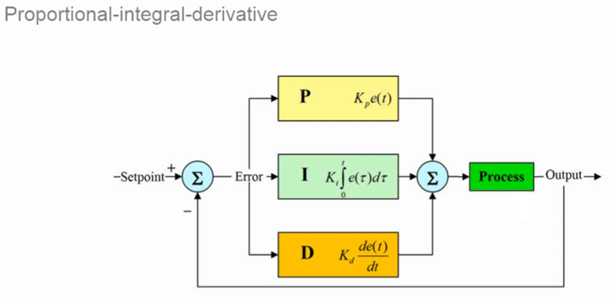
What is PID
Kp -- proportional gain
Ki -- integral gain
Kd -- derivative gain.

Slide 3

What does each term do
Run the first section of the matlab script.
This command window shows the transfer function for the virtual plant shown in the previous slide.

Slide 4
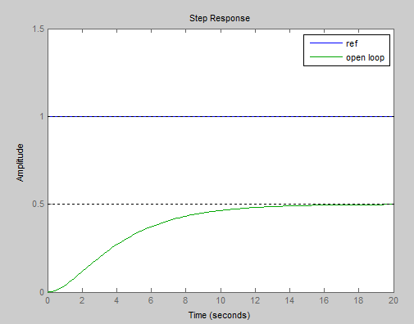
What does each term do
Run the second section of the matlab script.
This shows the open loop response to an input step change

Slide 5
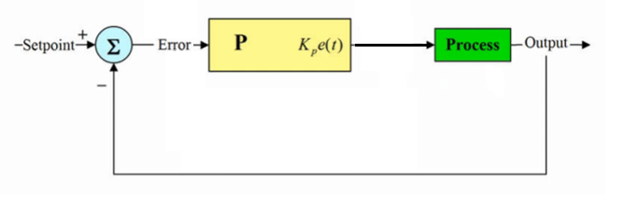
What does each term do
Proportional term
The proportional term applies proportional control to the process, that is the corrective output from the controller is proportional to the error, subject to the gain Kp.

Slide 6
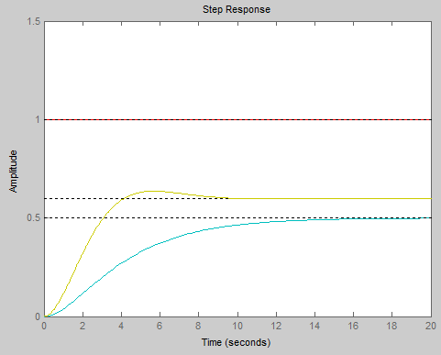
What does each term do
Proportional term
Applying proportional only control to the virtual process
(run section 3 of the script)
From the graph, right, we can see the response is significantly quicker than earlier but the offset still exists.
Altering the value of Kp can improve the offset, at the cost of system stability.

Slide 7
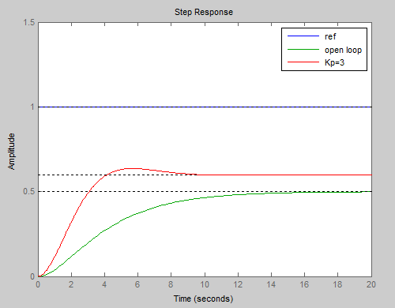
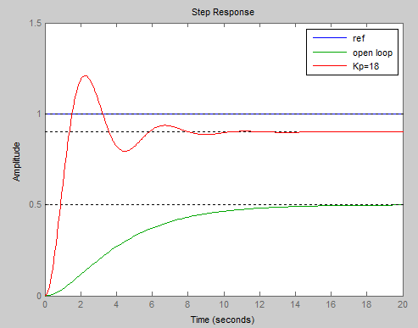
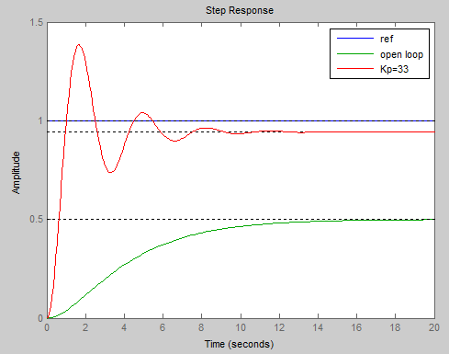
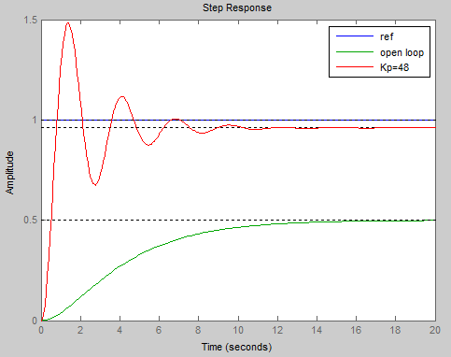
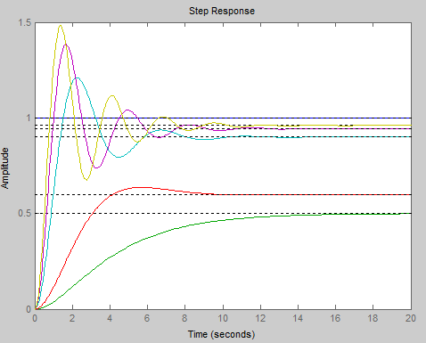
What does each term do
Proportional term
Applying proportional only control to the virtual process
The graphs shows changes in the value of Kp in steps of 15 and combined

Slide 8
What does each term do
Proportional term
Applying proportional only control to the virtual process always results in an offset error value( set point – steady state output) to the output. Increasing the gain speeds up the response and limits the offset but decreases the stability of the system
As can be seen the offset is reducing but the instability (output oscillation) is increasing

Slide 9
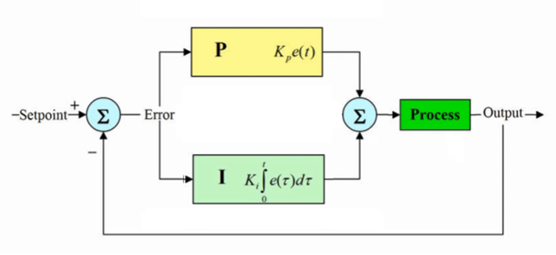
What does each term do
Integral term
The integral term applies integral control to the process, that is the corrective output from the controller is proportional to the integration of the error signal, subject to the gain Ki. This is used to eliminate the steady state error of proportional only control.
Proportional – integral (pi) control

Slide 10
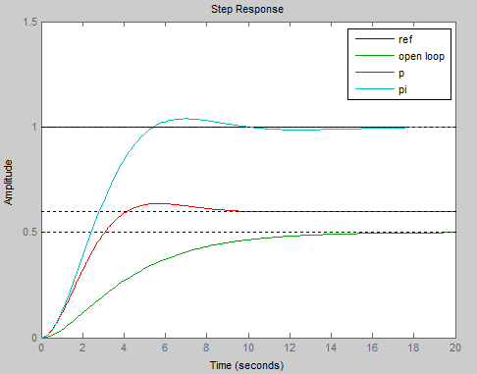
What does each term do
Integral term
Applying proportional and integral control to the virtual process
(run section 4 of the script)
From the graph, right, we can see the response is fast and that the offset has been removed.

Slide 11
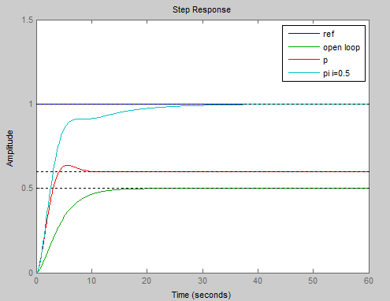
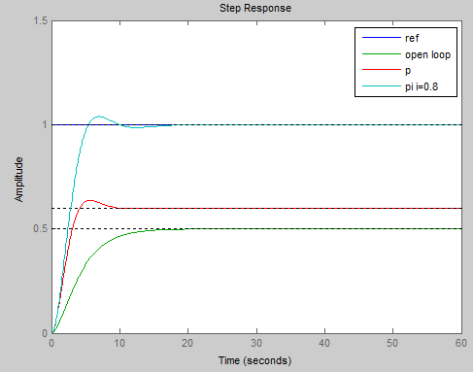
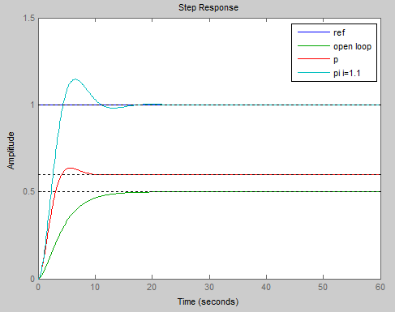
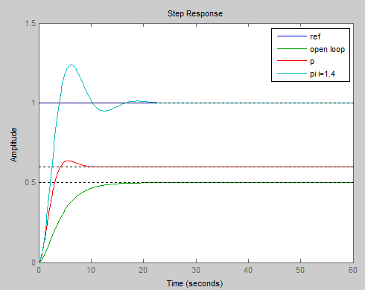
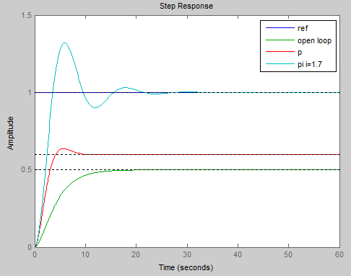
What does each term do
Integral term
Applying Proportional and Integral (pi) control to the virtual process
The graphs shows changes in the value of Ki in steps of 0.3 from 0.5

Slide 12
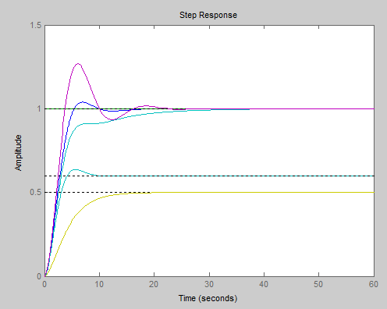
What does each term do
Integral term
Adding the integral term to the proportional control to the virtual process results in the offset error being eliminated . Too low a value of Integral gain can be seen by no overshoot and a slow climb to the required output. Optimal gain shows a small over shoot with steady state being achieved within 2 cycles approximately. Too much gain decreases the stability of the system and has no benefit.
As can be seen in this graph increasing the integral gain from 0.5 shows that the optimum value is at approx. 0.8 and then becoming more unstable as the gain is increased in this case to 1.7

Slide 13
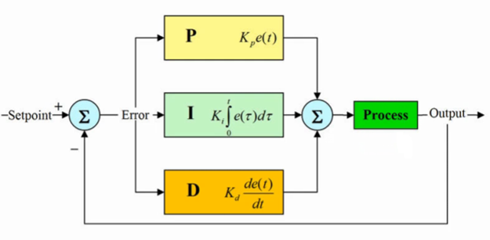
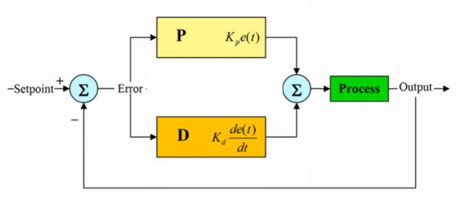
What does each term do
Derivative term
The derivative term applies derivative control to the process, that is the corrective output from the controller is proportional to the differentiation of the error signal, subject to the gain Kd. This is used to control the output based upon the rate of change of the input. Derivative may be used with proportional as part of a PD loop or as part of a PID loop.
Proportional – derivative (pd) control
Proportional – integral derivative (pid) control

Slide 14
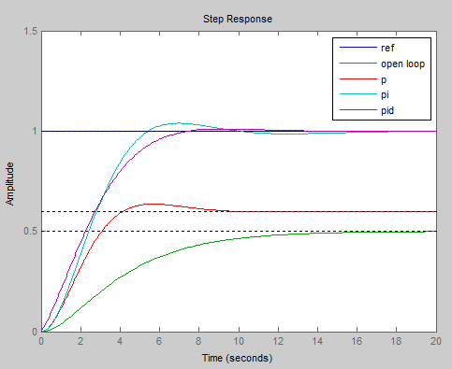
What does each term do
Derivative term
Applying proportional and derivative control to the virtual process
(run section 5 of the script)
From the graph, right, we can see that the amount of overshoot is lower.

Slide 15
PID tuning challenges
What do we mean by tuning a PID controller.
  Finding the gain values to meet the response time and stability (overshoot/ phase margin) specifications.
  The gain values may be found by:-
    Manual tuning – this is a trial and error process, it is time consuming and non-systematic. It may not produce optimal design and can lead to dangerous conditions. (unstable process)
    Rule based tuning - requires a lot of work, or simply cannot be applied (open-loop unstable systems). It cannot be fine tune.

