Slide 1

childhood obesity interventions in the UK over the past 10 years
Student name: maria Michael
Student ID: 191 38 94
MODULE CODE: BMHP 6020
DATE: May 15, 2022

Slide 2
Chapter 1. Introduction
WHAT IS CHILDHOOD OBESITY?
A child is considered obese if his/ her body mass index-for-age (or BMI-for-age) is greater than 95 percent of those in the same age group (Obesity Action Coalition, 2023).

Slide 3
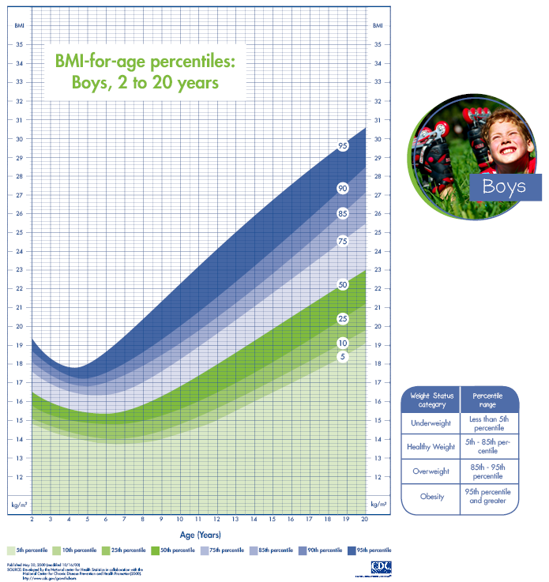
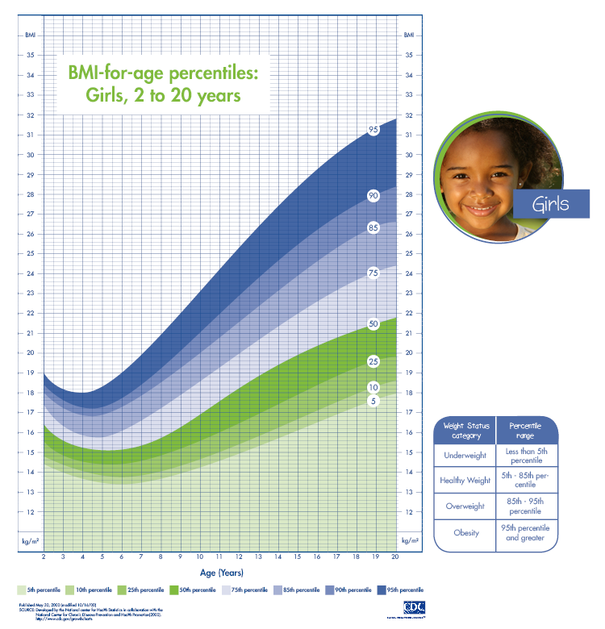
Chapter 1. Introduction

Slide 4
Chapter 1. Introduction (Cont’d)
Over the past decade, childhood obesity has become a matter of growing concern in the United Kingdom.
The NHS (2019) indicates that obesity affects approximately 20% of children between the ages of ten (10) and eleven (11) in the country.
Obesity increases the risk of developing several types of cancer including breast cancer and colon cancer, in addition to type 2 Diabetes.
There is also the increased risk of psychological health challenges such as depression and low self-esteem (Rankin, et al., 2016).

Slide 5

Chapter 2. Background
National Context
Childhood obesity and excess weight are among the major health challenges facing UK children and their families
Over 20% of primary school children are either obese or overweight prior to the start of schooling, and 33% are obese or overweight by the end of their primary school years
(Public Health England, 2019)

Slide 6
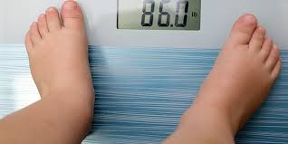
Chapter 2. Background (Cont’d)
There has been a marked increase in the number of UK children who are either obese or overweight (Baker, 2022)
Children residing in deprived areas are more likely to be obese (Public Health England, 2019)

Slide 7

Chapter 3. Methods
The following factors were used in deciding what articles to use for the dissertation:
Research terminologies Area of study Inclusion criteria
Exclusion criteria Data analysis Ethical considerations
The literature review was carried out using both CASP and Prisma
Databases such as ScienceDirect, Directory of Open Access Journals (DOAJ) and PubMed were used
The articles used were peer-reviewed, English language journals that covered the issue of childhood obesity and the interventions introduced over the last 10 years

Slide 8

Chapter 3. Methods (Cont’d)
Inclusion Criteria
  Publication dates from 2012 to present
  The availability of the full text of the publication
  Research taking the form of academic journal articles and scholarly papers
  Publications done in and relating to the United Kingdom;
  Publications covering the demographic group under examination (persons under the age of 18 years old)

Slide 9

Chapter 3. Methods (Cont’d)
Exclusion Criteria
  Publications made before the period under review, that is before 2012
  Dissertations and reviews of academic publications
  Articles without methodology, or that gave no findings from studies conducted
  Publications focused on adult and elderly populations in the UK
  Resources that were published in languages other than English.

Slide 10
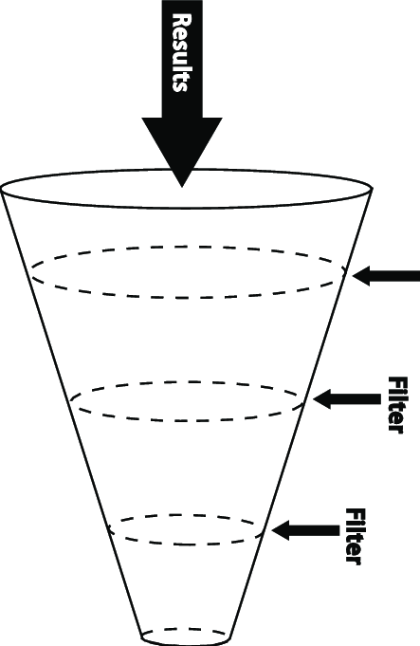
Chapter 4. results and discussion
The searches yielded 28 results, 16 from university sources, and 12 from journals
Ten (10) were eliminated due to the inadequacy of the information
Screening for effective methodology saw the removal of seven (7) more studies
Of the remaining eleven, one was removed randomly, as only ten were required

Slide 11
Chapter 4. results and discussion (cont’d)
The studies’ aims varied, but were all relevant to the research topic. For example:
  Five (5) of them focused on specific childhood obesity interventions - Dogra et. al., 2021; Gadsby et. al., 2020; Theis and White, 2021; Busam and Solomon-Moore, 2021; Solmi and Morris, 2015)
  Three focused on individual contributors to childhood obesity (Rogers et. al., 2023; Griffin et. al., 2021; Ramster et. al., 2019)
  Two examined potential outcomes of childhood obesity (NHS, 2018; Beynon, 2023)

Slide 12
Chapter 4. results and discussion (cont’d)
The following four major themes were identified in the ten studies selected:
The UK government’s policy is geared primarily to promoting healthier choices through positive behaviour changes and lifestyle decisions – an area that proved to lack enough concern to significantly reducing the health issues plaguing the UK (Theis and White, 2021)
Obese children generally experience stigma as a result of their condition (Busam and Solomon-Moore, 2021)
Socio-economic and cultural factors can both negatively and positively affect childhood obesity rates (NHS, 2018)
Childhood obesity interventions require a multifaceted approach if they are to be successful

Slide 13
Chapter 5. conclusion and recommendations
Multiple studies on childhood obesity in the UK have been undertaken
Childhood obesity is not a stand-alone issue, but instead a phenomenon that cuts across all sectors and aspects of life in the UK.
Several factors contribute to childhood obesity rates as well as the efficacy of interventions
As demographics change, so will childhood obesity rates throughout the country.
The various measures implemented to fight childhood obesity are in need of revision and monitoring to keep up-to-date of social and demographic changes
While studies on each of the factors would provide a useful foundation for developing interventions, it is important that the correlation among these factors be investigated so that a more unified path to reducing childhood obesity rates can be developed

Slide 14
references
Baker, C., 2022. Obesity Statistics. [Online]. Available at: https://commonslibrary.parliament.uk/researchbriefings/sn03336/#:~:text=Childhood%20obesity%20in%20England,the%20National%20Child %20Measurement%20Programme [Accessed 28 October 2022].
Beynon, C. (2023). Association between children living with obesity and Mental Health problems: a data analysis of the Welsh Health Survey, UK. BMC Public Health, 383 [Online]. Available at: https://doi.org/10.1186/s12889-023-15293-8 [Accessed 13 April 2023]
Busam, B., & Solomon-Moore, E. (2021). Public Understanding of Childhood Obesity: Qualitative Analysis of News Articles and Comments on Facebook. [Online]. Health Communication Available at: https://doi.org/10.1080/10410236.2021.1985859 [Accessed 11 April 2023]
Dogra, S. A., et. al. (2021). Delivering a childhood obesity prevention intervention using Islamic religious settings in the UK: What is most important to the stakeholders? Preventive Medicine Reports. [Online]. Available at: https://doi.org/10.1016/j.pmedr.2021.101387 [Accessed: 4 April 2023].

Slide 15
reference
Gadsby, E.W. et. al. (2020). Impact of a community-based pilot intervention to tackle childhood obesity: a ‘whole-system approach’ case study. BMC Public Health [Online]. Available at: https://doi.org/10.1186/s12889-020-09694-2 [Accessed 11 April 2023].
Griffin, N., et. al. (2021). A critique of the English national policy from a social determinants of health perspective using a realist and problem representation approach: the ‘Childhood Obesity: a plan for action’. BMC Public Health. [Online]. Available at: https://doi.org/10.1186/s12889-021-12364-6 [Accessed: 5 April 2023].
NHS (2018). National Child Measurement Programme - NHS Digital. [online]. Available at: https://digital.nhs.uk/data-and-information/publications/statistical/national-child-measurement-programme. [Accessed 9 January 2023].
NHS (2019). Obesity. [online]. Available at: https://www.nhs.uk/conditions/obesity/ [Accessed 8 January 2023].

Slide 16
references
Obesity Action Coalition, 2023. What is Childhood Obesity? [Online]. Available at: https://www.obesityaction.org/get-educated/understanding-childhood-obesity/what-is-childhood-obesity/#:~:text=A%20child%20is%20defined%20as,and%20less%20than%2095%20percent [Accessed 9 May2023]
Office for Health Improvement & Disparities (2022). Official Statistics Obesity Profile: statistical commentary December 2022. [online]. Available at: https://www.gov.uk/government/statistics/obesity-profile-december-2022-update/obesity-profile-statistical-commentary-december-2022 [Accessed 24 February 2023].
Public Health England (2019). Childhood Obesity: applying All Our Health. [online]. Available at: https://dera.ioe.ac.uk/34071/1/applying%20All%20Our%20Health%20child%20obesity-%20GOV.pdf [Accessed 23 March 2023].
Ramster, et. al. (2019). Tackling childhood obesity: a case study of hyperlocal inclusive design with the Stockwell Housing Estate in London. [Online]. Available at: https://researchonline.rca.ac.uk/4181/ [Accessed 6 April 2023].

Slide 17
reference
Rankin, J. et al., 2016. Psychological consequences of childhood obesity: psychiatric comorbidity and prevention. Adolescent Health, Medicine and Therapeutics, 1(7), pp. 125-146.
Rogers, N. T., et. al. (2023). Associations between trajectories of obesity prevalence in English primary school children and the UK soft drinks industry levy: An interrupted time series analysis of surveillance data. PLOS Medicine, 20(1), e1004160. [Online]. Available at: https://doi.org/10.1371/journal.pmed.1004160 [Accessed 6 April 2023]
Solmi, F. and Morris, S. (2015). Association between Childhood Obesity and use of regular medications in the UK: longitudinal cohort study of children aged 5-11 years. BMJ Open 2015 [Online]. Available at: https://bmjopen.bmj.com/content/bmjopen/5/6/e007373.full.pdf [Accessed 12 April 2023]
Theis, D. R. Z., & White, M. (2021). Is Obesity Policy in England Fit for Purpose? Analysis of Government Strategies and Policies, 1992–2020. Milibank Quarterly, 9 (1), pp126-170 [Online]. Available at: https://doi.org/10.1111/1468-0009.12498 [Accessed 12 April 2023].

