Slide 1
Three united thread
GROUP PROJECT
work-based learning project
David li ah choON (assistant front office manager)
ramen Tesigen (sous chef)
kerensa Langitan (group spa & wellness manager)

Slide 2

LUX* JUMPS OUT AND BARKS,
“creating a dog friendly environment within hospitality”

Slide 3
stray dogs Impact Worldwide
2010 - 2018
NEGATIVE IMPACTS
A loss of USD 15 million annually affected Puerto Rico (Davis, 2010)
60% of Canadian have pets and avoid hotels with stray dogs (Webster, 2013)
Rabies became a major public health problem in Cameroon (Raymond, 2015)
Ministry of Environment of Mauritius stated stray dogs might attack humans and vehicles (2015)
METHODS DONE TO REDUCE/ CONTROL
Drastic solutions including shooting, poisoning, and electrocution in Athens
Gruesome culling of stray in Mauritius (Daily Mail UK, 2015)
Air Transat supported adoption project on the Caribbean and Mexico (Davis, 2010)
Thousands of dogs had been sterilised in Mauritius HSI Africa (2018)

Slide 4

STATISTICS OF STRAY DOGS IN MAURITIUS*
Year 2016 - 80,000 stray dogs
Year 2018 - 200,000 stray dogs
Drastic increase ↑ 250%
* Numbers were taken according to the statistic of Ministry of Agriculture
in 2016 and Protection of Animal Welfare Society, PAWS in 2018

Slide 5
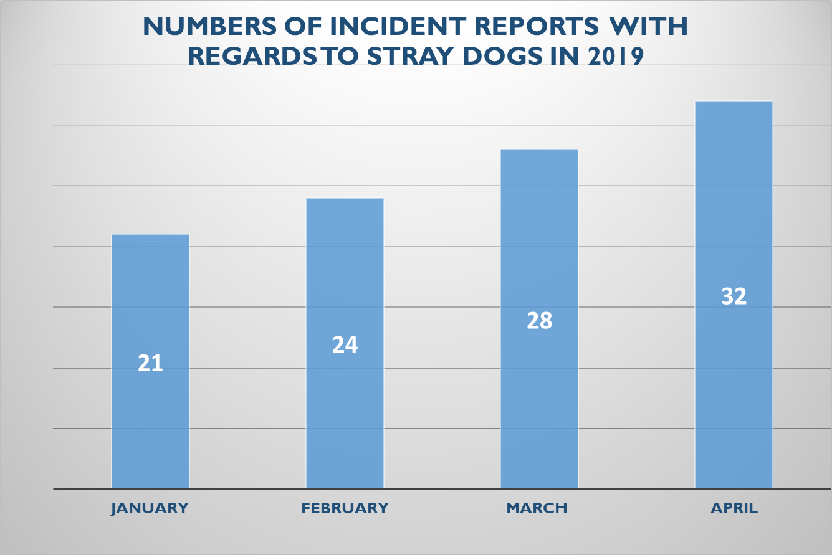
CHALLENGES at Lux* Grand Gaube

Slide 6
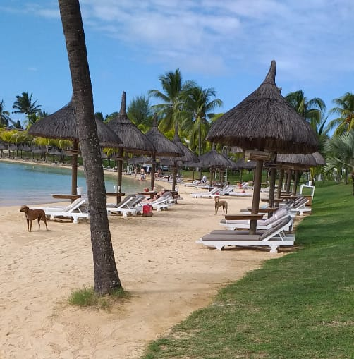
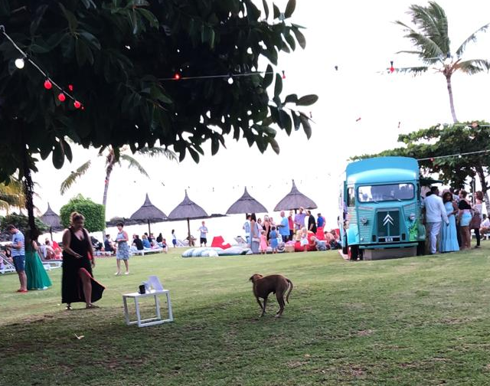
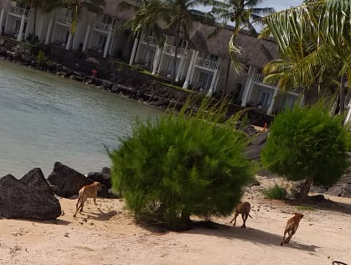
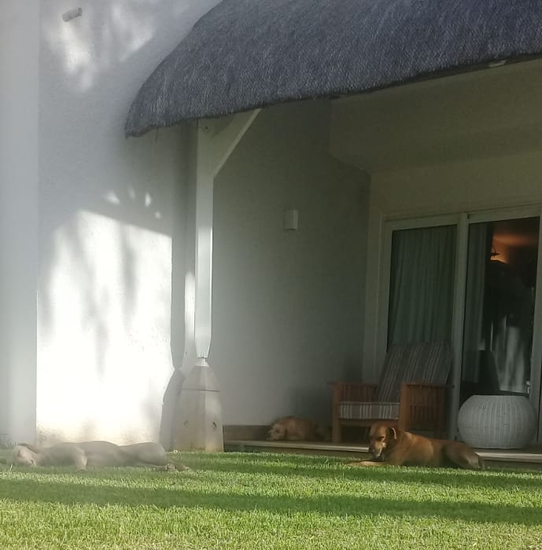
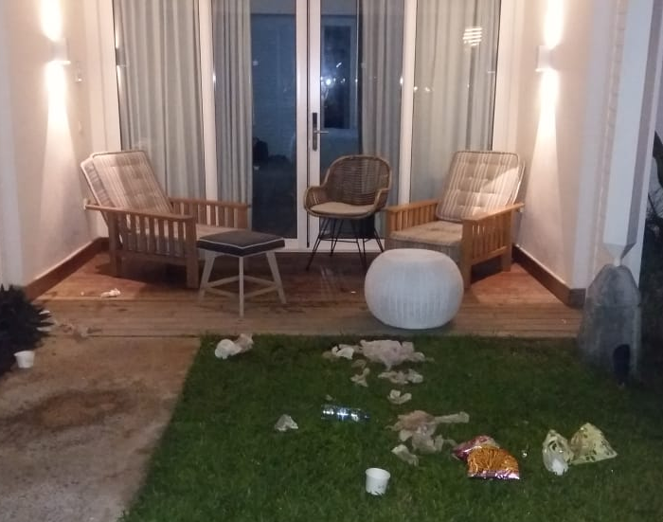
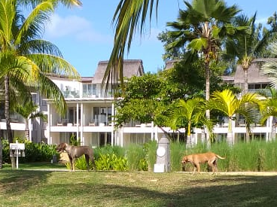

Slide 7
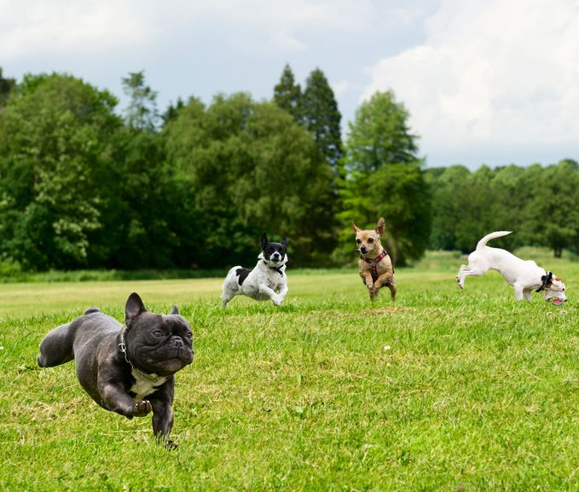


JUSTIFICATION
AIMS
To find out the most suitable dog-care program on location
To give a positive impact for tourists and community
To promote animal care awareness within hospitality
Incidents and labour inefficiency VS ‘Zero stray’
Culture VS Animal-welfare propaganda
                OBJECTIVES
To look for a sustainable way in tackling stray dog issue
To explore the possibility of having a temporary shelter

Slide 8

METHODS & FINDINGS
SURVEY
FOCUS GROUP
ONE TO ONE
OBSERVATION

Slide 9
SURVEY
  30 in-house guests and 72 team members
  Voluntary and anonymous
Analysis on stray dogs’ visibility, concern and feeling
65% of guests encountered strays VS 100% of team members on daily basis
    32% concerned of affecting guest stay and hotel image
    27% of hygiene
    27% of possible disease
    17% afraid of attack
    23% of team members also concerned of the dog welfare

Slide 13
91% agreed to participate in the improvement program
60% agreed on a temporary shelter at LUX* Grand Gaube

Slide 14
FOCUS GROUP
ONE TO ONE
Incorrect ‘stray’ term
No closed environment – create ‘guardian’ dogs
Sterilisation program
Adoption program and house check
Hotel sales & marketing
2 contradictive letters from the Ministry of Tourism
NGO supports worked faster than government
Workshops for team members → community
Access to adoption program
Participants:
4 NGO’s: Humane Society International (HIS), Prevention of Animal Welfare Society (PAWS), All Life Matters Animal Sanctuary (ALMAS), and 4 Paws on Wheel (4PoW)
District Council and Hotel security representative
Interviewee:
Chief security of Lux* Belle Mare

Slide 15
Observation
  Advanced permission
  Signed consent form
General behaviour of dogs
Feeding schedule 2x/ day for adult dogs and 3x/ day for puppies
All day water available
Proper dimension of kennels
General requirements
Observation was held at All Life Matters Animals Sanctuary (ALMAS), Pamplemousses, Mauritius.

Slide 16
CONCLUSION
No single ideal solution
Culture played a very important role
Time needed for education in treating animal well
Initiatives could be always taken by anyone
Aspects to consider: guests and team members views, transparency, proper sheltering, feeding, collaboration with animal-welfare organisations

Slide 17
RECOMMENDATIONS
Workshop of sterilisation program and animal welfare
Identify a maximum of 6 ‘guardian’ stray dogs, sterilise and tag with the hotel logo
A feeding, shelter-like area, open for guests
Use hotel food waste
Gated area for stray puppies and possible adoption
Transparency about the project
Events and campaigns with sustainability and marketing departments
Maintain relations with NGO’s and government for supports

Slide 18
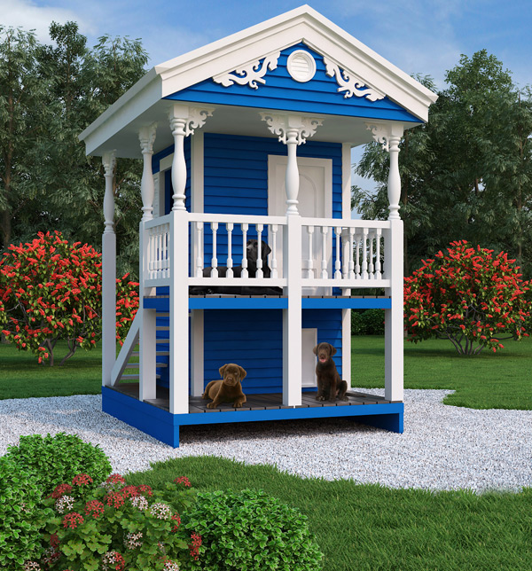
COST
Construction material and labour:
Dog Park/ fencing → Rs. 40,000
Shaded area → Rs. 60,000
An additional dog handler or carer → Rs. 12,000
Paddling pool → Rs. 5,000
Doggy pool and balls → Rs. 5,000
Total cost to start the project Rs. 122,000

Slide 19
Project sponsorship timeline proposal
Survey and analysis by August 2019
Financial approval by October 2019
Dog park allocation and security team training by November 2019 (guided by experts)
Dog fencing construction by December 2019 (identify guardian dogs)
Team members workshop, recruitment, training by December 2019
Event and Campaign by January 2020
Up and running project starting January/ February 2020

Slide 20
PERSONAL LEARNING OUTCOME & CONTRIBUTION
Ramen Tesigen

Slide 21
LITERATURE REVIEW
Online research on UWTSD library and google scholar
Diana Webster 2013 and Ted Davis 2010
FINDINGS
Survey : engage guest and team members participation
Focus group : take note and share
Observation : documentation and write-up
PERSONAL LEARNING
Working as a team
Use of google form
First time involved in guest survey participation
General knowledge on dog behaviour, dog sheltering, and awareness on rabies
PROFESSIONAL LEARNING
Align my individual project on food waste with the current project
Acquired points of considerations how to draft a plan
Time management on academic, professional, and personal life compared to the previous assignment
Improve English writing and speaking

Slide 22
PERSONAL LEARNING OUTCOME & CONTRIBUTION
David Li Ah Choon

Slide 23
LITERATURE REVIEW
Davis’ article 2010 : economic impact
Video footage on Trip Advisor (Daily Mail 2015)
FINDINGS
Survey – questionnaires and participants
Focus group – contact, presentation, draft
One to one – contact, interview, draft
PERSONAL LEARNING
Time management
Learn from collaborators how to make a research
Behaviour of human and stray dogs
PROFESSIONAL LEARNING
Prepared to face unhappy guests
Close relationship with NGOs
Help guests for adoption of stray dogs

Slide 24
PERSONAL LEARNING OUTCOME & CONTRIBUTION
Kerensa Langitan

Slide 25
LITERATURE REVIEW
Katz’ fundamental knowledge on dog behaviours
Pizam and Mansfeld’ on Tourism security and safety
Webster’s reference to assist on survey questionnaire
FINDINGS
Survey – questionnaire, Google Form, and analysis
Focus group – direct questions and discuss
Compile final project write-up and presentation
PERSONAL LEARNING
Better knowledge of different types of NGO’s related to animal welfare
Understanding of different habits and rituals within a culture
PROFESSIONAL LEARNING
Thorough, methodical research
Public speaking
Awareness of issue that involves emotions and culture VS solution

Slide 26

We make each moment matter – We care about what matters Thank You

