Slide 1

Strategies for Effective Communication in a Business Setting
Alexandra Padure 2130815
Ioana Otrocol 2125444
Livia Dragan 2130234
Valentina Dinca 2131463
Lecturer: Dr.Hafiz Rahmani
BMSW 4002
Effective team working and communication

Slide 2
Summary
Today presentation is about a case study regarding the strategies of effective communication between Tom and his team, to have a successful outcome on the project to opening another three warehouses in Europe.
In order to achieve their goal, they need to communicate efficient.

Slide 3


Communication is one of the main concerns at work. Creating and maintaining a regular work environment means effective workplace communication.
Communication is the key to success for Tom and his team is very important because they will have a important contract and this communicating they will be able to acquire and have good results.

Slide 4

For Tom and his co-workers communication is the key to success because , if we communicate with each other our task can be easier than is look. Here we have some example what communication is helpful for:
Build trust: once you are un a team is better to trust each other because that effective communication does and the ability to trust is important in a team.
Prevent or resolving problems :the ability to communicate can easily prevent conflicts and can resolve big problems
Better relationship: if a team communicate can build relationship between a leader and workers if you listen to your teammates you show them respect and that you care about them
Improve productivity: having a team members who understand their role , the role of others and your expectation can help you focus more on your work and not be distracted by workplace problems.
Figure 3: Teamwork importance: 15 ways teams are good for business, (2022)

Slide 5

promotes team building :As employers work together and grow as a team, they form bonds that grow into trust and friendship. It’s human nature also employees who liked and trust each other are best for business because they are more likely to : communicate well with each other.
Figure 4: 10 proven importance of teamwork in the workplace

Slide 6
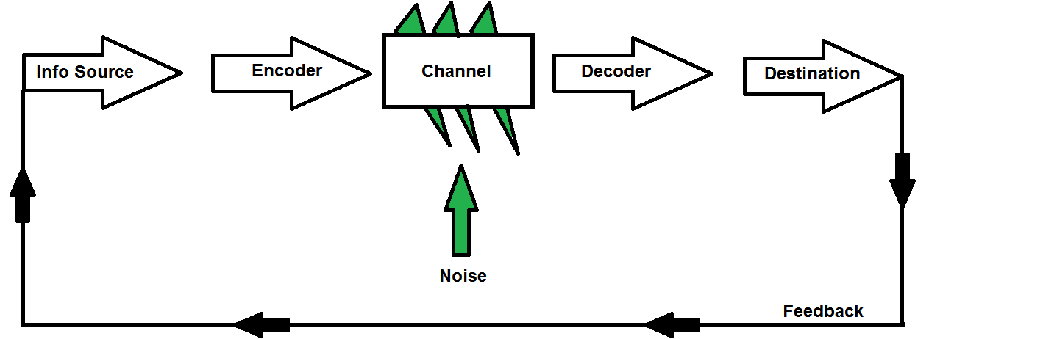
Model of communication
The model of Shannon-Weaver- communicate by a signal
Figure 5. The Shannon-Weaver Model, (2022)

Slide 7
Tom
Tom teams from all departments
Amazon
No channel of communication
Tom team
Conflict and disagreement
Feedback

Slide 8
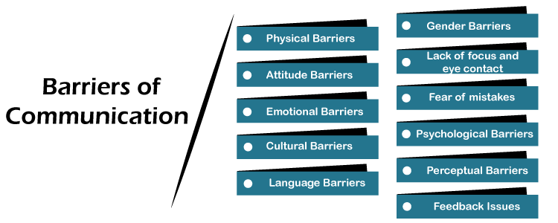
Now let’s discover which communication barriers have or can negatively impact the project team.
After analysing the case I would say that Tom team project has encountered some barriers which has already impacted negatively the team .
Figure 6. Barriers of Communication, (2022)

Slide 9

Some of the barriers are attitude barriers, emotional barriers ,feedback issues but the biggest barrier who have the most negative impact on the team is the perceptual barrier.
Tom did not take in consideration that people are different and they perceive the same things differently. This is a fact that he must take into consideration during the communication process. Knowing the levels of public perception is a must for a good communication. Any messages or communications he wants to transmit must be simple and clear. There should be no room for a diversified interpretative whole.
If Tom had been clear in the way he communicated with his team, he could have avoided many barriers.
Figure 7. How to Overcome the Seven Barriers to Effective Communications, (2022)

Slide 10

If Tom wants that his team project to overcome this barriers he will have to use regular feedback.
Without feedback his team will have no chance to learn and grow. Feedback supports creativity and innovation. Feedback ultimately gives us a sense of security because we know where we are and what our strengths, weaknesses and blind spots are.
Figure 8. 9 ways to encourage customers to give feedback

Slide 11

Business communication channels
The term "channel" refers to any method for delivering messages. A speaker may use verbal or nonverbal communication techniques.
The selection of various media has been the focus of studies about communication channels. The so-called Lendle Daft model of channel richness was created by Daft and Lengel in the middle of the 1980s. It advocated a hierarchy of media richness with four levels, with face-to-face being the richest and followed by phone, email, and text.
Figure 9. Hierarchy of media richness

Slide 12

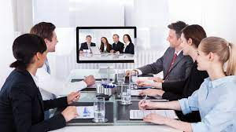
Proposal
Face-to-face interaction is crucial in business because it allows participants in a conversation to have visual contact with the other party or parties. Since both the speaker and the listener can see and understand signals such as nonverbal cues, it enables a better exchange of knowledge. Face-to-face is the right channel for information processing because it provides immediate feedback. Therefore, Tom should meet his team regularly.
Figure 10
Video conferencing should also be used to communicate successfully with his team and the other Amazon warehouses in Europe, if face-to-face interactions are not available because emails might be ambiguous and misinterpreted and do not build relationships.
Figure 11

Slide 13
References
  Figures 1 and 2: “Effective Communication in the Workplace: How and Why?”, December 2021 viewed at 11.11.2022 Available at https://www.spiceworks.com/hr/engagement-retention/guest-article/effective-communication-in-the-workplace-how-and-why/
  Figure 3: “Teamwork importance: 15 ways teams are good for business”, (2022,November 12), viewed at 13.11.2022 Available at: https://www.careeraddict.com/5-benefits-of-teamwork-in-the-workplace
  Figure 4: “10 proven importance of teamwork in the workplace”, 13.12.2022 Available at: https://hrmcmatrix.com/importance-of-teamwork-in-the-workplace/
  Figure 5. G,Beyer (2021) “The Shannon- Weaver Model”, wiewed at 11. 11.2022 Available at https://garthbox.com/the-shannon-weaver-model
  Figure 6: “Barriers of Communication – Javatpoint”. (n.d.). www.javatpoint.com. 11 November 2022 Available at: https://www.javatpoint.com/barriers-of-communication
  Figure 7: “How to Overcome The Seven Barriers to Effective Communications”. (2022, November 2). MultiCall viewed at 11 November 2022 Available at: . https://www.multicall.in/how-to-overcome-the-seven-barriers-to-effective-communications/
  Figure 8: “9 ways to encourage customers to give feedback” ,Call Center Helper, viewed at 12.11.2022 Available at: https://www.callcenter.com/9-ways-to-encourage-customers-to-give-feedback-118879.htm

Slide 14
Figure 9. Lengel, R.H. and Daft, R.L. (1988) “The selection of communication media as an executive skill,” Academy of Management Perspectives, 2(3), pp. 225–232. viewed at 10.11.2022 Available at: https://doi.org/10.5465/ame.1988.4277259
Marouf, L. (2008). “Communication Channels and Employee Characteristics: An Investigation”. Singapore Journal of Library & Information Management, 37.
Figure 10 . Aziz, S. (2019), https://wowbixmarketing.com. Viewed at 10.11.2022 Available at: https://wowbixmarketing.com/face-to-face-communication/ (Accessed: November 11, 2022).
Figure 11. Mclaughlin, M., Brame, D. and Mcallister, N.M. (2022) : https://uk.pcmag.com/cloud-services/9067/the-best-video-conferencing-software viewed at 10.11.2022 Available at: the-best-video-conferencing-software-for-2022_8fy3.640.jpg (640×360) (pcmag.com) (Accessed: November 11, 2022).
Lengel, R.H. and Daft, R.L. (1988) “The selection of communication media as an executive skill,” Academy of Management Perspectives, 2(3), pp. 225–232. viewed at 10.11.2022 Available at: https://doi.org/10.5465/ame.1988.4277259.
Denis.M. (2020) “Communication Theory”, wiewed at 11.11.2022 Available at https://www.communicationtheory.org/shannon-and-weaver-model-of-communication/

Slide 15


