Slide 1

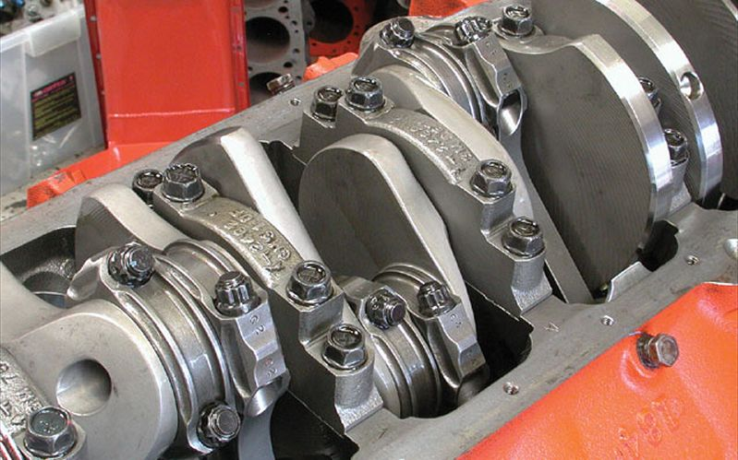
Mechanical Principles
Outcome 4 – Balancing
Level : BSc 2 / HND 2
Lecturer :Tim Tudor
Email : timothy.tudor@sm.uwtsd.ac.uk

Slide 2

Outcome 4
Outcome 1 (3-4 Weeks)
      Elastic constants and their relationships
      Two and three-dimensional loading
      Volumetric strain
      Other Elastic constants
Outcome 2 (8-9 Weeks)
      Loaded beams
      Pressure in thin walled vessels
      Pressure in thick walled vessels
Outcome 3 (9-10 Weeks)
      Friction Clutches
      Gear Trains
      Pulleys / Belts
Outcome 4 (4-5 Weeks)
      Flywheels
      Balancing

Slide 3
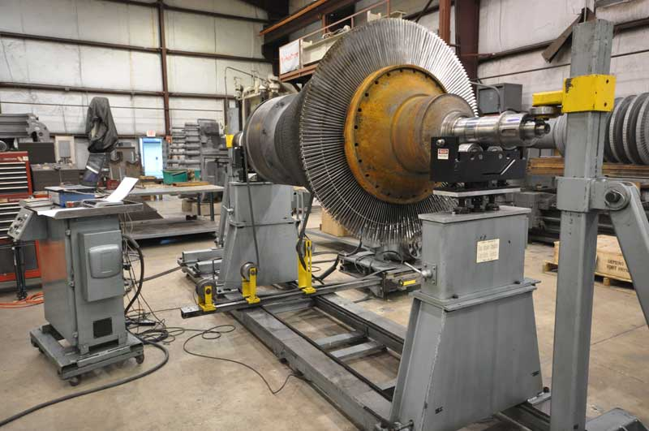
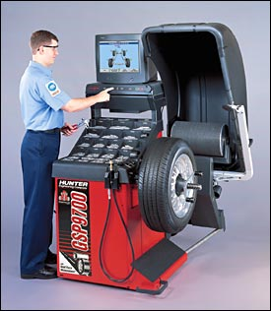
Balancing
The balancing of rotating bodies is important to avoid vibrations.
In heavy industrial machines such as steam turbines and electric generators, vibration could cause catastrophic failure.
Vibrations are noisy and uncomfortable and when a car wheel is out of balance, the ride is quite unpleasant.
In the case of a simple wheel, balancing simply involves moving the centre of gravity to the centre of rotation

Slide 4
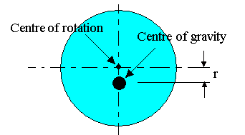
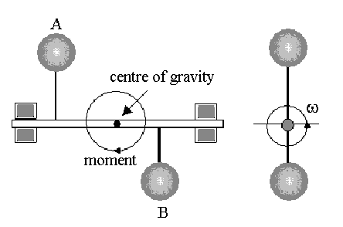
Balancing
For a body to be completely balanced it must have two things.
1. Static Balance.
This occurs when there is no resultant centrifugal force and the centre of gravity is on the axis of rotation.
2. Dynamic Balance.
This occurs when there is no resulting turning moment along the axis of rotation.

Slide 5
Balancing in a single plane
If the system is a simple disc then static balance is all that is needed as there are no turning moments along the axis or rotation.
Consider a thin disc or wheel on which the centre of gravity is not the same as the centre of rotation.

Slide 6
Balancing in a single plane
A simple test for static balance is to place the wheel in frictionless bearings.
The centre of gravity will always come to rest below the centre of rotation (like a pendulum).
If it is balanced it will remain stationary no matter which position it is turned to.

Slide 7
Balancing in a single plane
If the centre of gravity is distance r from the centre of rotation then when it spins at ω rad/s, centrifugal force is produced.
where M is the mass of the disc.
This is the out of balance force.
In order to cancel it out an equal and opposite force is required

Slide 8
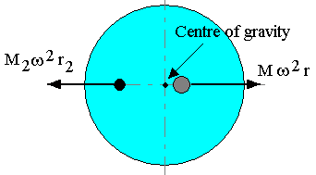
Balancing in a single plane
The balancing force is achieved by simply adding a mass M₂ at a radius r₂ as shown.
The resulting centrifugal force from each mass must have the same magnitudes but opposite directions, thus;
M ω² r = M₂ ω² r₂
M r = M₂ r₂
Placing the second mass at the suitable radius moves the centre of gravity to the centre of rotation.

Slide 9
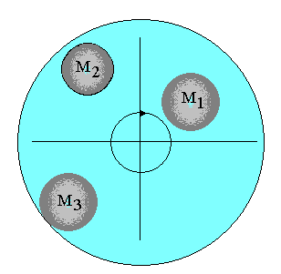
Balancing in a single plane
Now consider that our disc is out of balance because there are three masses attached to it as shown.
The 3 masses are said to be coplanar and they rotate about a common centre.
The centrifugal force acting on each mass is
F = M r ω².
Thus the forces acting on each mass are;
F₁=M₁r₁ω² F₂=M₂r₂ω² F₃=M₃r₃ω²

Slide 10
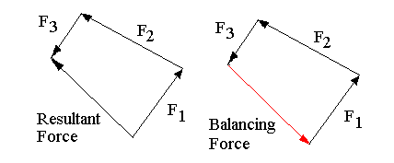
Balancing in a single plane
These forces are vector quantities as they have magnitude and direction
Direction is outwards in the radial direction.
We can add them up to find the total resultant force as shown.

Slide 11
Balancing in a single plane
If the system was balanced, there would be no resultant force
The force needed to balance the system must be equal in magnitude and opposite in direction to the resultant (the vector that closes the polygon).

Slide 12
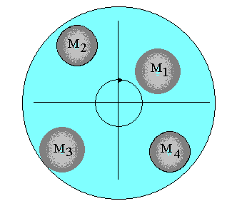
Balancing in a single plane
A balancing mass M₄ can be added at a suitable radius and angle such that the balancing force vector is produced.
Direction set by mass position and magnitude set by product Mr.

Slide 13
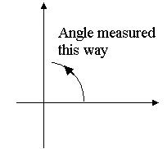
Balancing in a single plane
If static balancing is achieved, the disc will be balanced at all speeds.
Thus it is useful during analysis to define that ω = 1
Problems are solved by constructing the vector polygons.
Angles are measured and defined using the usual mathematical definition ;

Slide 14
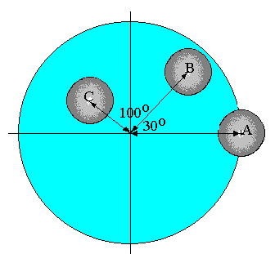
Worked Example
Three masses A, B and C are placed on a balanced disc as shown at radii of 120 mm, 100 mm and 80 mm respectively.
The masses are 1 kg, 0.5 kg and 0.7 kg respectively.
Find the 4th mass, M_{D} which should be added at a radius of 60 mm in order to statically balance the system.

Slide 15
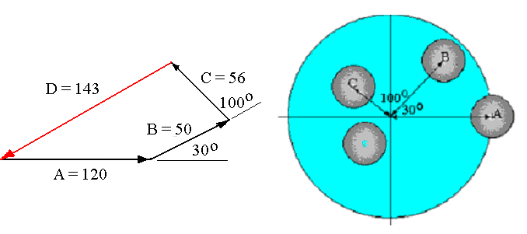
Worked Example
First draw up a table to calculate the value of M r for each mass.
Mass radius M r
A 1 120 120
B 0.5 100 50
C 0.7 80 56
D M_{D} 60 60 M_{D}
Then draw the M r polygon to find the value of M r for the 4th mass.
Use a scale 1mm = 1 kgmm

Slide 16
Worked Example
The resultant magnitude is 143 Kgmm at an angle of 208º anticlockwise of A as shown.
To calculate the mass required if radius is 60mm we use the following method.

Slide 17
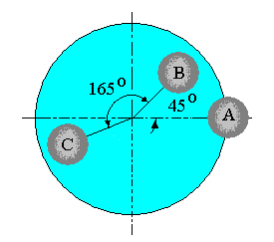
Example 1
Find the 4th mass that should be added at a radius of 50 mm in order to statically balance the system shown.
Mass A is 1 kg at 100 mm radius.
Mass B is 1.5 kg at 75 mm radius
Mass C is 2.0 kg at 90 mm radius.

Slide 18
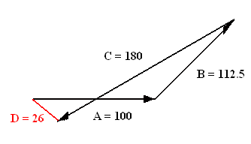
Example 1 - Answers
Find the 4th mass that should be added at a radius of 50 mm in order to statically balance the system shown.
First draw up a table to calculate the value of M r for each mass.
Mass radius M r
A 1 100 100
B 1.5 75 112.5
C 2 90 180
D M_{D} 50 50 M_{D}
Draw the M r polygon to find the value of M r for the 4th mass.
Mr = 26 kg mm hence M = 26/50 = 0.52 kg and the angle is 156º clockwise of A
Mass A is 1 kg at 100 mm radius.
Mass B is 1.5 kg at 75 mm radius
Mass C is 2.0 kg at 90 mm radius.

Slide 19
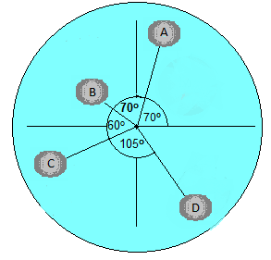
Example 2
Find the radius and angular position at which a 5th mass of 1.5 Kg should be placed to statically balance the system shown.
Mass A is 1 kg at 100 mm radius.
Mass B is 0.5 kg at 45 mm radius
Mass C is 0.25 kg at 80 mm radius
Mass D is 0.1 kg at 110 mm radius

Slide 20
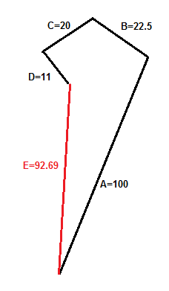
Example 2 - Answers
Find the radius and angular position at which a 5th mass of 1.5 Kg should be placed to statically balance the system shown.
Table to calculate the value of M r for each mass.
Mass radius M r
A 1 100 100
B 0.5 45 22.5
C 0.25 80 20
D 0.1 110 11
E 1.5 r_{E} 1.5r_{E}
Draw the M r polygon to find the value of M r for the 4th mass.
Mr = 92.69 kg mm hence r_{E} = 92.69/1.5 = 61.79 mm and the angle is 267.23º clockwise of A
Mass A is 1 kg at 100 mm radius.
Mass B is 0.5 kg at 45 mm radius
Mass C is 0.25 kg at 80 mm radius
Mass D is 0.1 kg at 110 mm radius

Slide 21
Dynamic Balancing
When masses are not in the same plane we must also achieve dynamic balancing.
Consider 2 masses statically balanced as shown but acting at different places along the axis. (Like Pistons)
For static balance M_{A}r_{A} = M_{B}r_{B}
It is clear that even with static balance, centrifugal force will produce a turning moment about the centre of gravity for the system.

Slide 22
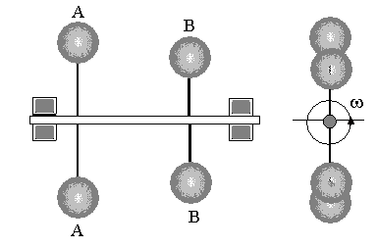
Dynamic Balancing
In this simple case, the problem is solved by adding equal and opposite forces at the two points as shown.
Dynamically Unbalanced
Dynamically Balanced

Slide 23
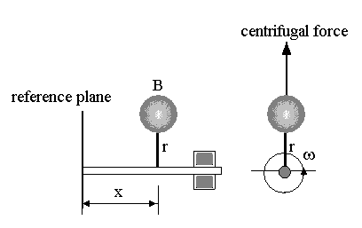
Dynamic Balancing
Consider the turning moment due to a single mass.
The centrifugal force produced is F = Mrω²
The turning moment about the reference plane = T.M. = F x = Mr ω ²x
For dynamic and static balance we must work out the resultant turning moment and add masses at appropriate points to cancel it out.

Slide 24
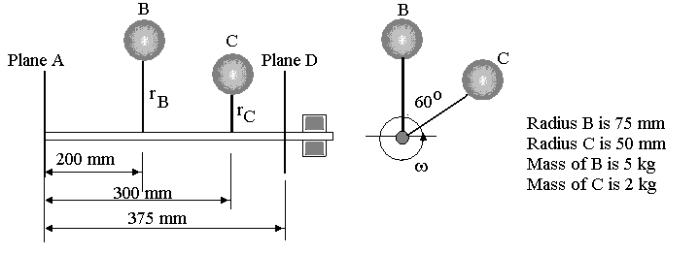
Worked Example
Find the mass and the angle at which it should be positioned in planes A and D at a radius of 60 mm in order to produce complete balance of the system shown.

Slide 25
Worked Example
Find the mass and the angle at which it should be positioned in planes A and D at a radius of 60 mm in order to produce complete balance of the system shown.
Make up a table as follows leaving unknowns as symbols.
M r Mr x Mrx
A M_{A} 60 60M_{A} 0 0
B 5 75 375 200 75 000
C 2 50 100 300 30 000
D M_{D} 60 60M_{D} 375 22 500M_{D}

Slide 26
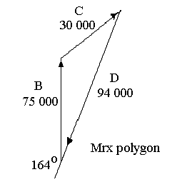
Worked Example
M r Mr x Mrx
A M_{A} 60 60M_{A} 0 0
B 5 75 375 200 75 000
C 2 50 100 300 30 000
D M_{D} 60 60M_{D} 375 22 500M_{D}
Now draw a (scaled) polygon of Mrx vectors in order to find the value of Mrx at D. Start with B in this case because it is vertical.
Mrx for D = 94 000 = 22 500 M_{D}
Hence M_{D} = 94000/22500 = 4.17 kg and it is positioned 254º
Now we calculate Mr for D.
Mr for D = 4.178 x 60 = 250.68

Slide 27
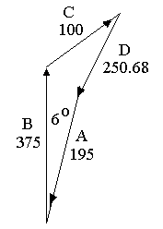
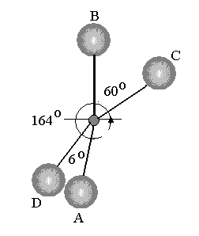
Worked Example
M r Mr x Mrx
A M_{A} 60 60M_{A} 0 0
B 5 75 375 200 75 000
C 2 50 100 300 30 000
D 4.17 60 250.68 375 94 000
Next we draw the polygon for the Mr values as shown.
The vector which closes the polygon represents Mr for point A
  Mr for A is 195.
  60M_{A} = 195
  M_{A} = 195/60 = 3.25 kg at 6º to the vertical.

Slide 28
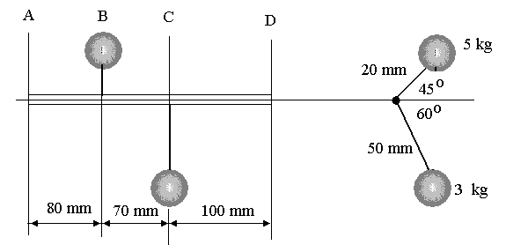
Example 3
The diagram below shows masses on two rotors in planes B and C. Determine the masses to be added on the rotors in planes A and D at radius 36 mm which will produce static and dynamic balance.
1 Kg
2.3 Kg
60mm
63mm
92mm

Slide 29
Example 4
A shaft has 4 discs A, B, C and D along its length 100 mm apart.
A mass of 0.8 kg is placed on B at a radius of 20 mm.
A mass of 2 kg is placed on C at a radius of 30 mm and rotated 120º from the mass on B.
Find the masses to be placed on A and D at a radius of 25 mm that will produce total balance.
(Answers 0.696 kg and 1.52 kg)

