Slide 1
ECAD5004
Introduction to Module
Module Lead: Rachel Wallis
rachel.wallis@uwtsd.ac.uk

Slide 2
Module AIMs
• To provide opportunities which extend knowledge, skills and understanding for teaching and learning Language and Mathematics in the primary school curriculum.
• To provide a critical overview of the age related expectations and pedagogical approaches for Language and Mathematics learning.

Slide 3
MODULE LEARNING OUTCOMES
Upon the successful completion of this module, the student should be able to demonstrate the ability to:
1. evidence secure knowledge of national age related expectations in language and mathematics
2. show a theoretical understanding of how children learn effective language and mathematical skills
3. show a developing ability of how to make pedagogical choices which ensure good learning and teaching
4. organise their knowledge and learning through the use of a range of information sources and present their work at the appropriate level.

Slide 4
THE ASSIGNMENT
MODULE CODE | MODULE TITLE | MODE OF ASSESSMENT
ECAD5004 | Teaching Language and Mathematics | Course Work with 100% weighting.

Slide 5
Title of Assignment: What helps me learn language and mathematics? : An analysis of a child’s learning in mathematics and language with recommendations for ensuring progress.
Written Assignment: 3, 500 words with 1, 500 word equivalent for the appendices.

Slide 6
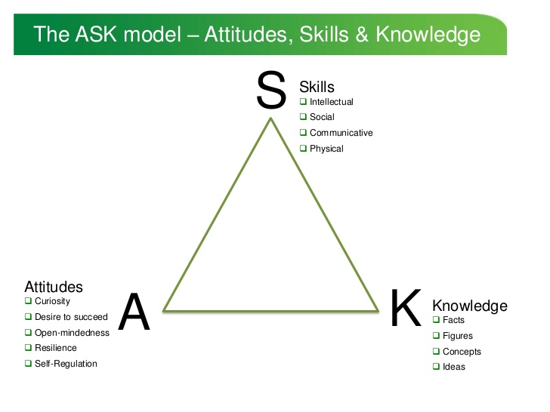
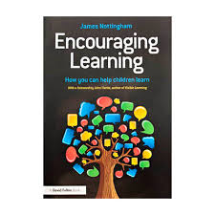
http://www.slideshare.net/jabulani4/develop-ask
Nottingham, J. (2013) Encouraging Learning Oxon: Routledge is available in the library (ebook)

Slide 7
Assignment Guidance: During PTE (part 1) you will be required to gather data using aspects of ‘The Mosaic Approach’. This data, related to one learner, should support the response to the question: ‘What helps me learn language and mathematics?’
The data needs to include:
• Observation;
• Map-making;
• Photographs;
• Interview with either the learner or the teacher of the learner;
• Samples of work.
This data can be used for the analysis of the child’s language and mathematics learning. The analysis should be supported with reference to reading.

Slide 8

Tools: tiles of the mosaic
Arfau: teil y mosaig
Photographs
Ffotograffau
Observation
Arsyllu
Child conferencing
Cynadledda Plant
Map making
Creu mapiau

Slide 9
Holistic View/Barn Gyfannol
Arsyllu
Ffotograffau
Creu mapiau
Cynadledda Plant
Observation
Photographs
Map making
Child conferencing

Slide 10
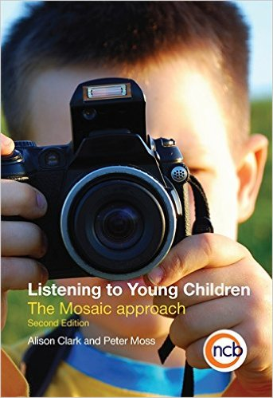

Reading related to the mosaic approach:
Clark, A. and Moss, P. (2011) Listening to Young Children: The Mosaic Approach (2nd ed.) National Children’s Bureau
Moss, P. (2006) Listening to Young Children: Beyond Rights to Ethics in Let’s Talk about Listening to Children Learning and Teaching Scotland: available at: http://www.educationscotland.gov.uk/Images/listeningtochildren_tcm4-324433.pdf
http://www.pupilvoicewales.org.uk/nursery/get-involved/mosaic-approach/ (available in English and Welsh)

Slide 11
IN SCHOOL
Identify one learner (‘average attainer’).
Ask the teacher and learner’s consent to help you with some university work – be ethical at all times.
You will need to use the confirmation letter in the module handbook

Slide 12
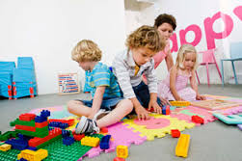
OBSERVATION
You should aim to observe the child learning in a variety of contexts in which he/she may be using language and mathematics. Observation notes can then be included as an appendix.
The observation might be when you are teaching or when you are not teaching, although any observations made when you are teaching would need to be noted after the lesson (e.g. in an observation notebook). Observations do not need to relate specifically to a mathematics or language lesson, but the observations you include within your appendix should relate to language or literacy and mathematics or numeracy. For example, within Foundation Phase you might want to include observation notes based on observing the child within the role play area of the classroom or within Key Stage 2 you might include observation notes related to a science lesson in which the child is using numeracy.
You do not need to include every observation you make; you only need to include observations which relate to the discussion.

Slide 13
http://learning.gov.wales/docs/learningwales/publications/140828-observing-children-en.pdf /
http://learning.gov.wales/resources/browse-all/observing-children/?skip=1&lang=cy

Slide 14
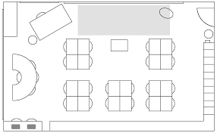
MAP MAKING
Map making is a term used within the mosaic approach but it does not mean creating a geographical map, it is more about identifying important places. For this assignment, the map making aspect is about being able to identify (with the child’s help) important places that relate to their language and mathematics learning. For example, you could:
-Ask the child to take you to places in the school where they learn (or use) language or mathematics
-Ask the child to draw/point out areas of the classroom where they like to learn language/mathematics
-Observe the child in different areas, identifying where language/mathematics is being used
The examples above (and how they are applied) will depend on the age you will be working with and the setting you are in; use your professional judgement about how this aspect could be applied.

Slide 15
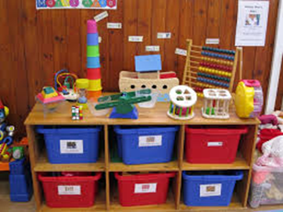
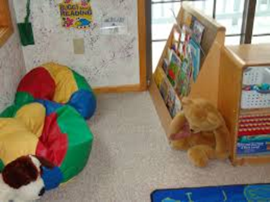
PHOTOGRAPHS
Using photographs is an aspect of the mosaic approach which allows a child to tell you about important things. The photographs included in the appendix should be taken by the child and any photographs taken should be taken and used in line with the school’s policy. In the context of this assignment, you could ask the learner to take photographs of things help them learn language and things that help them learn mathematics.

Slide 16
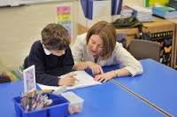
INTERVIEW (INFORMAL)
An informal interview with the learner would allow you to use the data gathered (e.g. from map making and photographs) in order to explore and understand the child’s perspective. In doing this, you should try to ensure you do not give ‘value judgements’ on what the child shares but that you genuinely seek to establish the child’s perspectives on what is being discussed. You could also use the opportunity to seek the child’s opinions about language and mathematics.

Slide 17
INTERVIEW
It is essential that when you interview children, you are sensitive and act ethically at all times; ensure the child feels comfortable and is aware that taking part is optional.
Remember that you will be trying find the child’s perspective and not testing the child; try to ask questions that are ‘open’ and that allow you to gain the child’s perspective.
You could decide to try a ‘creative’ approach to finding the child’s perspectives on language and mathematics.

Slide 18
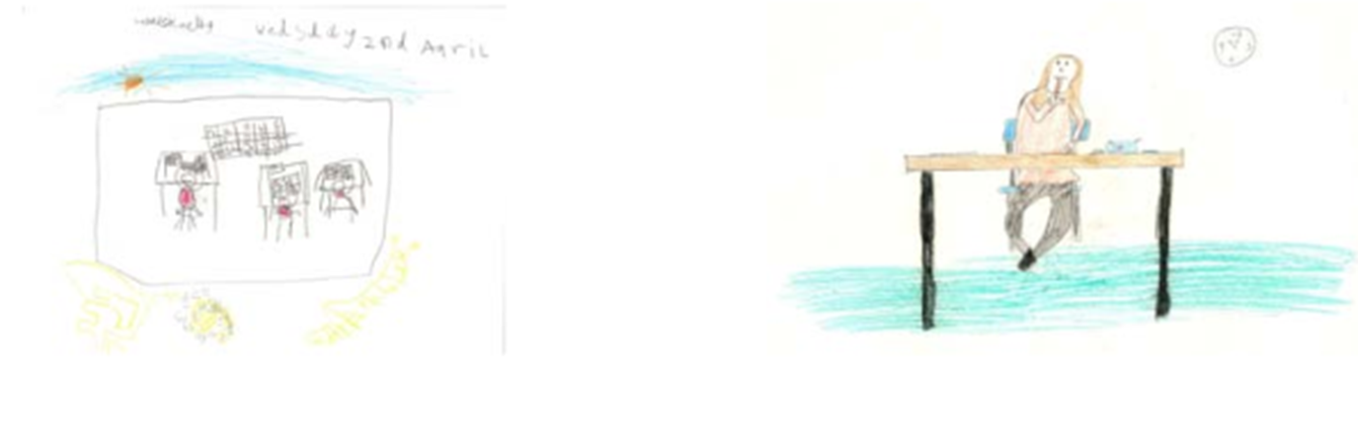

Slide 19
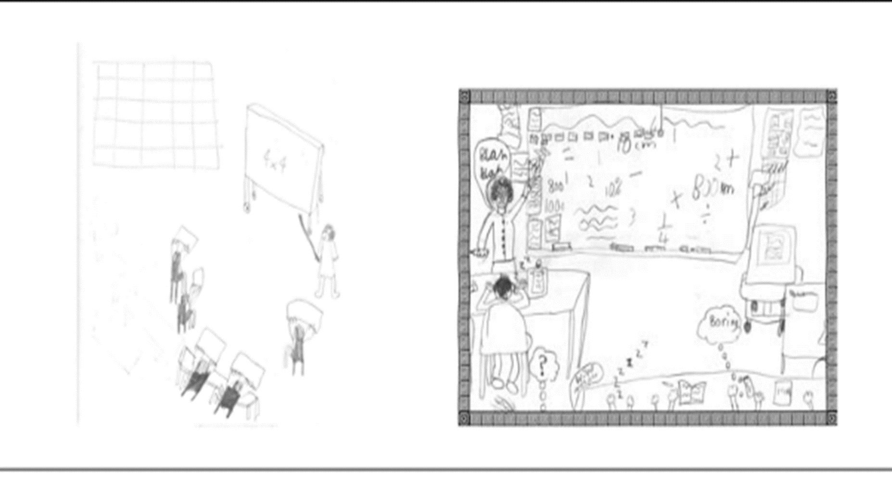

Slide 20
You may find it helpful to discuss the learner with the class teacher; this could be in place of an interview with the child or in addition to an interview with the child.

Slide 21
SAMPLES OF WORK
Through PTE you should collect samples of the learner’s work for language and mathematics. You do not need to collect everything the child does in language and mathematics, but focus particularly on collecting samples of work which tell you something about the child’s learning in language and mathematics.
On each sample of work, briefly note the context of the work (e.g. learning objective/whether the work was undertaken individually/grouped/paired and whether the child received help).
The samples of work collected will be considered further on your return to university after PTE.

Slide 22
BE PROFESSIONAL
Use your professional judgement about what data is appropriate to collect; the key thing is that you are able to gather some data that will inform you about the learner’s attitudes, skills and knowledge in relation to language and mathematics.

Slide 23
Getting Started…
Read the module handbook
Read ‘Observing Children’
You could read about the ‘ASK’ model of learning
You could read about the ‘Mosaic Approach’

