Slide 1
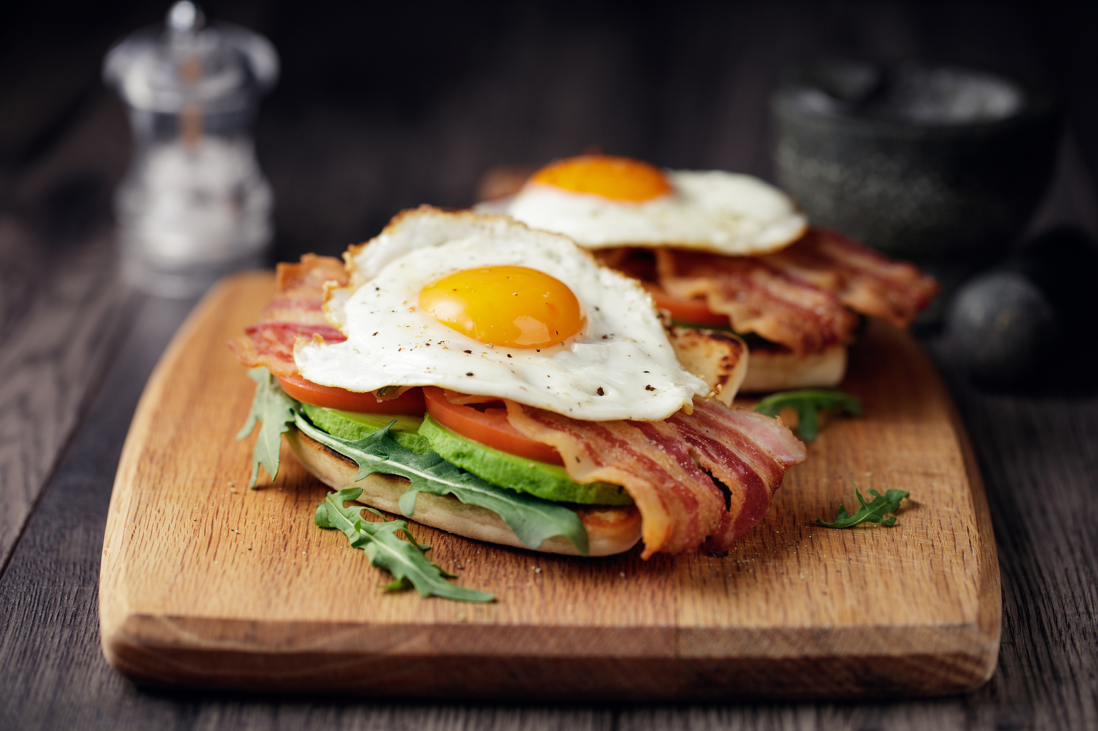
FRESHBITE MEALS
~ Digital Menu - New Term ~
☀️ BREAKFAST (Servered until 11:00 AM)
------------------------------------------------------------
• Porridge Bowl ..................................... £3.80
• Breakfast Wrap .................................... £4.20
• Fresh Fruit Pot ................................... £2.50
🥗 LUNCH (Available from 11:30 AM)
------------------------------------------------------------
• Chicken Salad Box ................................. £6.00
• Veggie Pasta Bowl ................................. £5.50
• Soup of the Day ................................... £3.90
🍪 SNACKS (All Day)
------------------------------------------------------------
• Granola Bar ....................................... £1.80
• Greek Yoghurt Cup ................................. £2.20
• Banana Bread Slice ................................ £2.50
🥤 DRINKS
------------------------------------------------------------
• Fresh Orange Juice ................................ £2.80
• Iced Coffee ....................................... £3.20
• Herbal Tea ........................................ £2.00
Eat Fresh. Feel Great. • FreshBite Meals
Fresh Bite Meals
Decision and literation Log
​
Eat Fresh. Feel Great. • FreshBite Meals

Slide 2
Decision & Iteration Log
1.Why I choose mt tool
I chose word because It is good for texts and business documents. It is helps me show business proposals clearly. I also used PowerPoint for my ley out and its easier for me to use so this supported my choice
2. What information I used
I used the weekly menu plans from the scenario. I added meal descriptions, key benefits, and nutritional highlights.
3.Howi created my artefact
First I typed the text into a word document.
Then I used bold headings to separate sections.
After that I've made a list with bullet points to show choices.
Finaly I checked the text again to make sure it was correct

Slide 3
4.What changes I made
At first my document was hard to read, so I added color and bold headings.
I changed the structure because long paragraphs where confusing.
I made the front bigger because it was too small.
I added the benefit section to make the information clearer.
5.Feedback I used
My tutor said the formatting should be more consistent .
A classmate said the text needed clearer headings.
I changed both based on the feedback.
6.Final explanation
The artifact helps the business owner see which meals are offered.
Its also shows that word can help businesses share information.

