Slide 1
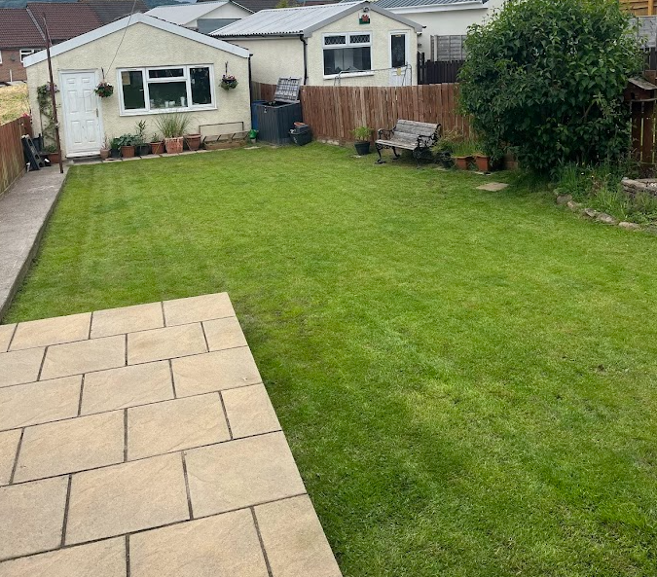
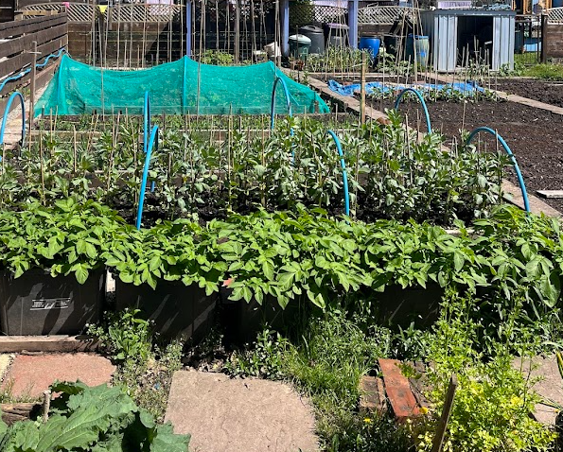
Sustainability in the early years part 1
Bethany Thomas
2100672

Slide 2
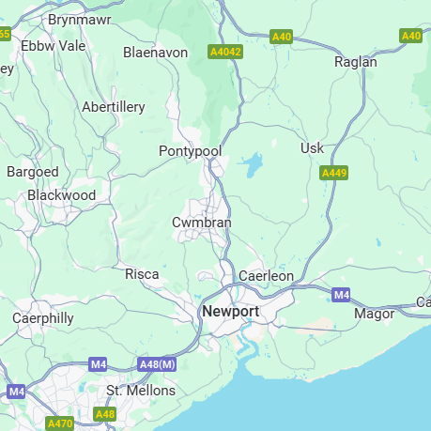
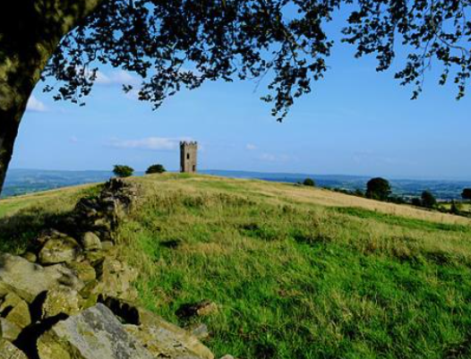
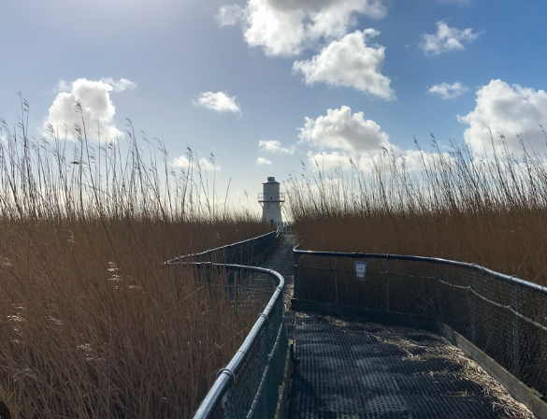
Discover
This is my location…
As a child, I have grown up in this area for as long as I can remember, and I have always enjoyed the countryside. When thinking of somewhere to observe, I was overwhelmed with a variety of places in which I could visit, such as the famous folly tower, or Newport Wetlands, however, I then began thinking much deeper, and realised that I am truly blessed to have such a beautiful garden that I can explore.

Slide 3

Why did I choose it?
Taking on the John Muir award has opened my eyes and given me such an opportunity to explore my garden on a much deeper level than I ever would have imagined.
Aswell as having this amazing garden space as seen in the picture, I also have an allotment attached to the side of my garden which gives me the opportunity to grow fresh produce for me and my family.
There are lots of little areas within my garden that I will explore in more depth.

Slide 4
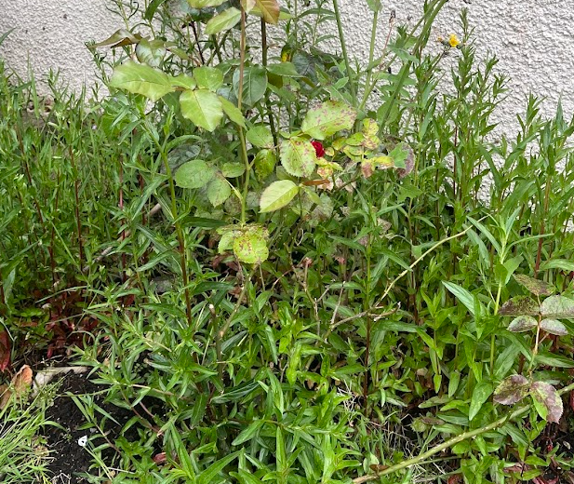
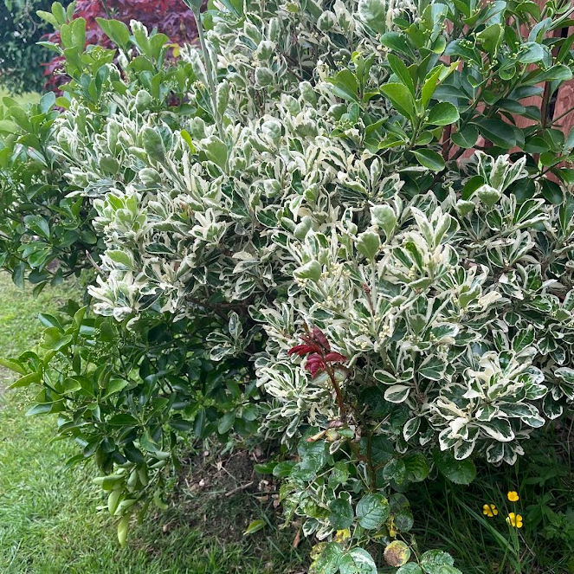
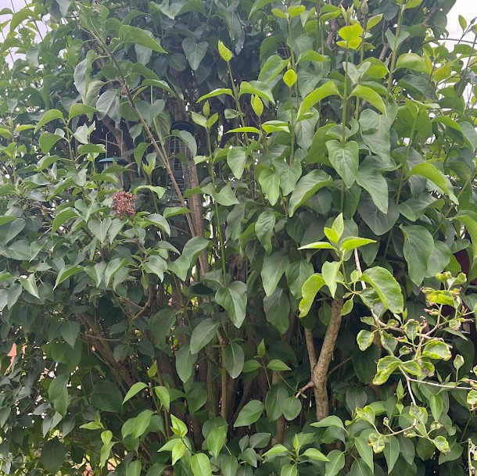
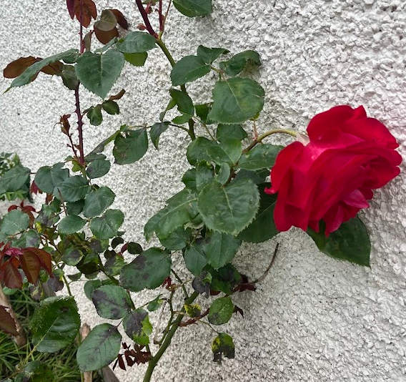
Explore
As I have never really had the opportunity or the time to fully explore my garden, I could not believe the lack of wildlife coming too my garden. The plants in this picture are really dull looking, there isn’t a very nice smell them and it does not attract anything to my garden.
As you can see, these are the plants, I already have in my garden.

Slide 5
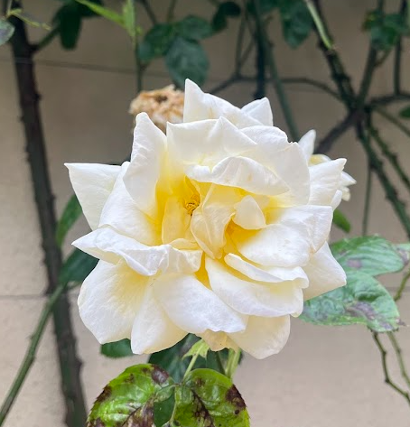
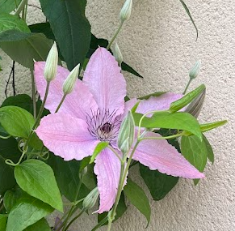
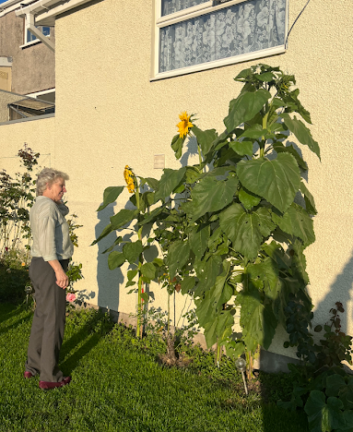
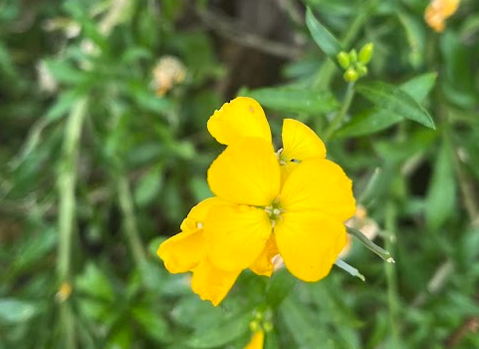
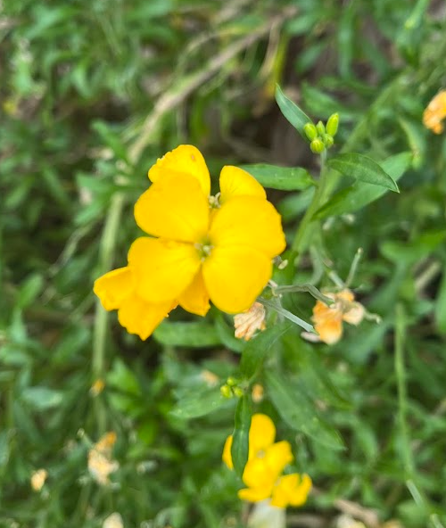
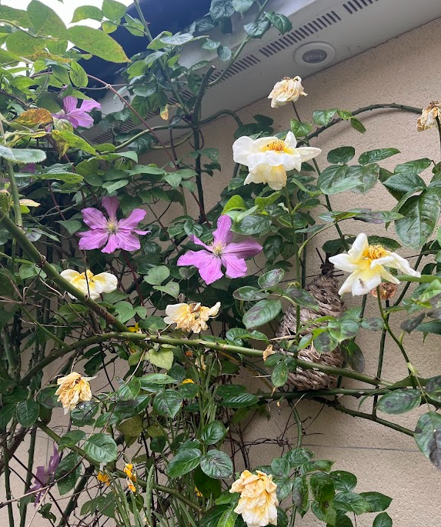
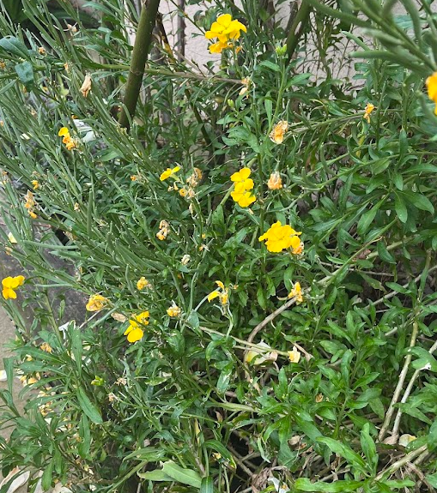
Conserve
In order to attract more wildlife to my garden, especially the bees, I took it upon myself to attend my garden centre and buy some flowers to attract the bees, to go with the flowers I already have.
These are my flowers in my garden now.
Sunflower competition with my nan

Slide 6
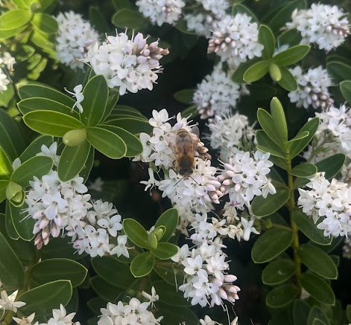
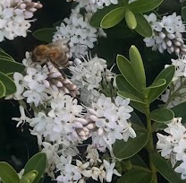
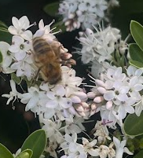
I also spent hours staring at these gorgeous flowers, watching hundreds of bee’s land on them at a time. It was fascinating to see the difference once I had planted flowers within my garden, and the amount of nature I attracted.

Slide 7
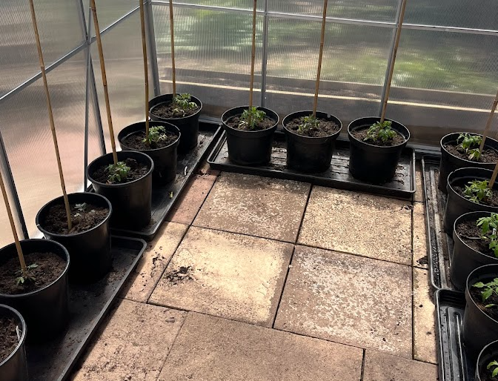
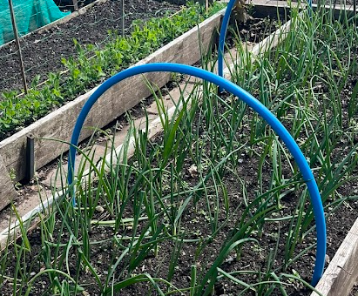
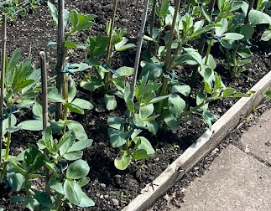
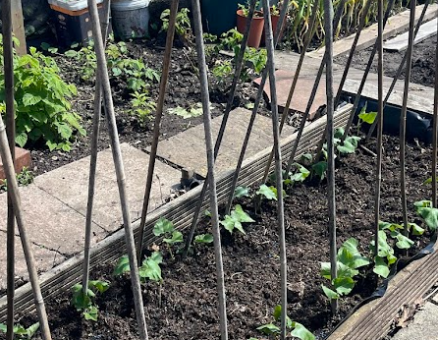
This is my grandfather's allotment next to our garden. As a child, I used to spend a lot of time down here, however, as I have got older, I have not really gone down as much. Recently, as part of the John Muir award, I decided to spend a lot of time planting fresh fruit and vegetables for all my family to eat. And what a success it has been!

Slide 8
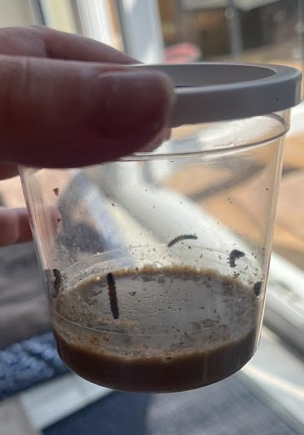
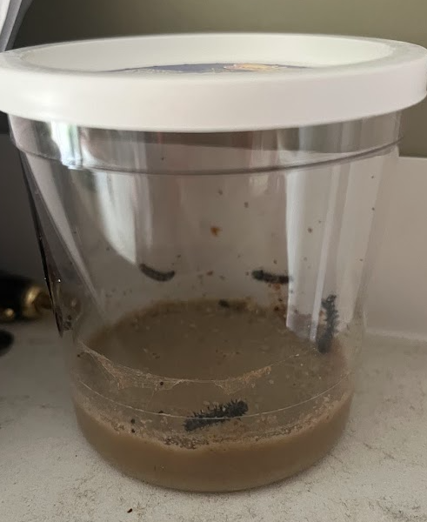
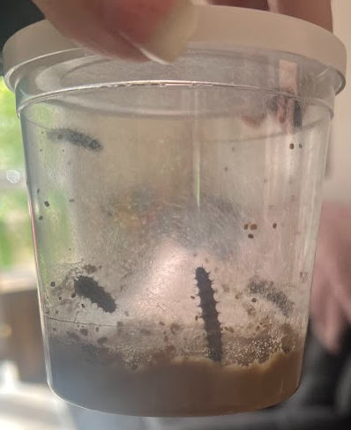
Day 1
Caterpillars had just arrived. Where very small, and you had to be extremely careful
Day 3
Caterpillars where definitely bigger and were eating the nectar at the bottom of the jar.
Day 5
1 caterpillar in particular looked as though he was about to start chrysalis.
I decided to order some caterpillars, that myself and my family could watch turn into butterflies, and then release within our garden.
So far, this is the process…

Slide 9
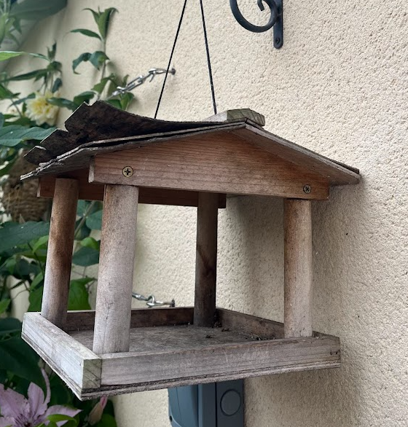
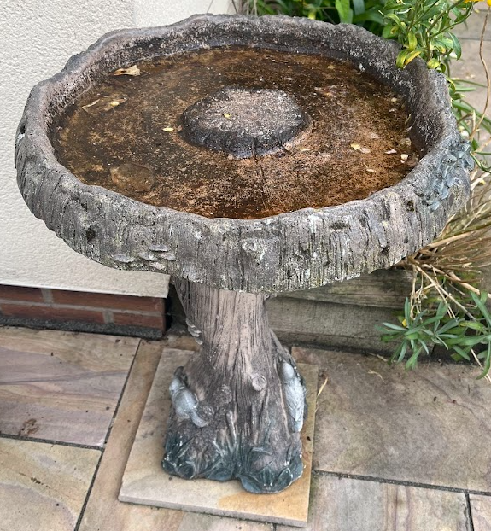
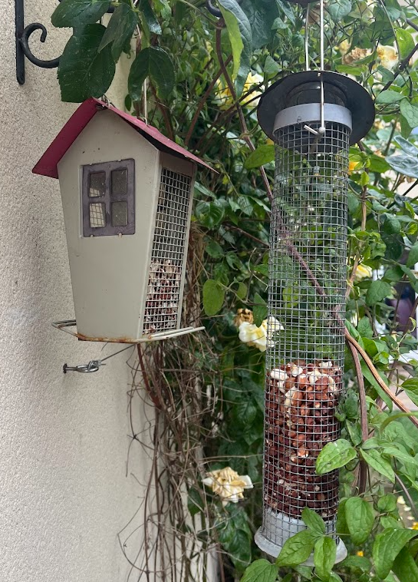
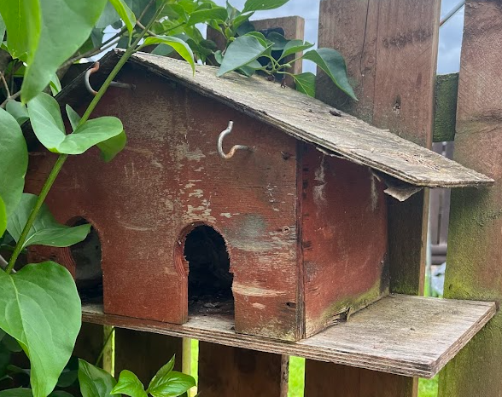
Taking part with the John Muir award has made me realise how incredibly lucky I am to have such an incredible garden, and not to take it for granted again. From now on, I am going to keep up with the upkeep of my garden and ensure I am continuously promoting sustainability and attracting wildlife tp my garden.
Here are some additions I also added to my garden to attract more wildlife.

