Slide 1

“How does the integration of information and intelligence enhance the effectiveness of both operational and digital policing?”
Tanith Coulson
230426

Slide 2

Introduction
Explore how information and intelligence improve operational and digital policing.
Examine how intelligence supports effective decision-making and police responses.
Assess the benefits and challenges of integrating information and intelligence.
Consider relevant legislation and guidance governing intelligence use.

Slide 3
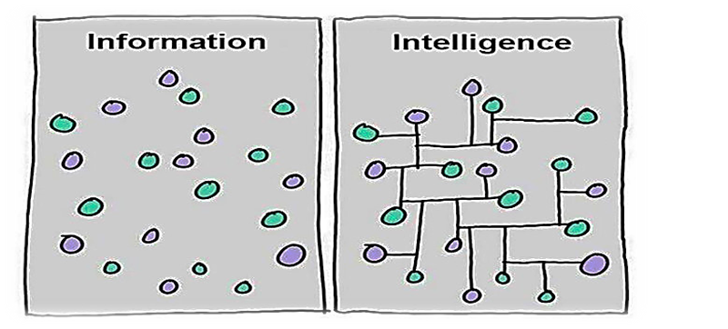
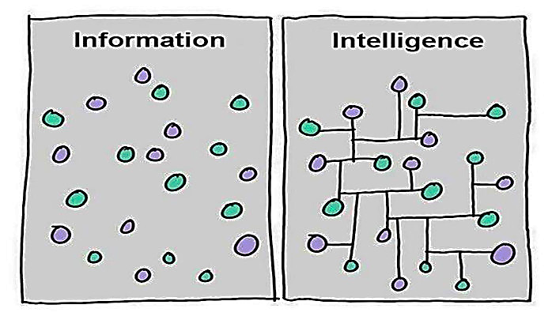
Definitions
Information
Two categories: police corporate and police operational information (College of Policing, 2023).
Recorded for a policing purpose – protecting life, preserving order, preventing crime or bringing offenders to justice.
Collected in three ways:
Routine collection, tasked information and volunteered information.
(College of Policing, 2023).
Information becomes intelligence
once it has been analysed and
evaluated
(Innes and Sheptycki, 2004).
Intelligence
Information that has been analysed to assess relevance
and reliability.
Used at three levels:
Strategic, tactical and operational.
(NCA, 2019).
Information has been collected
and developed for action.
Classified as confidential or
sensitive.
(College of Policing, 2013).

Slide 4
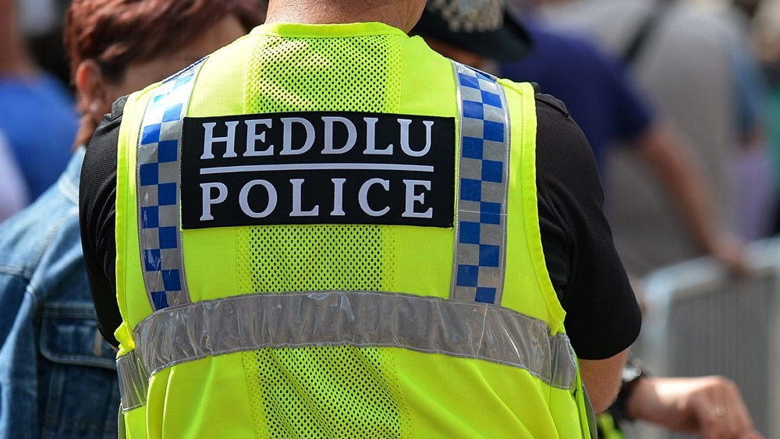
Operational Policing
Operational policing focuses on investigating crime, collecting evidence, and identifying suspects, as well as preventing crime and maintaining public order (Brown, 2021).
Information is gathered from multiple sources, then recorded, graded, and evaluated (Wood et al., 2022).
Sources include verbal information from frontline officers and the public, CCTV, and Automatic Number Plate Recognition (ANPR).
Intelligence supports operational policing by detecting crime, identifying suspects, and safeguarding vulnerable people.
(North Yorkshire Police, 2022).

Slide 5
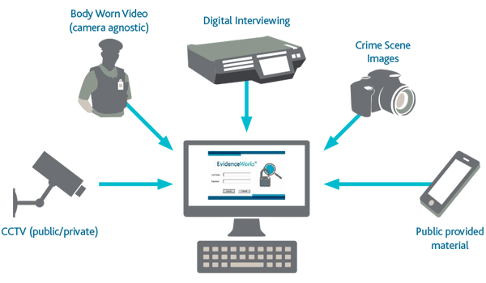
Digital Policing
Digital policing involves the use of technology and data to improve public safety, support decision-making and enhance policing services (NPCC, 2025).
Around 90% of crime now has a digital element - highlighting the growing importance of digital policing (techUK, 2022).
Digital policing is developing at an accelerating rate.
Tools once considered advanced (BWV, ANPR) are now standard practice.
New technologies: AI, drones and facial recognition – shaping modern digital policing.
(Estlin, 2025).
Reliance on digital tools comes with challenges, such as outdated IT and the need to manage data securely and legally.

Slide 6
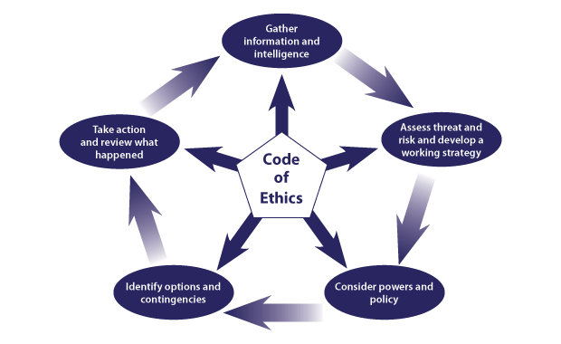
Integration of Information and Intelligence
National Intelligence Model
Intelligence is guided by national frameworks such as the NIM and College of Policing guidance.
Tells officers how to collect, analyse and use intelligence to make decisions.
Enables a problem-solving approach to law enforcement and crime prevention.
(College of Policing, 2005).
Four intelligence products that support and inform police decisions:
1. Strategic Assessment
2. Tactical Assessment
3. Problem Profile
4. Target Profile
(Keningale, 2022).
Intelligence is graded using the 3x5x2 method of the NIM (NAFN, 2023).
Demonstrates how intelligence is transformed into decisions that improve operational and digital policing.
The NIM needs a reliable, secure system to manage information (College of Policing, 2005).

Slide 7

Integration Challenges
Technological challenges
Outdated or poor ICT systems can slow intelligence.
Offenders may remain at large – as seen from nine forces in England and Wales (Waterhouse, 2019).
Statistics in 2018 show:
55% officers dissatisfied with their force’s overall ICT provision
30% officers and staff believe their force invests in technology wisely (Policing Insight, 2019).
Police duplicate work because systems don’t integrate – limits the ability to share or act on intelligence effectively.
New technologies often underused due to limited training and awareness.
(Muir, 2024).
Digital misinformation and false reporting
Sources can be inaccurate, incomplete, or deliberately misleading.
Police must invest time and resources verifying online content before acting.
Misinformation can lead to misallocated resources or escalation – as seen in the Southport riot in 2024 (The Independent, 2024).

Slide 8
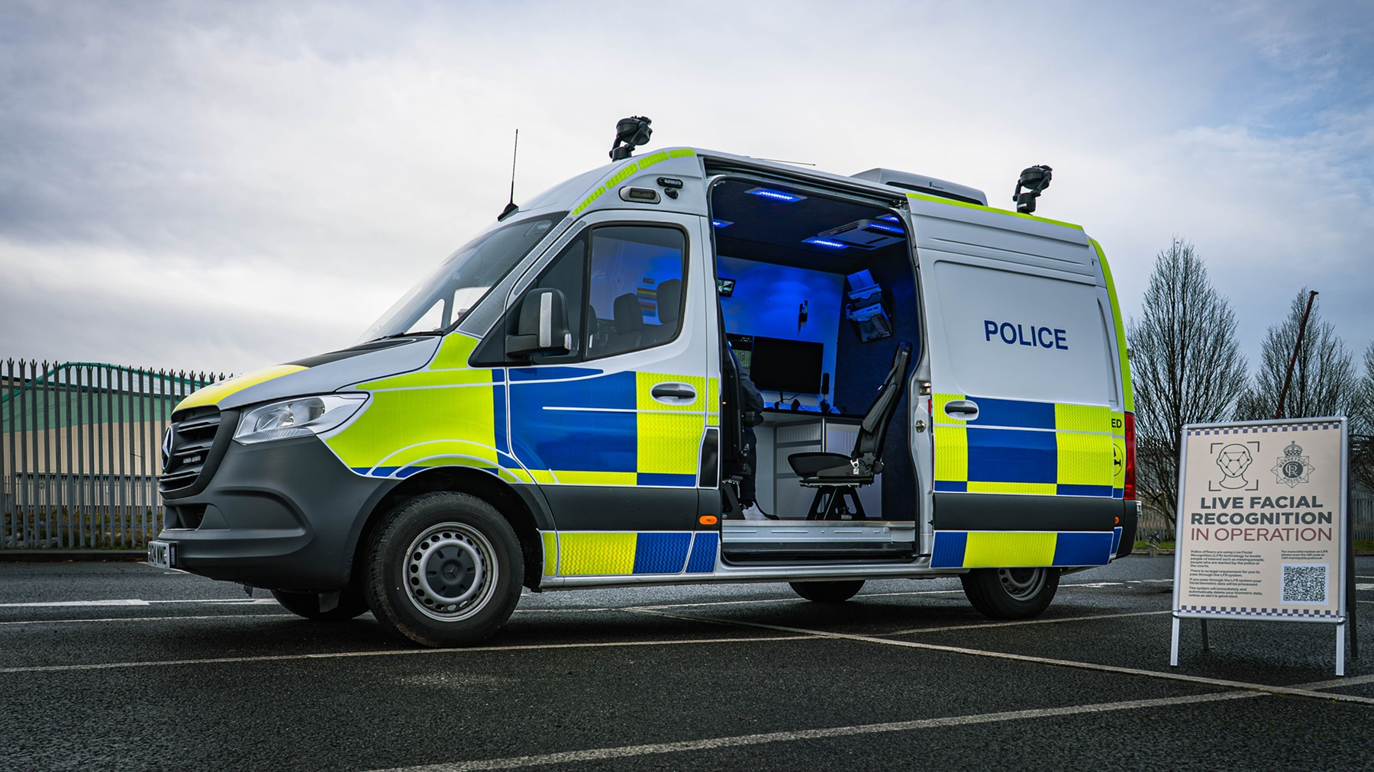
Case Examples:
Live Facial Recognition (LFR) - Met Police.
Violent offender jailed after the use of LFR – combined operational policing with digital to identify the suspect.
Without this technology, the offender would have continued to pose a threat to the public.
(Metropolitan Police, 2025).
580 arrests in 12 months; 7 false alerts (2025) – shows LFR is accurate.
60% are comfortable with police using LFR (Windsor, 2025).
Ethical concerns: privacy, regulation, accuracy – limits trust and effectiveness.
Small number of false alerts highlights potential errors.
The Soze tool – AI tool trialled by Avon and Somerset Police.
Analysed 27 complex cases in 30 hours (estimated would 80 hours for humans).
Saved approximately 15 million hours of work.
Gavin Stephens (NPCC) states AI and LFR support police work but do not replace officers.
(Vaughan, 2024).
Both demonstrate how digital tools can enhance decision-making and efficiency.

Slide 9

Future Improvements
National Policing Digital Strategy 2020-2030
Ensure staff have the knowledge, skills, and tools to tackle complex crimes.
Reduce manual, repetitive tasks to improve operational efficiency.
Connect data across forces and help police make smarter and faster decisions.
Use digital tools to enhance policing. For example: BWV, AI analysis, predictive tools.
Enable officers and staff to focus on important policing tasks – digital leadership, focus on critical and value-adding activities.
(NPCC, 2020).

Slide 10

Conclusion
The integration of intelligence and information enhances policing by improving decision-making, efficiency and public protection.
The National Intelligence Model helps transform information into actionable intelligence – the effectiveness depends on reliable technology and data sharing.
Digital tools like LFR and Soze highlight the benefits.
Challenges (outdated IT systems, misinformation) can undermine intelligence-led policing.
Effective integration in the future relies on improved technology, training, ethical data use.

Slide 11
References
Association of Chief Police Officers (ACPO) (2005). National Intelligence Model: Code of Practice. Available at: https://library.college.police.uk/docs/npia/NIM-Code-of-Practice.pdf (Accessed 7 January 2026).
Brown, J. (2021). Police powers: an introduction. commonslibrary.parliament.uk, [online] 8637(8637). Available at: https://commonslibrary.parliament.uk/research-briefings/cbp-8637/. (Accessed 6 January 2026).
College of Policing (2013). Collection and Recording. [online] College of Policing. Available at: https://www.college.police.uk/app/information-management/management-police-information/collection-and-recording. (Accessed 6 January 2026).
College of Policing (2013). Intelligence management. [online] College of Policing. Available at: https://www.college.police.uk/app/intelligence-management. (Accessed 6 January 2026).
College of Policing (2023). Police information and records management: code of practice (accessible). GOV. UK [online] Available at: https://www.gov.uk/government/publications/police-information-and-records-management-code-of-practice/police-information-and-records-management-code-of-practice-accessible. (Accessed 6 January 2026).
College of Policing (2023). Police Information and Records Management Code of Practice. [online] College of Policing. Available at: https://www.college.police.uk/guidance/police-information-and-records-management-code-practice. (Accessed 6 January 2026).
Estlin, A. (2025). Police Emerging Science and Technology Trends – Futures, Foresight and Horizon Scanning. [online] Blog.gov.uk. Available at: https://foresightprojects.blog.gov.uk/2025/06/19/police-emerging-science-and-technology-trends/. (Accessed 7 January 2026).
HMICFRS (2023). National intelligence model (NIM). [online] His Majesty’s Inspectorate of Constabulary and Fire & Rescue Services. Available at: https://hmicfrs.justiceinspectorates.gov.uk/glossary/national-intelligence-model/. (Accessed 7 January 2026).
Keningale, P. (2022). The National Intelligence Model: The barriers to its success. [online] BSC Policing Network. Available at: https://bscpolicingnetwork.wordpress.com/2022/05/31/the-national-intelligence-model-the-barriers-to-its-success/#. (Accessed 7 January 2026).

Slide 12
Metropolitan Police (2025). Violent offender jailed for eight years after Live Facial Recognition stop. [online] Mynewsdesk. Available at: https://news.met.police.uk/news/violent-offender-jailed-for-eight-years-after-live-facial-recognition-stop-503010. (Accessed 7 January 2026).
Muir, R. (2020). INTELLIGENT JUSTICE? A discussion paper on the use of police intelligence data to inform offender management decisions PERSPECTIVES ON POLICING: PAPER 7. [online] Available at: https://www.police-foundation.org.uk/wp-content/uploads/2010/10/perspectives_intelligent_justice.pdf. (Accessed 6 January 2026).
Muir, R. (2024). THE POWER OF INFORMATION HOW TO UNLOCK THE POTENTIAL OF DIGITAL, DATA AND TECHNOLOGY IN POLICING. [online] Available at: https://www.police-foundation.org.uk/wp-content/uploads/2010/10/power-of-information-FINAL.pdf. (Accessed 7 January 2026).
NAFN (2023). Intelligence Management 3 x 5 x 2. [online] Available at: https://www.local.gov.uk/sites/default/files/documents/Intelligence%20Managem. (Accessed 7 January 2026).
National Crime Agency (2019). Intelligence: Enhancing the Picture of Serious Organised Crime Affecting the UK - National Crime Agency. [online] Nationalcrimeagency.gov.uk. Available at: https://www.nationalcrimeagency.gov.uk/what-we-do/how-we-work/intelligence-enhancing-the-picture-of-serious-organised-crime-affecting-the-uk. (Accessed 6 January 2026).
National Police Chiefs’ Council and Association of Police and Crime Commissioners (2025). National Policing Digital Strategy 2025-2030. Available at: https://www.npcc.police.uk/SysSiteAssets/media/downloads/publications/publications-log/ddat/2025/national-policing-digital-strategy-2025-2030.pdf. (Accessed 6 January 2026).
North Yorkshire Police (2022). The power of intelligence: an insight into the world of intelligence in policing, 9 June. Available at: https://www.northyorkshire.police.uk/news/north-yorkshire/news/news/2022/06-june/the-power-of-intelligence--an-insight-into-the-world-of-intelligence-in-policing/#:~:text=Intelligence%20is%20a%20vital%20tool%20for%20policing.,All%20parts. (Accessed 6 January 2026).
techUK (2022). Policing in a digital age - how Artificial Intelligence, Intelligent Automation and Cyber can help keep citizens safe. [online] Available at: https://www.techuk.org/resource/policing-in-a-digital-age-how-artificial-intelligence-intelligent-automation-and-cyber-can-help-keep-citizens-safe.html. (Accessed 7 January 2026).
The Independent (2025). Southport riot police were held back by ‘outdated’ social media laws, MPs claim. [online] The Independent. Available at: https://www.independent.co.uk/news/uk/home-news/southport-stabbing-riots-police-social-media-misinformation-b2733098.html. (Accessed 7 January 2026).
Vaughan, H. (2024). AI tool that can do ’81 years of detective work in 30 hours’ trialled by police. [online] Sky News. Available at: https://news.sky.com/story/ai-tool-that-can-do-81-years-of-detective-work-in-30-hours-trialled-by-police-13220891. (Accessed 7 January 2026).
Waterhouse, J. (2019). Criminals escaping justice’ due to IT system. [online] BBC News. Available at: https://www.bbc.co.uk/news/uk-46964659. (Accessed 7 January 2026).
Windsor, R. (2025). The ethics behind facial recognition vans and policing. [online] The Week. Available at: https://theweek.com/crime/facial-recognition-vans-and-policing. (Accessed 7 January 2026).
Wood, D., Bradshaw, S., Dickens, T., Parker-McLeod, J., Simpson, F. and Weaver, G. (2022) Blackstone’s Handbook for Policing Students. 17th edn. Oxford: Oxford University Press.

