Slide 1
Module Title: Professional Career Development within H&SC
Module Number: LCHS 4009 (LON)
Assignment No: ASSIGNMENT 1
Student Name: Glenn Catalan
Student ID: 2442791
Lecturer’s Name: Soban Sadiq

Slide 2

Acknowledge use of AI
I have used AI tool which is Copilot.

Slide 3
Introduction
I am Glenn Catalan, taking up in Certificate Health and Social Care and this is my last term of the course. Currently I am working as a Caretaker in a residential building. I will be presenting my chosen skills, what it is all about and how will I apply it to my future career.

Slide 4

Working in Teams
Working in teams means collaborating toward a shared goal by bringing together different strengths and perspectives, becoming more effective as members progress through Tuckman’s stages of development (Tuckman, 1965).
Teamwork Involves:
• Working toward the same goal
• Communicating clearly and listening to others
• Sharing tasks and supporting each other
• Solving problems together using different strengths
• Taking responsibility for your role while helping the team succeed
Where and how I developed this skill?
I’ve developed my teamwork skills by working with others to complete tasks and solve problems. Through group work, volunteering, placements, and helping people in real situations, I’ve learned to communicate clearly, share ideas, take on different roles, and work towards a shared goal.

Slide 5
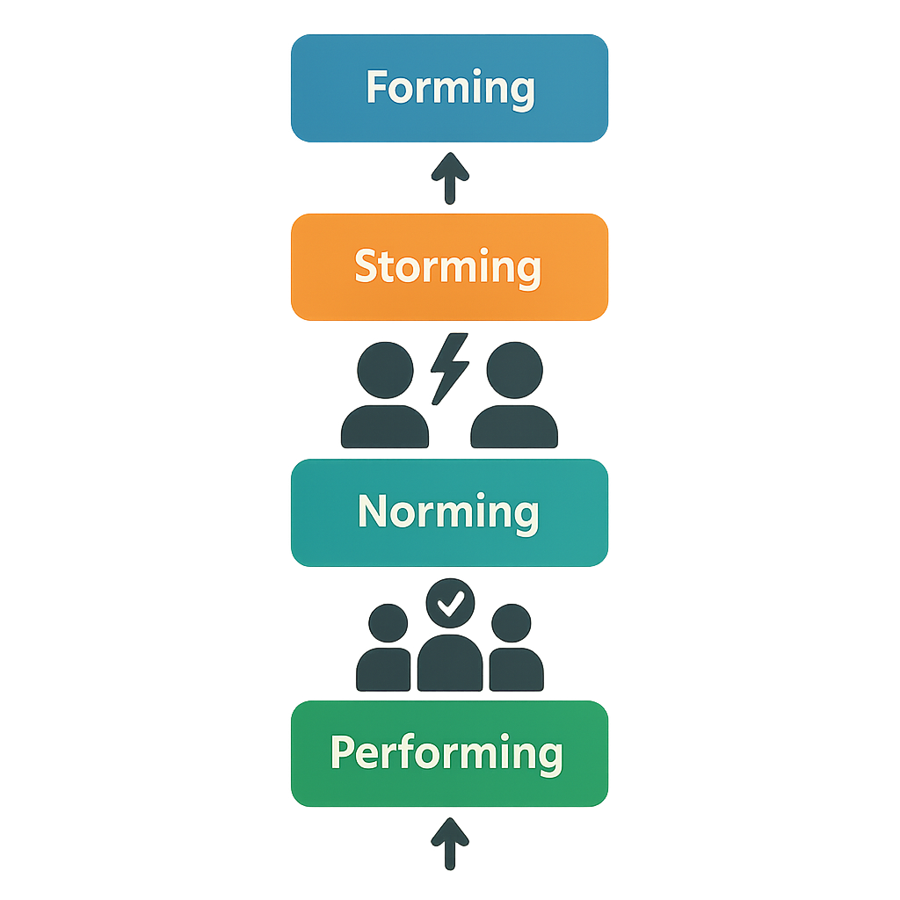
Tuckman’s Team Development Model
  Tuckman’s model explains the stages teams go through as they develop, showing how their effectiveness increases as communication, trust, and working relationships strengthen (Tuckman, 1965).
Key Stages
• Forming - The team meets for the first time, roles are unclear, and members look for guidance.
• Storming - Differences appear and conflict may arise as people challenge ideas.
• Norming – The team starts to agree on goals, routines, and ways of working.
• Performing – The group works effectively with strong cooperation and confidence.
How does this model help professionals in practice?
• It helps staff understand that early conflict is normal, not a sign of failure
• It promotes clear communication, shared goals, and trust-building.
• It guides leaders in supporting teams through challenges toward effective performance.
• It shows that strong teamwork develops gradually, improving collaboration across roles.

Slide 6
Importance of Working in Teams to Professional Practice
Why Teamwork Matters in Health & Social Care (HSE, 2021)
• Teams combine different skills and share information to keep care safe and consistent.
• Trust develops over time as teams move through forming, storming, norming, and performing.
How teamwork supports safe and effective care
• Staff pass on important information quickly, so everyone knows what to do.
• Different professionals notice risks sooner because they each see things differently.
• Work is organised well, which helps prevent mistakes and keeps care consistent.
How it improves outcomes for service users
• Care feels more organised and connected, not confusing.
• Staff can meet needs better because they used different skills together.
• Service users feel heard, supported and more confident in their care.
Benefits for everyone
• Service users: safer care, better communication, more confidence.
• Staff: shared workload, less stress, better problem‑solving.
• Organisation: higher quality care, fewer errors, stronger teamwork culture

Slide 7
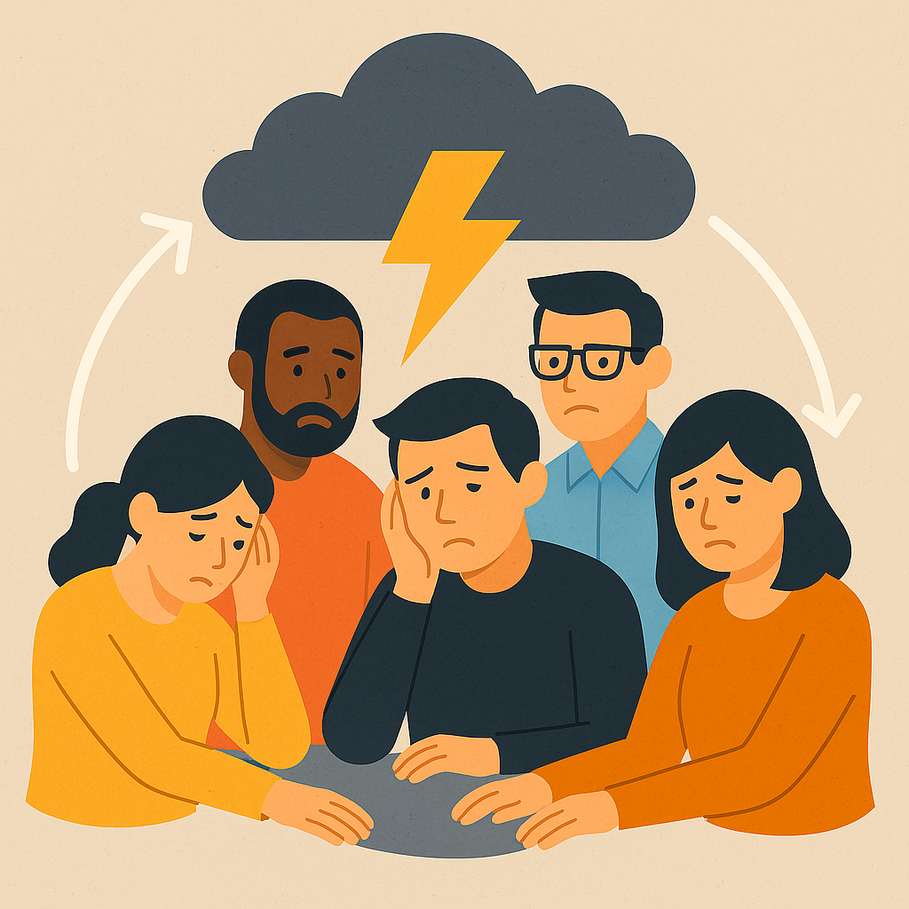
continuation
In Real‑world, Teamwork is poor
When nurses, carers, social workers, and therapists fail to work together effectively, the team gets stuck in the storming phase.
This leads to:
• Poor communication – updates aren’t shared and care becomes inconsistent
• Increased risk – delays, errors, and missed changes in a person’s condition
• Fragmented care – duplication, gaps, and confusion for the individual
• Low morale and conflict – staff feel unsupported and tensions rise
• Reduced quality of care – outcomes worsen and complaints increase

Slide 8
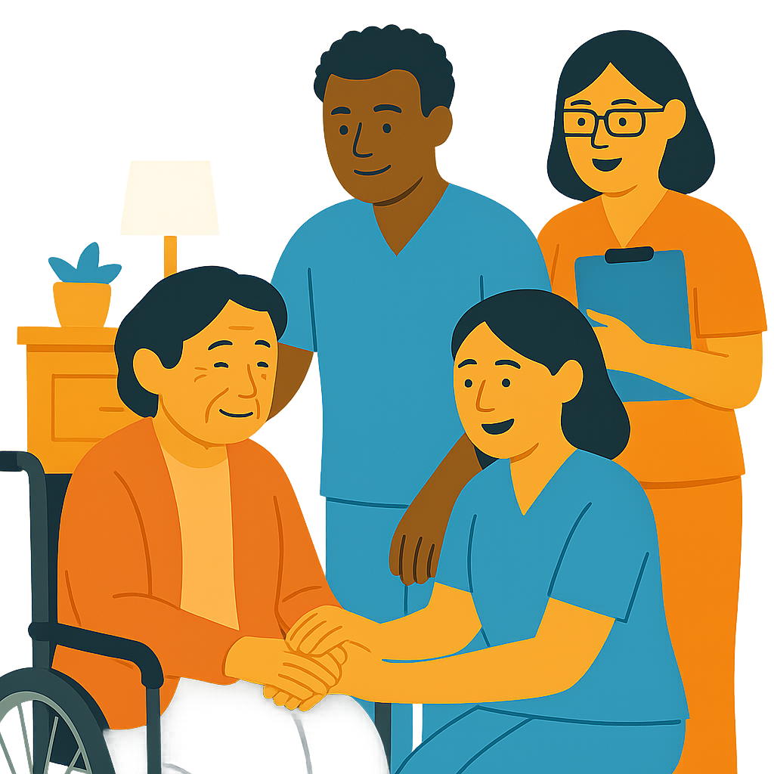
Practical Example of Using Teamwork Skills
Job Role and Setting
• Care assistant in a residential care home
Situation
• A resident becomes unexpectedly unwell during the morning routine, showing new signs of dizziness and confusion.
How the Teamwork Skill is Used
•. I update the nurse promptly and work with another care assistant to maintain the resident’s safety.
•. We coordinate tasks effectively: one supports the resident, one records observations, and another updates documentation.
How the Skill Guides My Actions
• Teamwork helps me stay organised, stay calm, and make sure everyone knows what they need to do.
• I use clear communication, support colleagues, and follow agreed steps so the response is smooth and consistent.
Impact on Care
• Patient experience: The resident feels calmer and supported because the team responds quickly and works together smoothly.
• Safety and quality: Sharing information early helps the nurse act faster, reducing risks and improving care.
• Overall outcome: The resident receives timely, well‑coordinated support, and the team works efficiently without confusion.

Slide 9

Teamwork Skills:
How They Support My Future Career
Why this Skill is Important
• Employability: Employers look for people who communicate well, share responsibilities, and work positively with others
• Future health & social care role: Teamwork helps provide safe, coordinated care alongside nurses, carers, therapists, and other professionals.
How it Supports my Career
• Builds my confidence in challenging situations
• Strengthens problem‑solving and decision‑making
• Helps me deliver safe, high‑quality care
• Supports my development toward future leadership roles.
(NHS England, 2020)
My Reflection
• Strength: I work well with others and communicate clearly.
• Development: I want to grow my confidence in speaking up and taking the lead when needed.

Slide 10
Conclusion
Developing teamwork skills is vital in health and social care because Tuckman’s model shows how teams grow stronger as communication, trust, and cooperation improve. Understanding stages like forming, storming, norming, and performing helps future carers work better with colleagues and support safe, well‑coordinated care. These skills also build confidence, improve problem‑solving, and prepare you for future roles were working in partnership is essential.

Slide 11
References List
Tuckman, B.W. (1965) ‘Developmental sequence in small groups’, Psychological Bulletin, 63(6), pp. 384–399.
Health and Safety Executive (HSE) (2021) Teamworking in health and social care. Available at: https://www.hse.gov.uk (Accessed: 11 March 2026).
NHS England (2020) Working in partnership: Improving teamwork in health and care. Available at: https://www.england.nhs.uk (Accessed: 12 March 2026).

