Slide 1
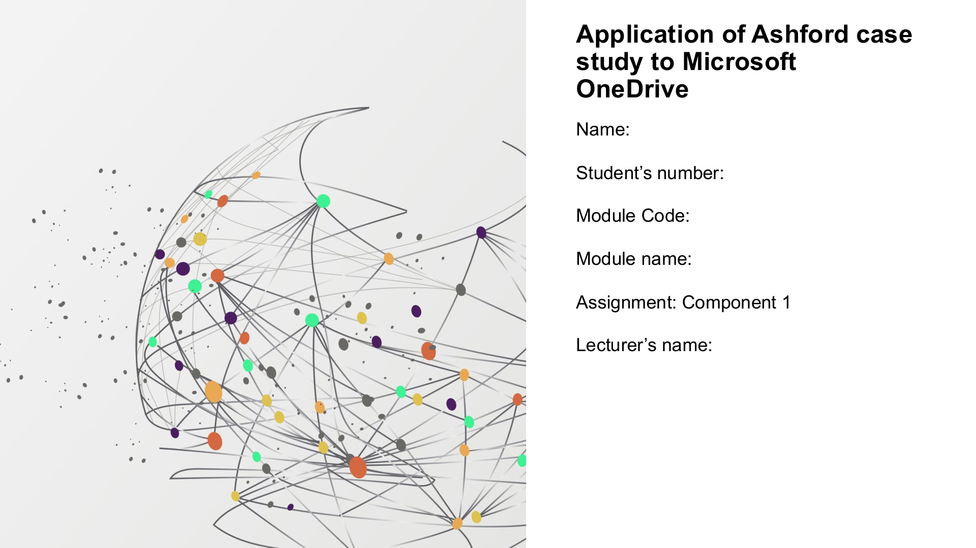
Valentine c Okereke
2605104
LcHs4007
One drive
Bianca Dodgen

Slide 2
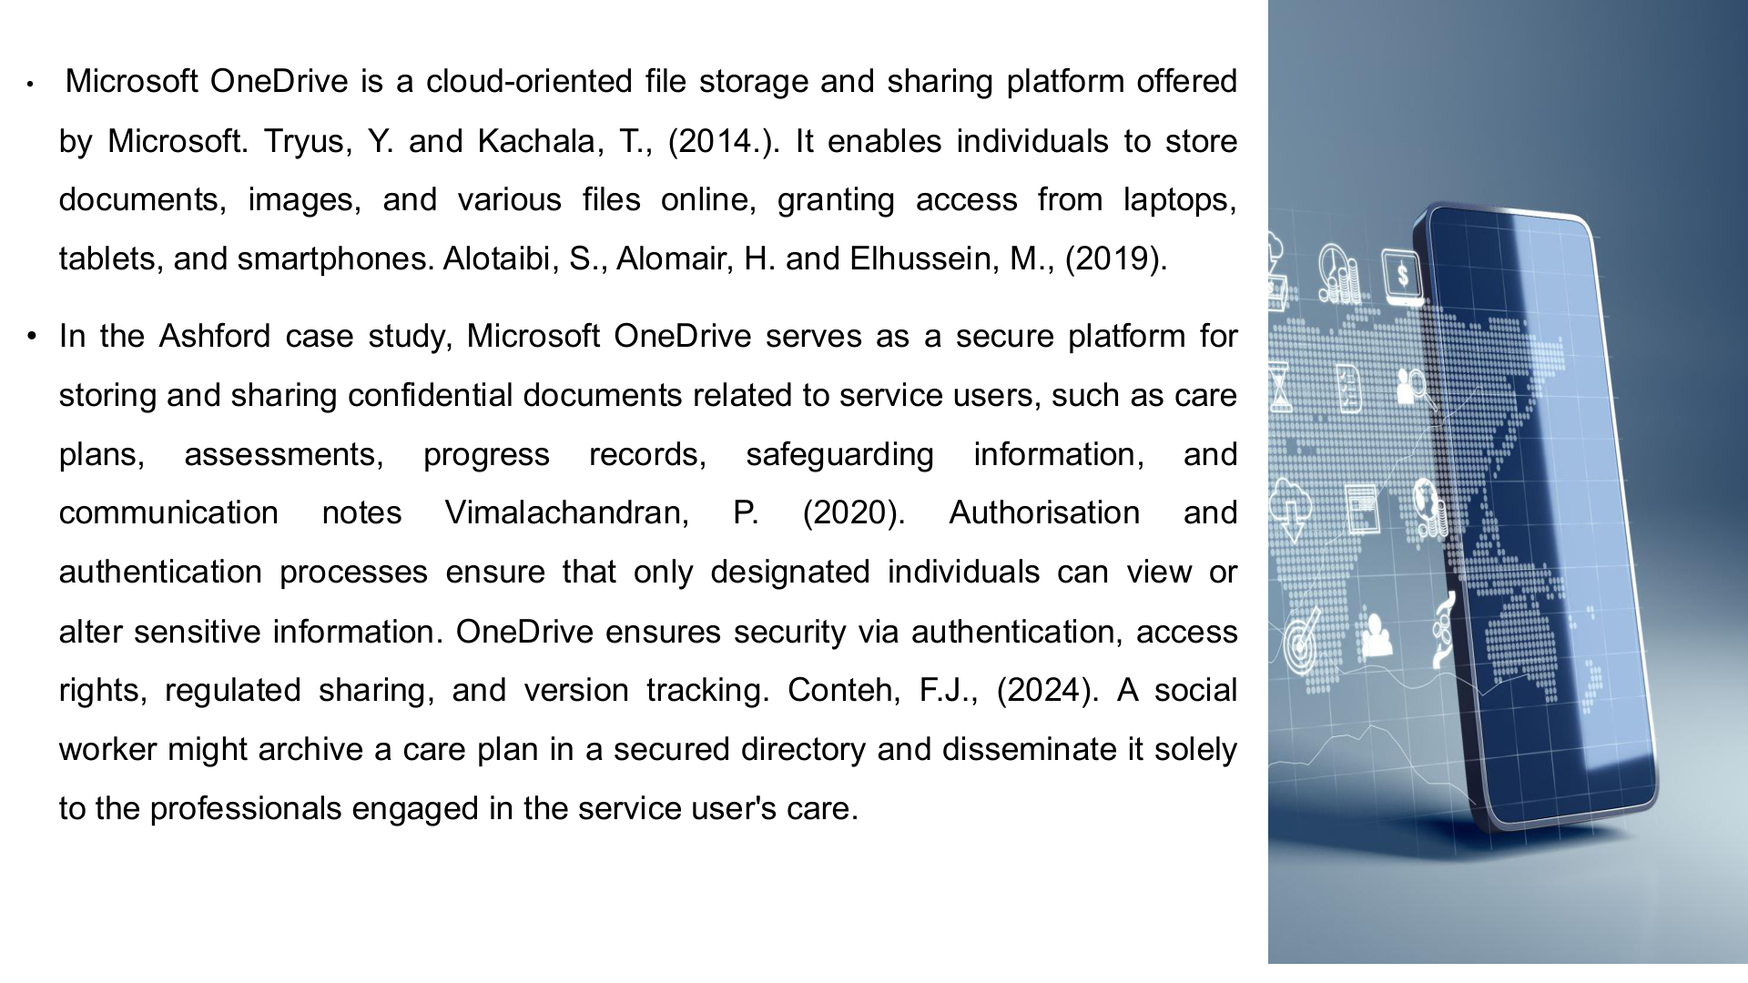

Slide 3
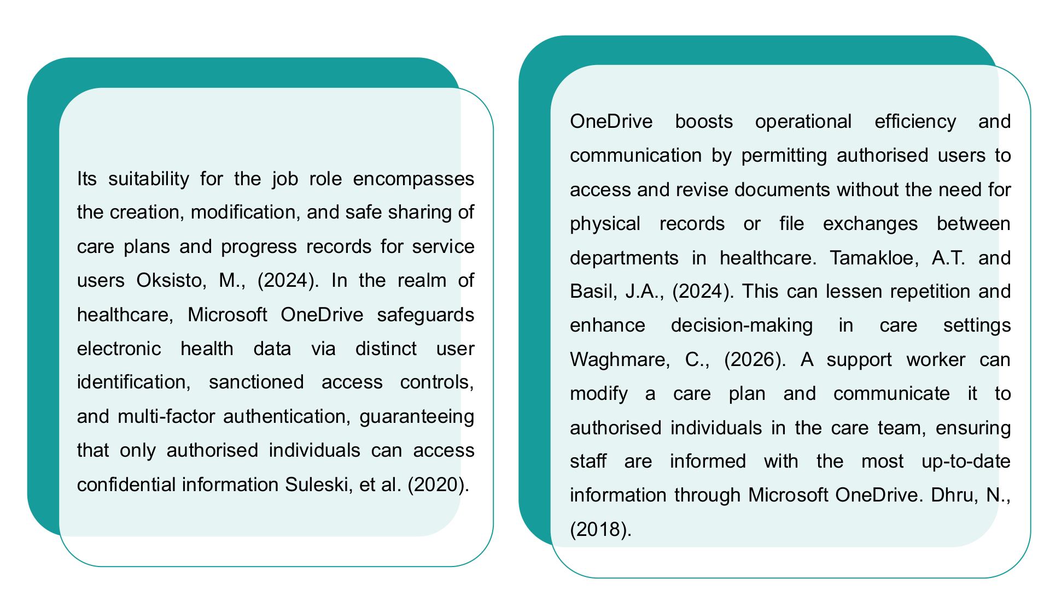

Slide 4


Slide 5
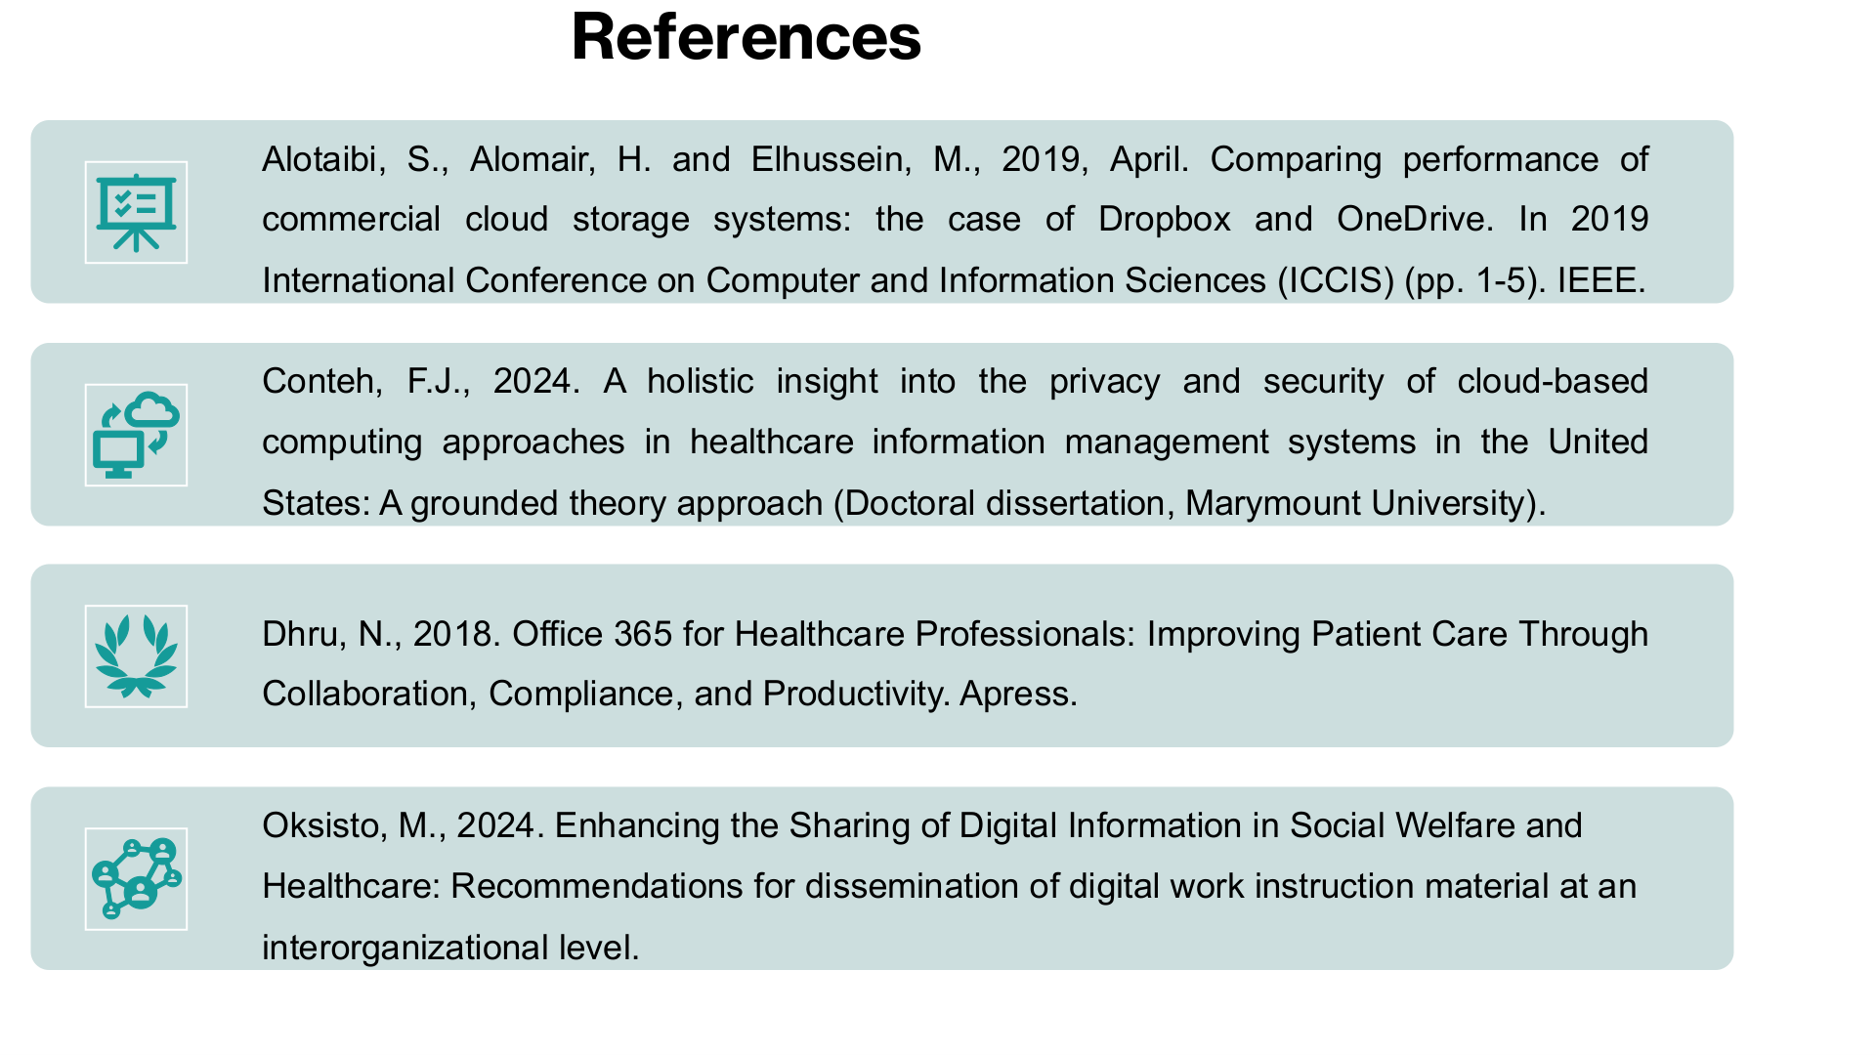

Slide 6
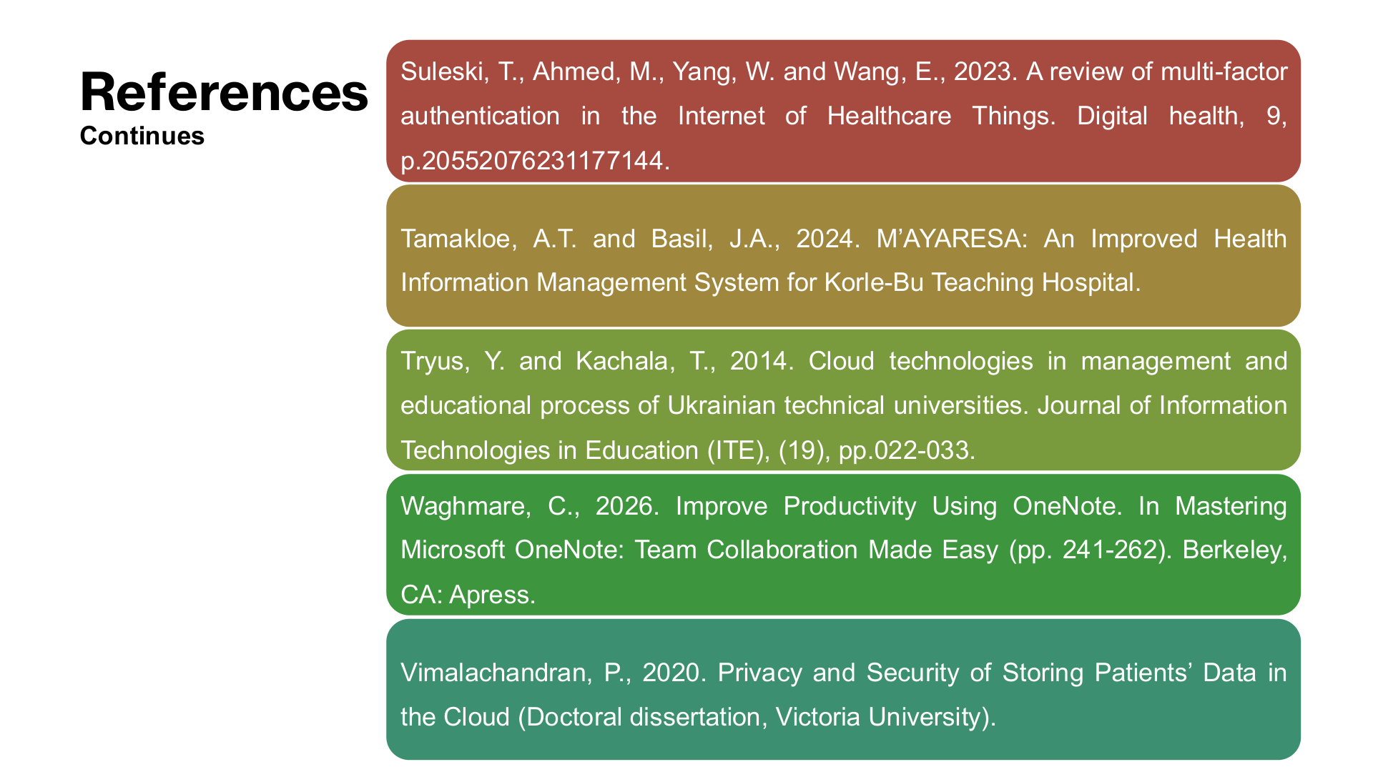

Slide 7

Workplace Task – Care Records and Rotas
Student name:fahema akter ID: 2506897@student.uwtsd.ac.uk
Microsoft OneDrive is a cloud storage and collaboration service that helps organizations safely share and access the latest version of documents.
With OneDrive, challenges like duplicated work, inconsistent records and unclear rotas are directly solved at Ashford Community Care Service.
Centralised storage means that the records of care, medication plans and rota are kept up to date and available across different settings (Al-Kuwaiti & Aziz, 2021).
OneDrive will help Ashford build on its collaboration and eliminate inefficiencies in everyday operations.

Slide 8

Advantages of OneDrive
OneDrive is made specifically for handling care records and rota documents. Accessible files allow staff working in service users' homes, supported living and the main office to access files in real time, ensuring continuity of care.
Studies have demonstrated the ability of EHR systems to provide more efficiency and lower error rates, and to ensure that information is up to date and available. (Kruse et al., 2018)
This translates to Ashford having less missed information and more transparent scheduling, which in turn would lead to an improvement in service delivery and staff coordination (Greenhalgh et al., 2017).
This Photo by Unknown Author is licensed under CC BY-NC-ND

Slide 9
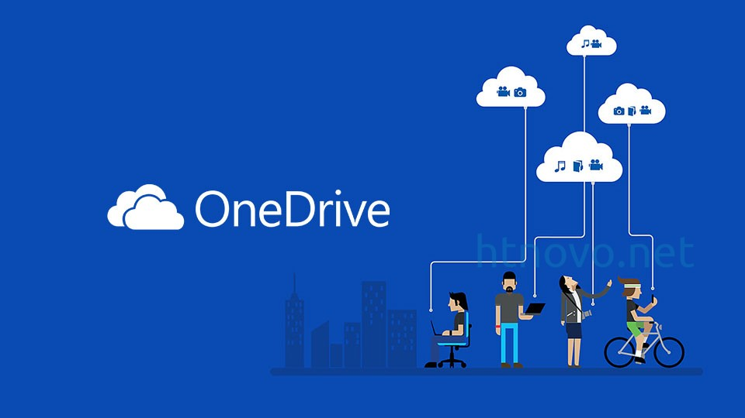
Limitations of OneDrive
OneDrive is great, but there are some drawbacks. Internet access is important and staff need training to prevent accidental access or overwriting of files (Greenhalgh et al., 2017).
The staff may not have the same level of digital literacy, potentially limiting the ability to adopt it (Top & Ali, 2021).
Furthermore, if there are no guidelines regarding folder organization and naming, it can lead to confusion.
These challenges highlight the importance of structured implementation and ongoing support to ensure OneDrive is used effectively within Ashford (Al‑Kuwaiti & Aziz, 2021).
This Photo by Unknown Author is licensed under CC BY-SA

Slide 10

Recommendations for Ashford
To get the most out of OneDrive, Ashford needs to establish some sort of folder structure based on the service user and some sort of naming conventions (Kruse et al., 2018).
Version history and permission settings should be taught at training workshops, and supervision should be carried out every week to confirm adherence to file updates (Greenhalgh et al., 2017).
Continuous IT support will be crucial for staff confidence and to resolve technical problems (Top & Ali, 2021).
These practices will reduce duplication, facilitate communication and improve service delivery, leading to better service quality outcomes for Ashford's users (Buntin et al., 2011; Microsoft, 2023).

Slide 11

References
Al‑Kuwaiti, A. and Aziz, F., 2021. Electronic health records and efficiency in healthcare. Journal of Health Informatics, 14(2), pp.45‑56.Buntin, M.B., Burke, M.F., Hoaglin, M.C. and Blumenthal, D., 2011. The benefits of health information technology: a review of the recent literature shows predominantly positive results. Health Affairs, 30(3), pp.464‑471.Greenhalgh, T., Wherton, J., Papoutsi, C., Lynch, J., Allwood, G., Hughes, G., Hinder, S., Fahy, N., Procter, R. and Shaw, S., 2017. Beyond adoption: a new framework for theorizing and evaluating nonadoption, abandonment, and challenges to the scale‑up, spread, and sustainability of health and care technologies. Journal of Medical Internet Research, 19(11), p.e367.Kruse, C.S., Stein, A., Thomas, H. and Kaur, H., 2018. The use of electronic health records to support population health: a systematic review of the literature. Journal of Medical Systems, 42(11), pp.214‑223.Microsoft, 2023. Microsoft 365 for healthcare organisations. [online] Available at: https://www.microsoft.com/en-us/microsoft-365/solutions/healthcare (microsoft.com in Bing) [Accessed 4 October 2026].Top, M. and Ali, S., 2021. Integration of digital tools in healthcare organisations: challenges and opportunities. International Journal of Healthcare Management, 14(1), pp.1‑10.
This Photo by Unknown Author is licensed under CC BY-SA

Slide 12
Advantages of OneDrive for Ashford
How OneDrive Can Improve Care Records
Student name: Aisha Hussain ID: 2534042@student.uwtsd.ac.uk
Advantage | Practical benefit for Ashford
Single record location | Reduces duplicated care records and different versions of the same document.
Access across locations | Staff can access the latest record when working in service users’ homes, supported living or the office.
Faster information sharing | Care workers and coordinators can access updated information without repeatedly sending files.
Improved consistency | Staff can work from the same current record, supporting clearer care information (Lidströmer et al., 2024).
Cloud-based health-record systems can improve accessibility and information management when appropriate controls are used (Lidströmer et al., 2024).

Slide 13
Limitations and Practical Solutions
Limitation | Risk at Ashford | Practical solution
Unauthorised access | Confidential service-user information could be viewed by inappropriate staff. | Use role-based access.
Accidental sharing | Care records could be shared with the wrong person. | Restrict sharing to authorised staff.
Cybersecurity threats | Compromised accounts could expose sensitive records. | Use MFA (Multi-Factor Authentication) and staff cybersecurity training.
Incorrect use | Staff may continue creating separate copies, causing duplication. | Introduce one standard recording procedure.
Effective access control is important for protecting electronic health information (Cobrado et al., 2024).

Slide 14
Recommendation: Implementing OneDrive at Ashford
Create one standard structure
Set up an agreed OneDrive folder system for each service user and their care records.
⬇
Set role-based access
Give support workers, senior staff, nurses and care coordinators access according to their responsibilities.
⬇
Train all staff
Provide practical training on updating, storing and securely sharing care records.
⬇
Review and monitor
Senior staff should regularly check access permissions and record consistency (Cobrado et al., 2024; Lidströmer et al., 2024)

Slide 15
REFERENCES
Cobrado, U.N., Sharief, S., Regahal, N.G., Zepka, E., Mamauag, M. and Velasco, L.C. (2024) ‘Access control solutions in electronic health record systems: A systematic review’, Informatics in Medicine Unlocked, 49, 101552. Available at: https://doi.org/10.1016/j.imu.2024.101552
Lidströmer, N., Davids, J., ElSharkawy, M., Ashrafian, H. and Herlenius, E. (2024) ‘Systematic review and meta-analysis for a Global Patient co-Owned Cloud (GPOC)’, Nature Communications, 15. Available at: Nature Communications article

