Slide 1



Current Situation at StitchCo
The shift from traditional piecework to fully automated production lines caught the StitchCo workforce off guard, bringing much anxiety and fear as a result. Many of the workers were unable to deal with the abrupt change and thought that their current set of skills would be rendered worthless after the transition occurred. They felt that they had lost their identities, and they confidence in their roles was drastically diminished.
Due to management's failure to provide employees with adequate information and understanding about the purpose and benefits of automation, employees filled the void with their own assumptions. These misconceptions only added more friction to the process of change, causing employees to withdraw emotionally from the process and become less engaged with their work, resulting in a decline in overall performance levels.

Slide 2

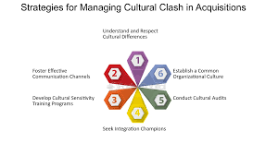
Structural & Cultural Breakdown
The culture of StitchCo has been traditionally centred around the values of individual craftsmanship, independence and speed. The shift from piecework to automation has created a cultural dichotomy between the traditional values of independence, speed and craftsmanship and the culture of teamwork, flexibility, and digital skills needed to function in an automated production environment, causing ongoing confusion and frustration for many employees.
The failure of the organisation to effectively integrate its culture, structure and people into the new technological model resulted in problems with a lack of clarity regarding employee roles, an increase in conflict between employees and reduced employee motivation. The failure of the business to properly align the existing work processes to the requirements of automated workflows has resulted in dramatic decreases in overall performance by the employees who have not been able to effectively adapt to the demands of an automated workflow environment.

