Slide 1

Managing and Leading Sports Organisations
By Thomas Studholme

Slide 2
What makes someone a good leader?
What defines a good leader is someone who can be mission driven, instruction centred, collaborative, and aims to build trust to improve the quality of productivity, strengthen culture, and enhance the achievements of a group.
Effective leaders are said to be able to shape beliefs, values, norms and shared practices within a group. Trust that is characterized by honesty, competence, openness, consistency and helpfulness, is essential for collaboration and sustainable improvement.
Leadership contributes to building this trust through transparency, fairness, communication, and mutual support. Without trust, efforts for improvement are weakened, along with motivation, innovation, and collective commitment flourish.

Slide 3
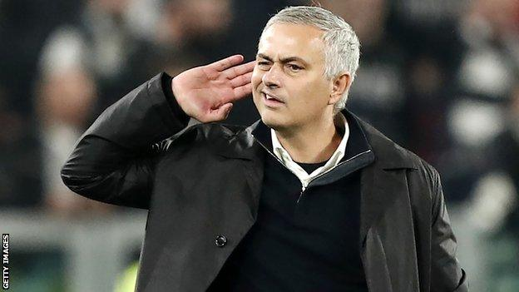
Leadership Approaches - Transactional
Transactional leadership is a leadership style based on exchanges between leaders and followers. Within a functional leadership perspective, it focuses on clarifying tasks, setting expectations, and ensuring that followers meet agreed-upon objectives through contingent rewards or corrective actions. Leaders monitor performance and provide feedback, stepping in when standards are not met. This approach supports organisational effectiveness by maintaining structure, reinforcing roles, and ensuring goal fulfillment in dynamic environments.
Transactional leadership promotes efficiency, clarity, and accountability. By clearly defining roles and linking performance to rewards, it helps ensure task completion and organisational stability. It is particularly effective in structured settings where goals, procedures, and performance standards are well defined. The emphasis on monitoring and corrective feedback also supports consistent performance.
Transactional leadership however, does have its limits. It centers on fulfilling obligations rather than strategic problem solving or long term adaptation. It may overlook broader strategic functions such as environmental monitoring and innovation. If leadership models focus too narrowly on transactional (or transformational) behaviours, important task and strategy oriented skills may be ignored, leading to incomplete assessments of leadership effectiveness and potential bias in evaluating leaders.

Slide 4
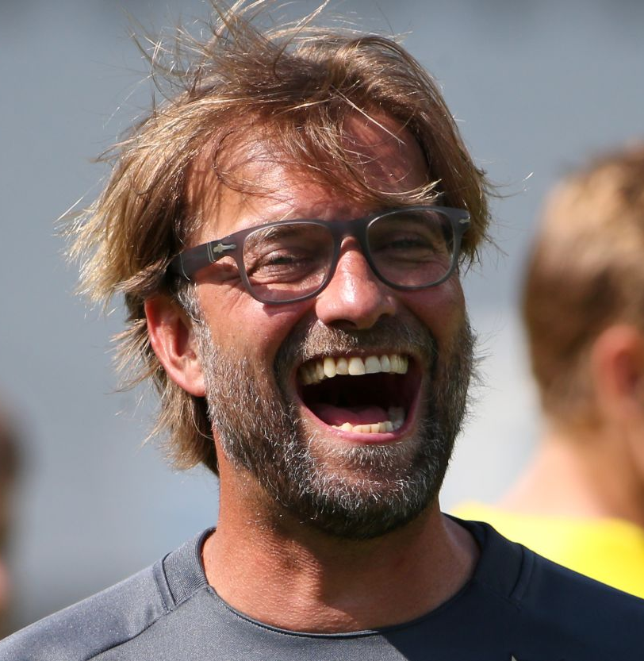
Leadership Approaches – Transformational
Transformational leadership is defined as a leadership style characterised by the ability to inspire and motivate followers to transcend their self interests for the good of the organisation. It appeals to followers' higher ideals and moral values, fostering shared purpose and personal growth. This style is built around four key components known as the "Four I's". These are "Idealised Influence", "Inspirational motivation", "Intellectual stimulation", and "Individualised consideration".
One major advantage of transformational leadership is its strong association with positive outcomes such as increased employee engagement, organisational commitment, job performance, innovation, and adaptability. It empowers followers and promotes long term growth.
However, unlike transactional leadership, it relies heavily on intrinsic motivation and moral influence, which may require strong personal credibility and consistent ethical behaviour from leaders to be effective

Slide 5
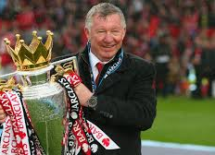
Leadership Approaches - Situational
Situational leadership is suggested to be based on Kurt Lewin's model. Which is the idea that effective leaders adjust the balance between authority and freedom, depending on the needs of the group.
It is described as a leadership triangle with three styles, which are autocratic, democratic and laissez-faire. Autocratic providing strong direction and control, Democratic which combines leadership with participation and dialogue, and Laissez-faire which is where the leader steps back and watches how participants work together and how productive they are (and stepping in when needed).
Situational leadership can increase engagement and motivation, as well as improve productivity and morale, it can encourage dialogue, commitment, and shared decision making, and even reduce conflict and prejudice through open participation
Within Situational leadership however, Democratic leadership must be learned as it doesn’t happen naturally, too much structure can create dependence on the leader, too much freedom from Laissez-faire can lead to confusion, low performance, and conflict.

Slide 6
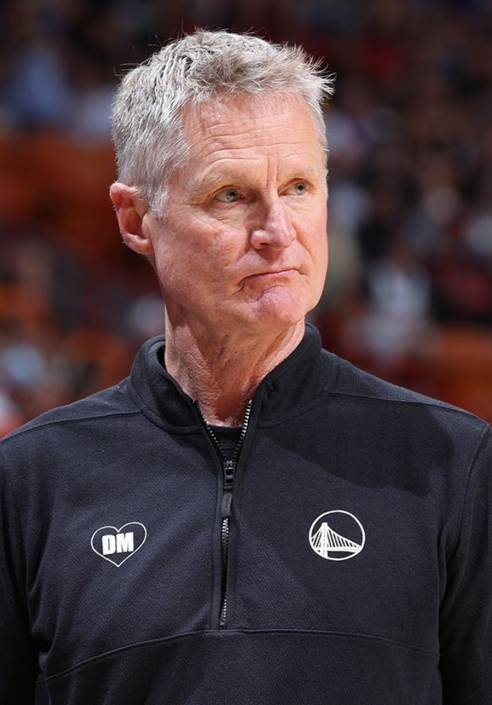
Leadership Approaches - Servant
Servant leadership is a leadership approach where the leader's primary motivation is to serve first, then lead. Originally introduced by Robert K. Greenleaf, it focuses on the growth, well-being, and autonomy of followers rather than on power or personal success.
Servant leaders are to empower and develop people, show humility and authenticity, accept others and build trust, provide direction, and act as stewards who work for the good of the whole. The core foundation is a combined motivation to lead and a need to serve.
It can increase follower growth, autonomy, and wellbeing, it can improve performance and organisational citizenship behaviours (such as helping and teamwork). It can enhance team effectiveness through empowerment and collaboration, it can encourage sustainability and corporate social responsibility at the organisational level, and it can build trust, fairness, and string leader-follower relationships.
There are some limitations with the style, it doesn’t clarify a single definition; conceptual confusion exists. There are many different measurement tools which create inconsistency, and the style itself may not fit all contexts, some situations may require a different style altogther. This highlights how ineffective a Servant approach may be.

Slide 7
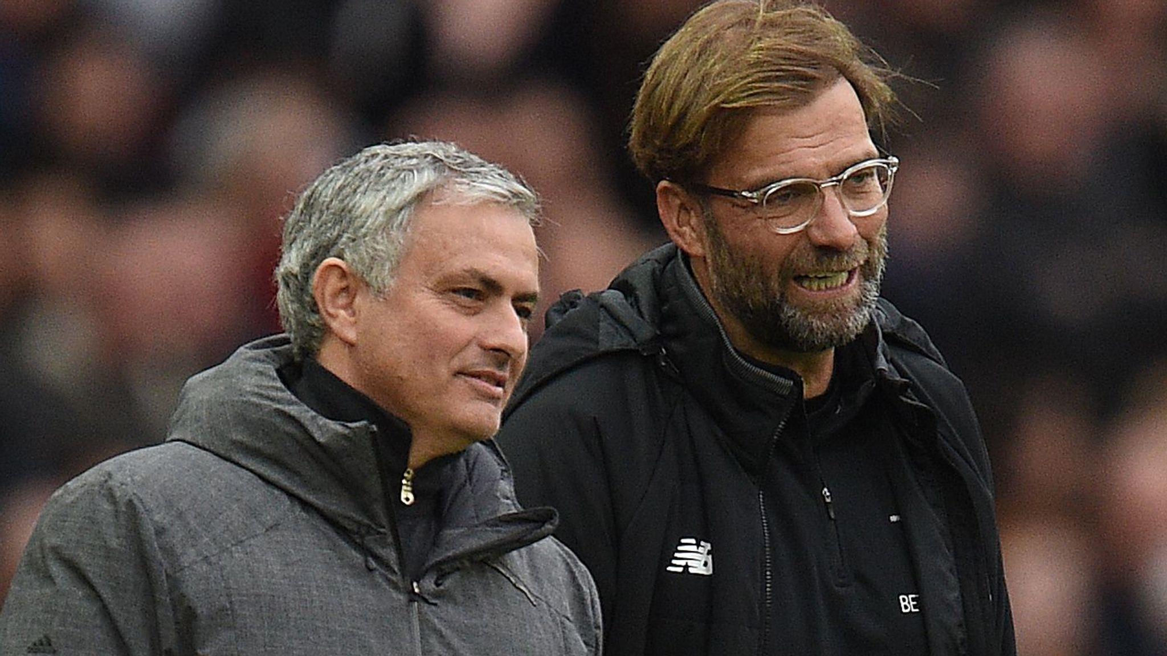
Theories in Practice (Transactional & Transformational)
A transactional leader, such as Mourinho, focus on clear exchanges. Mourinho, when he took over Chelsea in 2004, set clear expectations, defined clear and specific goals, and created a system so that his players knew exactly what was expected of them in matches and training. Mourinho rewarded those who followed his system, but refused to reward players who didn't. Chelsea went on to win the premier league with the fewest goals conceded. This shows the effectiveness of a transactional style
Klopp used a transformational style. When he took charge of Liverpool in 2015. He came in and changed the vision of the supporters, turning them from doubters to believers and created an emotional connection between the fans and the club. Klopp also elevated players like Jordan Henderson into a well respected captain, and Mohamed Salah into one of the best players in the world despite him being regarded as a "reject" at Chelsea. Klopp also transformed the team's playing identity with his Gergenpressing tactics and getting the team to work as a collective effort. Liverpool went on to win the champions league in 18/19 and the Premier League the following year in 19/20

Slide 8
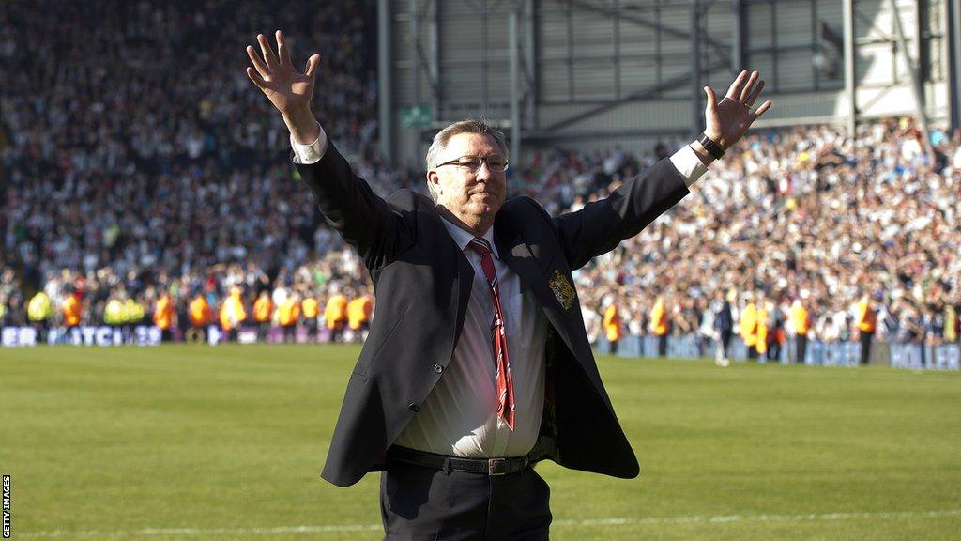
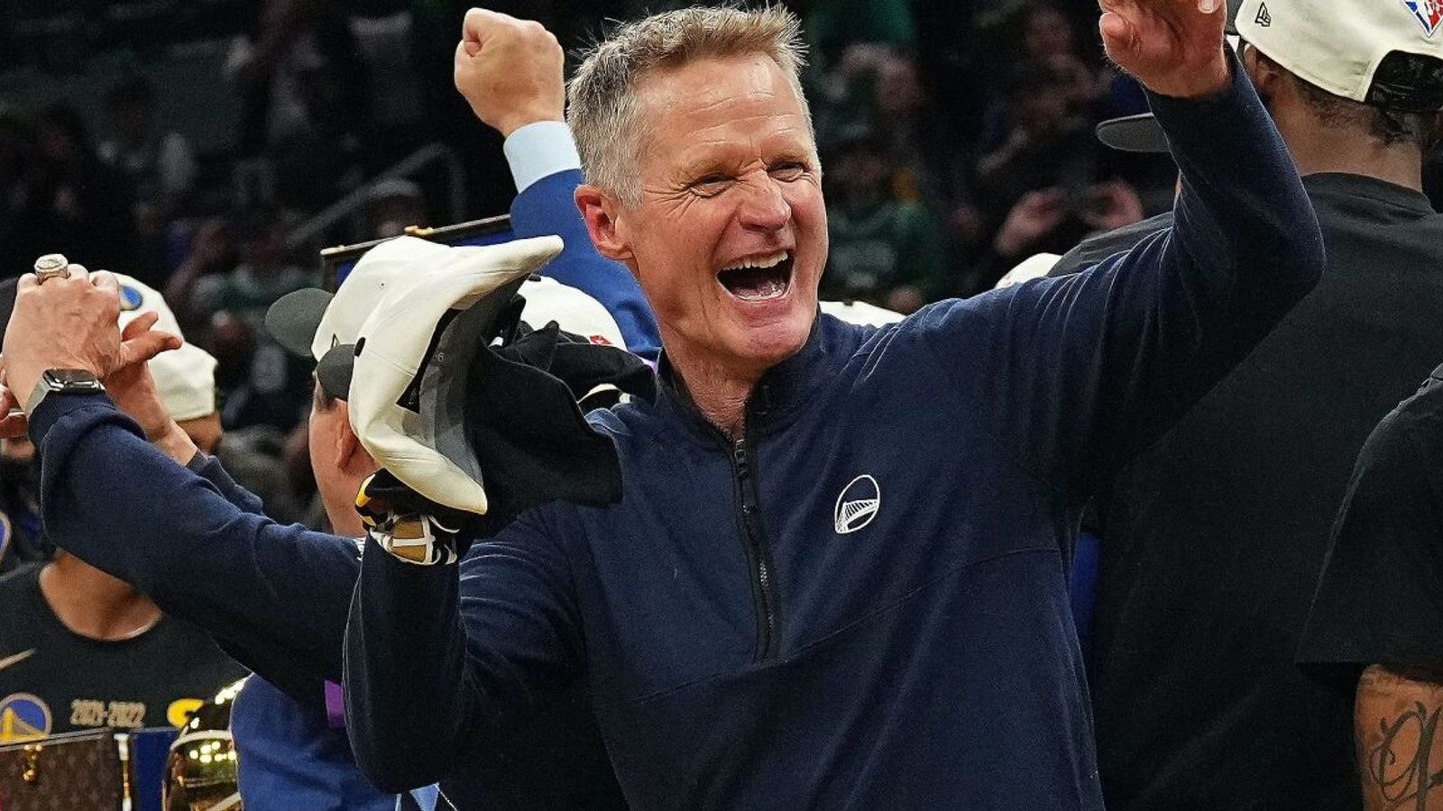
Theories in Practice (Situational & Servant)
Sir Alex Ferguson demonstrated himself as a Situational leader in multiple ways throughout his managerial career. He adjusted his style to the team's maturity. During the mid 80s to early 90s he used a very Autocratic approach to fix the lack of discipline at the club. During the class of 92 days with players like Beckham, Giggs, and Neville, he shifted his coaching style to nurture the high talent whilst maintaining high expectations. With veteran players, he used a more laid back approach, encouraging older players to take more responsibility on and off the pitch. This is evident Man Uniteds domination of football, winning countless Premier Leagues, 2 Champions Leagues, FA Cups and many more.
Steve Kerr promoted a system where players would have a voice in term decisions (this could be seen as Democratic). Rather than completely dominating his authority, he would encourage veteran players including Steph Curry to speak up for the team. Kerr publicly stated that his job was to create an environment where players can thrive rather than him controlling every outcome. This built relational trust rather than fear based authority. Kerr's Golden State Warriors won multiple championships including the NBA Finals 2025 and NBA Finals 2022.

Slide 9
Main Findings
Transactional leadership focuses on structure, monitoring and reward based exchanges to ensure task completion. It promotes clarity, efficiency, and accountability, especially in stable environments. However, it is limited in encouraging innovation or long term strategy and may overlook broader leadership competencies if relied on too heavily.
Transformational leadership inspires followers through vision, moral influence, and the "four I's". It is strongly linked to engagement, commitment, and innovation. Critically, its success depends on the leader's credibility and ethical consistency, making it vulnerable if trust or authenticity is lacking.
Situational leadership emphasises adapting style to group needs. Its flexibility can improve morale and productivity. However, finding the right balance is challenging because too much control creates dependency, while too much freedom can cause confusion and low performance.
Servant leadership prioritises follower growth, empowerment, and stewardship. It builds trust, collaboration, and organisational citizenship. Yet, it lacks conceptual clarity, has inconsistent measurement tools, and may not be effective in all contexts, particularly where strong directive leadership is required.

Slide 10

Conclusion
To conclude, this presentation was made to identify Transactional, Transformational, Situational and Servant leadership styles, and critically assess each one.
Based on findings, it can be determined that the effectiveness of each style is down to how well the leader can apply it in practice, with each style having their own benefits and drawbacks perspectively.

Slide 11
Reference List
Suleyman Davut Göker (2018) Leadership. Edited by S.D. Göker. London, England: IntechOpen.
Antonakis, J. and House, R.J. (2014) “Instrumental leadership: Measurement and extension of transformational–transactional leadership theory,” The Leadership quarterly, 25(4), pp. 746–771. Available at: https://doi.org/10.1016/j.leaqua.2014.04.005.
Sanmugam, V. (2025) Impact of Transformational Leadership Development for Business Sustainability with Gender Balance as a Mediator For Nestlé in Malaysia. University of Wales Trinity Saint David.
Warrington, D., How Jose Mourinho lost his touch, FourFourTwo, 6 April 2018, https://www.fourfourtwo.com/features/how-jose-mourinho-lost-his-touch
Morgan, R., Jurgen Klopp: Full story of how Liverpool went from doubters to believers, Sky Sports, 19 May 2024, https://www.skysports.com/football/news/11661/13137810/jurgen-klopp-full-story-of-how-liverpool-went-from-doubters-to-believers
Winter, H., How Klopp turned doubters into believers, Liverpool FC, 8 October 2020, https://www.liverpoolfc.com/news/features/411431-henry-winter-how-klopp-turned-doubters-into-believers.
Smith, M. & Figgins, S., The Jurgen Klopp way: How the charismatic German led Liverpool to long-awaited Premier League glory, Scroll.in, 29 June 2020, https://scroll.in/field/965912/the-jurgen-klopp-way-how-the-charismatic-german-led-liverpool-to-long-awaited-premier-league-glory.
Crosby, G. (2021) “Lewin’s Democratic Style of Situational Leadership: A Fresh Look at a Powerful OD Model,” The Journal of applied behavioral science, 57(3), pp. 398–401. Available at: https://doi.org/10.1177/0021886320979810.
van Dierendonck, D. (2011) “Servant Leadership: A Review and Synthesis,” Journal of management, 37(4), pp. 1228–1261. Available at: https://doi.org/10.1177/0149206310380462.
Ferguson, A. (2013) Alex Ferguson: My Autobiography. London: Hodder & Stoughton.
Kerr, S. (2021) Steve Kerr on Importance of Work-Life Balance & Leadership — Stanford Graduate School of Business interview (leadership style insight) https://www.gsb.stanford.edu/insights/steve-kerr-importance-work-life-balance
Steve Kerr explains leadership culture, 2022, Courtney Majocha — values such as joy, compassion, mindfulness and competition — at Harvard Law School (authentic servant-style emphasis) https://hls.harvard.edu/today/steve-kerr-holds-court-at-harvard-law/

