Slide 1
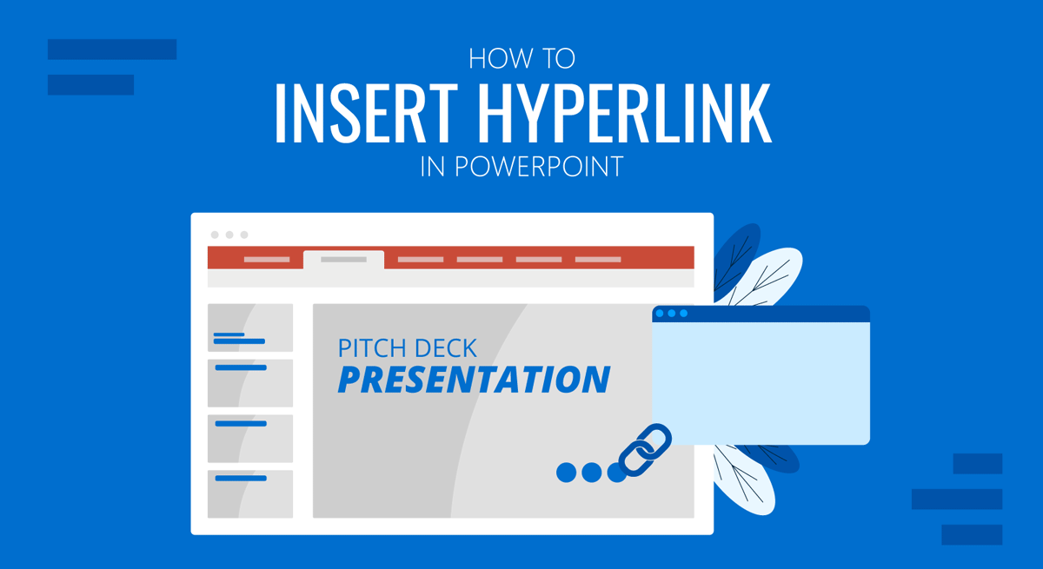
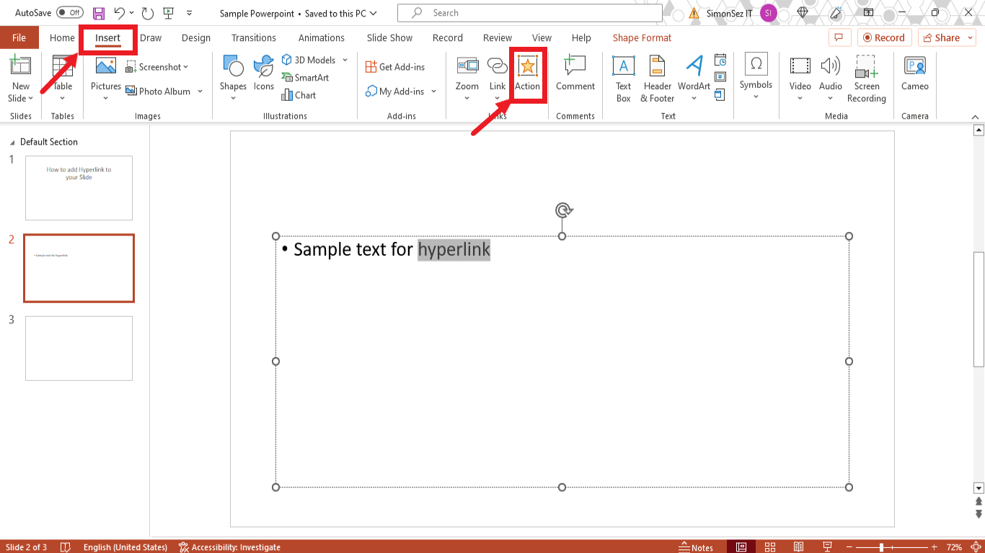
How to insert hyperlinks in a PowerPoint to insert hyperlinks in a PowerPoint
Step 1: Select the text or object: Highlight the text or select the object (like an image or shape) that will act as the hyperlink.
Go to Insert tab: Click on the "Insert" tab in the PowerPoint ribbon.
Click Hyperlink: In the "Links" group, click on the "Hyperlink" button.
Choose Link Type: Select the type of hyperlink you want to create:
Existing File or Web Page: Link to a website or a file on your computer.
Place in This Document: Link to another slide in your presentation.
Create New Document: Link to a new document that will be created.
E-mail Address: Link to send an email.
Enter the address/location: Input the URL for a website, the file path for a document, or select the slide number.
Add a ScreenTip (Optional): Add a descriptive text that will appear when the user hovers over the hyperlink.
Click OK: Confirm the hyperlink creation.
Open up PowerPoint, make the heading with going on to home and it will give you different options of text/layout, the size of text and the color of text.
Choose a topic that you want to speak about.
Advantages | disadvantages
Allows users to relate content | Miss important information as it can affect the flow of reading.
Easy access to information | You can get the wrong links sometimes.
Good engagement | People with disabilities might struggle on finding it hard to use the links.

