Slide 1

Written communication and
De-escalation

Slide 2
Agenda
Types of written communication
Nursing records
De-escalation
Practise sessions

Slide 3
Written communication in the workplace
Patient notes
Internal emails/external emails
Patient letters
Letters of complaint
Resignation letters
CV cover letters

Slide 4
Importance of good written communication
Demonstrates professionalism
Builds good rapport/relationships
Builds trust
Conveys accurate medical information
Provides reassurance
Provides record of communication
Legal reasons
Good for self-promotion (jobs)
A substitute for verbal communication when need to organise thoughts and convey a point more clearly

Slide 5
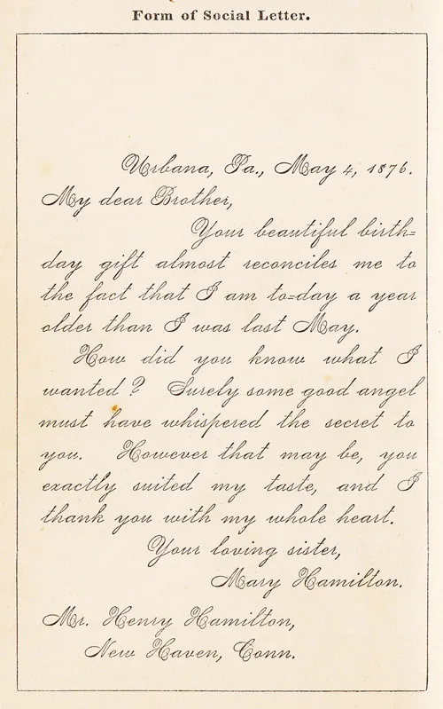
Changes in style

Slide 6
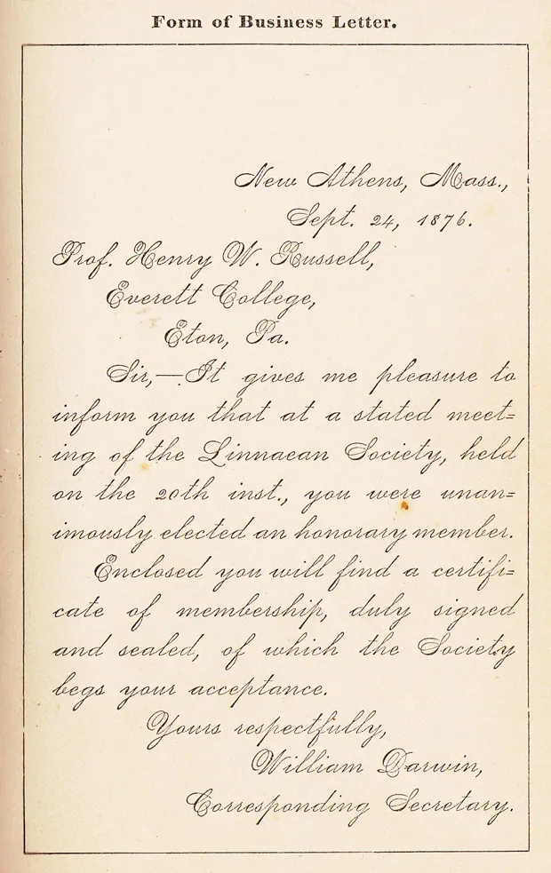
Changes in style

Slide 7
Old versus new
Old
Mechanical type-written
Carbon copy
Formal tone
Regular mail (not immediate)
Shorthand dictation
Perfect grammar and punctuation
Typed by secretary
New
Email (faster)
Text messages
Self-typed
Less formal language
Spelling grammar errors
Provides accurate record of communication for legal reasons (no “lost in the Mail”)

Slide 8
Standard business letter & email etiquette
Standard business letter: indeed.com
https://uk.indeed.com/career-advice/career-development/business-letter-format
Email etiquette: indeed.com
https://uk.indeed.com/career-advice/career-development/email-etiquette

Slide 9
How to write in nursing notes
The Nursing and Midwifery Council code of conduct state that notes must be “clear and accurate”
Notes must be kept up-to-date for patient protection and legal reasons (Bodell, 2017)

Slide 10
How to write in nursing notes
Sub-standard record-keeping can result in being removed from the NMC register
Notes are evidence of care and reminder if complaint or investigation (Bodell, 2017)

Slide 11
How to write in nursing notes
Write as you go: write as soon as possible, and don’t wait until the end of the shift. This will keep it fresh in your mind
Use a systematic approach: ACBDE/SBAR: describe what happened, provide your clinical/nursing assessment, explain what you did about the situation. (Bodell, 2017)

Slide 12
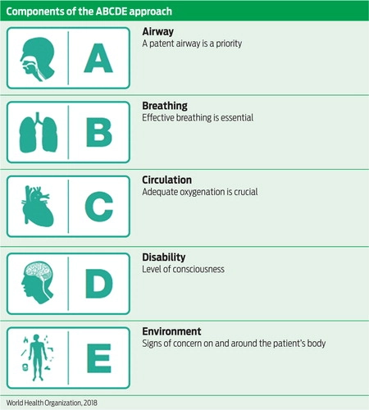
abcde

Slide 13
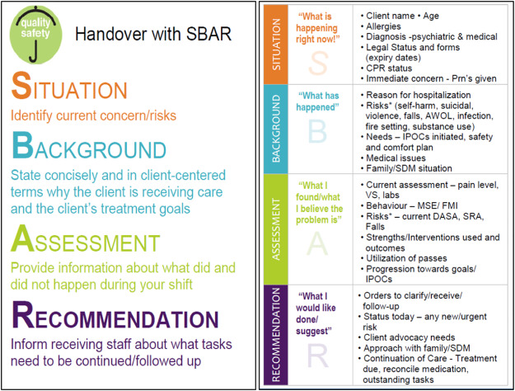
sbar

Slide 14
How to write in nursing notes
Keep it simple: easy to read and quick, so the next staff can get up to speed quickly
Be concise: fewer lines can provide more information than a whole page
Summarise don’t duplicate: if you have already provided a full assessment in other nursing documents, don’t make more work for yourself (Bodell, 2017)

Slide 15
How to write in nursing notes
Keep it simple: easy to read and quick, so the next staff can get up to speed quickly
Be concise: fewer lines can provide more information than a whole page
Summarise don’t duplicate: if you have already provided a full assessment in other nursing documents, don’t make more work for yourself (Bodell, 2017)

Slide 16
How to write in nursing notes
Remain objective and avoid speculation: only write down what you see, hear, and do.
Write down all communication: this includes communication with doctors, family, and other healthcare professionals. Use names where possible. (Bodell, 2017)

Slide 17
How to write in nursing notes
Avoid abbreviations: Write out complete terms as different areas can have different meanings. Find out your trust’s pre-approved abbreviation list.
Consider the use of a scribe: Emergency events such as cardiac arrests, trauma calls or medical emergencies commonly have poor documentation. Consider appointing a member of staff to write things down as you go; times and doses of medications, medical reviews, clinical interventions etc. (Bodell, 2017)

Slide 18
How to write in nursing notes
Write legibly: so that any other person can read your writing
Ensure documentation is signed and dated: student staff and unregistered may need to have documentation counter-signed. (Bodell, 2017)

Slide 19

De-escalation techniques

Slide 20
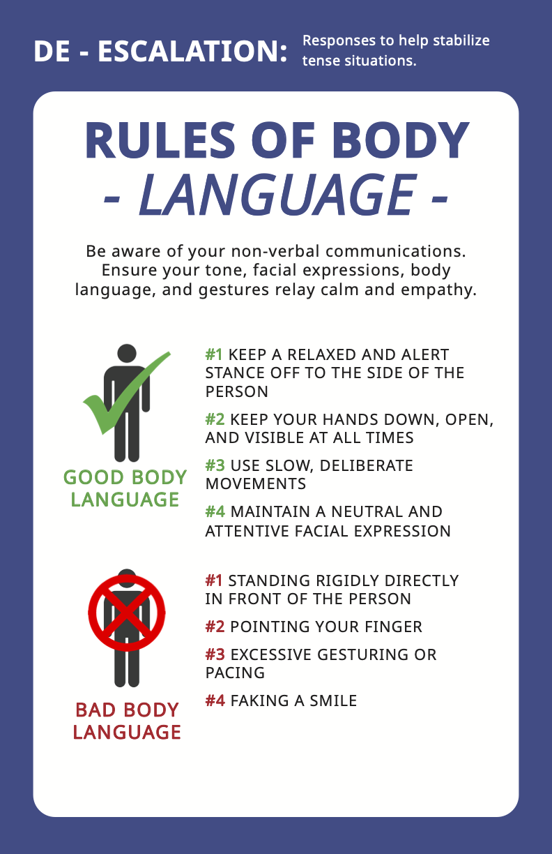

Slide 21
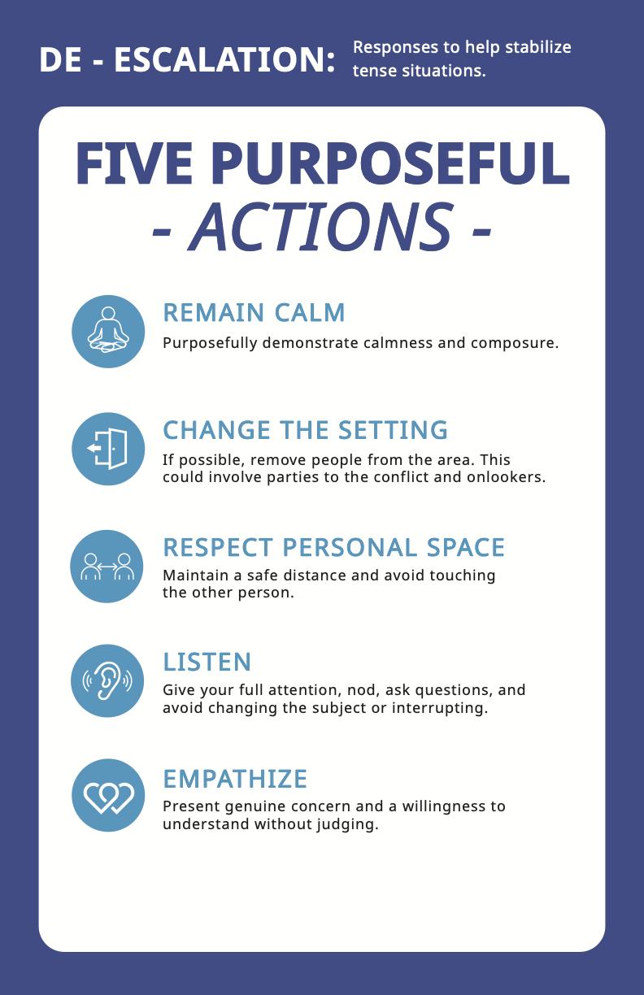

Slide 22
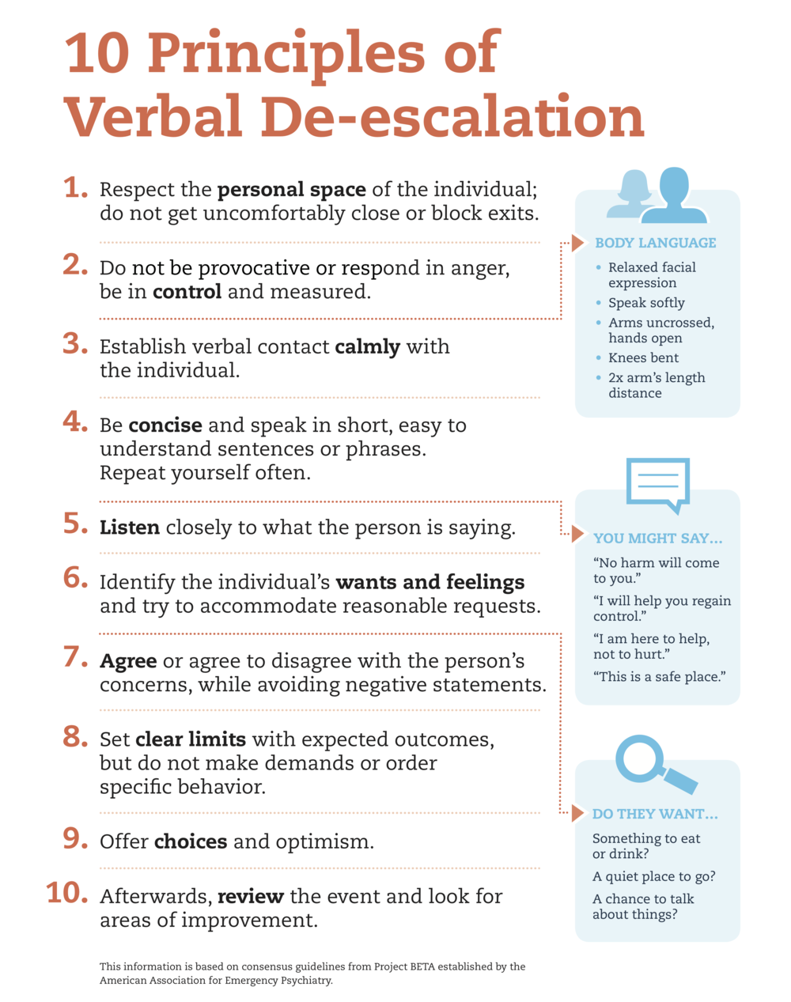

Slide 23
De-escalation techniques
De-escalation techniques
https://hub.tmlt.org/tmlt-blog/de-escalation-techniques-and-resources

Slide 24
References
Bodell, M (2017) How to Write in Nursing Notes. Available at: https://nursingnotes.co.uk/news/write-nursing-notes/ (Accessed: 26 March 2023)
Business Letter Format and Example. Available at: https://uk.indeed.com/career-advice/career-development/business-letter-format (Accessed 25 March 2023)
How to End an Email Professionally (with examples) Available at: https://uk.indeed.com/career-advice/career-development/how-to-end-an-email
De-escalation Techniques and Resources. Available at: https://hub.tmlt.org/tmlt-blog/de-escalation-techniques-and-resources

