Slide 1


Presentation by Gwen Jones
case study analysis
Attention Deficit Hyperactivity Disorder
(ADHD)

Slide 2
Table of content
01
Case study
03
02
References
ADHD
04
03
Research timeline
Challenges +
Recommendations

Slide 3
Case study

Slide 4

Case summary
  The case highlights a woman with Attention Deficit Hyperactivity Disorder.
  this was undignosed for most of her life.
  The case studies past criminal history revolves over drug offences.
  struggles with reoffending ending in repeated short-term custodial sentences.

Slide 5
Attention Deficit Hyperactivity Disorder, what is it?

Slide 6

ADHD
  Classified as a neurodevelopmental disorder.
  ADHD causes difficulties with things such as irrationality, impulsivity, organisation and concentration (NHS, 2025).
  Many people use medications to help with ADHD, however they are not always attainable and is a long process to find the correct type and dosage (National Institute of Mental Health, 2024).
  More commonly diagnosed in youth and adolescents and so many adults with ADHD may not be aware of their ADHD or are not officially/medically diagnosed as such.

Slide 7

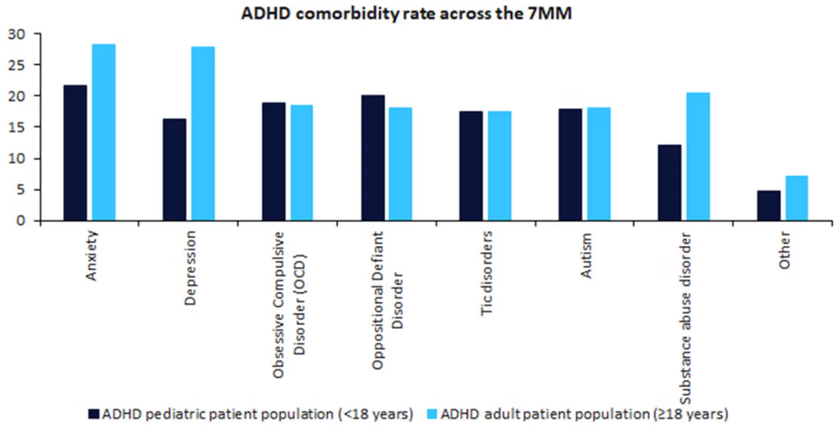
Comorbidity
  Research by Downey and colleagues reported that around 32% of clinically referred ADHD adults have/had drug abuse or dependancies (McGough et al., 2005).
  Meaning is two or more disorders
occurring at the same time.
  High correlation between mood
mood disorders such as anxiety, OCD,
depression
(GlobalData Healthcare, 2024).
  Criminality, substance abuse and victimisation
also more higher in ADHD (ghirardi, 2019).
photo accessed at (GlobalData Healthcare, 2024)

Slide 8
Challenges
+ Recommendation

Slide 9


Gender
Challenges
  Boys are more likely to get diagnosed due to higher external symptoms, whereas women are more prone to masking and internalising their behaviours (Mowlem et al., 2019).
  Clinical samples of ADHD revealed dominance in males, leading to a gap in gender and negligence of diagnosis and research . (Arnold, 1996).
  Convictions of individuals with ADHD higher in males over females. with relevant risk more common in women and absolute risk more common in men (Anna‐Karin Ångström et al., 2024).

Slide 10
Gender
Recommendations
  Changing ADHD from a predominantly male focused behavioural disorder towards an equal and non gender biased disorder where external attitudes there may be room to understand the needs of women with ADHD. (Young et al., 2020).
  All English women’s prisons reported lack of well being support. An increased support for mental health in womens prisons is needed to work with their ADHD and comorbid disorders (NHS England, 2023).

Slide 11

Late diagnosis
Challenges
  The diagnosis process in the UK can take around 12-50 weeks if screened through the NHS (ADHD UK, 2023).
  Around £650 for a private assessment (Private ADHD, 2024).
  Females with ADHD diagnosed later in life have a higher comorbidity with mood disorders such as anxiety and depression due to the late diagnosis (Siddiqui et al., 2024).
  Physical well-being nurses are used in custody screenings instead of nurses specialised in mental health (Young et al., 2018).

Slide 12
Late diagnosis
  The London police force works for fast-tracked screenings for those suspected of ADHD and better awairness for detainees with undiagnosed ADHD (City of London Police, 2023).
  HMP Brixton bringing in specialist psychological services and therapies with assessments aiding in diagnosis(CJJI, n.d.).
  Improvements in the NHS need to be made for ADHD to prevent them having to go through the CJS.
  Specialist mental health training for officers.
Recommendations

Slide 13

Re-Offending
Challenges
  Organisation being a symptom of ADHD, leads to poor time management (Marais, 2025), and so tasks such as probation meetings become more difficulties for ADHD individuals.
  Attention difficulties also contribute largely to the amount of reoffending, with memory loss and taking in information being a symptom of ADHD (ADDA, 2023) this may affect life after prison, with following bail conditions becoming a challenging task.

Slide 14
Re-Offending
Recommendations
  Probation services reported a lack of training in the management of an individual with ADHD (Young et al., 2014).
  ADHD treatments proven to lower recidivism and benefiting in rehabilitation programmes. (Carlander et al., 2024)
  With the use of antipsychotic, psychostimulants or other medications used to help with ADHD, violent reoffending was decreased by 32% in men and 41% in women. (Young et al., 2018).

Slide 15
Reference list
ADDA (2023). ADHD Memory Loss: Science-Backed Ways to Boost Your Memory. [online] ADDA - Attention Deficit Disorder Association. Available at: https://add.org/adhd-memory-loss/.
ADHD UK (2023). NHS ADHD Assessments Waiting Lists Report. [online] adhduk.co.uk. Available at: https://adhduk.co.uk/nhs-adhd-assessments-waiting-lists-report/.
Anna‐Karin Ångström, Andersson, A., Garcia‐Argibay, M., Chang, Z., Lichtenstein, P., D’Onofrio, B.M., Tuvblad, C., Ghirardi, L. and Larsson, H. (2024). Criminal Convictions in Males and Females Diagnosed with Attention Deficit Hyperactivity disorder: a Swedish National Registry Study. JCPP Advances, 4(1). doi:https://doi.org/10.1002/jcv2.12217.
Arnold, L.E. (1996). Sex differences in ADHD: Conference summary. Journal of Abnormal Child Psychology, 24(5), pp.555–569. doi:https://doi.org/10.1007/bf01670100.
Carlander, A., Rydell, M., Kataoka, H., M. Hildebrand Karlén and Bagge, A. ‐S L. (2024). A Remedy for Crime? A Systematic Review on the Effects of Pharmacological ADHD Treatment on Criminal Recidivism and Rehabilitation in Inmates With ADHD. Brain and Behavior, 14(11). doi:https://doi.org/10.1002/brb3.70120.
City of London Police. (2023). City of London Police First in the Country to Screen Suspects for ADHD. [online] Available at: https://www.cityoflondon.police.uk/news/city-of-london/news/2023/may/city-of-london-police-first-in-the-country-to-screen-suspects-for-adhd/#:~:text=The%20City%20of%20London%20Police%20is%20the,(CPS)%20and%20the%20National%20Police%20Chiefs'%20Council..
Ghirardi, Laura (2019). The comorbidity between attention-deficit/hyperactivity disorder and other neurodevelopmental disorders : aetiology, treatment and outcomes. Karolinska Institutet. Thesis. https://hdl.handle.net/10616/46807

Slide 16
Reference list
VGlobalData Healthcare (2024). Comorbidities associated with ADHD present an opportunity for pipeline products. [online] Clinical Trials Arena. Available at: https://www.clinicaltrialsarena.com/analyst-comment/comorbidities-associated-with-adhd/?cf-view.
Marais, S.D. (2025). How ADHD fuels disorganization. [online] Rula. Available at: https://www.rula.com/blog/disorganized-adhd/ [Accessed 2 Mar. 2026].
McGough, J.J. (2005). Psychiatric Comorbidity in Adult Attention Deficit Hyperactivity Disorder: Findings From Multiplex Families. American Journal of Psychiatry, 162(9), pp.1621–1627. doi:https://doi.org/10.1176/appi.ajp.162.9.1621.
Mowlem, F., Agnew-Blais, J., Taylor, E. and Asherson, P. (2019). Do Different Factors Influence Whether Girls versus Boys Meet ADHD Diagnostic criteria? Sex Differences among Children with High ADHD Symptoms. Psychiatry Research, [online] 272, pp.765–773. doi:https://doi.org/10.1016/j.psychres.2018.12.128.
National Institute of Mental Health (2024). Attention-Deficit/Hyperactivity disorder: What You Need to Know. [online] National Institute of Mental Health. Available at: https://www.nimh.nih.gov/health/publications/attention-deficit-hyperactivity-disorder-what-you-need-to-know.
NEURODIVERSITY IN THE CRIMINAL JUSTICE SYSTEM A review of evidence. (n.d.). [online] Criminal Justice Joint Inspection . Available at: https://cdn.websitebuilder.service.justice.gov.uk/uploads/sites/43/2024/09/2021-07-15-Neurodiversity-in-the-Criminal-Justice-Sustem-a-review-of-evidence.pdf.
NHS (2025). ADHD in adults. [online] nhs.uk. Available at: https://www.nhs.uk/conditions/adhd-adults/.
NHS England (2023). A review of health and social care in women’s prisons. [online] www.england.nhs.uk. Available at: https://www.england.nhs.uk/long-read/a-review-of-health-and-social-care-in-womens-prisons/.

Slide 17
Reference list
Privateadhd.com. (2024). PrivateADHD. [online] Available at: https://www.privateadhd.com/product/private-adhd-assessment?gad_source=1&gad_campaignid=22299713509&gbraid=0AAAAA9WQThBR7cDx4YJtUR42T3XPh7F7s&gclid=Cj0KCQiA5I_NBhDVARIsAOrqIsaRxAzV8uzj-8qB8StlXLlruTvjeUTgmega70PtaZmvptjtJ5DCxb8aAgoXEALw_wcB [Accessed 1 Mar. 2026].
Siddiqui, U., Conover, M.M., Voss, E.A., Kern, D.M., Litvak, M. and Antunes, J. (2024). Sex Differences in Diagnosis and Treatment Timing of Comorbid Depression/Anxiety and Disease Subtypes in Patients With ADHD: A Database Study. Journal of attention disorders, 28(10). doi:https://doi.org/10.1177/10870547241251738.
Susan, Y., Gisli H, G., Emily J, G., Amit, J., Romana, F., David, H. and Marios, A. (2014). Beyond the Gates: Identifying and Managing Offenders with Attention Deficit Hyperactivity Disorder in Community Probation Services. AIMS Public Health, [online] 1(1), pp.33–42. doi:https://doi.org/10.3934/publichealth.2014.1.33.
Young, S., Adamo, N., Ásgeirsdóttir, B.B., Branney, P., Beckett, M., Colley, W., Cubbin, S., Deeley, Q., Farrag, E., Gudjonsson, G., Hill, P., Hollingdale, J., Kilic, O., Lloyd, T., Mason, P., Paliokosta, E., Perecherla, S., Sedgwick, J., Skirrow, C. and Tierney, K. (2020). Females with ADHD: An expert consensus statement taking a lifespan approach providing guidance for the identification and treatment of attention-deficit/ hyperactivity disorder in girls and women. BMC Psychiatry, [online] 20(1), p.404. doi:https://doi.org/10.1186/s12888-020-02707-9.
Young, S., Gudjonsson, G., Chitsabesan, P., Colley, B., Farrag, E., Forrester, A., Hollingdale, J., Kim, K., Lewis, A., Maginn, S., Mason, P., Ryan, S., Smith, J., Woodhouse, E. and Asherson, P. (2018). Identification and treatment of offenders with attention-deficit/hyperactivity disorder in the prison population: a practical approach based upon expert consensus. BMC Psychiatry, [online] 18(1). doi:https://doi.org/10.1186/s12888-018-1858-9.

Slide 18
Research timeline
Background reading
I accessed most of my reading and research using tools from both google scholar and the UWTSD hwb.
Planning
To find the most relevant research for me to use I mainly went for the sources that reaffirmed the points that I wanted to make.
Structure
The structure I had in mind developed before I began researching, however it did help in how to word certain sentences.
Wider reading
Initially I did not include information from ADHD organisations and charities until I began researching different options avaliable in curiosity.
Reflection
I believed I faced many challenges in this presentation, mainly due to being too picky and indecisive over the research I wanted to use.
Reflection
Next time I would instead not overthink my research as much as I missed out on some important discussions and points

Slide 19
Thank you!

