Slide 1
Module Name : Electronics II
Module Code : ACDA6001
Topic : State Reduction Example
Lecture : 11
Lecture By,
Mrs. Jenifer Prince Devaraj,
Lecturer - Embedded Electronics,
Faculty of Applied Computing,
UWTSD
Email:j.prince-devaraj@uwtsd.ac.uk

Slide 2
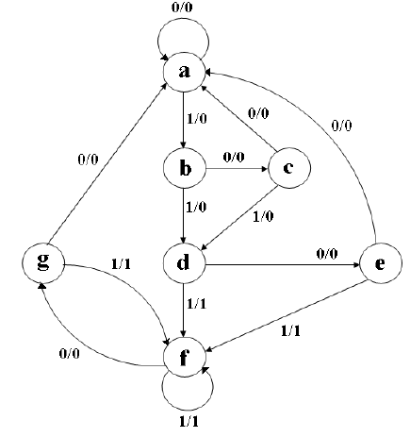
(i) Determine the reduced state diagram for the state diagram given below.
(ii) Also, for the obtained reduced state diagram answer the following and design a synchronous Sequential Circuit using D Flip Flop.
State Reduction - Example
Show the Reduced State Table
Show its state Assignment.
Obtain the PS- NS Table.
Obtain Excitation Table.
Output Expressions
Logic Circuit
UWTSD Lectures / ACDA6001 – Electronics 2

Slide 3
(i) To draw the Reduced State Diagram
Step 1: State Table
State Reduction - Example
 | Next State |  | Output(z)
Present State | x = 0 | x = 1 | x = 0 | x=1
a | a | b | 0 | 0
b | c | d | 0 | 0
c | a | d | 0 | 0
d | e | f | 0 | 1
e | a | f | 0 | 1
f | g | f | 0 | 1
g | a | f | 0 | 1
UWTSD Lectures / ACDA6001 – Electronics 2

Slide 4
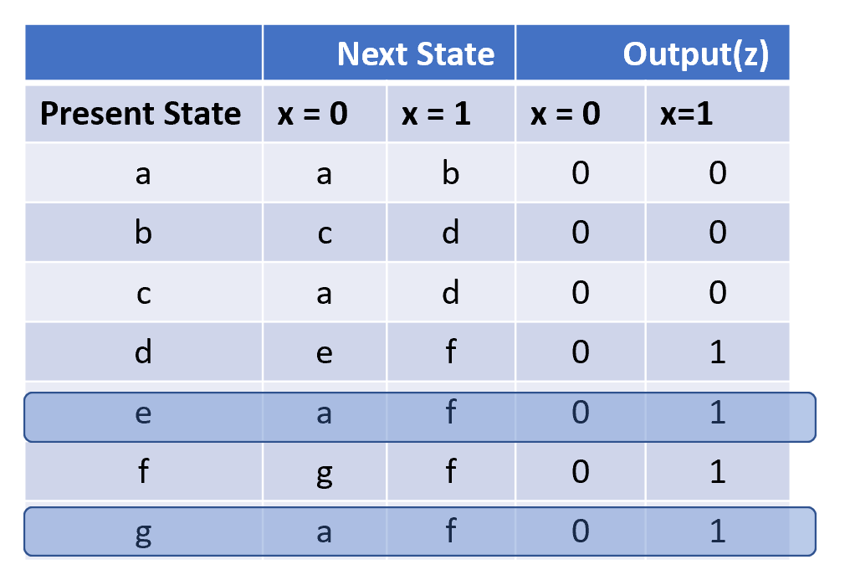
To draw the Reduced State Diagram
Step 2: Reduced State Table
State Reduction - Example
 | Next State |  | Output(z)
Present State | x = 0 | x = 1 | x = 0 | x =1
a | a | b | 0 | 0
b | c | d | 0 | 0
c | a | d | 0 | 0
d | e | f | 0 | 1
e | a | f | 0 | 1
f | e | f | 0 | 1
UWTSD Lectures / ACDA6001 – Electronics 2

Slide 5
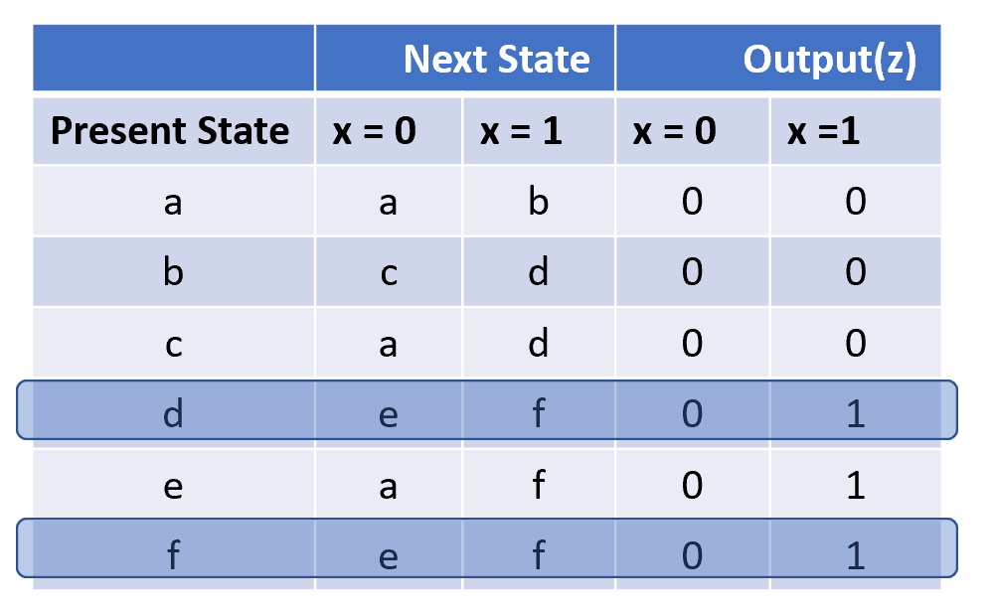
To draw the Reduced State Diagram
Step 2: Further Reduced State Table
State Reduction - Example
 | Next State |  | Output(z)
Present State | x = 0 | x = 1 | x = 0 | x =1
a | a | b | 0 | 0
b | c | d | 0 | 0
c | a | d | 0 | 0
d | e | d | 0 | 1
e | a | d | 0 | 1
UWTSD Lectures / ACDA6001 – Electronics 2

Slide 6
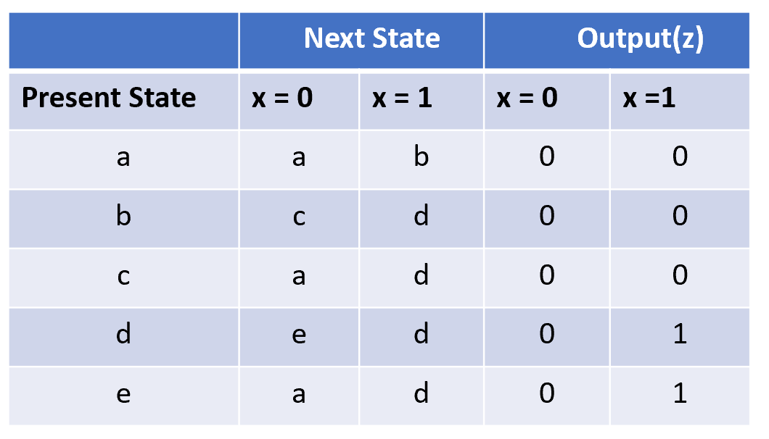
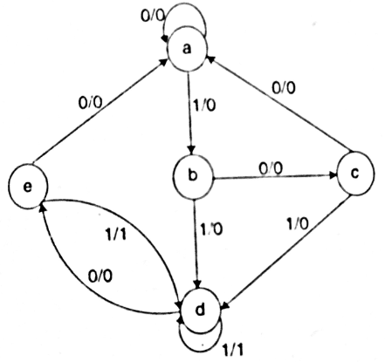
To draw the Reduced State Diagram
Step 3: Reduced State Diagram
State Reduction - Example
UWTSD Lectures / ACDA6001 – Electronics 2

Slide 7
(ii) From Reduced State Diagram
Step 1: Show its Reduced state Table
State Reduction - Example
UWTSD Lectures / ACDA6001 – Electronics 2

Slide 8
(ii) From Reduced State Diagram
Step 2: Show its state Assignment
State Reduction - Example
a ---> 000
b ---> 001
c ---> 010
d ---> 011
e---> 100
UWTSD Lectures / ACDA6001 – Electronics 2

Slide 9
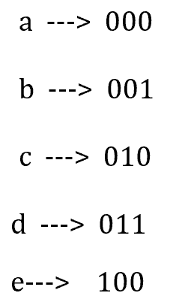
State Reduction - Example
Present State | Input | Next State | Output
q2 q1 q0 | X | Q2 Q1 Q0 | Z
0 0 0 | 0 | 0 0 0 | 0
0 0 0 | 1 | 0 0 1 | 0
0 0 1 | 0 | 0 1 0 | 0
0 0 1 | 1 | 0 1 1 | 0
0 1 0 | 0 | 0 0 0 | 0
0 1 0 | 1 | 0 1 1 | 0
0 1 1 | 0 | 1 0 0 | 0
0 1 1 | 1 | 0 1 1 | 1
1 0 0 | 0 | 0 0 0 | 0
1 0 0 | 1 | 0 1 1 | 1
1 0 1 | 0 | d d d | d
1 0 1 | 1 | d d d | d
1 1 0 | 0 | d d d | d
1 1 0 | 1 | d d d | d
1 1 1 | 0 | d d d | d
1 1 1 | 1 | d d d | d
Step 3: PS – NS Table
 | Next State |  | Output (z)
Present State | x = 0 | x = 1 | x = 0 | x =1
000 | 000 | 001 | 0 | 0
001 | 010 | 011 | 0 | 0
010 | 000 | 011 | 0 | 0
011 | 100 | 011 | 0 | 1
100 | 000 | 011 | 0 | 1
OR
UWTSD Lectures / ACDA6001 – Electronics 2

Slide 10
Step 4: Obtain Excitation Table using D Flip- flop.
State Reduction - Example
Present State | Input | Next State | Output | D Flip-flop
q2 q1 q0 | X | Q2 Q1 Q0 | Z | D2 D1 D0
0 0 0 | 0 | 0 0 0 | 0 | 0 0 0
0 0 0 | 1 | 0 0 1 | 0 | 0 0 1
0 0 1 | 0 | 0 1 0 | 0 | 0 1 0
0 0 1 | 1 | 0 1 1 | 0 | 0 1 1
0 1 0 | 0 | 0 0 0 | 0 | 0 0 0
0 1 0 | 1 | 0 1 1 | 0 | 0 1 1
0 1 1 | 0 | 1 0 0 | 0 | 1 0 0
0 1 1 | 1 | 0 1 1 | 1 | 0 1 1
1 0 0 | 0 | 0 0 0 | 0 | 0 0 0
1 0 0 | 1 | 0 1 1 | 1 | 0 1 1
1 0 1 | 0 | d d d | d | d d d
1 0 1 | 1 | d d d | d | d d d
1 1 0 | 0 | d d d | d | d d d
1 1 0 | 1 | d d d | d | d d d
1 1 1 | 0 | d d d | d | d d d
1 1 1 | 1 | d d d | d | d d d
UWTSD Lectures / ACDA6001 – Electronics 2

Slide 11
From the Reduced State Diagram
Step 5: K Map Expressions
State Reduction - Example
UWTSD Lectures / ACDA6001 – Electronics 2

Slide 12

State Reduction - Example
$$D_{2}=q_{1}q_{0}\overline{X} \\ D_{1}=\overline{q_{1}}q_{0}+q_{1}X+q_{2}X \\ D_{0}=X \\ Z=q_{1}q_{0}X+q_{2}X$$
UWTSD Lectures / ACDA6001 – Electronics 2

Slide 13
Step 6 : Logic Diagram
State Reduction - Example
UWTSD Lectures / ACDA6001 – Electronics 2

Slide 14
Reference
[1] S. Salivahanan and S. Arivazhagan, Digital Circuits and Design, Paperback ed. New Delhi, India: Vikas Publishing, Jan. 2018.
State Reduction - Example
UWTSD Lectures / ACDA6001 – Electronics 2

Slide 15
Thank you

