Slide 1
CALORIMETRY
NOTES
Dr Ewa Kazimierska
e.kazimierska@uwtsd.ac.uk

Slide 2




MACROSCOPIC HEAT
heating causes changes of temperature but different substances heated with the same amount of energy do not give the same temperature change
Substance
Object
specific heat (capacity), c_{p}
heat capacity, HC
Amount of heat needed to raise the temperature of 1 g of the substance by 1 °C
Amount of heat needed to raise the temperature of an object by 1 °C
$$c_{p}=\frac{q}{mass × ∆T }$$
[J/g-°C]
$$HC=\frac{q}{ ∆T }$$
[J/°C]
q = mass × ΔT × C_{p}
q = ΔT × HC
EXAMPLE
If it takes 28.0 J to raise the temperature of 8.0 g of a metal by 5.0 °C, calculate the specific heat of the metal.
EXAMPLE
An insulated coffee cup has a heat capacity of 12.0 J/°C. Calculate the amount of heat needed to raise the temperature of the coffee cup by 14.0 degC
28.0 J = 8.0 g × 5.0 °C × c_{p}
c_{p} = 0.70 J/g-°C
q = 14.0 °C × 12.0 J/°C
q = 168 J/ °C
Notes:
In order to quantify the energy changes the heat capacity is used

Slide 3
CALORIMETRY
EXAMPLE
A 15.0 g piece of metal at 95 °C is dropped into 26.0 g of water at 25 °C. If the final temperature of the combination is 32 °C, calculate the specific heat of the metal. The specific heat of water is 4.184 J/g-°C.
First law of thermodynamics:
Energy cannot be created nor destroyed, just transferred
Assume heat and heat transfer
heat lost by one = heat gained by other
q (system) = - q (surroundings)
q(metal) = mass × ΔT × C_{p} =
=15.0 g × (32 – 95) °C × Cp metal
= -945 × Cp metal J
q(water) = mass × ΔT × C_{p} =
= 26.0 g × (32 – 25) °C × 4.148 J/g- °C =
= 761 J
-945 × Cp metal J = - 761 J
Cp metal = 0.805 J/g- °C

Slide 4
SAMPLE PROBLEM
50.0 g of hot water at 90 °C is added to 25.0 g of water at 22 °C that is contained in insulated cup that has a heat capacity of 75 J/ °C. Determine the final temperature. The specific heat of water is 4.184 J/g- °C.
q (system) = -q (surroundings)
hot water
cold water + cup
q (hot water) = mass × ΔT × C_{p} = 50.0 g × (T_{f} – 90) °C × 4.184 J/g- °C
q(cold water) = mass × ΔT × C_{p} = 25.0 g × (T_{f} – 22) °C × 4.184 J/g-°C
q(cup) = HC × ΔT = 75 J/°C × (T_{f} – 22) °C
q(hot water) = - [q(cold water) + q(cup)]
209.2(T_{f} – 90) °C = - [104.6(T_{f} – 22) °C + 75(T_{f} – 22) °C]
209.2T_{f} – 18828 = - 104.6T_{f} + 2301.2 - 75T_{f} + 1650
388.8 T_{f} = 22779.2
T_{f} = 58.6 °C

Slide 5
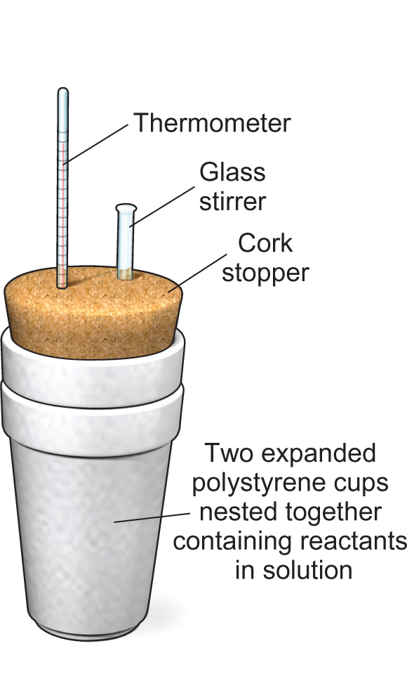
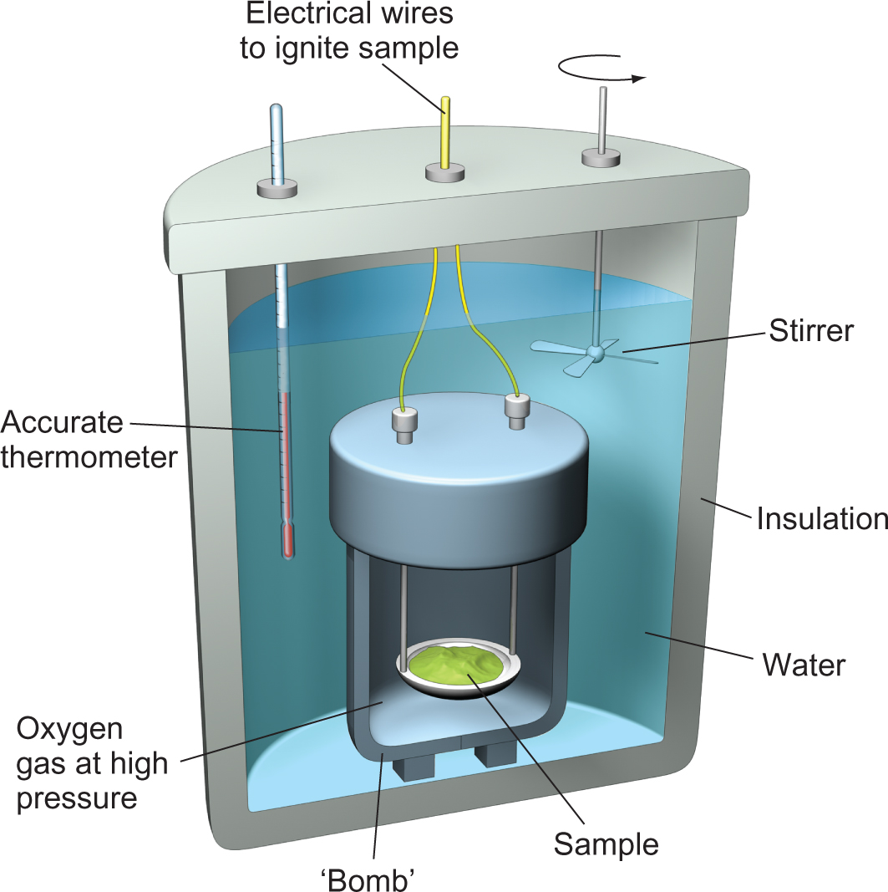
CALORIMETERS
Solution Reaction
Combustion Reaction
Simple coffee cup
Bomb
https://youtu.be/ohyA9amFfsc

