Slide 1
CertHE Skills for the Workplace
Module: BMSK4005
Professional Career Development
Session 5

Slide 2


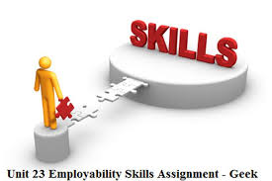

Slide 3
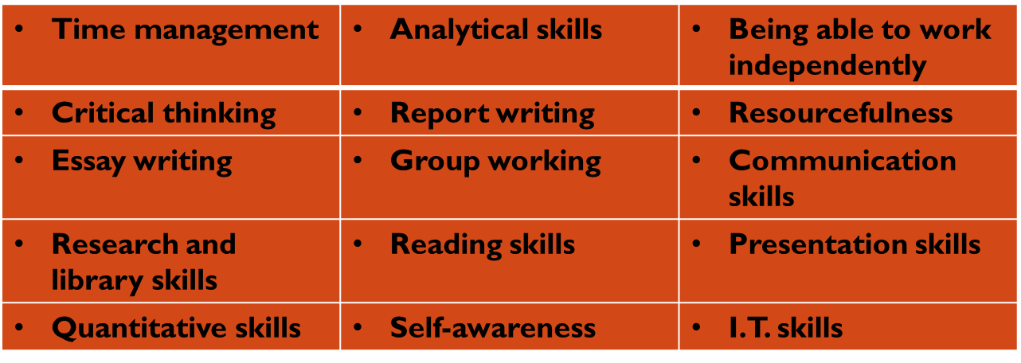
How do you rate yourself?
Take minutes to assess yourself against each of these and jot down a score against each – with ‘1’ being Poor, and ‘5’ being Excellent.
Notes:
Ask for feedback from the group – how do they rate themselves on these skills? Max score would be 75….where are their weaknesses/areas for development? They need to be recording all of these as part of their personal development planning – which we will cover in detail later in the module.

Slide 4
Key Questions
How good do you think you are at these skills ?
What evidence do you have?
Which skills are a priority for your development? Why?
Are there any other skills you need to develop?
How you are going to do this?

Slide 5
Time management
Employees who manage their time well are more productive, more efficient, and more likely to meet deadlines
They focus on the most important and time sensitive tasks and limit the amount of time wasted on non-essential duties
Effective time management requires staff to analyse their workload, assign priorities, and maintain focus on productive endeavours. Employees who are excellent time managers can eliminate distractions and enlist support from colleagues to help accomplish their goals.

Slide 6
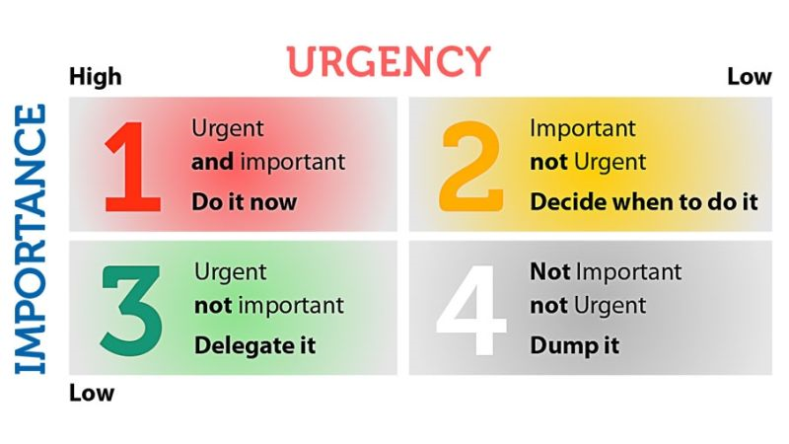
Time Management…
When looking at Stephen Covey’s time management Matrix (1989), where do you spend your time?
 | Not Important | Important
Urgent | Not important but Urgent - 3 | Important & Urgent - 1
Not Urgent | Not Important & Not Urgent - 4 | Important but Not Urgent - 2
Notes:
Use a general discussion to take feedback on how well student’s are managing their time – how good is their personal organisation. What are the biggest challenges? 60 to 80% should typically be spent in Important but Not Urgent – it’s where you have planned your work and are working your plan! You are in control. 15 to 20% is then available for Important & Urgent – emerging issues, problems, conflict, crises that need sorting IMMEDIATELY. You shouldn’t spend much time in the others at all, unless it is an absolute emergency requiring ‘all hands to the pump’ – no matter what your job.
In reality both students and mangers struggle with planning and time management. In 1989 Stephen Covey developed the “time management Matrix” a tool illustrating how individuals tended to go about managing their time using broad categories of importance and urgent.
Urgent means – it requires immediate attention – act NOW
Importance – to do with results and contributes to mission, goal priorities.

Slide 7
Four categories
Crisis
Unscheduled interruptions
Escapes and routines
Planning
Notes:
Crisis – individuals constantly dealing with urgent and important and you will not have time to do any planning. Life will seem on the edge and while thrill can excite some people over the long term it will burn the individual out
2. unscheduled – your are paying attention to the urgent but not necessarily important so the urgent things will be done but not the important until a crisis happens. Interruptions (friends/ social media text messages/ snap chats) distractions are all unscheduled tasks that’s divert from important tasks.
Escapes and routine – unimportant and non urgent activities (vegetating, wasting time, watching something you tube/ tv, - can be big drains on time typically low energy not even seen as leisurely like sports or walking) - not always relaxing.
Planning – developing to do lists, prioritise, benefits are fewer crisis since they are planned and not surprising and no need for unintentional escapes because life should be conducted in a calmer manner with less time wastage.
Covey is recommending that we start to balance things so that we spend time looking and planning for important activities: if they are well planned, then they should never become urgent.

Slide 8

Take careful note of this……what steps should we take to avoid this ?
https://www.youtube.com/watch?v=arj7oStGLkU

Slide 9
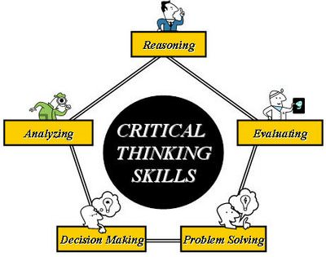
Critical Thinking
Critical thinking is development and use of information beyond memory and repetition
Notes:
Identify gaps, errors, weaknesses in others work
Provide strong argument for a particular view
Provide a clear detailed interpretation of situations and events

Slide 10
Strong argument
Providing credible evidence
Evaluating the quality of evidence
Notes:
Strong argument – how weak or strong based on 3 components (1. extent to which evidence supporting the argument is provided, 2. quality of evidence, 3. ease with which contradictory evidence can be provided). Strong argument is when difficult to find any weaknesses, being able to evaluate the strength of the argument.
The more you know about topic easier it is to evaluate it
Credible - refers to how believable source of information is and how easy it is to identify opposing argument. (qualities of good sources Authenticity/ Validity/ Current relevance/ Reliable/ Facts)
Using strongest evidence

Slide 11
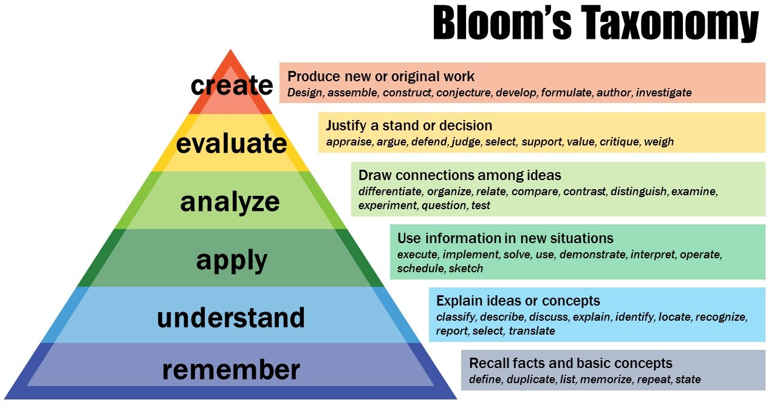
Notes:
Most often cited work on critical thinking was developed by Benjamin Bloom (1956)- seen as a hierarchical set of skills by which work is typically assessed.
A student who tend to demonstrate skills at lower end of hierarchy will get lower marks by reproducing the knowledge as it doesn’t involve high level of skills or shows understanding its just simply shows good memory. Higher marks would go to showing evaluation of ideas after having understood applied it in practice and analysed it.
knowledge – demonstrates reproducing knowledge
Understanding and comprehension – ability to explain to another person
Application – know what you are writing about using examples
Analysis – ‘why do things happen the way they do’- what happens if we change things around looking at being creative
Evaluate – to see if argument, facts are true or not
Create – understand topic and fit it into wider picture by demonstrating understanding, of how and why it works but also how its influenced by other factors

Slide 12
Analytical Skills
Analytical skills refer to the ability to collect and analyse information, problem-solve, and make decisions.
Analytical skills are used in everyday life through detecting patterns, brainstorming, observation, interpreting data, integrating new information, theorising, and making decisions based on multiple factors and options available.
Employers look for employees with the ability to investigate a problem and find a solution in a timely, efficient manner.
Hiring managers desire a person who uses clear, logical steps and excellent judgment to understand an issue from all angles before executing an action. Solutions can be reached by clear-cut, methodical approaches or more creative

Slide 13
Developing analytical skills
Collect the Right Information
Numeracy Skills
Strategic Thinking
Attention to Detail Skills
Technical skills
https://www.businessphrases.net/analytical-skills/
Notes:
1. collect the right information required for a specific situation. Collecting information is the beginning of the analytical process. Information is a great power! If you gather the right information, you have a better chance to resolve the problem;  Determine exactly what you want to know.
 List down all possible sources of information.
 Determine which are the best sources of information and which are just useful.
 Determine the methods and ways of collecting information. For example, if you are in the marketing area, online survey tools are a great way to collect information.
 Determine gaps in your knowledge and try to fill these gaps.
 Think about who will use this information – only you or some of your colleagues and managers and etc.
2. Numeracy skills - basic mathematical skills that include a range of abilities to understand and analyze numerical information and to make the right conclusions and decisions. Knowledge of numbers and figures;
 Understanding relationships between numbers;
 Interpreting mathematical information;
 Ability to remember;
 Visual perception of information;
 Ability to organize information;
 Argumentation and logical thinking;
 Calculation skills;
 Understanding trends (for example with the help of data visualization software,);
 Scheduling or budgeting (for example with the help of project scheduling software and etc.);
 Measurement and data analysis;
 Working with graphical information and different graphical software such as Gantt chart software, flowchart software
3. Strategic thinking is the ability to know what you want to achieve and how to achieve it Clear vision about what you want to achieve.
 Understand and analyze your current position and resources.
 Prioritization.
 Develop a strategic action plan.
 Being flexible.
 The ability to learn.
 Understand underlying processes with the help of business process management software.
4. To pay attention means to focus on an action or thing. In business aspect, attention to detail definition includes the ability to concentrate on a task.
Detail-oriented strengths give you the ability to see hidden details and connections when you analyse situations, to be more effective and to minimize the risk of errors
5. In our information and high technology era, good technical skills and knowledge are a must for all level of management and job positions

Slide 14
How to improve my analytical skills?
Learn to be more observant
Practice describing a process step-by-step
Try to find a relation between two completely different objects
Play analytical games
Learn brain and memory training from courses, books, and other sources
Notes:
When it comes to analytical thinking, it starts with attention to detail and observation. You have to be able to see hidden details and connections
Finding connections -Think about things in terms of cause and effect
3. Finding not obvious connections between two objects are crucial from problem-solving and decision-making. (Chess;
 Puzzle;
 Backgammon Table;
 Any kind of strategy games)
Try to paint an idea that you have or an action that your are going to do.
 Try to make graphics of different trends by years or months.
 List down different arguments for an idea or a point of view you have.
 List down possible solutions for different problems (for example write solutions for a problem of your best friend).
 Explain different things to kids or to your friends.
 Make lists of pros and cons your decisions or ideas you have.

Slide 15
Resourcefulness
The ability to find quick and clever ways to overcome difficulties
Resourcefulness is about optimising what you have to work with
It is not simply a matter of doing more with less
Resourcefulness mind-set drives to find a way. An attitude of resourcefulness inspires out-of-the-box thinking, new ideas, and the ability to visualise all the possible ways to achieve what you goal

Slide 16
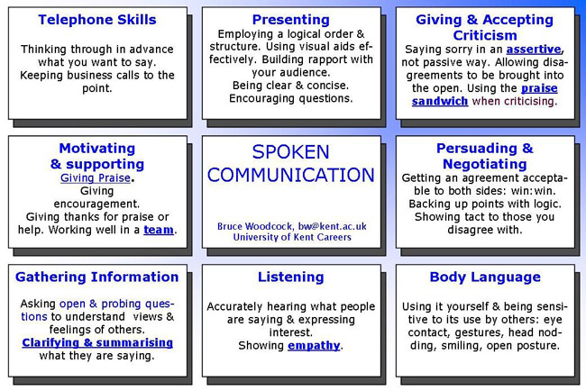
https://www.kent.ac.uk/careers/sk/communicating.htm
Notes:
Listening
Good listening has an enormous quality of nowness. Helpful listening is a form of meditation.
David Brandon
Some people talk to animals. Not many listen though. That's the problem.
Winnie the Pooh
◾Make effective use of body language and speech. Be sensitive to the other person's body language as well as what they say: eye contact, gestures, appropriate humour and analogies.
Use appropriate body language yourself: face the person with an open, attentive posture and maintain good eye contact (look at the speaker a lot, but don't stare all the time), smiling and nod your head from time to time.
The “Top Ten” Skills shortages among graduates
% of employers surveyed
1 Commercial Awareness 67%
2 Communication Skills 64%
3 Leadership 33%
4 Ability to work in a team 33%
5 Problem solving 32%
6 Conceptual ability 21%
7 Subject Knowledge & competence 19%
8 Foreign languages 19%
9 Numeracy 19%
10 Good general education 15%
Source: Association of Graduate Recruiters “Skills for Graduates in the 21st Century” www.agr.org.uk
◾Listen attentively. Express interest in what people are saying and don't interrupt them.
Listen More Than You Talk - Richard Branson
◾Be aware of any prejudices or misconceptions you or the speaker may have.
◾Good listening builds a rapport and understanding with the speaker and allows them to freely express their views. It motivates them to say more.
◾Poor listening makes assumptions, creates resistance and hostility, demotivates the speaker, inhibits their development and creates dependence on the listener.
◾Use ACTIVE LISTENING. ◾These reflect back what the speaker is saying in other words to clarify understanding: you paraphrase and repeat back key points.
◾They may summarise and bring new interpretations to the speakers words.
◾ They show you're listening carefully and checks you are understanding correctly what they are saying allowing the speaker to confirm or correct your feedback.
◾They encourage the speaker to elaborate and to define their problems.
◾It is often the most useful way of giving positive feedback to someone: "I hear what you're saying and take it seriously". You can't keep saying "uh-huh" or "yes" for too long without it sounding false
Empathy
People with a musical quality to their speech (a big variation in pitch and rhythm called prosody) tend to be more empathic. Lisa Aziz-Zadeh of the University of S. California found that people whose speech is most intonated, lilted or "sing-song" have more ability to empathise with others and to convey emotion.
◾Empathy means being open to the ideas of others and sensitive to their values and feelings: trying to see things from the other person's perspective.
◾It is about demonstrating that you understand, that you can listen from other person's point of view and reflect their meaning
◾Each individual has a unique perspective which should be valued. We each occupy our own private world and never completely know what's going on inside other people's minds.
◾Be prepared to disclose your own feelings and beliefs to encourage others to do the same: be open with other people
Confirm and clarify
◾Ask yourself exactly what you want to gain from the conversation: a lack of clarity can lead to confusion and poor decisions.
◾Asking clarifying questions: "How?", "Why?", "When?", "Who?", "What?", "Where?", will help the other person crystallise their thoughts.
◾Summarise the main points in simple language.
◾Get the other person's agreement that your summary is accurate.
◾Define the problem and then move the focus to the solution: separate the points that relate to the problem and those that relate to the solution.
◾Agree on the action you will both take: even if this is that there will be no action
Jargon free language
A survey of managers by the Institute of Leadership found that the most most irritating jargon/management speak phrases were "thinking outside the box", "going forward" and "let's touch base", so try to avoid such phrases when applying for jobs.
◾ Use simple words and clear unambiguous language.
◾Be succinct: take time and effort to distill ideas to an absolute minimum.
◾Make simple points that everyone agrees on.
Jargon in job titles
Partnership relationship manager
Secretary
Person-centred transition facilitator Social worker
Ambient replenishment controller Shelf stacker
Head of services, infrastructure & procurement Caretaker
Multimedia storyteller & experience architect Journalist
Talent, employment relations, outsourcing & change manager HR manager
Transformation & re-enablement project manager Probation officer
Revenue protection officer Ticket inspector
Graduate transitions facilitator Careers adviser!
For more like this try our job matching games
◾Use the active not passive voice. "I will send it to you" rather than "It will be sent to you".
◾Avoid Jargon!
NOT: "We need to incentivize our best of breed to think outside the box in focusing our core competencies on mission critical key deliverables."
BUT: "We should motivate our staff to use their skills on important tasks".
For help with removing jargon see the Plain English Campaign
Giving feedback
◾Feedback has also been called constructive criticism.
◾Only give feedback if the gain will exceed the pain: only use it for important things.
Praise more than you criticise! Identifying and developing strengths is more effective than focusing too much on negatives.
◾Constructive criticism which shows the person how they can improve. Not "Debbie was hopeless!", but "Debbie made some very useful contributions but her voice was a bit quiet. I couldn't hear her very well, so she needs to raise her voice a bit in future."
◾It's a good idea to ask permission: "Do you mind if I give you some feedback?". This gives the person time to prepare.
◾Try to give feedback immediately: on the spot if possible: it's most effective when fresh in the person's mind. The more quickly it is given the more relevance and power it will have.
◾Be direct and honest. Get quickly to the point, don't have long and embarrasing introductions, although starting with some genuine praise based on what the person has actually done will help (see the praise sandwich below).
◾Give feedback in private if at all possible, it's insensitive to do this in front of others.
◾Focus on the most concrete and recent example
◾Stick to a single clear issue, don't pack in too much criticism as this can be disheartening.
◾Don't repeat the same point over and over: this will just build up resentment.
◾Only criticise behaviours that can be changed: "You need to improve your computing skills" rather than "You're stupid"!
◾Give feedback on a person's behaviour not about the person themselves. Give accurate descriptions of behaviour not comments about the person's qualities and worth as an individual: "You have been late for work a lot in the last month"rather than :"You're lazy"!
◾Don't compare the person with other people, as this can build jealousy: "Jane is always punctual"communication-skills
◾Use "I" not "You" statements: "I feel upset" not "You made me feel upset".
◾Use specific examples. Don't say "You're hopeless at this", say "We need to give you training on how to do this"! ◾describe the behaviour
◾describe your reaction
◾ explain why you feel this way
◾ show you understand what's behind their behaviour
◾ suggest a different way of behaving
◾Stick to facts: describe behaviour but also what happened as a result.
◾The best decisions are those people reach for themselves. Try not to tell the other person directly what they should and shouldn't do. Let them explore their behaviour and say themselves what needs to be done. This avoids the build up of resentment.
◾Allow the criticised person to express any concerns they may have.
◾Use tentative words such as "sometimes" and "perhaps" rather than "always" and "never": these allow the other person to avoid argument by saying that "always" is not strictly true.
◾Keep your emotions under control.
◾At the end, Check understanding: "Does what I've said make sense to you?" and summarise what you've agreed.
◾Talk openly about your own concerns if necessary.
◾Include positive comments. The praise sandwich can be an effective way to give criticism to someone without alienating them: 1.First make a positive statement to the person: "I think you are really trying your best"
2.Then the criticism "But you need to structure your essay more logically".
3.Make another positive statement to finish "However it's a very good first attempt"
Any fool can criticize, condemn, and complain - and most fools do.
There are two types of people who don't say much: those who are quiet and those who talk a lot.
You can close more business in two months by becoming interested in other people than you can in two years by trying to get people interested in you.
Dale Carnegie
◾If you are recieving feedback youself, try to accept it in a positive and non-defensive manner.
Giving Praise
◾Tell people something they have done that you like or what you like about them.
◾Give them thanks if they have done something for you. Even a simple thank you can make a big difference.
◾Give encouragement. If someone is not sure that they are able to do something, give them encouragement if you think they can do it.
◾Describe positive behaviour and it's effect in concrete terms "I really appreciate how you took the time to ...."
◾Respond to praise by thanking the person.

Slide 17
Barriers to learning& learning to overcome them
Everyone has barriers to learning – some of these are obvious, some are less so.
Barriers may be external – family, logistics (no car, travel is difficult), dependency on others, money, work, friends, private life, terminology, etc.
Barriers may be internal – skill levels, levels of knowledge, perceived abilities, behavioural, attitudinal, psychological, etc.
Notes:
Facilitator to explain these and stress that some of the internal barriers are often more difficult to address than the external barriers.

Slide 18
Assignment deadline 22nd June 3pm
Tutorial next week 9am – 1pm

