Slide 1

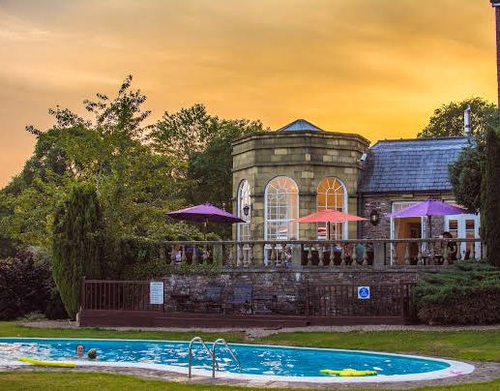
Personnel resourcing and development
NAME: Milen Dimitrov
Student Code:
Lecturer: Abdi Rahman

Slide 2


Introduction
Peterstone Court Country is a luxury hotel located in Brecon, Wales and it allows guests to access many touristic locations.
The presentation will offer a wide range of information about the PESTLE analysis of the hotel and its effectiveness, about the Human Resource Management functions, about the interview process and many others
Notes:
Peterstone Court Country is a 5 star hotel located in Brecon, Wales and it gives to the guests the opportunity to access many touristic locations.
The presentation will offer a wide range of information about the PESTLE analysis of the hotel and its effectiveness, about the Human Resource Management functions, about the interview process and many others things such as factors affecting diversity, culture and equality in the Peterstone Court Country Hotel.

Slide 3


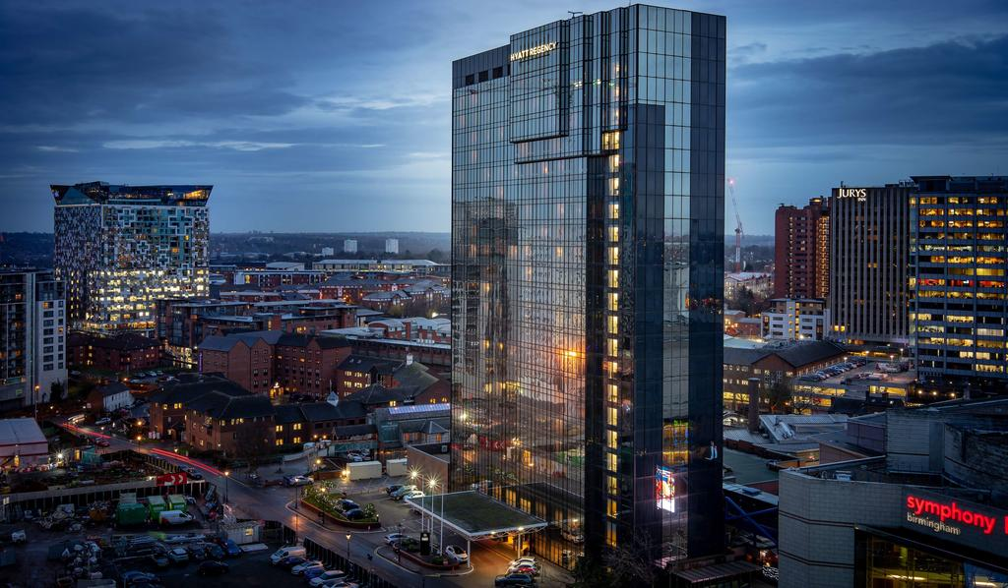

P
E
PESTLE analysis is a procedure throughout which the environment is being analysed from all aspects in a comprehensive way.
The PESTLE analysis has to do with the investigation of the following factors:
Political Factors
Economic Factors
Social Factors
Technological Factors
Legal Factors
Environmental Factors
T
L
Notes:
PESTLE analysis is a procedure throughout which the environment of the hotel is being analysed using all aspects and departments of the hotel in a comprehensive way which will show out helpful results that can be used in order to make improvements in the hotel.
The factors that are analysed during the procedure are: political, economic, social, technological, legal and environmental
All of the factors being external factors they do offer a wide range of aspects that have to be improved.

Slide 4

1. POLITICAL FACTORS
Those political factors are highly influencing the decisions that are about to be taken when thinking about improving things in the hotel with the aim of attracting more guests. There is one specific reason why these external factors are affecting, this being because of Brexit which in the last period of time has been a massive issue in the UK. Brexit is and will carry on being an issue because this has changed a lot of legislations and rules withing the rules of new people coming in the UK.
Therefore, the Peterstone Court Country House hotel has to deal with a reduction in the number of guests, however, this is not sever high chances for the level of reduction to be really big because there are still tourists coming from some other areas wishing to visit such nice places around the hotel.
Notes:
Those political factors are highly influencing the decisions that are about to be taken when thinking about improving things in the hotel with the aim of attracting more guests. There is one specific reason why these external factors are affecting, this being because of Brexit which in the last period of time has been a massive issue in the UK. Brexit is and will carry on being an issue because this has changed a lot of legislations and rules withing the rules of new people coming in the UK.
Therefore, the Peterstone Court Country House hotel has to deal with a reduction in the number of guests, however, this is not sever high chances for the level of reduction to be really big because there are still tourists coming from some other areas wishing to visit such nice places around the hotel.

Slide 5

2. Economic FACTORS
The economy position can be influenced by the period of the year and this because people are less expected to take a holiday in a time of the year when the weather does not help them to visit things around and to enjoy the lovely places near the hotel. In addition, the economy and the profit of the hotel varies from period to period. Next to that as mentioned in the slide, regarding to Brexit there is a possibility for the economy and the profit to get down regarding to the reason of the international guests that are not able to enter the country with ease.
Notes:
The economy position can be influenced by the period of the year and this because people are less expected to take a holiday in a time of the year when the weather does not help them to visit things around and to enjoy the lovely places near the hotel. In addition, the economy and the profit of the hotel varies from period to period. Next to that as mentioned in the slide, regarding to Brexit there is a possibility for the economy and the profit to get down regarding to the reason of the international guests that are not able to enter the country with ease.

Slide 6

3. SOCIAL FACTORS
The hotel is catalogued as being a luxury hotel, a 5 star one that allows the guests to access plenty of services for additional payments next to the basic payment for a basic rent which usually is approximately £150. Therefore, because the price is not the smallest, the target of people that are most likely to come in the hotel for a stay are mainly upper and middle classes including business mans. People from the working classes might find it difficult to pay that much for a night only and in situations like this they are more likely to chose a cheaper hotel.
Notes:
The hotel is catalogued as being a luxury hotel, a 5 star one that allows the guests to access plenty of services for additional payments next to the basic payment for a basic rent which usually is approximately £150. Therefore, because the price is not the smallest, the target of people that are most likely to come in the hotel for a stay are mainly upper and middle classes including business mans. People from the working classes might find it difficult to pay that much for a night only and in situations like this they are more likely to chose a cheaper hotel.

Slide 7

4. TECHNOLOGICAL FACTORS
The technological factors are those factors that are very necessary in all environments. However, when it comes to the Peterstone Court Country Hotel it is well-developed considering the technological area of the hotel and this because it is uses one of the newest brand of technologies.
The technological factors are influencing the way the members of staff are working and this because the technology is used all the time for the internal and external communication and decision making, these all making the member’s of staff work easier and quicker to ensure that all the guests are receiving answers and help in a frame time.
Notes:
The technological factors are those factors that are very necessary in all environments. However, when it comes to the Peterstone Court Country Hotel it is well-developed considering the technological area of the hotel and this because it is uses one of the newest brand of technologies.
The technological factors are influencing the way the members of staff are working and this because the technology is used all the time for the internal and external communication and decision making, these all making the member’s of staff work easier and quicker to ensure that all the guests are receiving answers and help in a frame time.

Slide 8

5. LEGAL FACTORS
The legal factors have to do with the changes in law and specific procedures that need to be updated and carefully placed in practice by all employees in order to ensure that the hotel is safely running the business (Thomas Bush 2016).
Notes:
The legal factors have to do with the changes in law and specific procedures that need to be updated and carefully placed in practice by all employees in order to ensure that the hotel is safely running the business (Thomas Bush 2016).
There are some certain policies such as the Consumer’s Law, the Discrimination Law, the health and safety law, the employment law, import/export law. All the mentioned laws are very important in all hospitality industries including Peterstone Hotel and this because they are all working together, cooperating with the aim of running the hotel safely.

Slide 9

6. ENVRIONMENTAL FACTORS
Environmental Policies
Climate Change
Green Agenda
Pollution
Availability of natural resources
Recycling
Waste Disposal
Notes:
The environmental factors could be either internal or external, but the difference between is that the external ones are related to how the economic and technological factors are developing as well in order to increase the hotel as a business environment (Umar Farooq 2018)
As mentioned on the slide above the most common environmental factors influencing the hotel are: environmental policies, climate change, green agenda, pollution, availability of natural resources, recycling and waste disposal. All of them factors are influencing how many people are coming in the hotel and this because, for example, no one likes to come in a holiday if the weather is bad and rainy because in that situation people may be stuck in the hotel and not able to visit such places around

Slide 10

Selection Process
During the selection process the employers are testing the job applicants considering what each one has to offer and after all the best candidates are being chosen for potential interviews (Robins and Coulter 2012)
There are the three most common strategies used by HR during the selection process. (see in notes)
Notes:
During the selection process the employers are testing the job applicants capabilities taking into consideration what each one has to offer and after all the best candidates are being chosen for potential interviews (Robins and Coulter 2012)
The most common strategies used by HR during the selection process are the following:
Ask specific aspects related to the behavioural reactions
Test aspects and specific details about the administrative skills and abilities
Carefully test and build an impression about the applicant’s personality characteristics.

Slide 11


Effectiveness of selection process
Notes:
Considering what Cole (2002) said, selection is the procedure that is very productive and useful in all types of industries and this because even if time and costs are lost within the process, a decent employee that has a respectable capability for the position will hardly work for the business bringing then a major level of advantages, including economic advantages for the business

Slide 12


Recruitment
Notes:
The process includes sorting out such descriptions for the Human Resource Management with the aim of making all the details of the position clear for the applicants (Armenakis and Bernerth 2009).

Slide 13


Effectiveness of recruitment process
Notes:
The recruitment process is well-thought-out as being effective for the reason that collects a great amount of candidates that need the specific job position (Taylor 1999). In addition to that, for the reason that it attracts more people, the competition is more intense and regarding to that people may take everything more seriously in order for the position to be given to them.
In addition to what was mentioned, recruitment is good and quick and this because everyone applies in a short amount of time either online using a specific system or personally at the company handing in a CV and a Cover letter

Slide 14
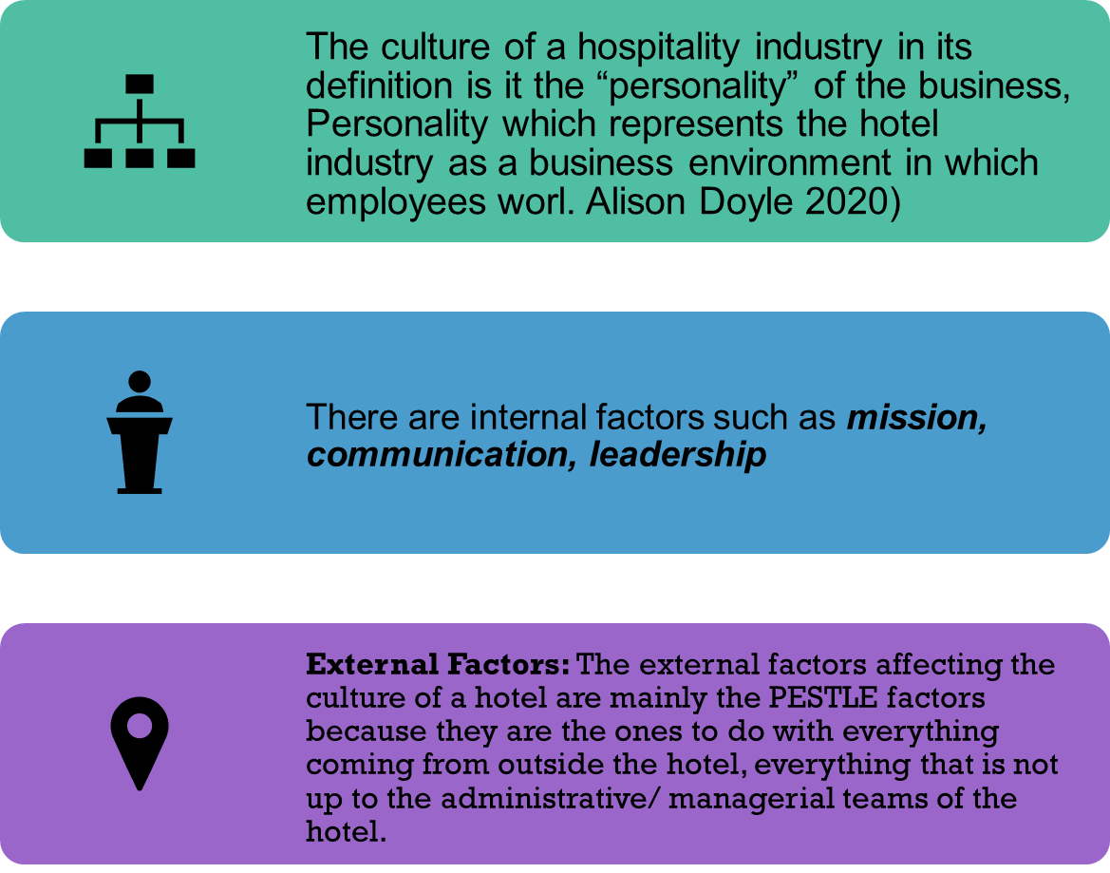
Factors affecting the culture
Notes:
The culture of the hotel as an organisation is defined as being the “personality” of a organisation, personality that defines the place in which employees work as a business environment (Alison Doyle 2020), this meaning that the managerial and the administrative teams must be more than careful when structuring the hotel.
Internal Factors: mission, communication, leadership
Mission- this factor must be discussed in a clear way in order for everyone to understand the aim of the hotel (in our case the aim of the Peterstone Hotel) and how the hotel will achieve the aim.
2. Communication- is occurring between teams such as the managers team and another employees in order
to clarify such changes, actions and activities that are taking place in the hotel. Next to that the communication could highly affect the culture of the hotel if it is not used productively. For example, some people could feel like the communication given to them from the hotel side is not good enough for them to understand what services are exactly given.
3. Leadership: leadership is good, but in some cases it could be something that is influencing negatively. For example, some people could feel embarrassed with their work when some managers are overtaking their role of “model” and this could affect the way the employees are working in order to provide good services to the guests.
External Factors: The external factors affecting the culture of a hotel are mainly the PESTLE factors because they are the ones to do with everything coming from outside the hotel, everything that is not up to the administrative/ managerial teams of the hotel.

Slide 15

Factors affecting and diversity
Diversity is seen as being a big issue in our days and this regarding to the continuous changes that are made in the country and not only.
There are factors linked with the diversity such as:
Ethic Diversity issues
Gender equalities
Age
Sexual orientation
Religion
Notes:
Diversity in a hotel industry has become an issue over the last years and this because there is a wide range of Romanian, Bulgarian or Polish employees in most of the environment and regarding to that Ethic Diversity has become a severe issue to deal with. Therefore, the ethnicity is one of the factors affecting diversity. Some other factors that are highly affecting the diversity in such industries as the hospitality and tourism industry are gender equalities which includes the idea of a man earning more than a women, age as some employers tend to make such differences in paying an over 21st year old and paying a 19th year old, sexual orientation as some hospitality environments may not allow couples of the same sex to be members of staff and religion which used to be a big thing previously.

Slide 16


Factors affecting equality
It is that word which encourages the free choice civilisation, thing that suggests how all people can chose all the things they wish to do as long as they need that aspect for them. In addition to that, the factors that are negatively influencing the equality are the following: sex, religion, pregnancy, race, gender, social class, age…

Slide 17
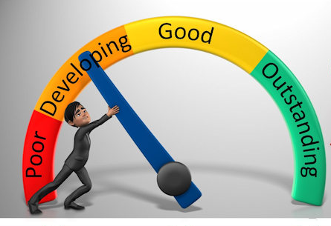
Methods of performance
Ranking Appraisal- this being based on writing down employees using their performances, this method would be good in a hospitality industry because it would motivate people to work harder and harder to avoid being on the bottom of the list.
Work Standards Approach- this method being based on setting specific targets that the employees have to meet. However, the targets that are designed need to be realistic using previous targets in order to ensure that the employees are capable to do the specific things
Notes:
There are multiple methods designed by the HRM that can be used in order to improve the performances and the work recording of employees in environments such as the Peterstone Court Country Hotel. The most common strategies for appraising performance in a business are the following:
Ranking Appraisal- this being based on writing down employees using their performances, this method would be good in a hospitality industry because it would motivate people to work harder and harder to avoid being on the bottom of the list.
Work Standards Approach- this method being based on setting specific targets that the employees have to meet. However, the targets that are designed need to be realistic using previous targets in order to ensure that the employees are capable to do the specific things

Slide 18

Conclusion
As a conclusion the Peterstone hotel is using most of the Human Resource Management functions such as the selection process and the recruitment process effectively in order to ensure that all members of staff are well experienced and acknowledged about everything that needs to be done in the hotel and how it is going to be done. Next to that the PESTLE analysis of the hotel has demonstrated that the external factors that are part of the analysis are highly influencing the way that hotel is running from all aspects including economy and the technology
Notes:
As a conclusion the Peterstone hotel is using most of the Human Resource Management functions such as the selection process and the recruitment process effectively in order to ensure that all members of staff are well experienced and acknowledged about everything that needs to be done in the hotel and how it is going to be done. Next to that the PESTLE analysis of the hotel has demonstrated that the external factors that are part of the analysis are highly influencing the way that hotel is running from all aspects including economy and the technology

Slide 19
References
Thomas Bush (2016), “Legal Factors affecting Business” [online] available on: https://pestleanalysis.com/legal-factors-affecting-business/, accessed on 29/02/2020
Kiesha Frue (2020),”PESTLE ANALYSIS”, [online] available on: https://pestleanalysis.com/norway-pestel-analysis/, accessed on 02/03/2020
Peterstone Court Country Hotel, “About us”, [online] available on: https://www.peterstone-court.com/, accessed on: 28/02/2020
Umar Farooq (2018), “Environmental Factors affect business”, [online] available on: https://www.marketingtutor.net/environmental-factors-affect-business/, accessed on: 29/02/2020

