Slide 1
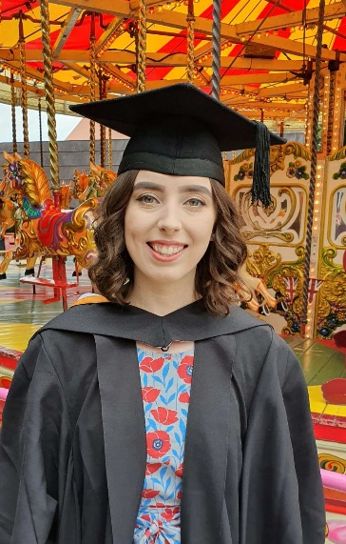


Amdana i
About Me
Name: Miss Abigail Charlotte McFarlane
Date of Birth: 3rd December 1997
Email: 1901791@student.uwtsd.ac.uk
BA (Hons) Textile Design at Falmouth University, specialising in digital print design.
I am originally from Newport and have moved to Swansea for the PGCE Primary. I lived in Penryn, Cornwall 2016-2019 whilst studying at Falmouth University.
I have enjoyed playing the piano from a young age and am able to play to a Grade 5 standard.
I trained in Tae Kwon-Do aged 5-17, achieving my black belt at age 11.
Y math o athro hoffaf bod
The kind of teacher I aspire to be
An inclusive and caring teacher with the focus on the voice of the pupil.
An inspiring teacher who makes learning fun.
A trusted and constant adult in children’s lives.
Profiad addysgu blaenorol
Previous teaching experiences
Leading group and one-to-one tasks, supporting in-class activities and school trips for Year 2 and Year 5.
Teaching art workshops, designing and creating class display boards and role play area.
Rhesymau dros ddewis addysgu fel proffesiwn
Reasons for entering the teaching profession
I am committed to becoming a teacher to help children develop skills, knowledge and understanding for success and opportunities now and in the future. I am passionate about creating a safe environment for children to attend so they can reach their individual learning potential and receive any additional support they may need.
Meysydd / pynciau medraf eu haddysgu
Areas / subjects I could teach
All core subjects
My area of expertise is in Textile Design. I have transferrable skills across Art and Design and Design and Technology. These include drawing, painting, printmaking, sewing and Adobe Photoshop.
Cefndir academaidd
Academic history
GCSEs: 6 Grade A*, 5 Grade A, 1 Grade B
A-Levels: Grade A - Welsh Baccalaureate, Art, Craft and Design; Grade B – History; Grade C – Biology
Undergraduate Degree: BA Second Class Honours (Upper Division) in Textile Design

