Slide 1
Introduction to Exercise Physiology
Geraint Forster

Slide 2
What is Exercise Physiology?
‘the study of how the body responds and adapts to exercise’ (Winter et al, 2007)
- Applies to both competitive sporting performance and promotion of general health.

Slide 3
Knowledge of Exercise Physiology can help us to:
Prescribe training programmes to optimize physical performance – maximizing adaptation whilst minimizing chance of overtraining.
Prescribe physical activity to promote and sustain health
Use exercise prophylactically and therapeutically with clinical populations

Slide 4
What does an exercise physiologist do?
Select, administer and interpret tests in order to develop knowledge and understanding of the exercise capabilities of humans. (Adapted from Winter et al, 2007)

Slide 5
Why do we assess?
Evaluate strengths and weaknesses of participant;
Evaluate effectiveness of a programme;
Evaluate health status of participant;
Provide an ergogenic aid;
Identify readiness to resume training/competing

Slide 6
Why do we assess? (Cont)
Develop knowledge and understanding of the requirements of a sport or activity;
Answer research questions
Bird and Davison (1997) cited by Winter et al (2007)

Slide 7
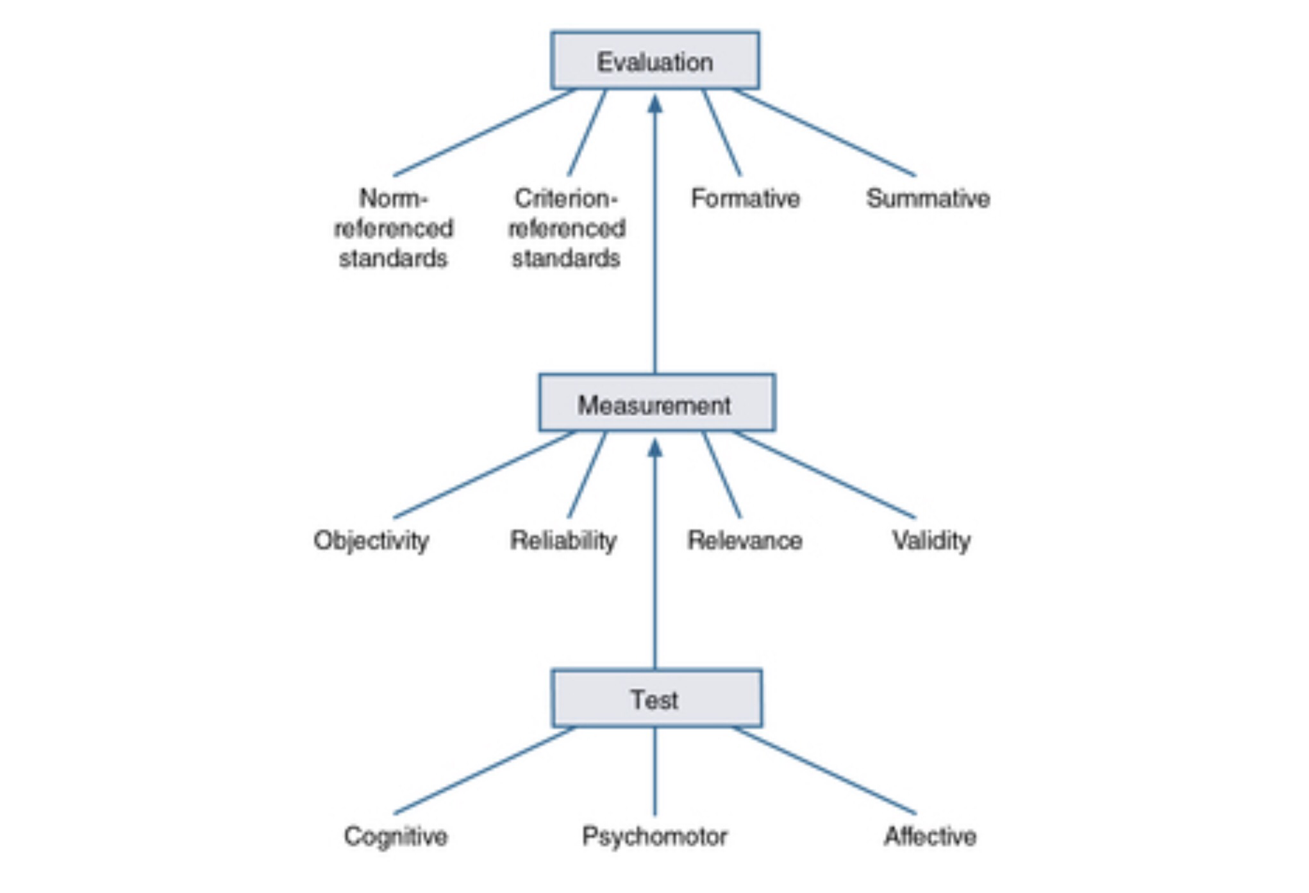
Relationship between tests, measurement and evaluation (Morrow et al, 2016)

Slide 8
General Principles for Exercise Testing
Health and Safety
  The ‘Health and Safety at work Act’ (1974) outlines that we have a Duty of Care to identify risks associated with an activity and take sensible measures to control those risks as far as is reasonably practicable.
  Risk Assessments should be carried out/followed for all activities

Slide 9
Pre-test guidelines
Informed consent must be obtained prior to testing (explain exact nature of tests prior)
A health screen must be carried out (e.g. PAR Q)
All equipment must be calibrated and serviceable
Room temperature should be 20-22 deg C, and humidity <60% with adequate airflow
Allow time for habituation
Consider effects of anxiety and try to limit

Slide 10
Pre-test participant instructions
Refrain from food, alcohol, caffeine or tobacco for 3h prior
Avoid exercise on day of assessment
Wear loose-fitting clothing appropriate for exercise
Bring a list of any medications they are taking
Drink ample fluid in 24 hours prior to ensure adequate hydration

Slide 11
Test sequence (ACSM, 2008)
Informed consent
Pre-exercise evaluation
Resting measurements (e.g. HR, BP)
Circumference measurements and body composition
Cardio-respiratory fitness
Muscular fitness
Flexibility

Slide 12
General Principles for Exercise Testing
Consider strategies for arousal (e.g. Motivational music, warm-up) or relaxation (e.g. Calming music, imagery, breathing exercises) if required.

Slide 13
When should a participant gain medical clearance prior to testing?
Par Q or other pre-testing measures indicate presence of risk factors.
ACSM algorithm should be used (ACSM’s Guidelines for Exercise Testing and Prescription, 2018)

Slide 14
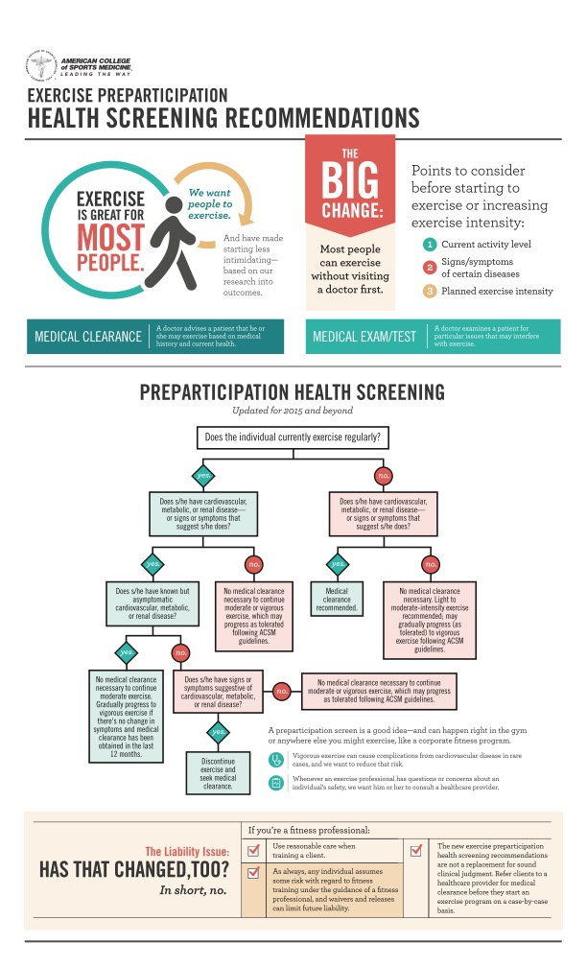
See video on sports lab moodle page on ‘pre-participation screening’

Slide 15
What can we measure?
Taken from Morrow et al (2016)

Slide 16
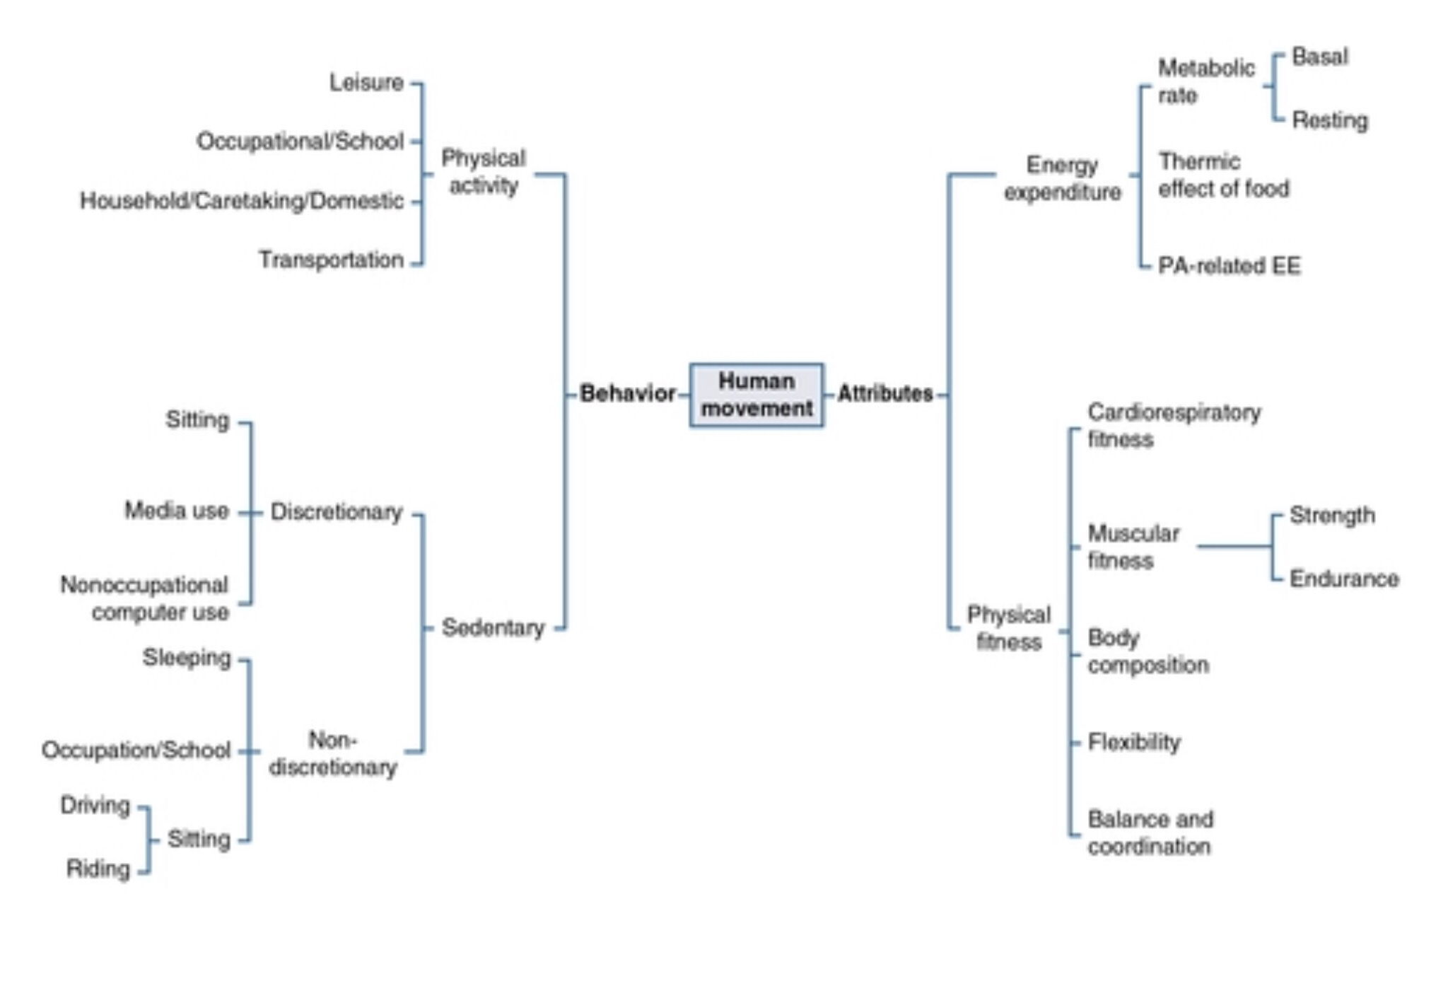
Adapted from Pettee-Gabriel, Morrow, and Woolsey (2012)

Slide 17
Results
Must be interpreted and explained to the participant
An opportunity to educate about their current health and fitness status.
Allows development of short- and long-term goals
Forms the basis for the exercise programme and subsequent evaluations (therefore must be stored safely and confidentially)

